Slide 1
NDP Selection for 802.11bf
Date: 2022-03-17
Authors:
Name | Affiliations | email
Steve Shellhammer | Qualcomm | shellhammer@ieee.org
Ali Raissinia |  | alirezar@qti.qualcomm.com
Bin Tian |  | btian@qti.qualcomm.com

Slide 2
Introduction
The Task Group needs to decide which NPD will be supported in 802.11bf
Here we provide a brief comparison between the HE (TB) Ranging NDP and the EHT NDP
We provide two options and indicate our preference
In the Backup we also provide some figures of the HE (TB) Ranging NDP and the EHT NDP

Slide 3
NDP Comparison
Parameter | Comparison
LTF Repetitions | HE (TB) Ranging NDP supports LTF Repetitions LTF Repetitions can increase SNR, which is very important for RF Sensing Applications LTF Repetitions are also useful with Secure LTFs, to allow for consistency checks in channel estimation, to detect security attacks EHT NDP does not support LTF Repetitions, but it does allow the receiver to optionally support more LTFs in an NDP that the number of supported spatial streams. If additional EHT-LTFs are used, then they shall be no more than twice the initial number of EHT-LTFs. (see backup)
Secure LTFs | HE (TB) Ranging NDP supports Secure LTFs to prevent security attacks This is critical for secure ranging It may be useful for secure RF Sensing (more discussion required on this security topic) EHT NDP does not support Secure LTFs
Bandwidths | HE (TB) Ranging NDP supports 20, 40, 80 and 160 MHz Discussions are ongoing to add 320 MHz support to HE (TB) Ranging NDP in a future 802.11 task group (e.g., 802.11az+) EHT NDP supports 20, 40, 80, 160 and 320 MHz
Puncturing | EHT NDP supports multiple static puncturing modes 802.11az+ could support static puncturing of 320 MHz to enable 240 MHz bandwidth operation, which is useful in some regulatory domains

Slide 4
Recommendation
We think it is important to select one of these NDP versions
We do not think it is a good idea to select multiple NDP versions since it will result in an exponential growth in the number of sensing measurement instances
We recommend selection of the HE Ranging NDP
  Since RF Sensing relies on measuring reflections from objects which may be weak reflections, the benefits of Repeated LTFs is extremely valuable, to increase the SNR to make measurement of the reflections possible
When the Ranging NDP is extended to support 320 MHz, the RF Sensing will benefit from the larger bandwidth

Slide 5
Straw Poll
Do you agree that 802.11bf should support only the HE Ranging NDP and the HE TB Ranging NDP?

Slide 6
Backup

Slide 7
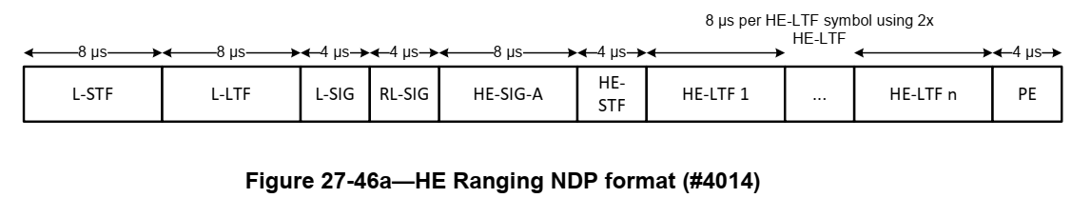
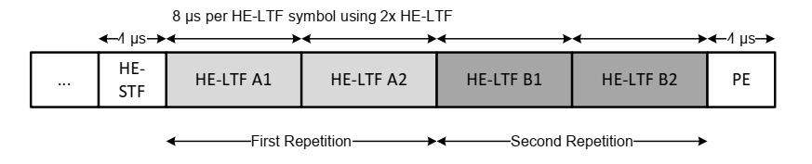
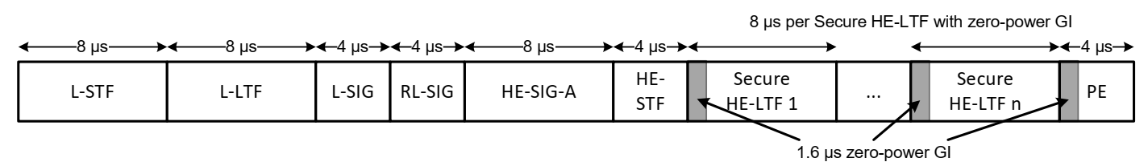
27.3.18a.1 HE Ranging NDP (11az)

Slide 8
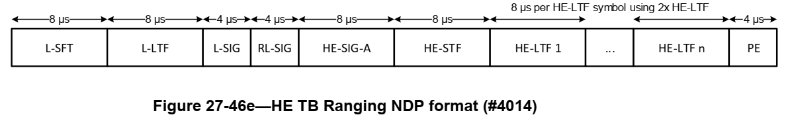
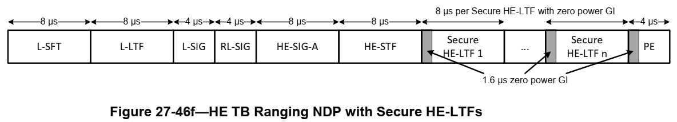
27.3.18a.2 HE TB Ranging NDP (11az)

Slide 9
27.3.18a.1 HE Ranging NDP (11az)
The HE Ranging NDP has the following properties:
  No beamforming steering matrix is applied to the waveform.
  Uses HE-LTFs or Secure HE-LTFs when the TXVECTOR parameter SECURE_LTF_FLAG is set to 0 or 1 respectively.
  Has a Packet Extension (PE) field that is 4 µs in duration. No energy is transmitted during the first 1.6 µs of the PE field if the HE-LTF field is using the secure HE-LTF, similar to no energy being transmitted during the GI of HE-LTF symbols
  The TXVECTOR parameter LTF_REP that indicates N_LTF_REP, the number of the HE-LTF repetitions. A value of N_LTF_REP equal to 1 indicates a single HE-LTF segment 34 without repetition, and a value of N_LTF_REP greater than 1 indicates the use of HE-LTF repetitions.
  The only supported mode is 2x HE-LTF with 1.6 µs GI
  No energy is transmitted during the GI of the HE-LTF symbols when secure HE-LTF is used, which is referred to as a zero-power GI.
  The number of HE-LTF symbols in an HE Ranging NDP depends on the number of space-time streams N_STS, the number of HE-LTF repetitions N_LTF_REP, and when Secure HE-LTFs are used, the number of users NUM_USERS.

Slide 10
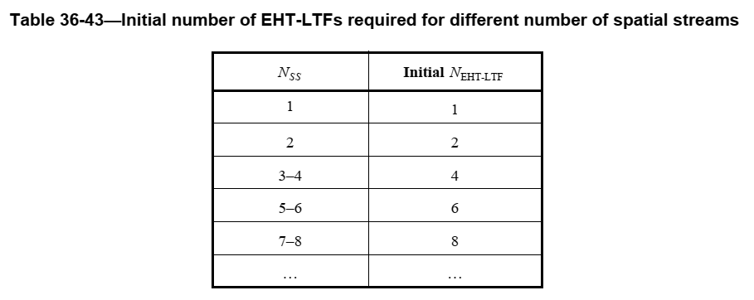
Extra EHT-LTFs
36.3.12.10 EHT-LTF
  Number of Initial LTFs specified in Table 36-43
If additional EHT-LTFs are used, then the total number of EHT-LTFs (which is signaled separately from Nss) shall be no more than twice the initial number of EHT-LTFs determined by the number of spatial streams as shown in Table 36-43 (Initial number of EHT-LTFs required for different number of spatial streams) and chosen from the set [2 4 8]. Supporting additional EHT-LTFs is optional for the receiver, which is indicated by the Extra LTFs Support for Non-OFDMA PPDU EHT PHY Capability field

Slide 11
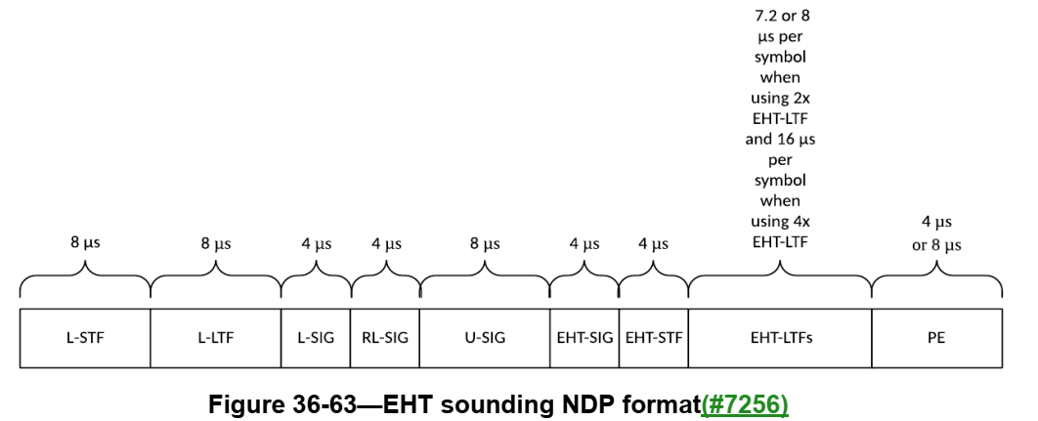
36.3.18 EHT sounding NDP (11be)

Slide 12
36.3.18 EHT sounding NDP (11be)
In the EHT sounding NDP, the 242-tone RUs overlapping the 20 MHz channels that are signaled as punctured through the Punctured Channel Indication field of the U-SIG field are punctured.
The allowed punctured patterns are given in Table 36-30 (5-bit punctured channel indication for the non-OFDMA case in an EHT MU PPDU)
It is mandatory to support the 2x EHT-LTF with 0.8 µs GI and 2x EHT-LTF with 1.6 µs GI. It is optional to support the 4x EHT-LTF with 3.2 µs GI. The other combinations of EHT-LTF type and GI duration are disallowed.
The EHT sounding NDP has a PE field that is given as follows:
  4 µs when the PPDU bandwidth is less than or equal to 160 MHz and the number of spatial streams is less than or equal to 8.
  8 µs for all the other cases

