Slide 1
Fractional Scaling Factor for Sensing Measurement Report
Date: 2022-03-25
Authors:
Name | Affiliations | email
Steve Shellhammer | Qualcomm | shellhammer@ieee.org
Ali Raissinia |  | alirezar@qti.qualcomm.com
Bin Tian |  | btian@qti.qualcomm.com

Slide 2
Background
Two methods have been considered for the Scaling Factor in the CSI pre-processing for the Sensing Measurement Report
  Real-Value Scaling (802.11n) CSI report
  Power-of-Two Scaling
Here we consider something more complex than power-of-two scaling but less complex than 802.11n scaling
  The goal is to improve the SQNR with a small increase in complexity compared to the power-of-two scaling
Here we consider a design with a fractional scaling factor

Slide 3
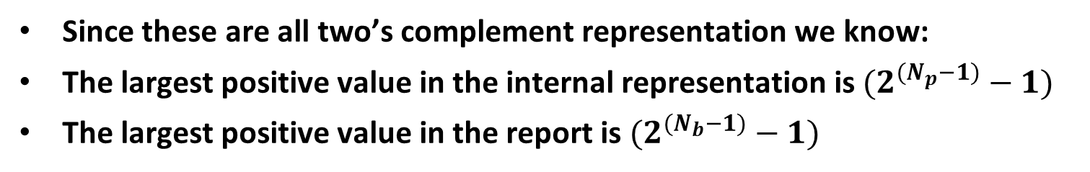
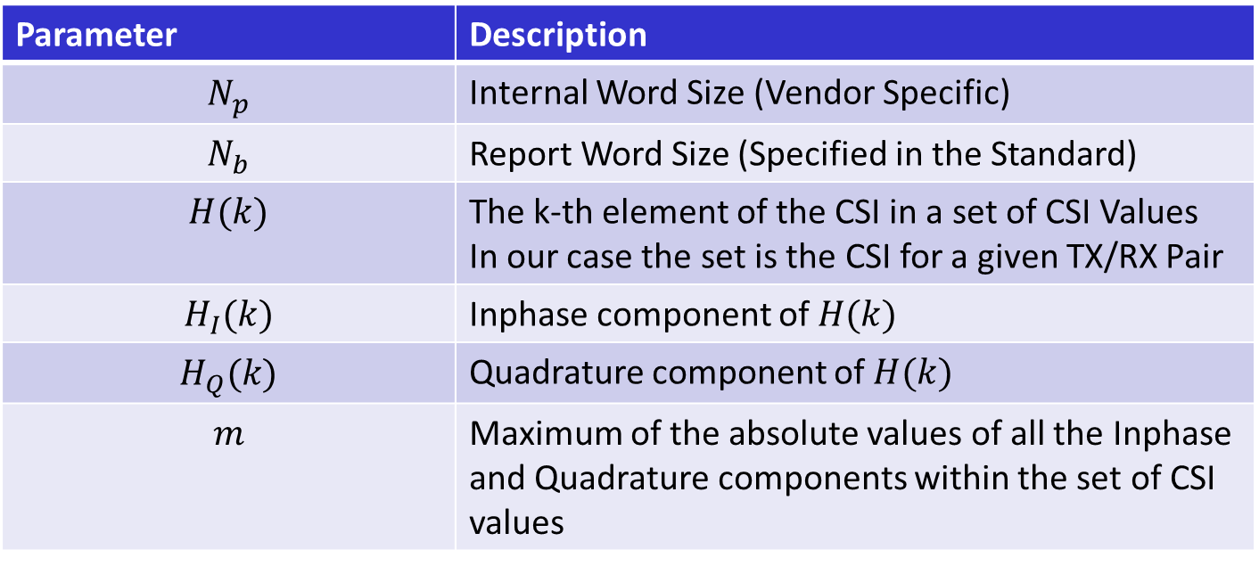
Notation
Parameter | Description
$$N_{p}$$ | Internal Word Size (Vendor Specific)
$$N_{b}$$ | Report Word Size (Specified in the Standard)
$$H(k)$$ | The k-th element of the CSI in a set of CSI Values In our case the set is the CSI for a given TX/RX Pair
$$H_{I}(k)$$ | Inphase component of $H(k)$
$$H_{Q}(k)$$ | Quadrature component of $H(k)$
$$m$$ | Maximum of the absolute values of all the Inphase and Quadrature components within the set of CSI values
Since these are all two’s complement representation we know:
The largest positive value in the internal representation is $(2^{{(N}_{p}−1)}−1)$
The largest positive value in the report is $(2^{{(N}_{b}−1)}−1)$

Slide 4
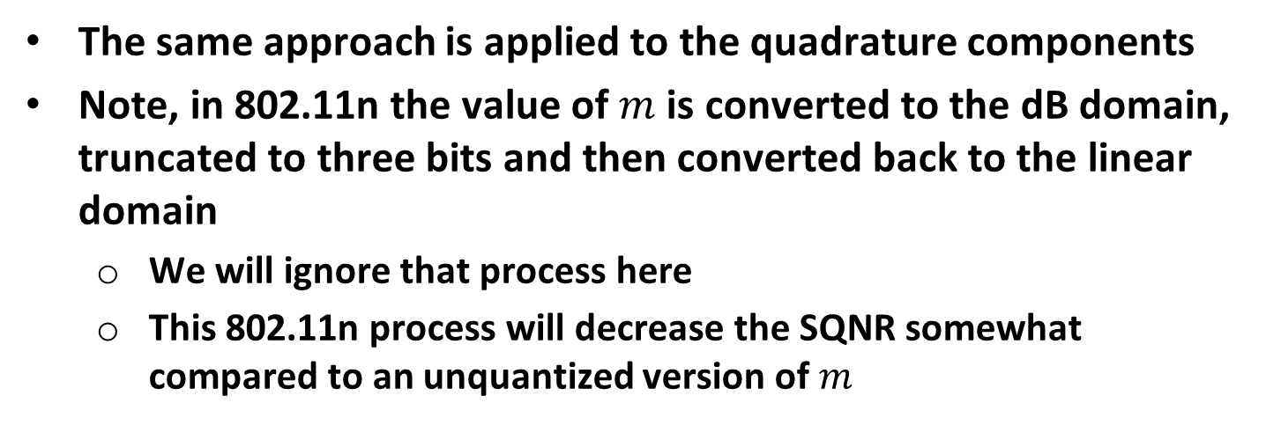
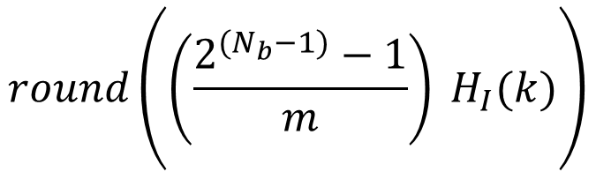
Background
Here is how real-value scaling and quantizing works
$$round\left(\left(\frac{2^{{(N}_{b}−1)}−1}{m}\right) H_{I}(k)\right)$$
The same approach is applied to the quadrature components
Note, in 802.11n the value of $m$ is converted to the dB domain, truncated to three bits and then converted back to the linear domain
  We will ignore that process here
  This 802.11n process will decrease the SQNR somewhat compared to an unquantized version of $m$

Slide 5
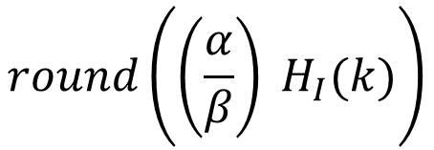
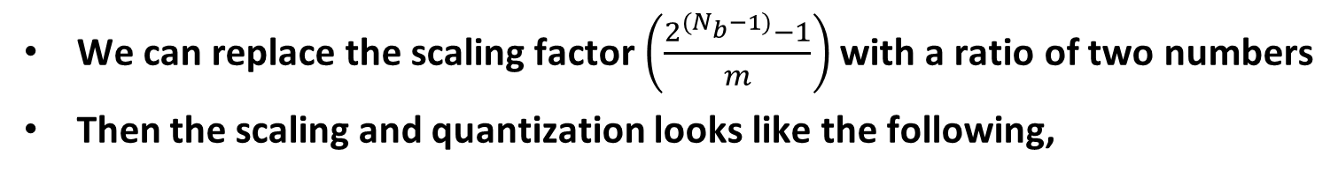
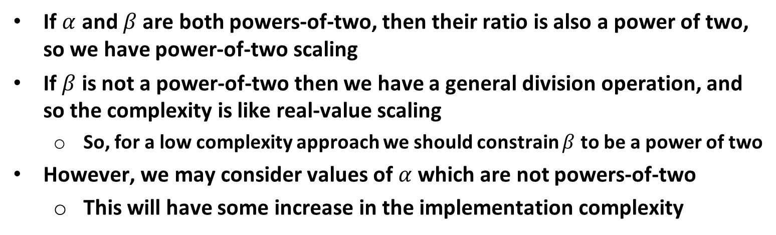
Fractional Scaling Factor
We can replace the scaling factor $\left(\frac{2^{{(N}_{b}−1)}−1}{m}\right)$ with a ratio of two numbers
Then the scaling and quantization looks like the following,
$$round\left(\left(\frac{α}{β}\right) H_{I}(k)\right)$$
If $α$ and $β$ are both powers-of-two, then their ratio is also a power of two, so we have power-of-two scaling
If $β$ is not a power-of-two then we have a general division operation, and so the complexity is like real-value scaling
  So, for a low complexity approach we should constrain $β$ to be a power of two
However, we may consider values of $α$ which are not powers-of-two
  This will have some increase in the implementation complexity

Slide 6
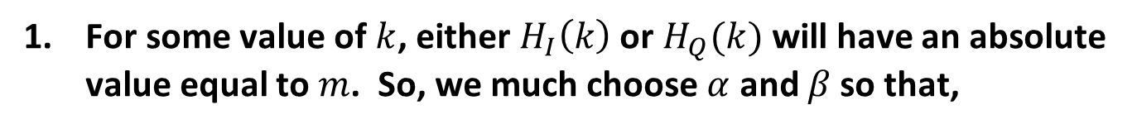

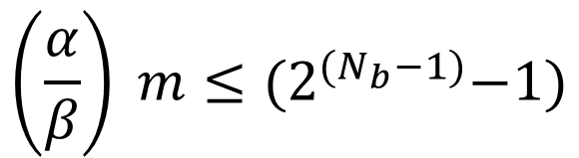
Constraints on $α$ and $β$
For some value of $k$, either $H_{I}\left(k\right)$ or $H_{Q}(k)$ will have an absolute value equal to $m$. So, we much choose $α$ and $β$ so that,
$$\left(\frac{α}{β}\right) m≤{(2}^{{(N}_{b}−1)}−1)$$
For reasonable complexity we need to have $β$ be a power-of-two

Slide 7
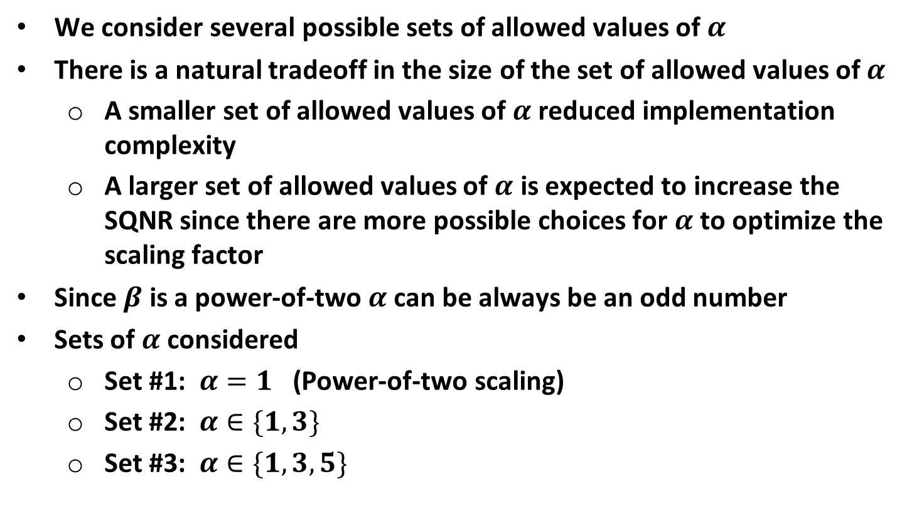

Set of Allowed Values of $α$
We consider several possible sets of allowed values of $α$
There is a natural tradeoff in the size of the set of allowed values of $α$
  A smaller set of allowed values of $α$ reduced implementation complexity
  A larger set of allowed values of $α$ is expected to increase the SQNR since there are more possible choices for $α$ to optimize the scaling factor
Since $β$ is a power-of-two $α$ can be always be an odd number
Sets of $α$ considered
  Set #1: $α=1$ (Power-of-two scaling)
  Set #2: $α∈\{1, 3\}$
  Set #3: $α∈\{1, 3, 5\}$

Slide 8
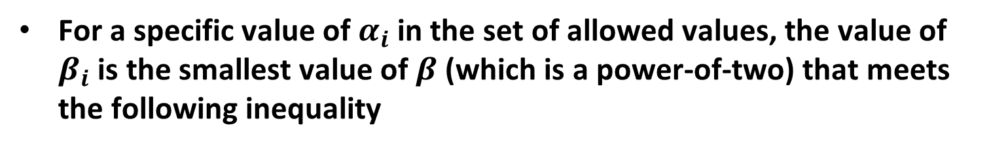

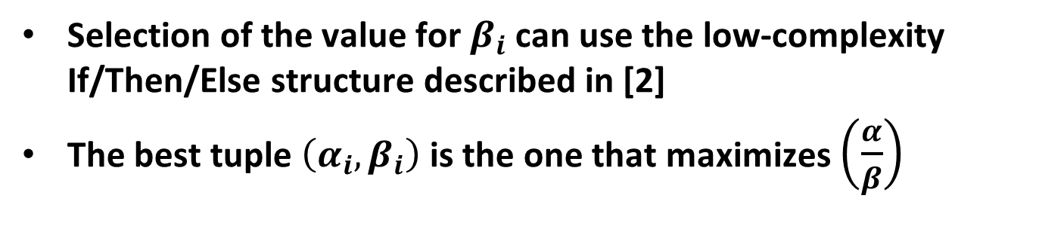
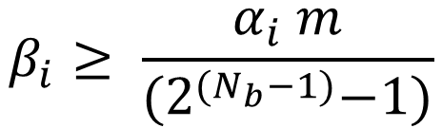
Selection of the values of $α$ and $β$ for Fractional Scaling
For a specific value of $α_{i}$ in the set of allowed values, the value of $β_{i}$ is the smallest value of $β$ (which is a power-of-two) that meets the following inequality
$$β_{i}≥ \frac{α_{i} m}{{(2}^{{(N}_{b}−1)}−1)}$$
Selection of the value for $β_{i}$ can use the low-complexity If/Then/Else structure described in [2]
The best tuple $\left(α_{i}, β_{i}\right)$ is the one that maximizes $\left(\frac{α}{β}\right)$

Slide 9
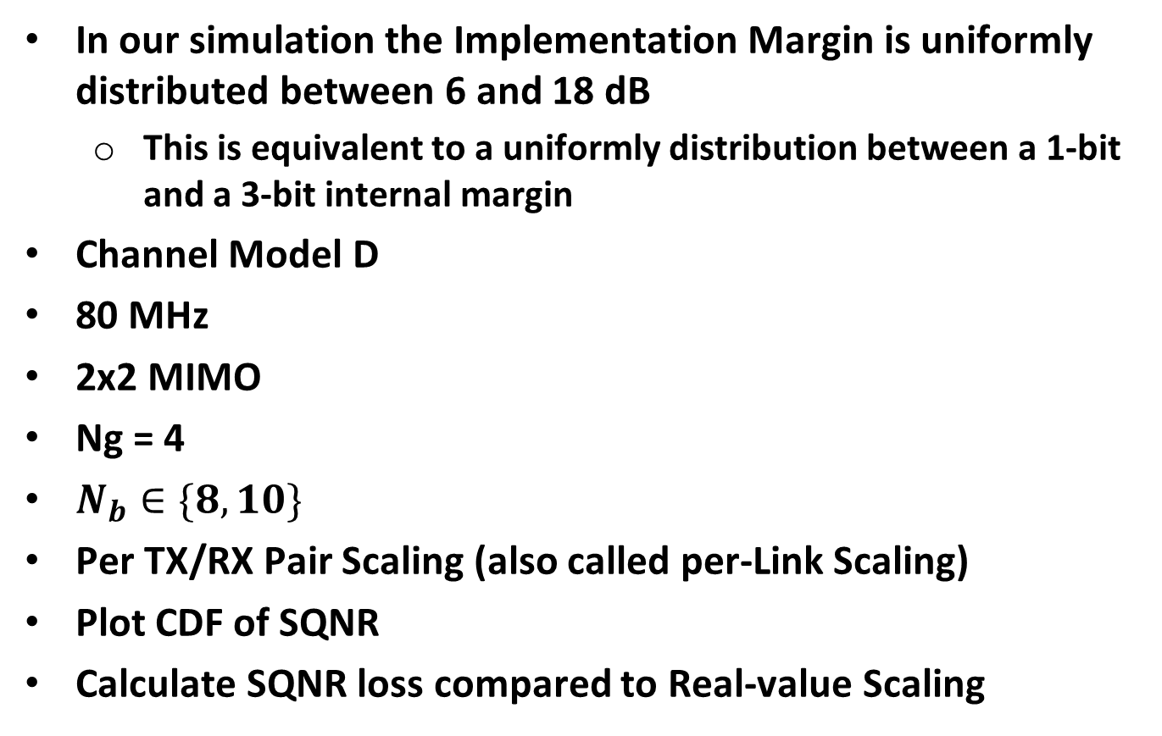
SQNR Simulation
In our simulation the Implementation Margin is uniformly distributed between 6 and 18 dB
  This is equivalent to a uniformly distribution between a 1-bit and a 3-bit internal margin
Channel Model D
80 MHz
2x2 MIMO
Ng = 4
$N_{b}∈\{8, 10\}$
Per TX/RX Pair Scaling (also called per-Link Scaling)
Plot CDF of SQNR
Calculate SQNR loss compared to Real-value Scaling

Slide 10
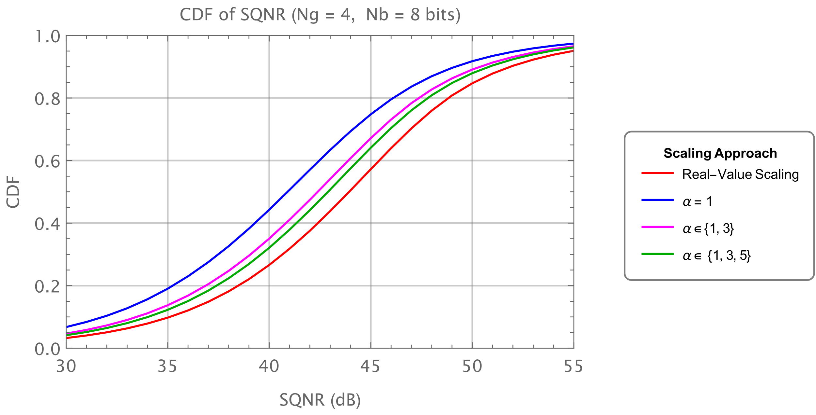
CDF of SQNR (Nb = 8 bits)
Fractional Scaling improves the SQNR relative to Power-of-Two Scaling
  At an increase in implementation complexity

Slide 11
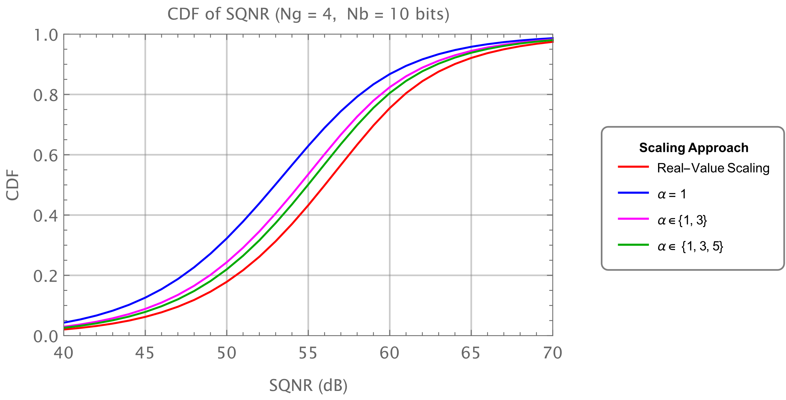
CDF of SQNR (Nb = 10 bits)
Fractional Scaling improves the SQNR relative to Power-of-Two Scaling
  At an increase in implementation complexity

Slide 12
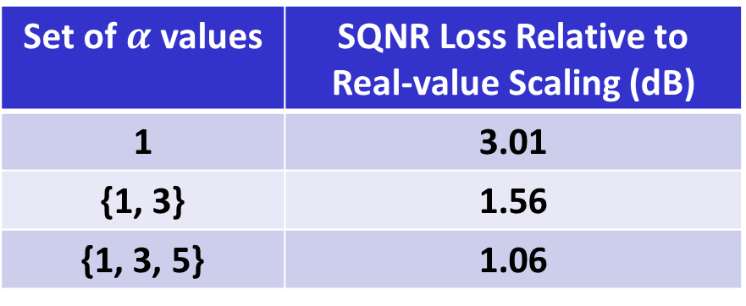
SQNR Loss Relative to Real-value Scaling
Set of $α$ values | SQNR Loss Relative to Real-value Scaling (dB)
1 | 3.01
{1, 3} | 1.56
{1, 3, 5} | 1.06

Slide 13
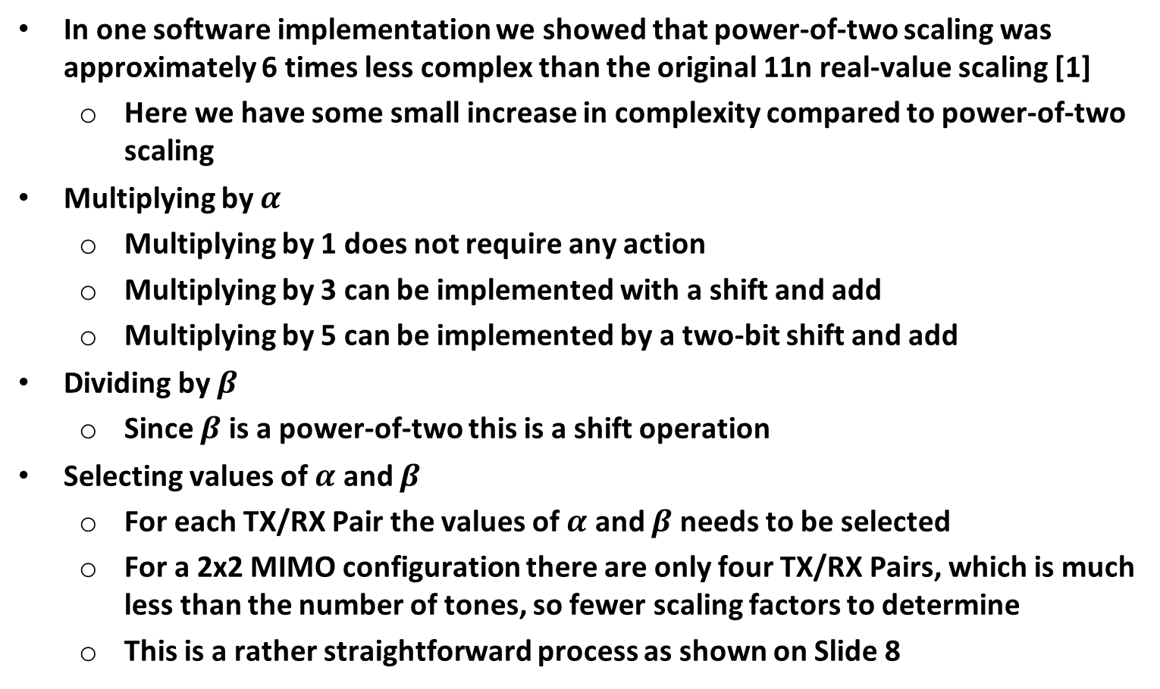
Implementation Complexity
In one software implementation we showed that power-of-two scaling was approximately 6 times less complex than the original 11n real-value scaling [1]
  Here we have some small increase in complexity compared to power-of-two scaling
Multiplying by $α$
  Multiplying by 1 does not require any action
  Multiplying by 3 can be implemented with a shift and add
  Multiplying by 5 can be implemented by a two-bit shift and add
Dividing by $β$
  Since $β$ is a power-of-two this is a shift operation
Selecting values of $α$ and $β$
  For each TX/RX Pair the values of $α$ and $β$ needs to be selected
  For a 2x2 MIMO configuration there are only four TX/RX Pairs, which is much less than the number of tones, so fewer scaling factors to determine
  This is a rather straightforward process as shown on Slide 8

Slide 14
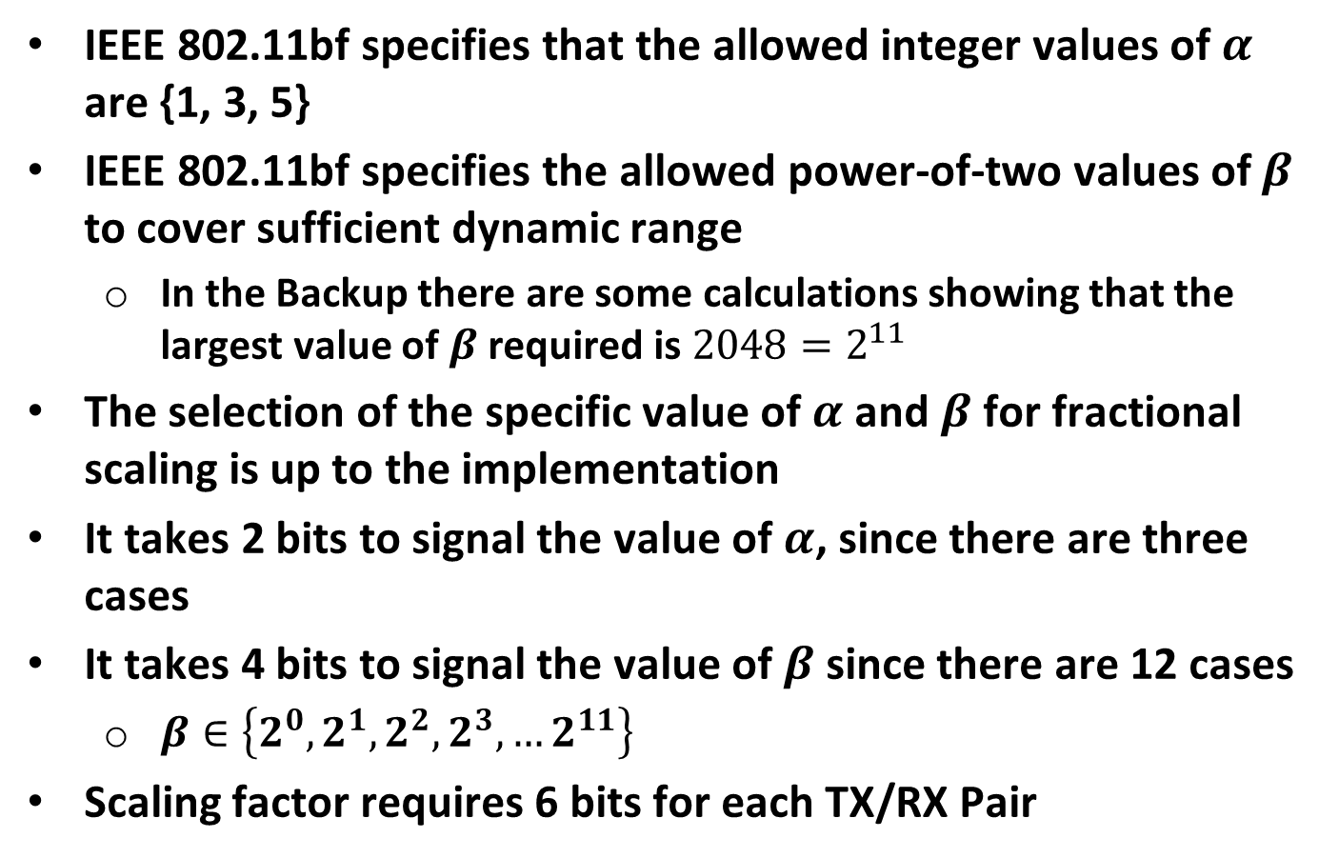
Proposal
IEEE 802.11bf specifies that the allowed integer values of $α$ are {1, 3, 5}
IEEE 802.11bf specifies the allowed power-of-two values of $β$ to cover sufficient dynamic range
  In the Backup there are some calculations showing that the largest value of $β$ required is $2048=2^{11}$
The selection of the specific value of $α$ and $β$ for fractional scaling is up to the implementation
It takes 2 bits to signal the value of $α$, since there are three cases
It takes 4 bits to signal the value of $β$ since there are 12 cases
  $β∈\left\{2^{0}, 2^{1}, 2^{2}, 2^{3}, …2^{11}\right\}$
Scaling factor requires 6 bits for each TX/RX Pair

Slide 15
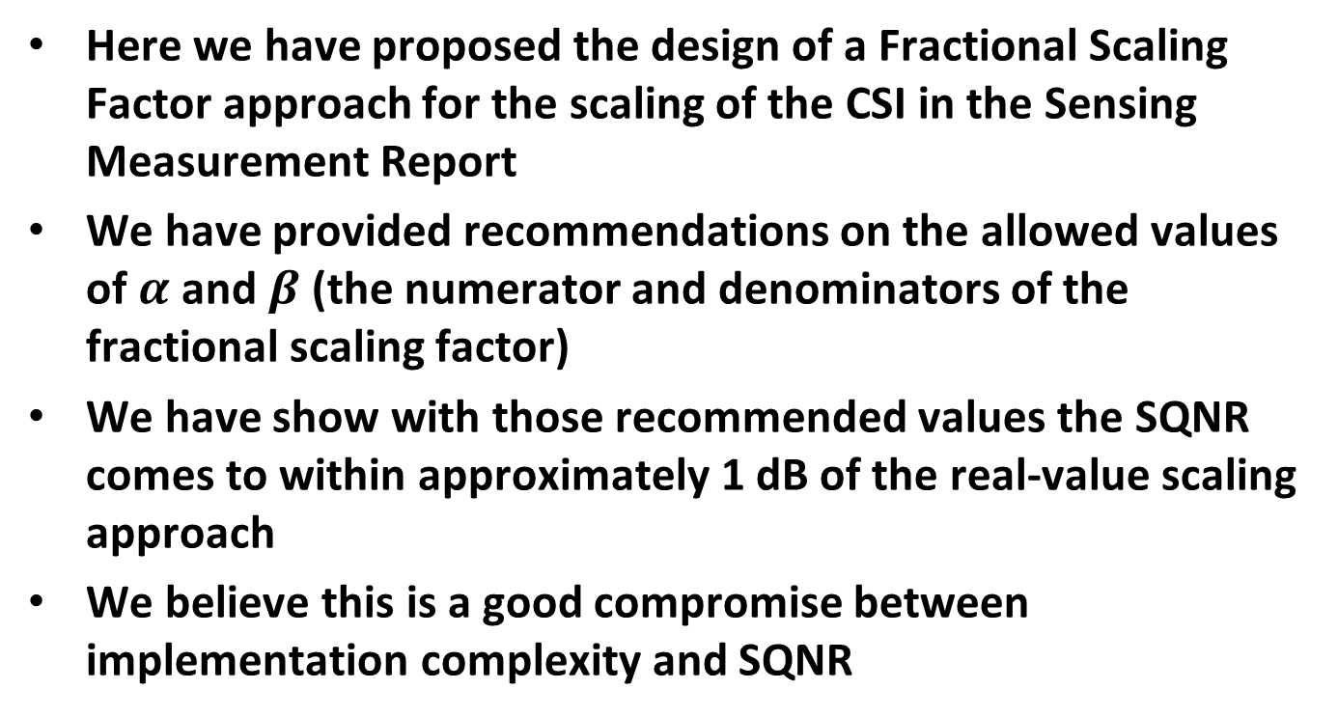
Summary
Here we have proposed the design of a Fractional Scaling Factor approach for the scaling of the CSI in the Sensing Measurement Report
We have provided recommendations on the allowed values of $α$ and $β$ (the numerator and denominators of the fractional scaling factor)
We have show with those recommended values the SQNR comes to within approximately 1 dB of the real-value scaling approach
We believe this is a good compromise between implementation complexity and SQNR

Slide 16
References
Steve Shellhammer, et. al., “Low-Complexity Scaling and Quantization for CSI Report,” IEEE 802.11-21/1573r0, September 2021
Steve Shellhammer, “Calculation of the Scaling Factor in the Sensing CSI Report,” IEEE 802.11-21/1705r0, October 2021

Slide 17

Backup
Range of $β$ Values to be Supported

Slide 18
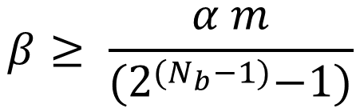


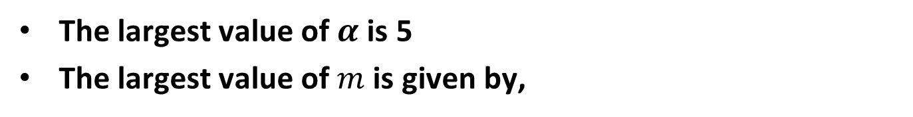
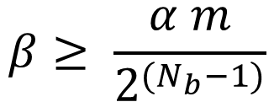
Calculation of Maximum Value $β$ Required
We have the following inequality
$$β≥ \frac{α m}{{(2}^{{(N}_{b}−1)}−1)}$$
This can be closely approximated by,
$$β≥ \frac{α m}{2^{{(N}_{b}−1)}}$$
The largest value of $α$ is 5
The largest value of $m$ is given by,
$$m≤\left(2^{{(N}_{p}−1)}−1\right)≤2^{{(N}_{p}−1)}$$

Slide 19
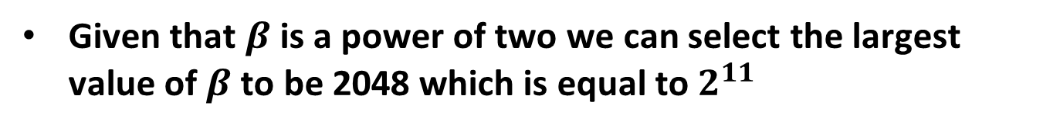


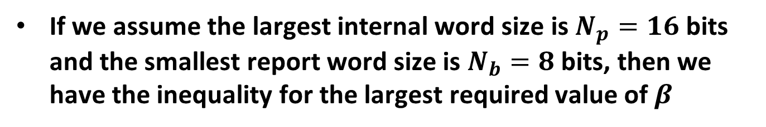
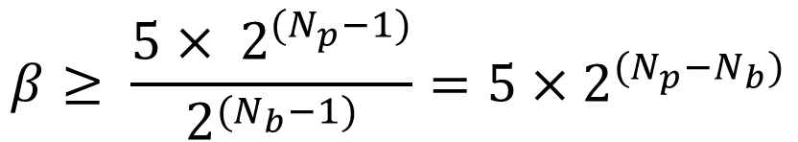
Calculation of Maximum Value $β$ Required
So, we have the inequality for the largest value of $β$,
$$β≥ \frac{5× 2^{{(N}_{p}−1)}}{2^{{(N}_{b}−1)}}=5×2^{{(N}_{p}−N_{b})}$$
If we assume the largest internal word size is $N_{p}=16$ bits and the smallest report word size is $N_{b}=8$ bits, then we have the inequality for the largest required value of $β$
$$β≥5×2^{8}=1280$$
Given that $β$ is a power of two we can select the largest value of $β$ to be 2048 which is equal to $2^{11}$

Slide 20
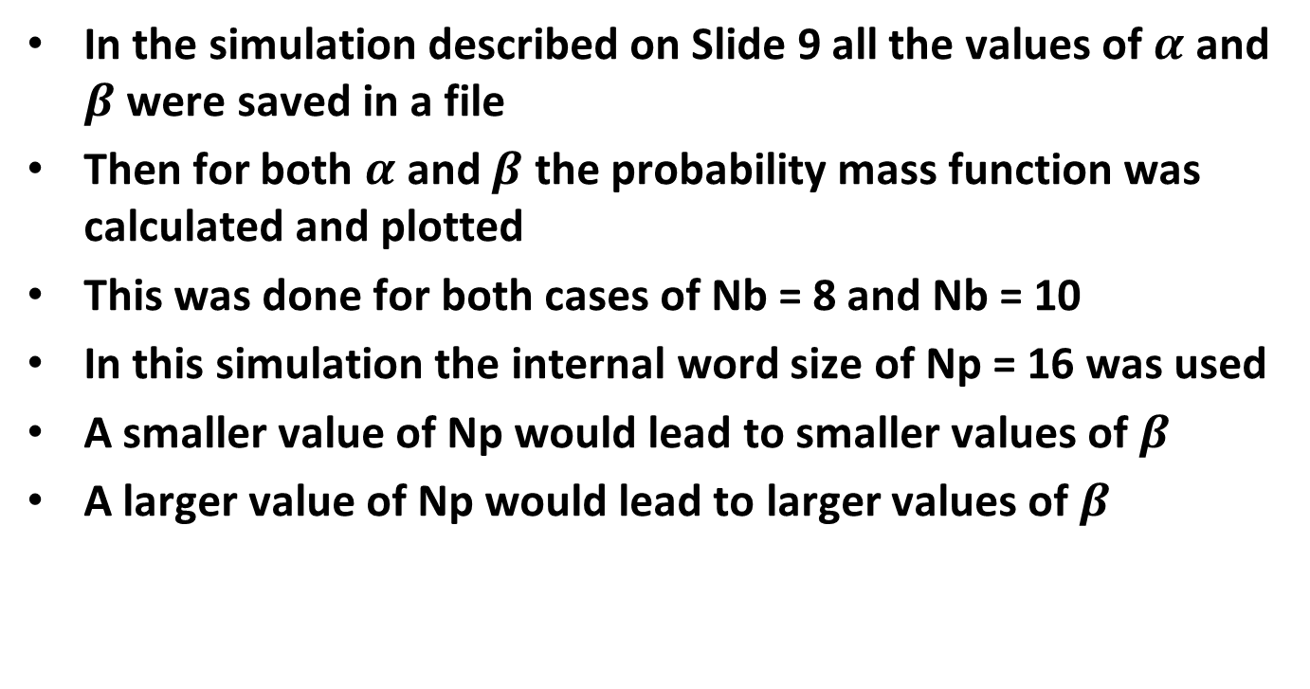
Simulation
In the simulation described on Slide 9 all the values of $α$ and $β$ were saved in a file
Then for both $α$ and $β$ the probability mass function was calculated and plotted
This was done for both cases of Nb = 8 and Nb = 10
In this simulation the internal word size of Np = 16 was used
A smaller value of Np would lead to smaller values of $β$
A larger value of Np would lead to larger values of $β$

Slide 21
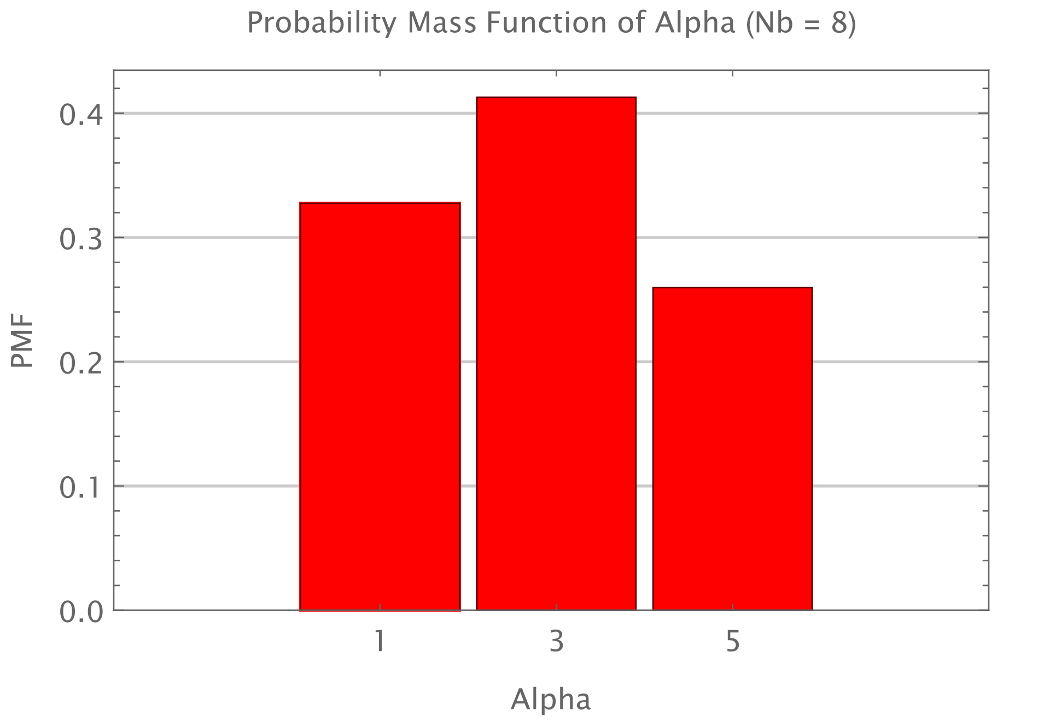
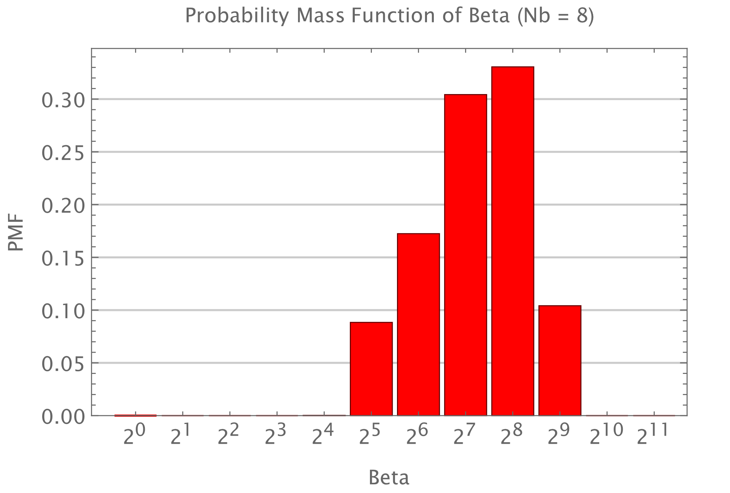
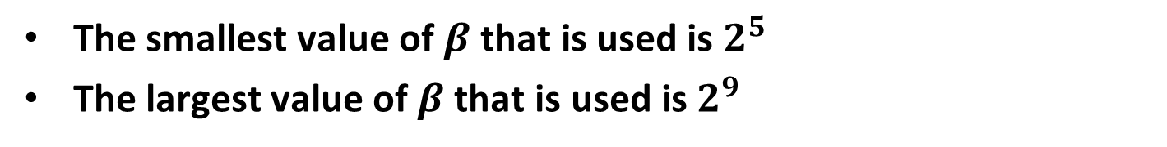
Probability Mass Functions for $α$ and $β$ (Nb = 8)
The smallest value of $β$ that is used is $2^{5}$
The largest value of $β$ that is used is $2^{9}$

Slide 22
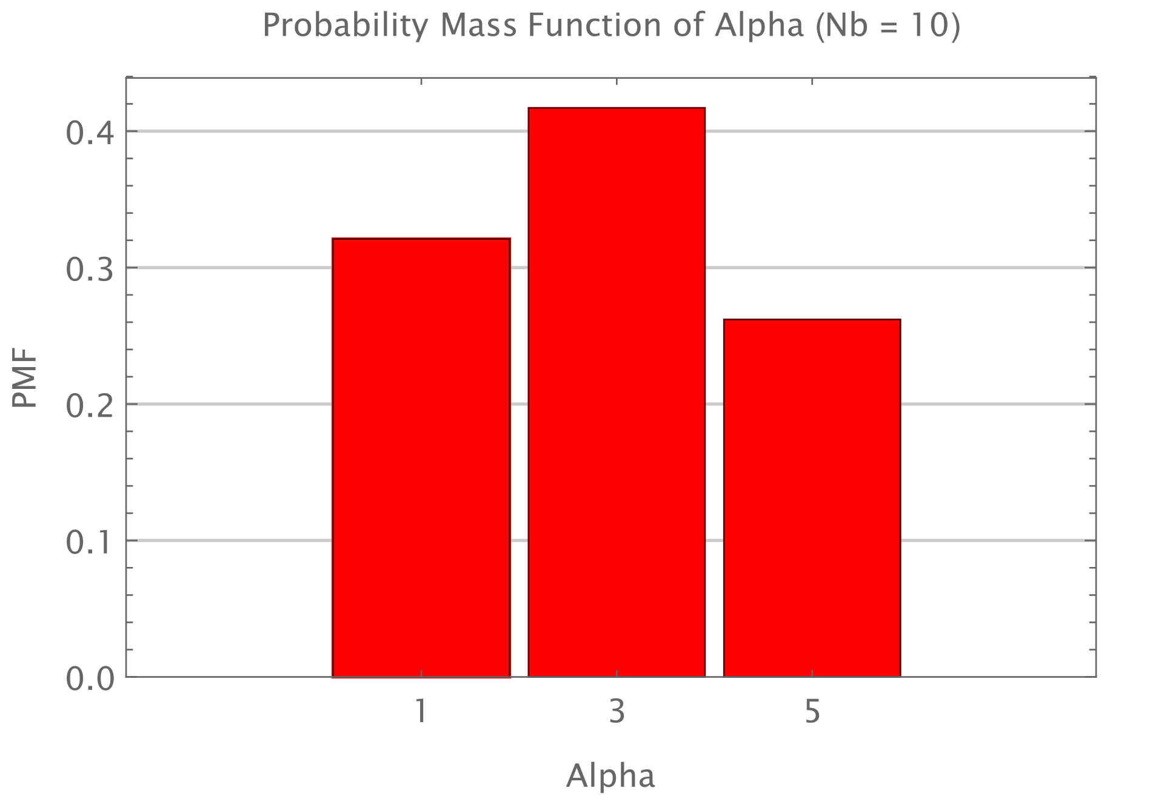
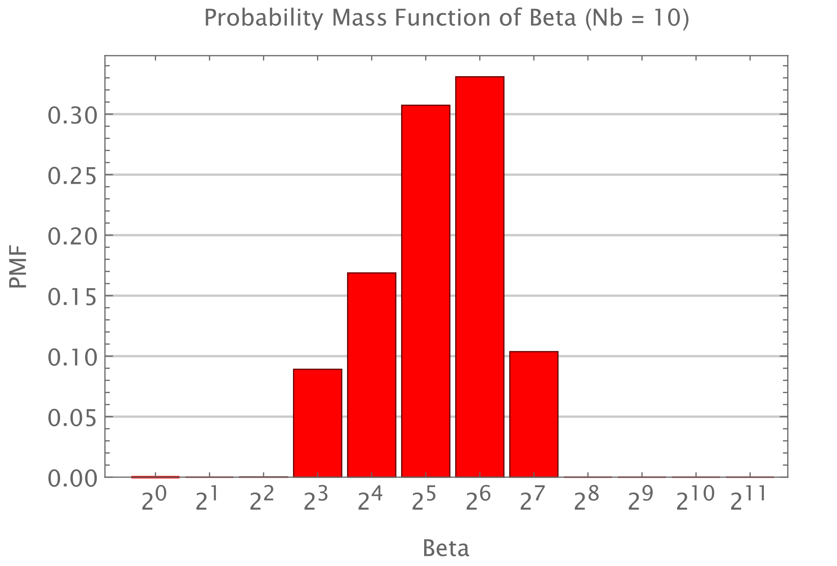
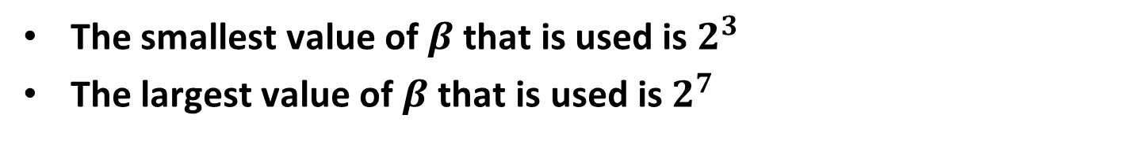
Probability Mass Functions for $α$ and $β$ (Nb = 10)
The smallest value of $β$ that is used is $2^{3}$
The largest value of $β$ that is used is $2^{7}$

