Slide 1
Discussion of NSTR and EMLSR
Date: 2021-03-06
Authors:
Name | Affiliations | Address | Phone | Email
Yunbo Li | Huawei | Shenzhen, China |  | liyunbo@Huawei.com
Yiqing Li
Ming Gan
Yuchen Guo
Guogang Huang
Yuxin Lu
Yousi Lin
Edward Au
Stephen McCann
Notes:
September 2012

Slide 2
CID 5773
CID | Commenter | Section | Page.Line | Comment | Proposed Change | Resolution
5773 | Laurent Cariou | 35.3.15 | 281.17 | eMLSR has been introduced a bit late compared to other modes like NSTR and has therefore been introduced as optional. However, support for operation with non-AP MLD with the other main modes is mandatory at the AP MLD side (NSTR, STR). It would make sense that all the main modes are actually mandatory supported on all AP MLDs. On top of that, eMLSR has shown significant gains and is clearly a very important features for MLO in 11be. Also complexity to support eMLSR for an AP MLD that already supports operation for NSTR or STR non-AP MLD is relatively minor. | Make eMLSR support mandatory on AP MLD side.

Slide 3
Background
A pair of links on which a regular AP MLD operates is mandate to be STR.
A pair of links on which a non-AP MLD operates could be STR, NSTR, MLSR, or EMLSR, depending on the cost, size, frequency gap between these two links and so on;
MLSR can obtain performance gain by using link selection according to the traffic load and link quality, but it has worse performance on throughput and latency than NSTR and EMLSR;
This presentation focuses on NSTR and EMLSR and provides their performance comparison.

Slide 4
Performance loss compared with STR
NSTR
  For UL channel access, there may exist waiting time on one link for another link if an NSTR non-AP MLD intends to transmit on these two links simultaneously;
  When an AP MLD schedules the UL/DL transmission for an NSTR non-AP MLD, cross link interference constraint should be taken into account
  Blindness exists on one link due to the transmission on another link
EMLSR
  Overhead of initial control (MU-RTS/CTS, or BSRP/BSR)
  Overhead of switch delay between receiving mode and listen mode
  Blindness exists on one link due to the transmission on another link
  Blindness exists during the frequent switch
  Lack of frequency diversity resulting from more than one link

Slide 5
Comparison between NSTR and EMLSR
 | NSTR | EMLSR
MIMO | Flexible to be SISO or MIMO | Mandatory to support MIMO
RF switch | No | Frequent
Peak throughput (1+1 for NSTR; 2*2 for EMLSR) | Higher because of the frequency diversity | Lower due to Overhead of Initial Control and switch delay Interference among those streams, resulting in low MCS Sounding overhead
Whether UL transmission on link 1 will cause blindness on link2 or not? | No for single short packet (<72us) ; Yes for long packet (≥72us) | Yes
Whether DL transmission on link 1 will cause blindness on link2 or not? | No for most cases because BA is shorter than MediumSyncThreshold in many cases | Yes
Is simultaneous transmission allowed on more than link? | Yes | No
Probability for blindness | Relative Low | Relative high

Slide 6
Setting of System Level Simulation
Parameters | Value
# of AP MLDs | 2
# of affiliated APs for each AP MLD | 2
# of associated non-AP MLDs for each AP MLD | 8
coverage of BSS | 10 m * 10 m
Distance between two AP MLDs | 30 m
BW | 80 MHz
MCS | 11
Traffic direction | UL + DL
DL PPDU type | MU-MIMO (4*4)
UL PPDU type | MU-MIMO for TB PPDU (4*4); SISO for NSTR EDCA; 2*2 MIMO for EMLSR EDCA
MPDU size | 1500 Bytes for throughput simulation, 200Bytes for delay simulation
Switch delay of EMLSR | 128 us
Blindness period | 5.484 ms

Slide 7
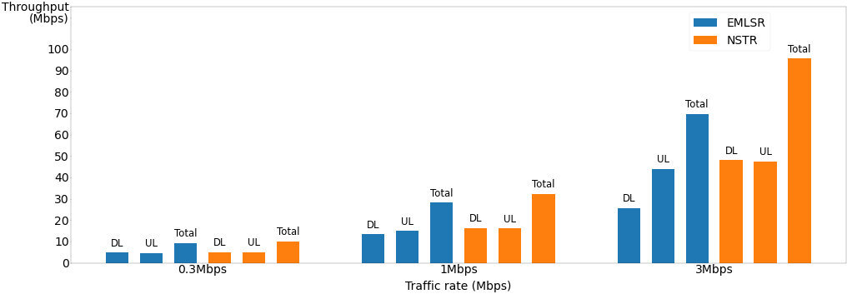
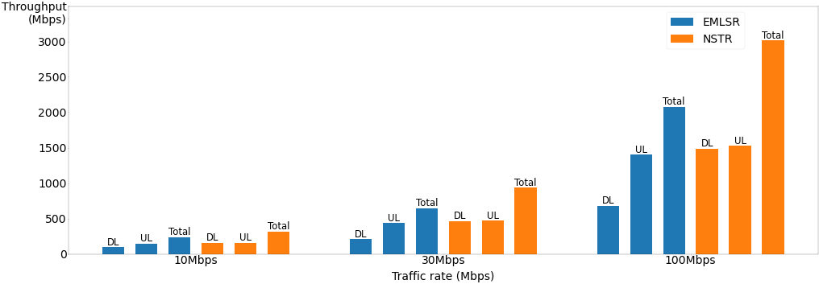
Simulation Results of Throughput
MPDU size = 1500Bytes; Max number of aggregation = 256
Traffic load of EMLSR:
8.5% for Aggr=1
14.8% for Aggr=2
7.7% for Aggr=4
4.3% for Aggr=8
23.1% for Aggr=4
13% for Aggr=8
7.5% for Aggr=16
16.7% for Aggr=32
12.5% for Aggr=64
10.4% for Aggr=128
37.6% for Aggr=64
31.3% for Aggr=128
28.2% for Aggr=256
100% for Aggr=64
100% for Aggr=128
94% for Aggr=256
Traffic load of NSTR:
5.7% for Aggr=2
4.1% for Aggr=4
2.5% for Aggr=8
12.4% for Aggr=4
7.6% for Aggr=8
5.6% for Aggr=16
15.1% for Aggr=32
13% for Aggr=64
12.5% for Aggr=128
39% for Aggr=64
37.6% for Aggr=128
36% for Aggr=256
100% for Aggr=64
100% for Aggr=128
100% for Aggr=256
3.1% for Aggr=1
Note 1: Traffic rate in X-axis means traffic rate per MLD in DL or UL. The traffic rates are same for each MLD, and in both DL and UL.
Note 2: Throughput in Y-axis means total throughput of 4 BSSs (two links and 2BSSs in each link)
Note 3: Aggr=n means there are n MPDUs in an A-MPDU.
Note 4: the traffic loads are rough estimations, not accurate loads
Note 5: OBSS load refers to traffic load since two BSSs have the same traffic load in simulation

Slide 8
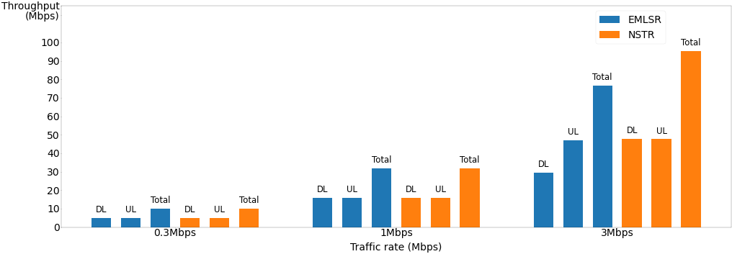
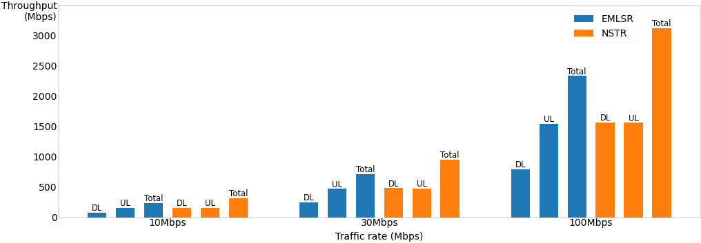
Simulation Results of Throughput
For simulation in previous slide, interference level between two APs is about -66dBm;
Two more simulations are provided with different interference levels between APs.
Interference level between two APs is about -76dBm

Slide 9
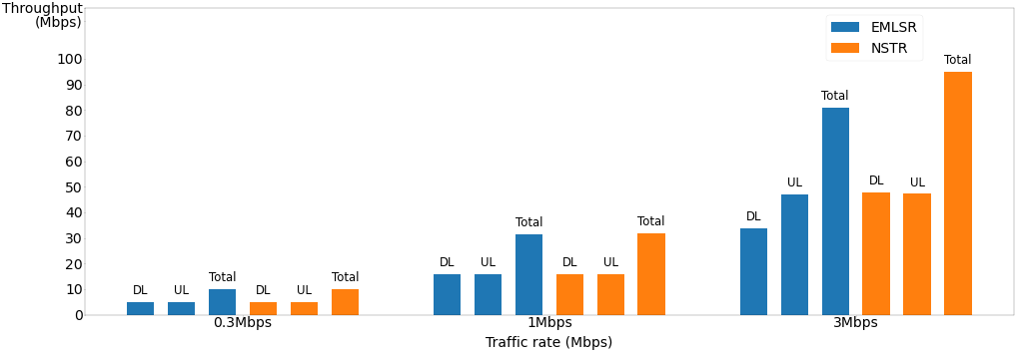
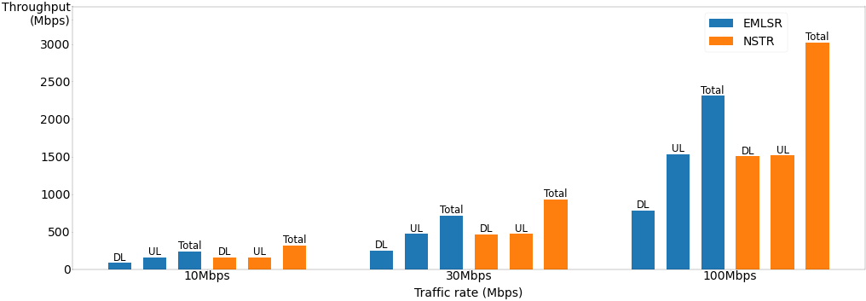
Simulation Results of Throughput
For simulation in previous slide, interference level between two APs is about -66dBm;
Two more simulations are provided with different interference levels between APs.
Interference level between two APs is about -56dBm

Slide 10
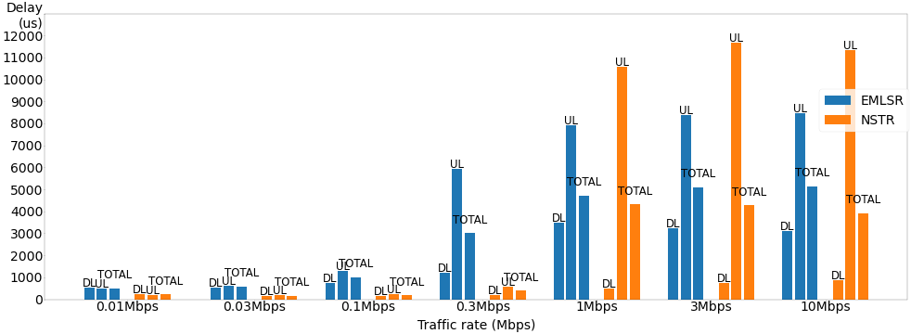
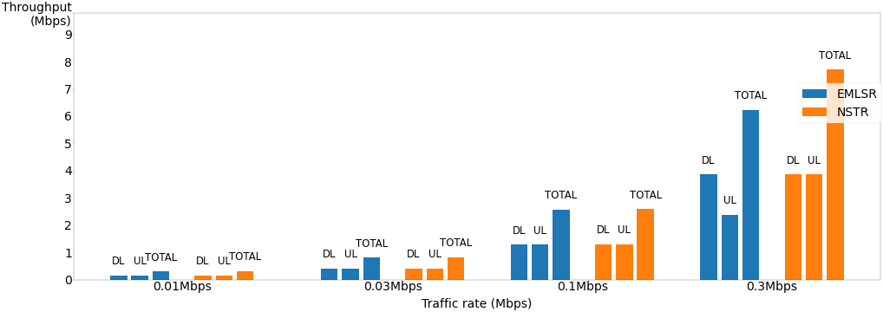
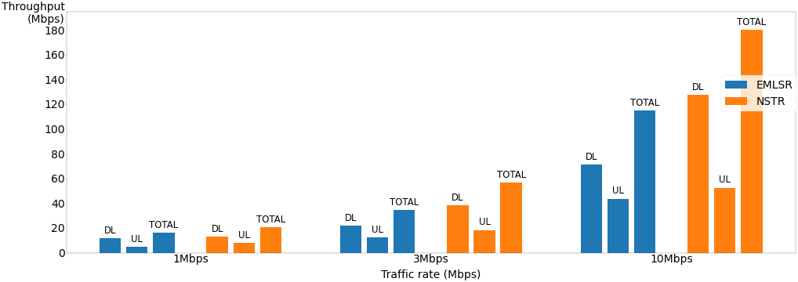
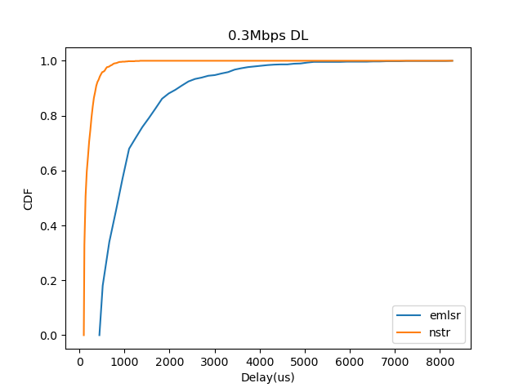
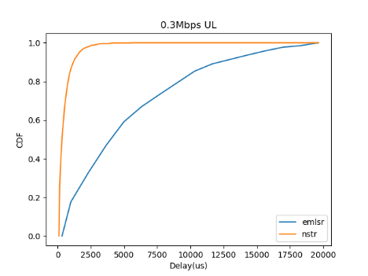
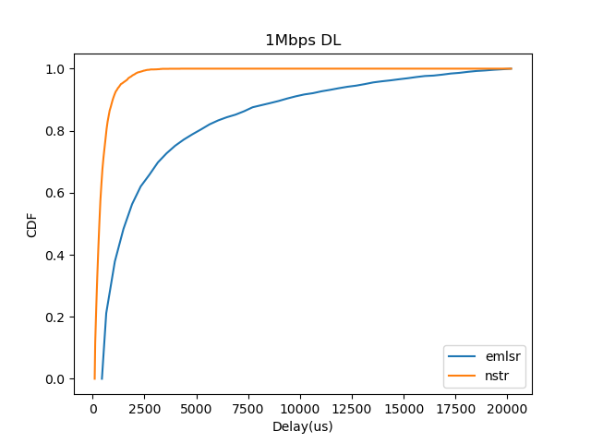
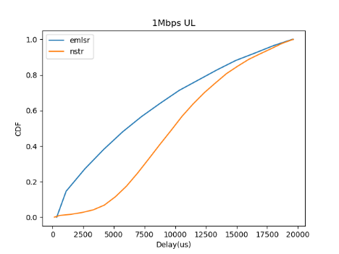
Simulation Results of Delay
MPDU size = 200 Bytes, Max number of aggregation = 256; MPDU life time = 20ms

Slide 11
Summary
A pair of links on which a non-AP MLD operates is not STR, there are three possible modes: NSTR, MLSR and EMLSR.
Based on the performance analysis, NSTR has much better performance compared with EMLSR
Given that NSTR and MLSR are mandatorily supported at AP MLD side and they provide flexibility to the non-AP MLD (One is for good performance, the other is for low cost ), it is not reasonable to mandate EMLSR at AP MLD side.

Slide 12
Straw Poll
Do you agree to resolve CID 5773 as below?
CID | Commenter | Section | Page.Line | Comment | Proposed Change | Resolution
5773 | Laurent Cariou | 35.3.15 | 281.17 | eMLSR has been introduced a bit late compared to other modes like NSTR and has therefore been introduced as optional. However, support for operation with non-AP MLD with the other main modes is mandatory at the AP MLD side (NSTR, STR). It would make sense that all the main modes are actually mandatory supported on all AP MLDs. On top of that, eMLSR has shown significant gains and is clearly a very important features for MLO in 11be. Also complexity to support eMLSR for an AP MLD that already supports operation for NSTR or STR non-AP MLD is relatively minor. | Make eMLSR support mandatory on AP MLD side. | Rejected. Base on the performance analysis in doc 11-22/0349r2, NSTR is the best, EMLSR is the second, and MLSR is the worst. Since NSTR and MLSR already been mandated at AP MLD side, mandating EMLSR at AP MLD side will add too many options and the complexity to AP MLD side.

