Slide 1
Discussion of NSTR and EMLSR
Date: 2021-03-06
Authors:
Name | Affiliations | Address | Phone | Email
Yunbo Li | Huawei | Shenzhen, China |  | liyunbo@Huawei.com
Yiqing Li
Ming Gan
Yuchen Guo
Guogang Huang
Yuxin Lu
Yousi Lin
Edward Au
Stephen McCann
Notes:
September 2012

Slide 2
CID 5773
CID | Commenter | Section | Page.Line | Comment | Proposed Change | Resolution
5773 | Laurent Cariou | 35.3.15 | 281.17 | eMLSR has been introduced a bit late compared to other modes like NSTR and has therefore been introduced as optional. However, support for operation with non-AP MLD with the other main modes is mandatory at the AP MLD side (NSTR, STR). It would make sense that all the main modes are actually mandatory supported on all AP MLDs. On top of that, eMLSR has shown significant gains and is clearly a very important features for MLO in 11be. Also complexity to support eMLSR for an AP MLD that already supports operation for NSTR or STR non-AP MLD is relatively minor. | Make eMLSR support mandatory on AP MLD side.

Slide 3
Background
A link pair in an AP MLD, except mobile AP MLD, is mandate to be STR.
A link pair in a non-AP MLD could be STR, NSTR, MLSR, or EMLSR;
Considering the differences between AP MLD and non-AP MLD (e.g. cost, size, etc.), it is normal that AP MLD side can achieve STR while non-AP MLDs cannot;
MLSR can reach limited gain by selecting a better link based on the traffic load, but cannot increase the throughput or reduce the latency through ML operation. MLSR will obviously have a worse performance than NSTR and EMLSR;
This presentation mainly discusses NSTR and EMLSR.

Slide 4
Performance loss compared with STR
NSTR
  In UL channel access, the link finished the backoff first needs to wait for another link of the NSTR link pair if the non-AP MLD intends to simultaneously transmit on two links;
  When AP MLD schedules the UL/DL transmission, due to cross link interference constrain at non-AP MLD side, needs to be considered
  Blindness of one link due to the transmission on another link exceeds the MediumSyncThreshold;
EMLSR
  Overhead of initial control (MU-RTS/CTS, or BSRP/BSR)
  Overhead of switch delay between receiving mode and listen mode
  Blindness once a link switches back to listening mode

Slide 5
Comparison between NSTR and EMLSR
 | NSTR | EMLSR
MIMO | Flexible to be SISO or MIMO | Mandatory to support MIMO
RF switch | No | Frequent
Peak throughput (1+1 for NSTR; 2*2 for EMLSR) | higher | Lower due to Lower MCS for 2SS Sounding cost
Whether UL Data transmission in link 1 will cause blindness in link2 | No for single short packet (<72us) ; Yes for long packet (≥72us) | Yes
Whether DL Data transmission in link 1 will cause blindness in link2 | No for most cases. Because, in many cases, BA is shorter than MediumSyncThreshold | Yes
Delay (for short frame) | May be better than EMLSR due to less chance to enter blindness | May be worse than NSTR due to higher chance to enter blindness

Slide 6
Setting of System Level Simulation
Parameters | Value
# of AP MLDs | 2
# of affiliated APs for each AP MLD | 2
# of associated non-AP MLDs for each AP MLD | 8
coverage of BSS | 10 m * 10 m
Distance between two AP MLDs | 30 m
BW | 80 MHz
MCS | 11
Traffic direction | UL + DL
DL PPDU type | MU-MIMO (4*4)
UL PPDU type | MU-MIMO for TB PPDU (4*4); SISO for NSTR EDCA; 2*2 MIMO for EMLSR EDCA
MPDU size | 1500 Bytes
Switch delay of EMLSR | 128 us
Blindness period | 5.484 ms

Slide 7
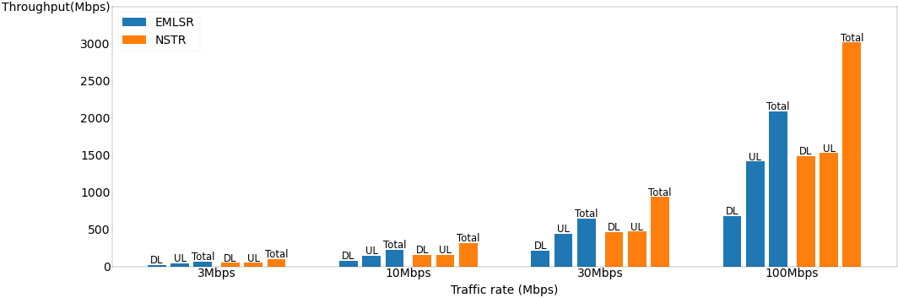
Simulation Results of Throughput
Max number of aggregation = 256

Slide 8
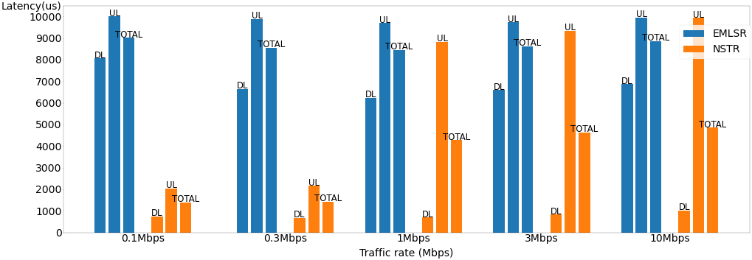
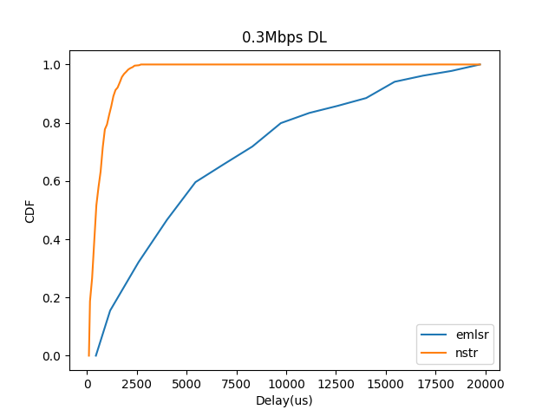
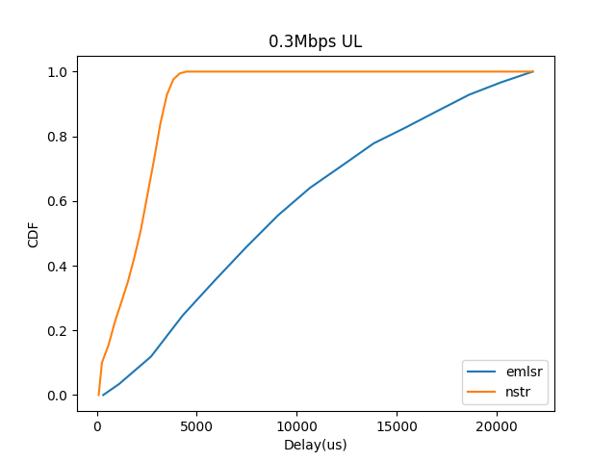

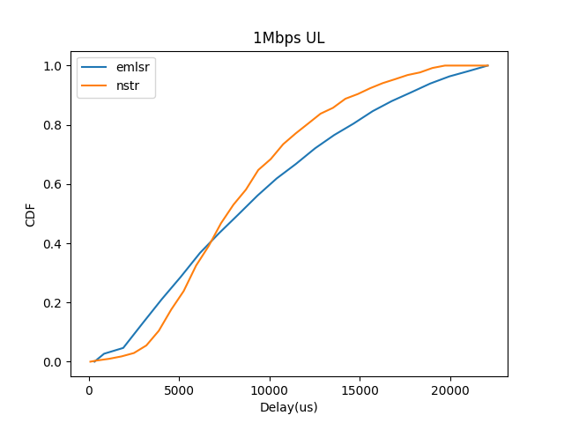
Simulation Results of Delay
MPDU size = 200 Bytes

Slide 9
Summary
When a link pair of a non-AP MLD cannot realize STR, there are three possible modes to choose: NSTR, MLSR and EMLSR.
Based on the performance analysis, NSTR is the best, EMLSR is the second, and MLSR is the worst;
NSTR and MLSR are already mandatorily supported at AP MLD side, a non-AP STA could choose NSTR for better performance, or MLSR for simple operation;
Mandate EMLSR at AP MLD side will add too many options which add the complexity at AP MLD side;
Suggest to keep EMLSR as an optional feature.

Slide 10
Straw Poll
Do you agree to resolve CID 5773 as below?
CID | Commenter | Section | Page.Line | Comment | Proposed Change | Resolution
5773 | Laurent Cariou | 35.3.15 | 281.17 | eMLSR has been introduced a bit late compared to other modes like NSTR and has therefore been introduced as optional. However, support for operation with non-AP MLD with the other main modes is mandatory at the AP MLD side (NSTR, STR). It would make sense that all the main modes are actually mandatory supported on all AP MLDs. On top of that, eMLSR has shown significant gains and is clearly a very important features for MLO in 11be. Also complexity to support eMLSR for an AP MLD that already supports operation for NSTR or STR non-AP MLD is relatively minor. | Make eMLSR support mandatory on AP MLD side. | Rejected. Base on the performance analysis in doc 11-22/0349r0, NSTR is the best, EMLSR is the second, and MLSR is the worst. Since NSTR and MLSR already been mandated at AP MLD side, mandating EMLSR at AP MLD side will add too many options which add the complexity at AP MLD side.

