Slide 1
STA-STA sub7GHz WLAN sensing support by leveraging SBP
Date: 2022-02-14
Authors:
Name | Company | Address | Phone | Email
Enrico Rantala | Zeku |  |  | enrico.rantala@zeku.com
Khashayar Mirfakhraei
Yi-Hsiu Wang

Slide 2
Abstract
Sensing performance depends on receiver, transmitter and target locations
Currently SFD [1, 0504r7] defines WLAN sensing between AP-STA but we believe sensing performance could benefit from STA-STA sensing
Submission [2, 0312r0] discusses about collaborative WLAN sensing
In this submission we propose a solution to enable sub7GHz STA-STA WLAN sensing by leveraging Sensing-By-Proxy (SBP) framework

Slide 3
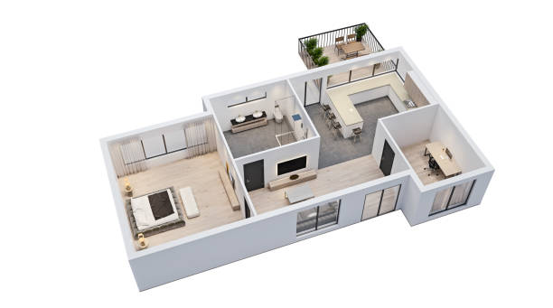
Example of STA-STA sensing
Assume two WLAN sensing capable STAs associated with a WLAN sensing capable AP
AP and one of the STAs may invoke WLAN sensing function (blue line) to sense the area of interest in red
Heuristically, STA-STA could be the preferred sensing pair (see backup slide)
Idea: the other STA could observe WLAN sensing as a “remote receiver” if it would know some of the operational parameters from the WLAN sensing
AP
STA-1
AP
STA
STA-5
STA-2
STA-4
STA
TARGET
STA-3

Slide 4

Sub7GHz STA-STA WLAN sensing support into SBP
We propose that SBP requesting STA may request one WLAN sensing capable non-AP STA to perform WLAN sensing with the AP
  This allows SBP requesting STA to choose WLAN sensing pair
We propose also that AP may make available operational parameters from the WLAN sensing such as timing (start time and duration), channel and bandwidth, for SBP requesting STA
  This allows SBP requesting STA to function as a “remote receiver”
Initiator & Receiver
AP
Example:
WLAN sensing
SBP
Responder & Transmitter
STA-1
STA-2
SBP requesting STA
“remote receiver”

Slide 5
Straw Poll #1
Do you support to add into SFD the following:
  Leverage existing SBP framework in enabling STA-STA WLAN sensing
  Y/N/A

Slide 6
Straw Poll #2
Do you support to add into SFD the following:
  In SBP procedure:
  SBP requesting STA may request one non-AP STA to perform WLAN sensing with the AP
  AP may signal TBD operational WLAN sensing parameters to SBP requesting STA
  Y/N/A

Slide 7
References
[1] Specification Framework for TGbf. https://mentor.ieee.org/802.11/dcn/21/11-21-0504-07-00bf-specification-framework-for-tgbf.docx
[2] Collaborative WLAN sensing. https://mentor.ieee.org/802.11/dcn/22/11-22-0312-00-00bf-collaborative-wlan-sensing-example-operations.pptx

Slide 8
Backup

Slide 9

Why STA-STA sensing
Intuitively, the most “interesting” STAs to pair are close to each other and in vicinity of the desired target
  Higher received signal strength
  Undesired targets farther away from the desired target
WLAN sensing defined
WLAN sensing not defined, could be an interesting sensing pair
Interfering
Undesired Targets
AP
WLAN sensing not defined, probably not an interesting sensing pair
STA-1
STA-5
STA-2
STA-4
STA-3
Desired Target

