Slide 1
Discussion on Threshold-based Sensing
Date: 2022-02-14
Authors:

Slide 2
Introduction
Changing of the Channel State Information (CSI) may carry information about the activities of interests in an environment
TGbf has made a few agreements on “Threshold-based measurement and reporting” based on the change of CSI
However, some of the terms in the agreed texts have not been clearly defined, which makes the decision on the details of sensing procedure difficult.
The purpose of this contribution is to highlight those issues and discuss some alternatives

Slide 3
What have been agreed [1]
Motion 18:
  An optional threshold-based measurement and reporting procedure is defined in which
  The difference between the current measured CSI and the previous measured CSI is quantified. The difference is referred to as CSI variation.
  A threshold value to be used by the sensing receiver in the threshold-based procedure is defined.
  By comparing the CSI variation with the threshold, the sensing receiver can send a feedback resulting from the large CSI variation to the sensing transmitter.
  Whether the threshold is predefined, or defined by the sensing receiver, transmitter, initiator or responder is TBD.
  The threshold-based procedure is not always required
Motion 33
  In the threshold-based measurement instance, the threshold for each responder to be compared with the CSI variation value is determined by the initiator.

Slide 4
Issues on Terms in the Agreement
The difference between the current measured CSI and the previous measured CSI, i.e., “CSI variation”, is not clearly defined
  What principle is the “CSI variation” based on?
  Without clear definition of “CSI variation”, does comparing “CSI variation” to a given threshold make sense?
    Can a threshold be given without understanding the definition of CSI variation?
    Is the definition of CSI variation implementation dependent, or application dependent, or both?
After comparing the CSI variation with the threshold, what is fed back from the sensing receivers?
  Feedback the measured CSI variation regardless of the threshold value or above/below threshold information (1 bit)
We will focus on the first issue in this contribution.

Slide 5
Ways to Obtain CSI Variation
NDP (predefined Signal)
Typical method in the literature [2]
Sensing Tx/Initiator
Sensing Rx
(Estimate CSI)
CSI Feedback (wire or air)
Compute CSI Variation
Applications have a prior knowledge about how the “CSI Variation” is defined
The algorithm strongly depends on application and implementation
Application
NDP (predefined Signal)
Proposed method for 802.11bf
Sensing Tx/Initiator
Sensing Rx
(Estimate CSI)
CSI Variation related feedback
Application
Compute CSI Variation
Can determination of a CSI variation be disengaged from sensing application?

Slide 6
Examples of Definitions of Channel Variation and Their applications [2]
CSI cross correlation (Human presence detection)
Mean absolute detection (Human presence detection)
Earth Mover’s Distance (Human dynamics monitoring)
LOS/NLOS detection (Motion detection)
Kernel SVM (Activity recognition)
Dynamic Time Wrapping (Activity recognition)
Euclidean distance (Human identification/authentication)
([2] listed 130 algorithms from 150+ references)

Slide 7
Discussion
Definition, or the principle, of CSI variation highly depends on types of sensing or sensing applications
Without defining the CSI variation and leaving it completely to implementation or application may make CSI variation feedback (or threshold-based sensing feedback) less useful for the 802.11 standard
  Consistency issues:
    The same threshold value may have different meanings for different CSI variation functions
    CSI variation based on one definition may be higher than a threshold and the CSI variation based on another definition may be lower than the same threshold
      E.g., CSI variation computed using mean absolute deviation for the same setting will be different from the CSI variation computed using standard deviation
802.11bf should at least provide a “reference” of the definition for CSI variation or a description of the basic principle and characteristics of CSI variation generated at sensing receivers

Slide 8
Possible Options
Define a “reference” for CSI variation based on “commonly” used algorithm(s)
  “Reference” means non-mandatory. It may be used for threshold-based feedback as well.
  “Commonly used” means useful for most applications
  Examples: Cross-correlation of CSI over time and/or frequency (see next slide)
  Relatively simple to be implemented
Provide guidelines or requirements for CSI variation algorithm(s)
  Should be a bounded function of CSI over time and frequency
    Can be further normalized between 0 and 1
  Maintain consistency over time and frequency
    Returns the same result in the same channel condition given the same measurement duration and channel bandwidth

Slide 9
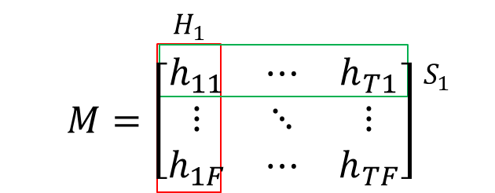
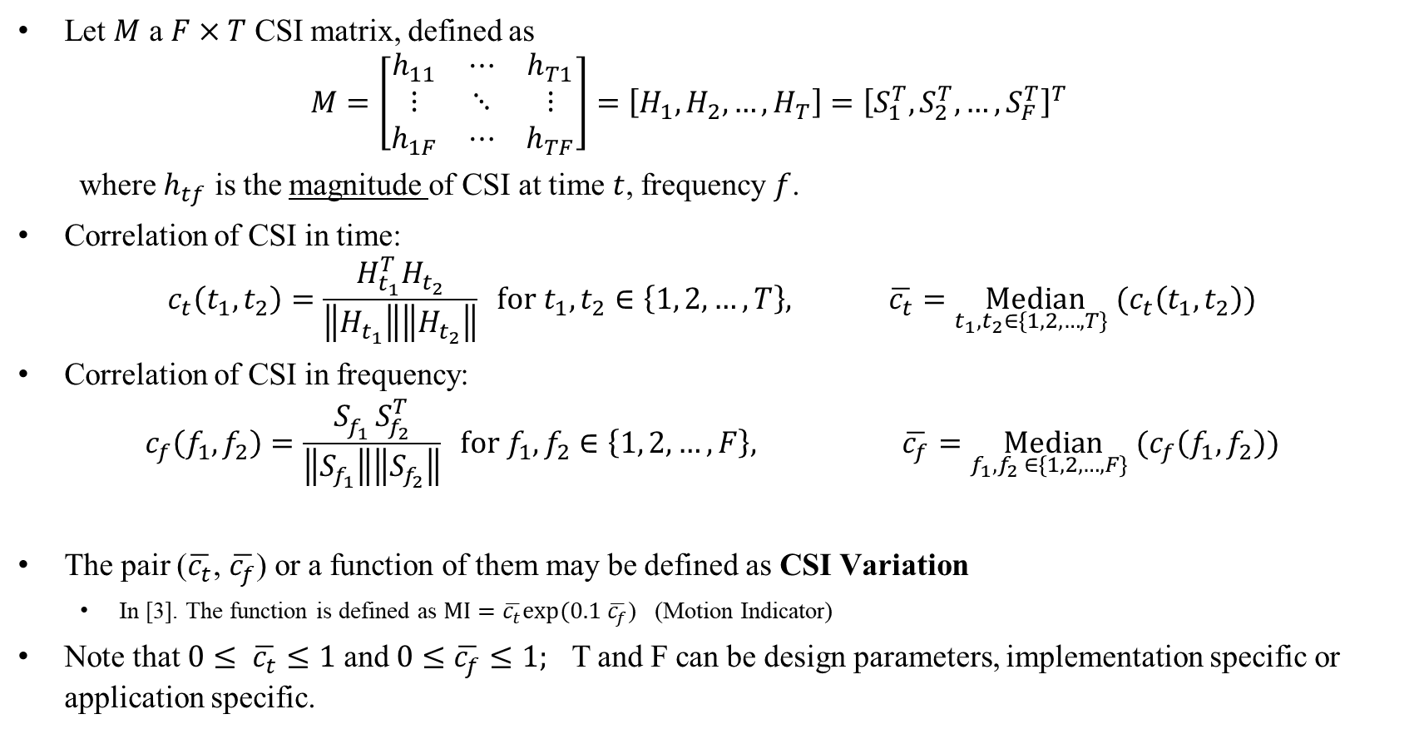
A Reference Definition of CSI Variation [3]
Let $M$ a $F×T$ CSI matrix, defined as
$$M=\left[\begin{matrix}h_{11} & ⋯ & h_{T1} \\ ⋮ & ⋱ & ⋮ \\ h_{1F} & ⋯ & h_{TF}\end{matrix}\right]=\left[H_{1},H_{2}, …, H_{T}\right]={\left[S_{1}^{T}, S_{2}^{T}, …, S_{F}^{T}\right]}^{T}$$
where $h_{tf}$ is the magnitude of CSI at time $t$, frequency $f$.
Correlation of CSI in time:
$$c_{t}\left(t_{1},t_{2}\right)=\frac{H_{t_{1}}^{T}H_{t_{2}}}{\left\|H_{t_{1}}\right\|\left\|H_{t_{2}}\right\|} for t_{1},t_{2}∈\left\{1, 2, …, T\right\}, \overline{c_{t}}=\underset{t_{1},t_{2}∈\{1, 2, …, T\} }{Median}{(c_{t}\left(t_{1},t_{2}\right))}$$
Correlation of CSI in frequency:
$$c_{f}\left(f_{1},f_{2}\right)=\frac{S_{f_{1}}^{}S_{f_{2}}^{T}}{\left\|S_{f_{1}}\right\|\left\|S_{f_{2}}\right\|} for f_{1},f_{2}∈\left\{1, 2, …, F\right\}, \overline{c_{f}}=\underset{f_{1},f_{2} ∈\{1, 2, …, F\} }{Median}{(c_{f}\left(f_{1},f_{2}\right))}$$
The pair ($\overline{c_{t}}$, $\overline{c_{f}}$) or a function of them may be defined as CSI Variation
  In [3]. The function is defined as $MI=\overline{c_{t}}exp⁡(0.1 \overline{c_{f}}$) (Motion Indicator)
Note that $0≤ \overline{c_{t}}≤1$ and $0≤\overline{c_{f}}≤1;$ T and F can be design parameters, implementation specific or application specific.

Slide 10
Conclusion
Discussed the issues in the agreed statements on threshold-based sensing
Discussed how the “CSI variation” is defined and implemented in the literature
Suggested that TGbf should agree on a definition of “CSI variation” before moving forward define other threshold-based sensing procedures
Provided an example found in the literature

Slide 11
References
[1] Claudio da Silva, “Specification Framework for TGbf,” 11-21/0504r7
[2] Yongsen Ma, et. al. “WiFi Sensing with Channel State Information: A Survey,” ACM Comput. Surv., Vol. 52, No. 3, Article 46. Publication date: June 2019
[3] T. Hang, et al., WiSH: WiFi-based real-time human detection, in Tsinghua Science and Technology, vol. 24, no. 5, pp. 615-629, October 2019

Slide 12
SP
Do you agree that TGbf should define the “CSI variation” in Motion 18 based on a reference metric in the threshold-based reporting phase?
  Note:
  The computation of the CSI variation should be based on this reference metric and the computing method is implementation dependent.
  Should the reference metric be made normative or informative is TBD.

