Slide 1
End-to-End QoS Measurement
Date: 2022-04-03
Authors:

Slide 2
Abstract
Recently a lot of QoS management mechanisms including the following have been introduced in IEEE 802.11-2020 and IEEE 802.11be.
  Stream Classification Service (SCS), Mirrored Stream Classification Service (MSCS), Restricted Target Wake Time (r-TWT), Multi-link SCS, Multi-link MSCS.
This document discusses the consideration points in the end-to-end QoS measurement procedure, when the QoS management mechanisms are applied to a Wi-Fi network.

Slide 3
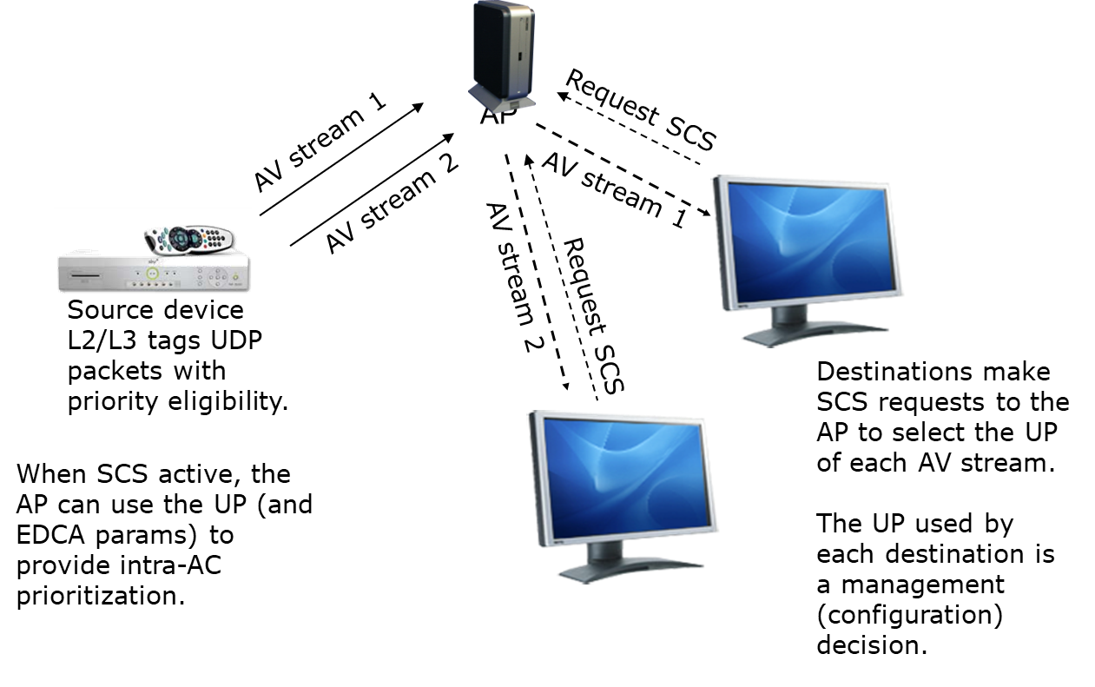
Recap: Stream Classification Service [1]

Slide 4
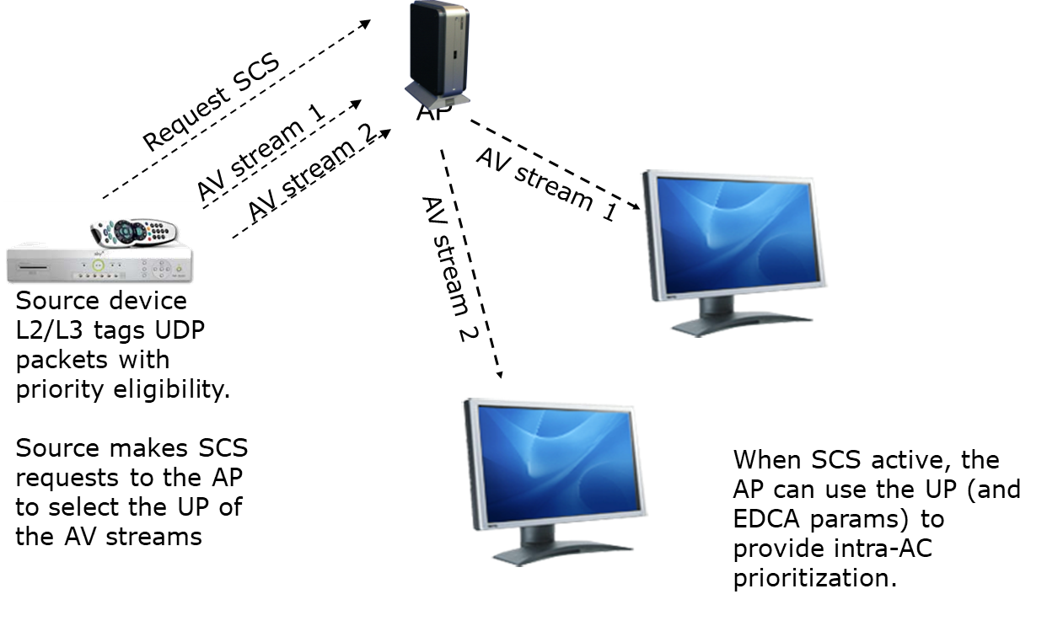
Recap: Stream Classification Service [1]

Slide 5
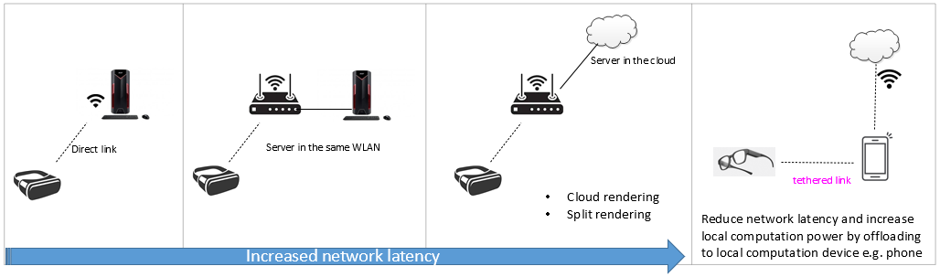
Recap: Restricted Target Wake Time [2]
A latency sensitive traffic stream can be characterized by the following parameterized model:
  Bursty, periodic
  Traffic amount varies driven by application (e.g. compression) in addition to wireless medium dynamics
An application may contain multiple such streams of different parameters
Tethered link is a common design to balance computation power, network bandwidth and latency
  Require support of peer-to-peer communication
XR System Paradigms
Example:

Slide 6
Recap: Restricted Target Wake Time [2]
Existing Protected TWT: TXOPs within TWT SPs shall be initiated with a NAV protection mechanism, such as (MU) RTS/CTS, or CTS-to-self frame. Under this rule:
  SP start time may vary if previous transmission didn’t finish
    resulting in unpredictability in delay and increased jitter
Propose additional rule: TXOP shall stop before a protected TWT SP starts
  Provide a more predictable latency performance: reduce jitter
  Reduce wake-up time: additional power saving
    Restricted TWT: term used in this presentation
Example:

Slide 7
End-to-End QoS Measurement
Most of the QoS management mechanisms defined in the IEEE 802.11 are applied to the specific traffic stream.
  traffic stream (TS): A set of medium access control (MAC) service data units (MSDUs) to be delivered subject to the quality-of-service (QoS) parameter values provided to the MAC in a particular traffic specification (TSPEC). TSs are meaningful only to MAC entities that support QoS within the MAC data service. These MAC entities determine the TSPEC applicable for delivery of MSDUs belonging to a particular TS using the priority parameter provided with those MSDUs at the MAC service access point (MAC SAP).

Slide 8
End-to-End QoS Measurement
Traffic stream is classified by the traffic classification (TCLAS) filter.
  traffic classification (TCLAS): The specification of one of several types of matching filter to classify protocol data units (PDUs) or medium access control (MAC) service data units (MSDUs) as belonging to a particular traffic stream (TS). Depending on the type of classification, the filter is applied within the MAC sublayer management entity (MLME), above the MAC, or within the MAC itself.

Slide 9
End-to-End QoS Measurement
If the packets (e.g., ICMP packet) that are used by the end-to-end QoS measurement procedure are not classified by the same traffic stream, the measured end-to-end QoS parameter (e.g., latency, throughput) may not represent the accurate QoS level.

Slide 10
End-to-End QoS Measurement
In the below example, the end-to-end latency measured by the ICMP 1-4 packets may overestimate the actual end-to-end latency value.
  This is because the real time packet belonging to the traffic stream on which the QoS management mechanism (like the restricted TWT) is applied can be treated with high priority.
High Priority
Restricted TWT SP
Real Time 6
Real Time 5
Real Time 4
Low Priority
ICMP 1
Real Time 3
Real Time 2
Real Time 1
802.11 link
ICMP 4
ICMP 3
ICMP 2

Slide 11
End-to-End QoS Measurement
Proposed Solution:
  The packets used by end-to-end QoS measurement have to be classified into the same traffic stream.
  For this purpose, the STA provides the TCLAS filters for both a real time packet and an end-to-end QoS measurement packet to define the traffic stream.

Slide 12
Conclusion
Even though various QoS management mechanisms are being developed in IEEE 802.11, an interface between the IEEE 802.11 Station Management Entity (SME) and the application program is not standardized.
  In order to effectively implement the proposed solution, the application layer should use the interface to provide the packet classification information and the expected QoS parameter for the traffic stream.

Slide 13
References
[1] Alex Ashley, “Stream Classification Service,” https://mentor.ieee.org/802.11/dcn/09/11-09-0725-01-00aa-stream-classification-service-presentation.ppt
[2] Chunyu Hu et al., “Protected TWT Enhancement
for Latency Sensitive Traffic,” https://mentor.ieee.org/802.11/dcn/20/11-20-1046-14-00be-prioritized-edca-channel-access-slot-management.pptx

