Slide 1
CID 5944 Discussion
Date: 2022-2-3
Authors:

Slide 3
Background
The current procedure in D1.3 has following access restrictions defined for an NSTR mobile AP MLD and a STA associated with an NSTR mobile AP MLD
  — A STA affiliated with the non-AP MLD may initiate a PPDU transmission to its associated
  AP affiliated with the NSTR mobile AP MLD in the nonprimary link only if the STA affiliated with the same MLD in the primary link is also initiating the PPDU as a TXOP holder with the same start time.
  — An AP affiliated with the NSTR mobile AP MLD may initiate a PPDU transmission to its
  associated non-AP STA in the nonprimary link only if the AP affiliated with the same NSTR mobile AP MLD in the primary link is also initiating the PPDU as a TXOP holder with the same start time.
Support of MU operation is optional for the APs affiliated with a mobile AP MLD
  More complexity for mobile AP to schedule TB-PPDUs (e.g. rate control for each non-AP on different links)
  Easier to implement SU scheduling or EDCA
MLD/STA who transmits non-RTA traffic in a long TXOP on the primary link blocks the access of other MLDs who wishes to transmit RTA traffic because:
  RTA MLD loses contention on the primary link to a non-RTA STA, or
  RTA MLD has newly arrived RTA traffic in the middle of a TXOP of non-RTA STA
It is desirable to have an access mechanism which allows RTA MLD to access 2ndary link while the primary link is occupied

Slide 4
Proposed exception
Allow UL access from an MLD on the secondary link with end of PPDU alignment with the intra BSS UL PPDU from another STA/MLD on the primary link
  TXOP limit=0 for such secondary link access
  The rate and the number of MPDUs (in a PPDU) for such secondary link access does not result in an immediate ack/BA on secondary link longer than a fixed duration (e.g. duration of an Ack frame in non-HT format on the primary link with the highest basic rate on the primary link)

Slide 5
Implemented simulator functionalities
NSTR Self-interference
PPDU start time alignment with waited EDCA on secondary link for PPDUs from the same MLD on different links (no waited EDCA on primary link)
PPDU end time alignment for PPDUs from the same MLD on different links
Baseline mobile AP BSS rule, i.e. data transmission on secondary link occurs (subject to EDCA) only when primary link also transmits from the same MLD
DL transmission to 2 different MLDs on primary and secondary link
  Allowing secondary link responder to send BA on secondary link only
UL PPDU end time alignment for PPDUs from different MLDs (suggested enhancement)
  Observing primary link intra BSS UL PPDU from another MLD and performing EDCA access on secondary link using end- time alignment with primary link PPDU

Slide 6
Topology A (single BSS)
MLD2~4 are associated with Soft AP MLD1
2 links: Primary (link1/wifi1) and Secondary(link2/wifi2), each 80MHZ BW
Fixed MCS QPSK ¾ for Data, QPSK1/2 for BA
Tested traffic sources:
  UL FTP source with 50MB file (AC 0), MPDU size 618B
  UL CBR source with 1400B per ms (AC 3), MPDU size 1470B
  To which MLD a source is attached is described in the next slide
FTP/AC 0 TXOP limit=5ms or 0
AC0: AIFSN=9, CW=15~1023
AC3: AIFSN=2, CW=3~7

Slide 7
Scenarios 1,2,3 and their cases (single BSS)
3 scenarios, each scenario has several cases
Delivered FTP traffic volume per source and CDF of CBR e2e delay are measured for 5 seconds duration
Scenarios:
  MLD3 CBR, MLD2 FTP
  MLD3 CBR, MLD2 FTP, MLD4 FTP
  MLD3 CBR, MLD2 FTP, MLD4 CBR
Cases:
  12000 (baseline): for testing the baseline mobile AP access with a long PPDU and a long TXOP for non-RTA AC and default TID-link mapping
    baseline mobile AP(D1.3), secondary link can tx only when primary link tx, i.e. start and end align for NSTR non-AP MLD. Each AMPDU can fit at most 12KB (~19 FTP MPDUs). TXOP for AC0 is 5ms
  4000: for testing the baseline mobile AP access with a short PPDU and a very short TXOP for non-RTA AC and default TID-link mapping
    Same as 12000 but max AMPDU length is 4KB, and TXOP limit is 0
  tm12: for testing the baseline mobile AP access with a long PPDU and a long TXOP for non-RTA AC and non-default TID-link mapping
    Same as 12000 but with AC0 mapped to primary link only, AC3 mapped to both primary and secondary links
  al12: for testing the proposed access with a long PPDU and a long TXOP for non-RTA AC and non-default TID-link mapping
    Same as tm12 but allowing UL AC3 secondary link EDCA access when primary link has an intra BSS UL PPDU, i.e. UL end-alignment for different MLDs
  al6: for testing the proposed access with a medium size PPDU and a long TXOP for non-RTA AC and non-default TID-link mapping
    Same as al12 but each AMPDU fits at most 6KB (~9 FTP MPDUs)
  al4: for testing the proposed access with a small size PPDU and a long TXOP for non-RTA AC and non-default TID-link mapping
    Same as al12 but each AMPDU fits at most 4KB (~6 FTP MPDUs)

Slide 8
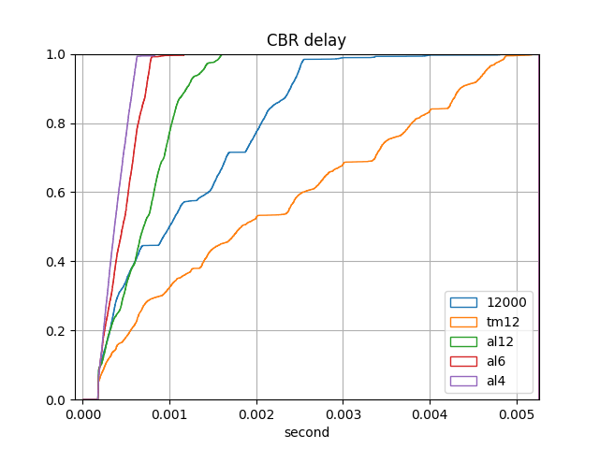
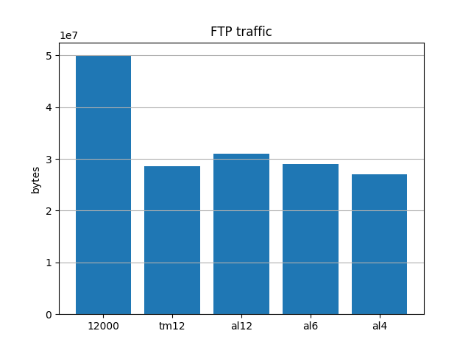
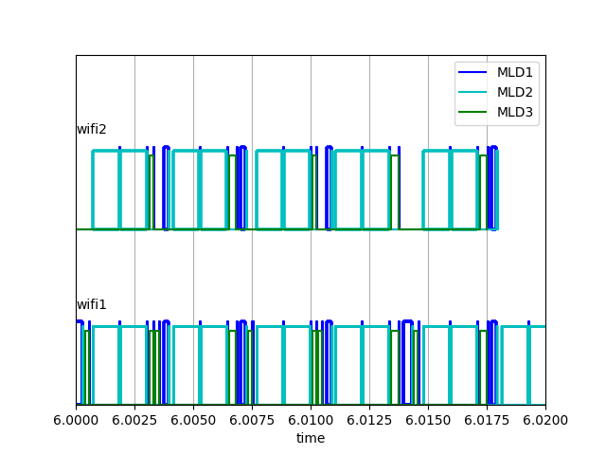
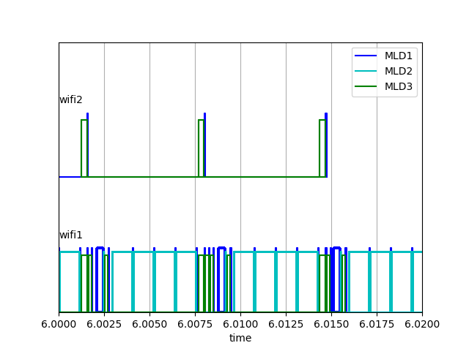
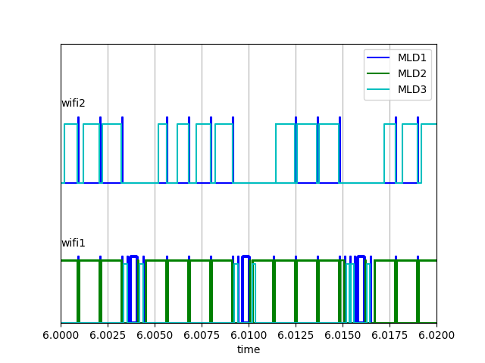
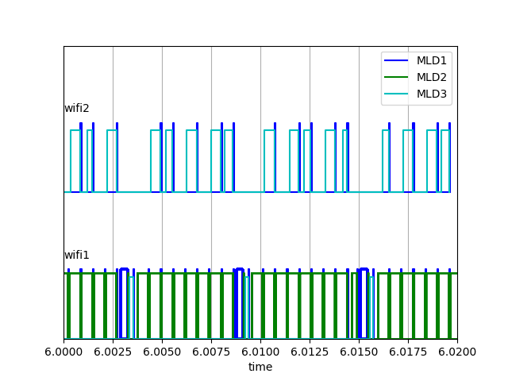
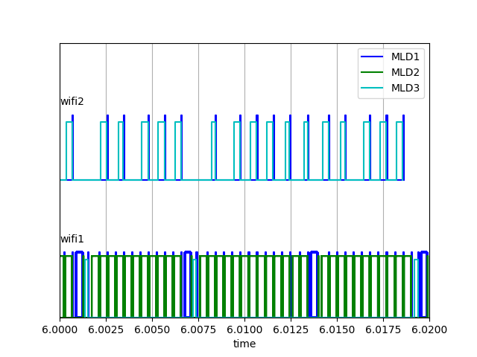
Test results (Scenario 1)
(per source node)
Channel snapshot (each block is a PPDU)
al12
al6
al4
12000
tm12
secondary
primary

Slide 9
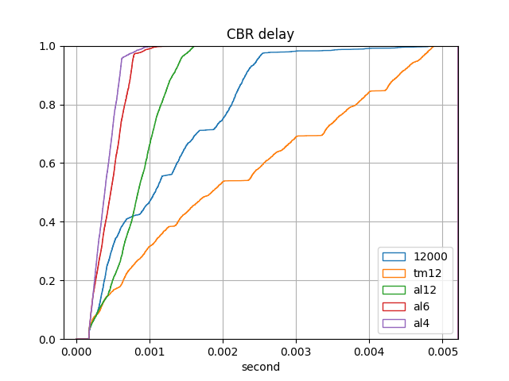
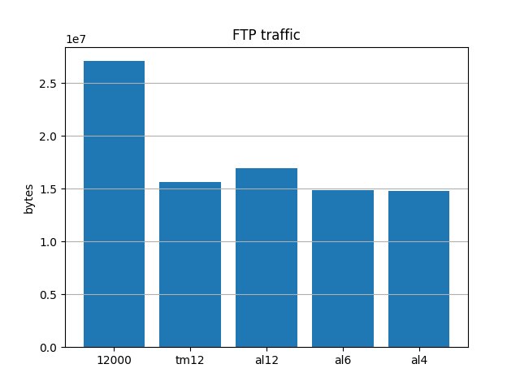
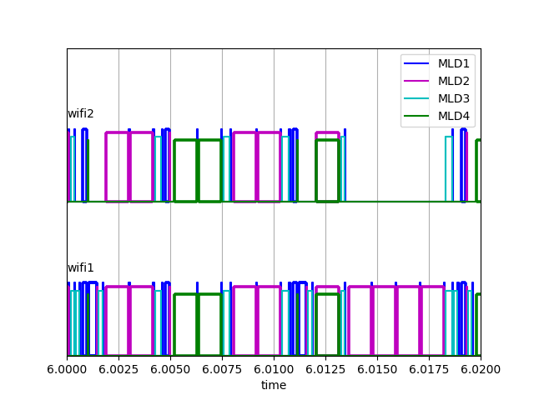
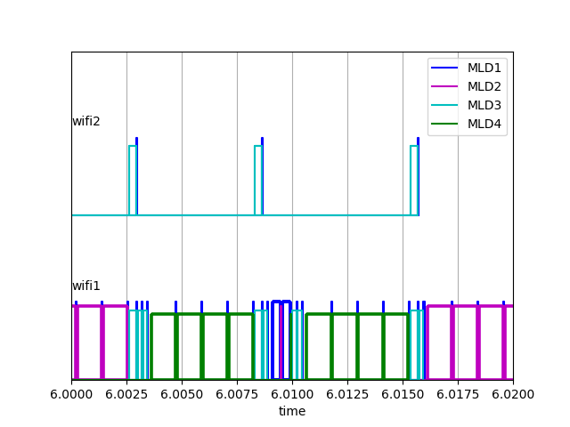
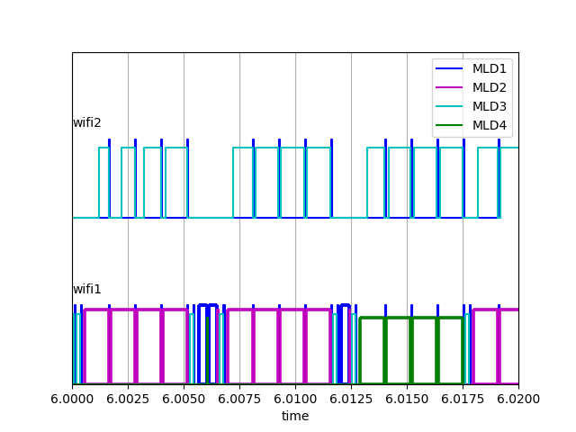
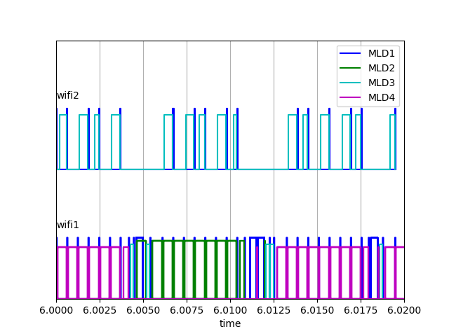
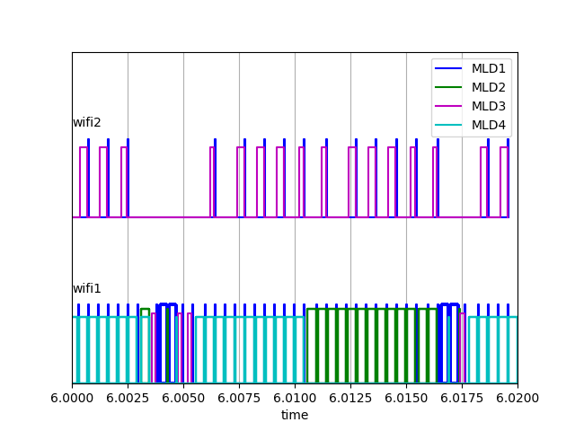
Test results (Scenario 2)
(per source node)
Channel snapshot
al6
al4
12000
tm12
al12
secondary
primary

Slide 10
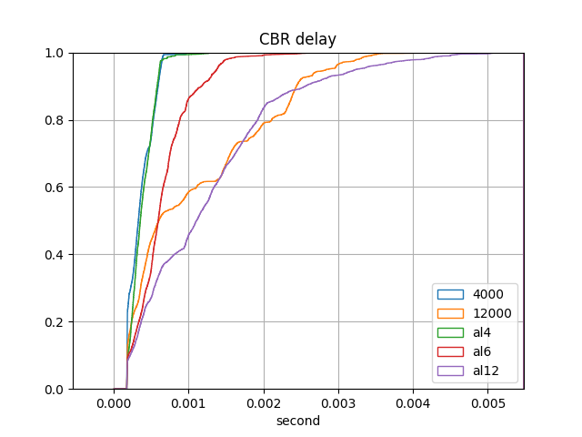
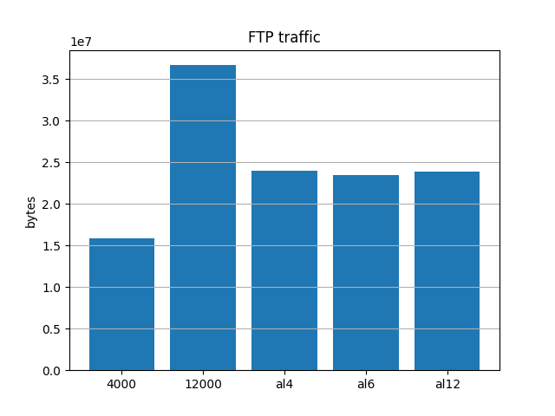
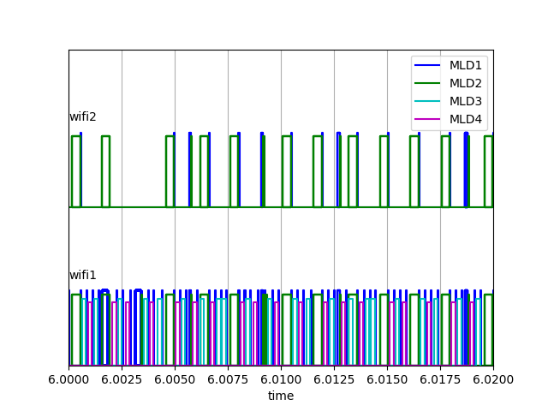
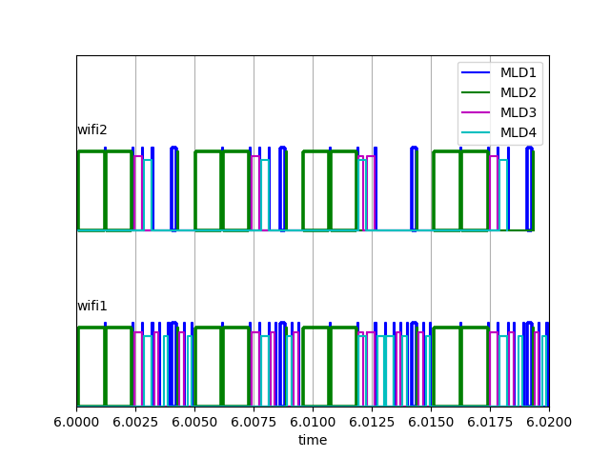
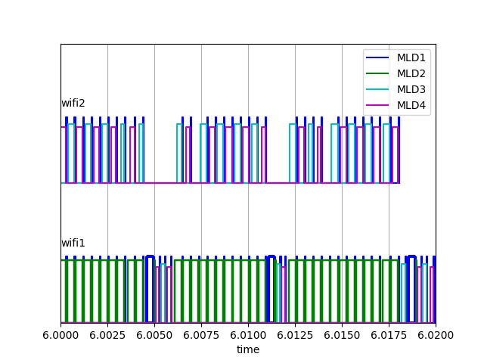
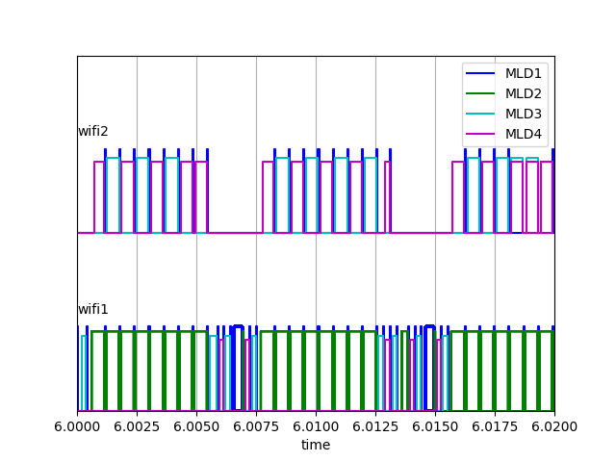
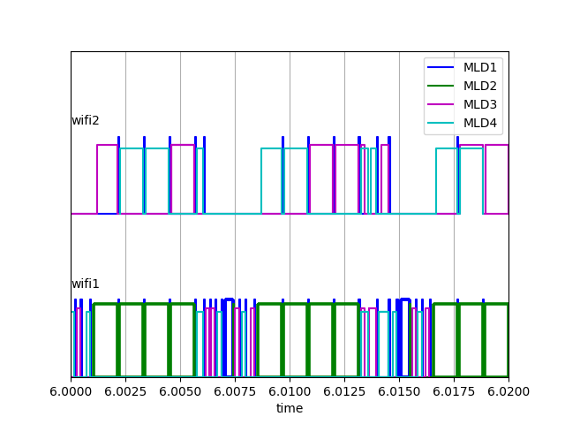
Test results (Scenario 3)
(per source node)
Channel snapshot
al6
al12
4000
12000
al4
secondary
primary

Slide 11
Topology B (OBSS)
Scenario: MLD3 CBR, MLD2 UL FTP, OBSS APx DL FTP
FTP/AC 0 TXOP limit=5ms for MLD2, FTP/AC 0 TXOP limit=3ms for legacy APx
Cases:
  Baseline: same as 12000 (baseline) in p7
  al12: same as al12 in p7
  al4: same as al4 in p7
  al4+: same as al4 but AC0 is mapped to both links for MLD2 but MLD2 link1(primary) txop limit=5ms on link 1 and txop limit=3.5ms on link 2 (nonprimary)

Slide 12
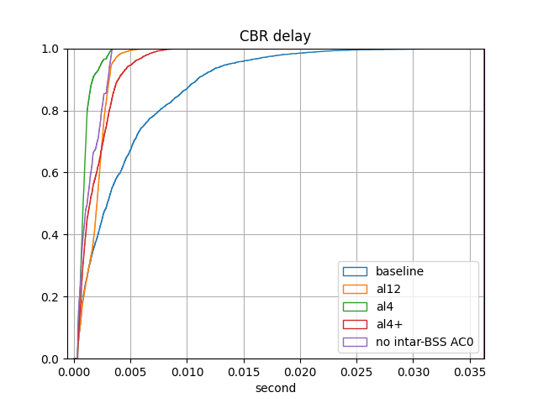
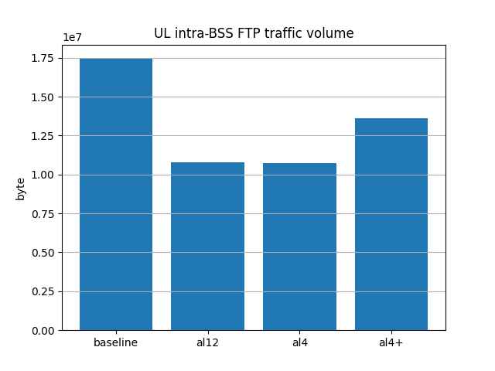
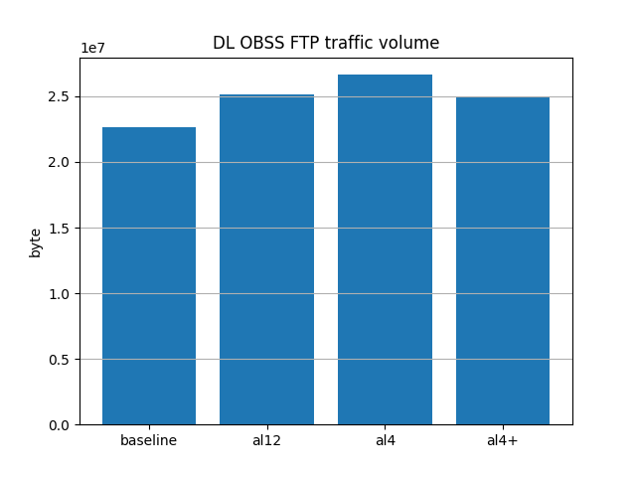
Topology B (OBSS)
UL delay from MLD3
The reason the baseline delay is bad because APx can start 80MHz TXOP when MLD2 has ongoing 40MHz TXOP, blocking MLD3 on link1
Allowing UL end-aligned transmission from MLD3 on link2 alleviates the issue
Allowing MLD2 to be mapped to link2 but with a shorter TXOP limit (al4+) reduces penalty to MLD2 while MLD1 still get acceptable delay

Slide 13
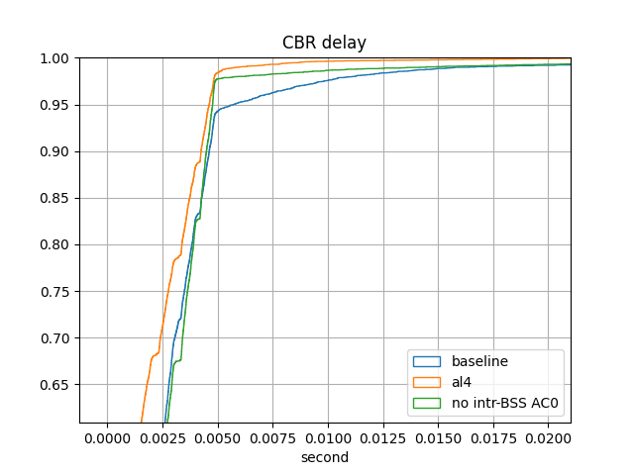
Topology C (OBSS)
Scenario: MLD3 CBR, MLD2 UL FTP, OBSS APx DL FTP, OBSS APy DL FTP
FTP/AC 0 TXOP limit=5ms for both BSSs
Cases:
  Baseline: same as 12000 (baseline) in p7
  al4: same as al4 in p7
UL delay from MLD3

Slide 14
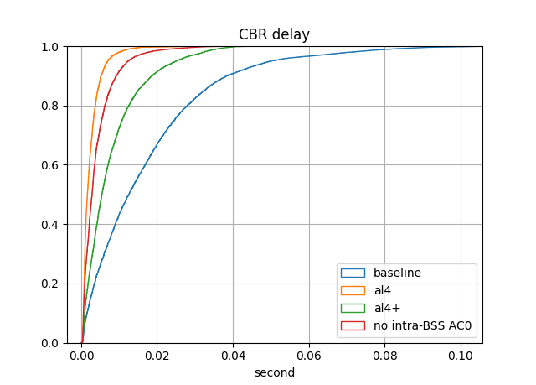
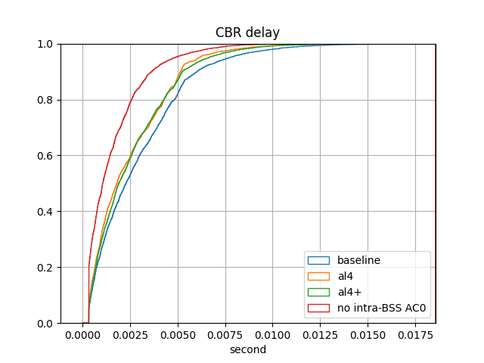
Topology D (OBSS)
UL delay from MLD3
Same as topology B, except AP moves to the left 10m
Cases: same as topology B
  A DL AC3 traffic source is added to MLD1 to observe DL latency to MLD3
DL delay from MLD1

Slide 15
Observations
TID to link mapping does not work by itself when applied to a mobile AP BSS for improving latency
  tm case in previous results
  All traffic must be mapped to primary link, which is the bottleneck
  Bad performance for both CBR and FTP
TID to link mapping can improve latency (at the expense of FTP volume) if allowing latency sensitive traffic to be end-aligned on secondary link with an intra BSS UL PPDU sent by another MLD on primary link, i.e. UL end alignment from different MLDs
  al12/6/4 cases in previous results
By enforcing a small PPDU size and TXOP limit=0 for low priority traffic mapped on both links (4000 case in scenario 3), the latency for high priority traffic can be satisfied but low priority throughput suffers even more when compared with mapping only 1 link to the low priority traffic
With end alignment from different MLDs, the max PPDU length on the primary link affects latency
  With shorter UL PPDU length on the primary link, more access opportunities for higher priority traffic UL access on secondary link with UL end alignment, at the expense of a higher overhead on the primary link
  With longer UL PPDU length on primary link, the overhead on the primary link is smaller but access opportunities for higher priority on secondary link reduces, causing more high priority MLD to access primary link. The resulting FTP throughput on primary link does not change significantly compared to shorter UL AMPDU length on the primary link

Slide 16
Straw Polls
Do you agree to allow UL PPDU end time alignment for PPDUs from a STR MLDs on the primary and secondary link in a NSTR mobile AP BSS? i.e. start time is allowed not to be aligned
Do you agree to allow UL PPDU end time alignment for PPDUs from different MLDs on the primary and secondary link in a NSTR mobile AP BSS?

Slide 17
Proposed resolution (SP1): revised
Modify the last paragraph of 35.3.19.1
…
STAs affiliated with a non-AP MLD that is associated with an NSTR mobile AP MLD and APs affiliated with an NSTR mobile AP MLD shall follow the procedure defined in 35.3.16.6 (Start time sync PPDUs medium access) when intending to transmit in the nonprimary link with the following additional constraints and with the exceptions of (a) below.
  —A STA affiliated with the non-AP MLD may initiate a PPDU transmission to its associated AP affiliated with the NSTR mobile AP MLD in the nonprimary link only if the STA affiliated with the same MLD in the primary link is also initiating the PPDU as a TXOP holder with the same start time.
  —An AP affiliated with the NSTR mobile AP MLD may initiate a PPDU transmission to its associated non-AP STA in the nonprimary link only if the AP affiliated with the same NSTR mobile AP MLD in the primary link is also initiating the PPDU as a TXOP holder with the same start time.
(a) A STA operating on the nonprimary link and affiliated with a non-AP MLD which has a pair of setup links that is a STR link pair, may perform the same channel access procedure as described in 35.3.16.5 (PPDU end time alignment) for the AP MLD, with the PPDU on the primary link starts earlier than the PPDU on the nonprimary link

Slide 18
Proposed resolution (SP1&2): revised
Modify the last paragraph of 35.3.19.1
…
STAs affiliated with a non-AP MLD that is associated with an NSTR mobile AP MLD and APs affiliated with an NSTR mobile AP MLD shall follow the procedure defined in 35.3.16.6 (Start time sync PPDUs medium access) when intending to transmit in the nonprimary link with the following additional constraints and with the exceptions of (a) and (b) below.
  —A STA affiliated with the non-AP MLD may initiate a PPDU transmission to its associated AP affiliated with the NSTR mobile AP MLD in the nonprimary link only if the STA affiliated with the same MLD in the primary link is also initiating the PPDU as a TXOP holder with the same start time.
  —An AP affiliated with the NSTR mobile AP MLD may initiate a PPDU transmission to its associated non-AP STA in the nonprimary link only if the AP affiliated with the same NSTR mobile AP MLD in the primary link is also initiating the PPDU as a TXOP holder with the same start time.
(a) A STA operating on the nonprimary link and affiliated with a non-AP MLD which has a pair of setup links that is a STR link pair, may perform the same channel access procedure as described in 35.3.16.5 (PPDU end time alignment) for the AP MLD, with the PPDU on the primary link starts earlier than the PPDU on the nonprimary link, or
(b) A STA operating on the nonprimary link and affiliated with a non-AP MLD may perform channel access assuming a TXOP limit equal to 0 when a backoff counter of the STA reaches zero, if the non-AP MLD has detected an ongoing UL intra-BSS PPDU transmission on the primary link. The PPDU in the channel access shall be end-aligned with the ongoing primary link PPDU and the PDDU shall not solicit an immediate response with a TXTIME that is longer than an Ack frame transmitted in non-HT format using the highest basic rate on the primary link. The STA affiliated with the non-AP MLD and has a backoff counter already reached zero for an AC operating on the nonprimary link, may perform a new backoff procedure following deferral procedures as described in 10.23.2.4 (Obtaining an EDCA TXOP) and 10.3.4.3 (Backoff procedure for DCF) when the non-AP MLD detects an ongoing UL intra-BSS PPDU on the primary link. CW[AC] and QSRC[AC] are left unchanged.

Slide 19
Backup

Slide 20
Scenarios with DL traffic
Traffic and MCS
 | AP MLD | MLD2 | MLD3 | MLD4
Scenario4 | DL FTP | UL FTP | UL cbr | UL cbr
Scenario5 | DL cbr | UL FTP | UL cbr | UL cbr
Scenario6 | DL cbr | UL FTP | UL cbr | UL cbr (UL MCS 16QAM ¾)
Unless otherwise specified:
cbr: AC_VO, AIFSN=2, CW=3~7, mapped to both links, interval/size described in previous slides
FTP: AC_BE, AIFSN=9, CW=15~1023, mapped to both links, for 5 sec
MCS corresponding to QPSK ¾ for data, MCS corresponding to QPSK ½ for BA
UL/DL AC_BE TXOP=1ms (addressing the case long DL/UL AC_BE TXOP blocking DL RTA traffic )
Perform TX on both links if both links EDCA BO counter=0 and has at least 2 MPDUs buffered
Max AMPDU 4000B

Slide 21
Access parameters/methods
 | Case1 | Case2
Scenario4 | D1.31 access rule | Use end-alignment on link2 UL FTP mapped to primary link only
Scenario5 | D1.31 access rule | Use end-alignment on secondary link UL AC_BE AIFSN=4 UL AC_BE CW=7~15 UL FTP mapped to primary link only
Scenario6 | D1.31 access rule | Use end-alignment on secondary link UL FTP mapped to primary link only

Slide 22
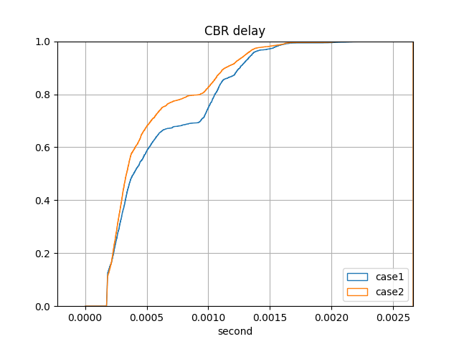
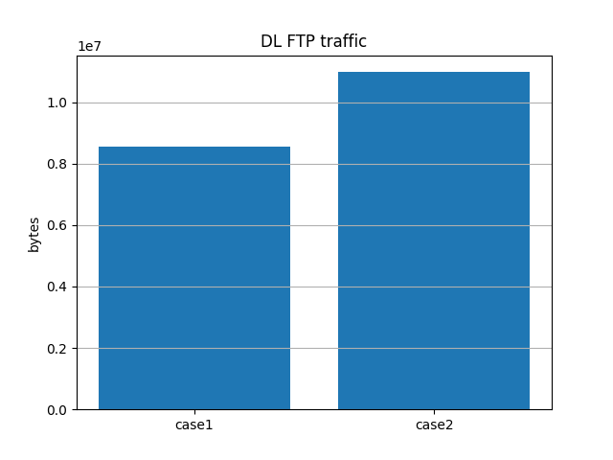
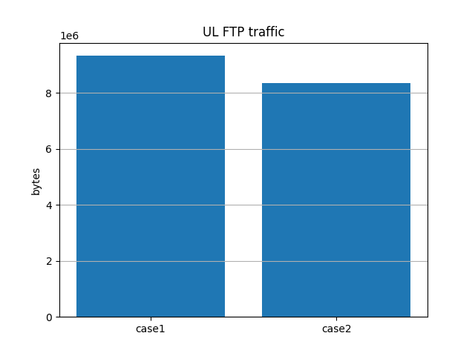
Scenario 4

Slide 23
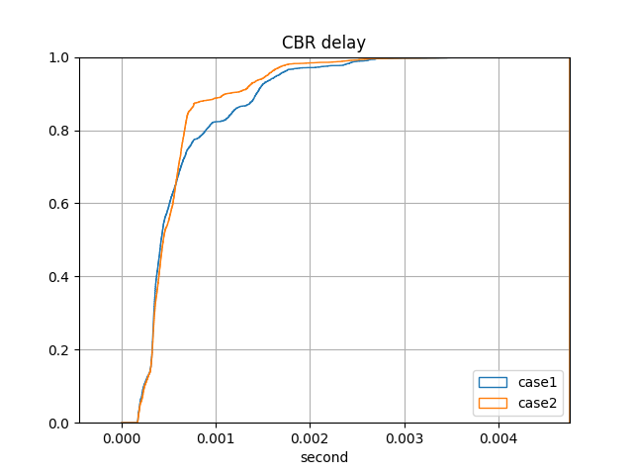
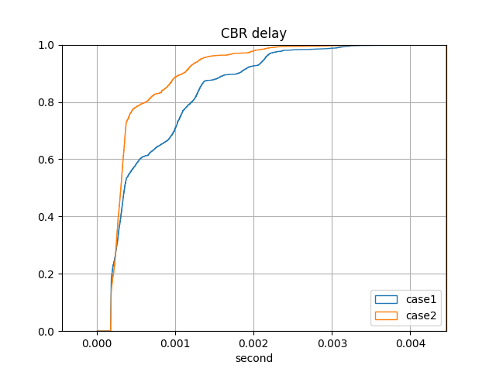
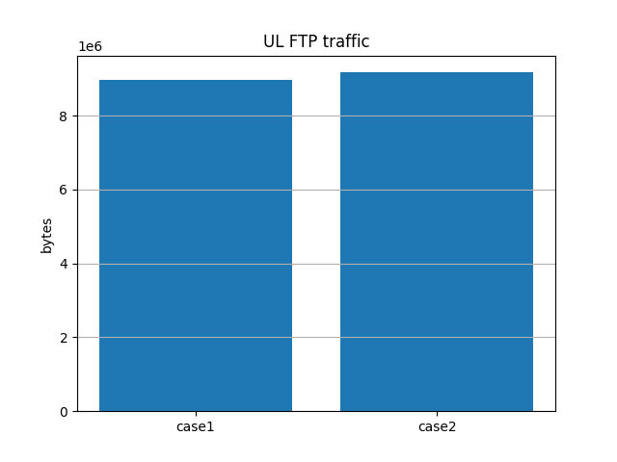
Scenario 5
DL
UL

Slide 24
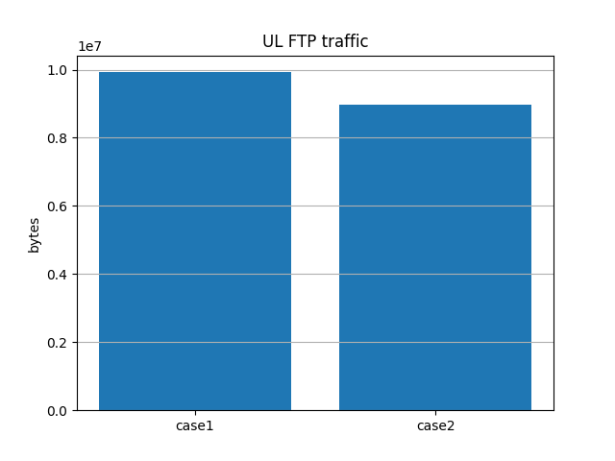
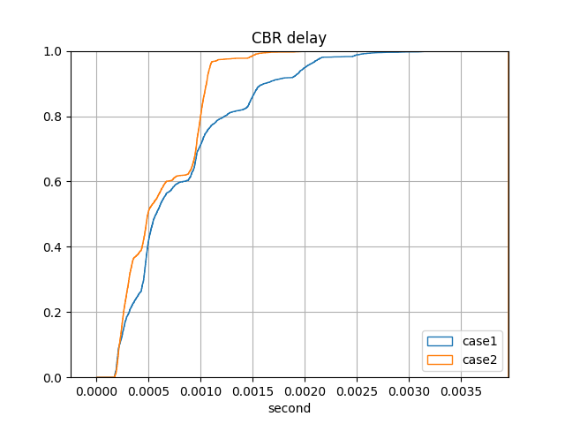
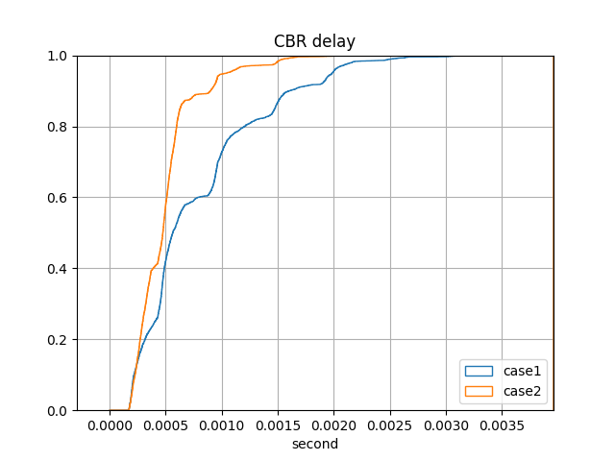
Scenario 6
DL
UL

Slide 25
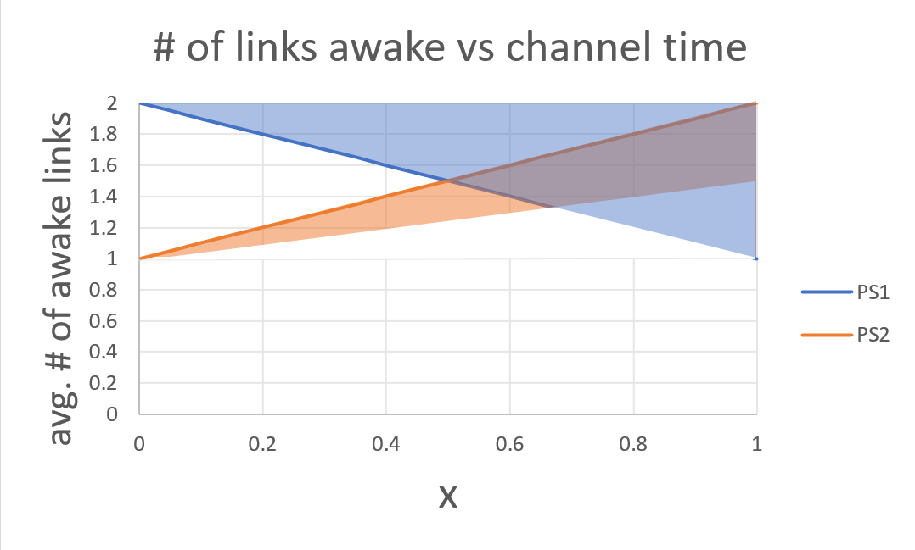
non-primary link (link2) AP power save methods
Assumes AP primary link (link 1) is always awake
X: sum channel time of intra-BSS AC_BE and AC_VO MLDs if all traffic is sent on 1 link
PS1:
  link2 doze if receiving intra-BSS UL PPDU on link1 but not on link2.
  Both links are awake if link1 not detecting intra-BSS PPDU
PS2:
  Link2 doze when link1 is not receiving UL intra-BSS PPDU
  Link2 awake an offset later after link1 detects UL intra-BSS PPDU

