Slide 1
3GPP Coexistence Update
Date: 2022-01-24
Authors:

Slide 2
Abstract
While 3GPP Rel 12-14 developed specifications for LAA LTE (5GHz) and Rel 15-16 specified NR-U (PHY), a few developments concerning coexistence in unlicensed spectra (Rel 17-18) are discussed in this document.

Slide 3
3GPP Access Technologies in Un-licensed Spectra. Timeline.
2015
2016
2017
2018
2019
2020
2021
2022
Rel 12
Rel 13
Rel 14
Rel 15
Rel 16
Rel 17
Rel 18
LAA LTE
DL 5GHz
Lic+Unlic
eLAA
UL 5GHz
Lic+Unlic
NR-U (6GHz)
RAN1 SI
NR-U (6GHz)
RAN1 WID
Unlicensed
NR-U
RAN4
(ChBW=100MHz)
60GHz
LAA LTE: Licensed Assisted Access LTE
eLAA LTE: enhanced Licensed Assisted Access
NR-U: NR Unlicensed (Spectra)
SL-U: Side-Link Unlicensed (Spectra)
SL-U

Slide 4
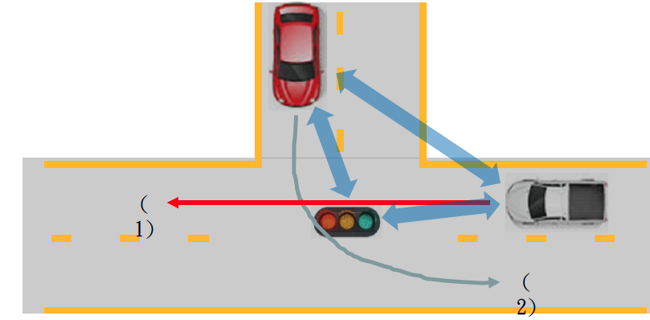
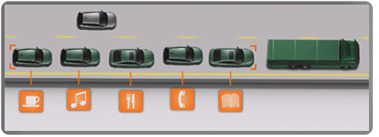
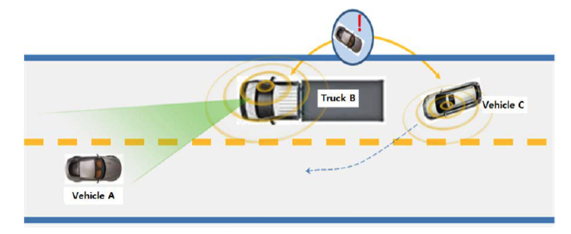
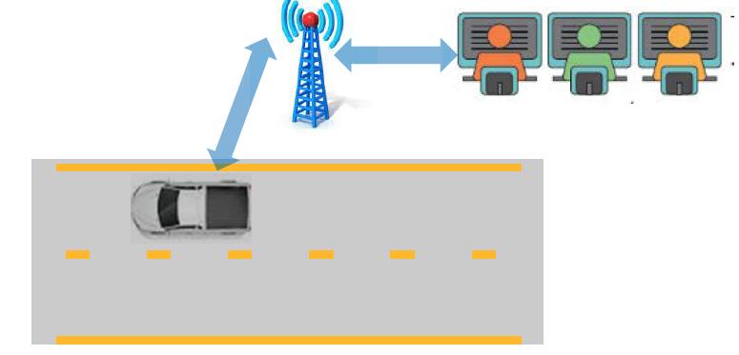
Side-Link. Use Cases [1]
LTE developed Side-Link specifications starting with Rel 12-13, initially as LTE D2D (Device-to-Device)
LTE Slide-Link described the frame structure, channel access used by the air interface to support proximity services (ProSe).
The technology became of high interest, being later optimized for vehicular applications. 5G Rel 16 [1] introduced enhanced V2X, targeting applications of interest for vehicular public safety/car manufacturers.
Rel 17 standardized Proximity based services, extending the scope to public safety and commercial services.
Advanced Driving
Platooning
Extended
Sensors
Remote Driving
Source LG

Slide 5
Side-Link. Enhanced V2X KPI
 | Latency [ms] | Reliability [%] | Data Rate [Mbps] | CommunicationRange [m]
Platooning | 10-25 | 90-99.99 | Up to 65 | ~80
Advanced driving | ~3-100 | ~99.99-99.999 | Up to 50 (DL) | ~500
Extended sensors | ~3-100 | ~90-99.999 | 25 | Up to 1000
Remote driving | Up to 20 | ~99.999 | 1/25 (DL/UL)
The high data rates backed by high reliability requirements may additionally increase the medium
occupancy in unlicensed spectra.
* 3GPP, TS22.866

Slide 6
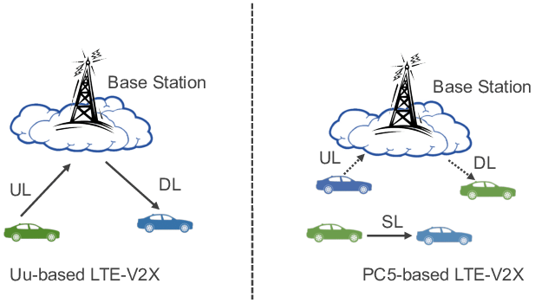
Side-Link. Main modes of Operation
Out-of-coverage
In-coverage
Side-Link Modes of Operation [2]
Side-Link developed a new PHY (new transport and PHY channels) and IP Stack
Of specific interest for this discussion is the out-of-coverage operation, based mostly on the better availability of UL resources, developing UE to UE communication.
Initial spectrum support: 5.885-5.925GHz

Slide 7
Rel 18 Side-Link
Rel 18 intends to expand [3] the commercial applications, identifying two key new requirements:
Increased sidelink data rate
Support of new carrier frequencies (carrier aggregation) for Side-Link
The increased data rate is driven by new applications, like sensor video information, shared between vehicles with high degree of automation. The expected data rates, go beyond what was specified by NR Rel 17.
The adopted solution addressing these new requirements expands SL operation onto unlicensed spectra (SL-U), for both Modes 1 and 2.
Following heavy negotiations, SL-U channel access mechanism has been confined to the NR-U frame-work.
However, if NR-U will not properly support SL-U requirements, then SL-U WG will make further
recommendations to RAN Plenary, potentially re-opening NR-U for further changes.
Intended bands of unlicensed operation: n46 (5150-5925MHz) and n96 (5925-7125MHz)/n102

Slide 8
Rel 18 SL-U. Possible Coverage Scenarios
A. Studied by NR-U
UE01 connected to gNB01 and also within the AP01 coverage
B. Studied by 5G SL
UE03 connected to UE04 (ITS 5.9 GHz spectrum)
C. Not studied neither by NR-U nor by NR SL
C1. Partial NR-U and Wi-Fi coverage
UE01 covered by gNB and AP01
UE02 connected to UE01 and covered only by AP01
C2. No NR-U coverage and Wi-Fi coverage
UE03 connected to UE04 (covered by AP01
UE04 connected to UE01 and covered only by AP01
Dependent on the NR-U and Wi-Fi coverage scenarios, the NR-U specs workframe may be exceeded, which in return may require NR-U amendments

Slide 9
Rel 18 Enhanced Positioning
Rel 18 intends to increase the accuracy of positioning and also add support for new applications (selection):
Increased positioning accuracy to cm level, possible based on NR carrier phase measurements (indoor)
Support Side-Link positioning
Increased accuracy of iIoT applications (e.g. robotics)
All the above would require higher data rates, possible leading in the future (Rel 19?) to expand the support to
unlicensed spectra.

Slide 10
SL-U Timeline [4]
A more accurate update of SL-U direction (in or out NR-U workframe) may become available by Q3/2022

Slide 11
References
3GPP TS22.886
‘Securing Vehicle-to-Everything (V2X) Communication Platform’, M. Hasan et al
RP-213678, RAN Plenary #94e, December 2021
RP-213469, RAN Plenary #94e, December 2021

