Slide 1
Next 802.11 generation after 11be
Date: 2022-01-11
Authors:
Name | Affiliation | Address | Phone | Email
Laurent Cariou | Intel | 2111 NE 25th Ave, Hillsboro OR 97124, USA | +1-503-712-5560 | laurent.cariou@intel.com
Robert Stacey |  |  |  | robert.stacey@intel.com
Carlos Cordeiro |  |  |  | carlos.cordeiro@intel.com

Slide 2
Key messages
It is time to start a new study group for next generation Wi-Fi, following 802.11be
The goals of this project should be focused on multiple objectives to be competitive and address future market needs/evolution
  Continue pursuing deterministic operation (e.g., in terms of worst-case latency at a given reliability)
  Continue increasing throughput and capacity
Slide 2
Laurent Cariou, Intel

Slide 3
Content
Timeline
Motivation and rationale for the proposed scope/objectives for next generation Wi-Fi
Slide 3
Laurent Cariou, Intel

Slide 4
Timeline
As mentioned before (see 1598r1), the Wi-Fi market is moving to a 4 years cadence for the launch of new mainstream PHY/MAC generations
Meaning a new task group every 4 years
Following this approach, we would have:
  11be R1 products around end of 2023
  11be R2 products around end of 2025
  11bX (next gen) R1 products around end of 2027
  …

Slide 5
IEEE 802.11bX Timeline
TGbe
TGbX
Mar 2019: PAR approved
May 2019: First TG meeting
May 2021: D1.0
Mar 2022: D2.0
Nov 2022: D3.0
Mar 2024: Final 802.11 WG approval
Mar 2023: PAR approved
May 2023: First TG meeting
May 2025: D1.0
Mar 2026: D2.0
Nov 2026: D3.0
Mar 2028: Final 802.11 WG approval
Implications for TGbX:
if we have a year-long SG, TGbX should be created around July 2022
As discussed in 11be, we are thinking about a light 11be R2 and to move undefined agreed 11be R2 features to TGbX (see 1598r1): Multi-AP coordination features

Slide 6
High-level next gen cellular (6G) objectives
Plan to start standardization with release 20 in 3GPP
  2025: end of study item phase
  2028: end of work item phase
  2 years to reach product launch: first products planned for 2030
    This would be roughly 2 years after estimated time of next gen .11 if we follow plan in previous slides
    Wi-Fi needs to be competitive and ambitious with regards to 6G objectives
6G aims to improve multiple KPIs, for example:
  10x throughput
  0.1ms latency
  spectral efficiency
  Spatial reuse - area efficiency
  Energy efficiency
Note that, similarly to what happened for 5G, these objectives will be reached with a combination of lower bands as well as mmWave (and possibly Terahertz)

Slide 7
Some trends that we see for 2028-2030 timeframe
(1) Deterministic operation
  Applications like XR will become a key driver and are expected to become mainstream in few years in multiple/most deployment scenarios
    setting stringent requirements for deterministic low latency and throughput
    Some of these applications/devices are targeting usage in mobile scenarios (glasses for instance) with very stringent low latency needs:
      This also calls for improved lossless and seamless mobility within an ESS in a house/enterprise
  TSN networks
  Cloud/edge computing also requires low and predictable latency
Aim for improved deterministic operation (e.g., worst-case latency at given reliability, 0.1ms latency)

Slide 8
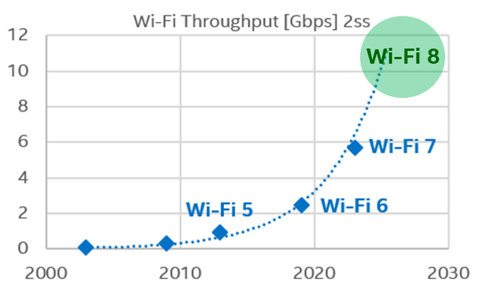
Some trends that we see for 2028-2030 timeframe
(2) Toward 10Gig Wi-Fi
  As usual, the need for more throughput/data rate is in constant evolution
    Projections from Fiber Broadband Association predicts that in 2030, household will need more than 2Gbps of broadband by 2030 (a x16 increase compared to 2021 (130Mbps))
    Some projections showing even up to 30Gbps demand for broadband
  Need increase throughput and throughput at range on Wi-Fi to efficiently deliver this to the entire house
  10G: cablelabs-launches-10g-challenge-support-innovators-and-accelerate-development-applications (10gplatform.com)
We’ve had gigabit Wi-Fi in clients since 11ac → in 2028+, we should aim at 10Gbps Wi-Fi

Slide 9
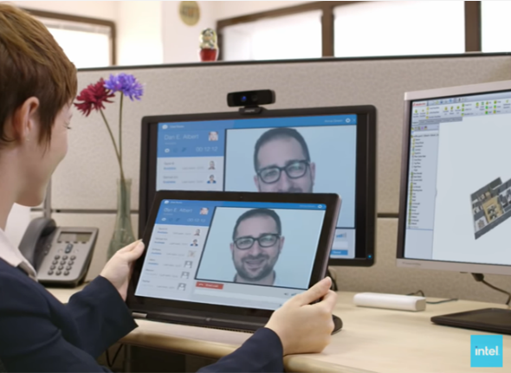




Some trends that we see for 2028-2030 timeframe
Device Sharing Experiences
Utilize resources (e.g., compute, screen, hotspot) from a second device in different form factors and OSs
Share data, notifications, etc., with nearby devices
(3) More and more P2P links
  How to better manage P2P and infrastructure links?
Display Expansion
(Wireless display connection)
Inking / Stylus
(Companion inking device)
XR gaming
PC/Phone to HDM
Camera
(Multi-camera / platform)
PC – Phone Collaboration
(Seamless, cross-device app usage)

Slide 10
Defining the objectives for next generation Wi-Fi
Takeaway from the previous trends and 6G objectives clearly demonstrates the need for the following in the 2028 timeframe:
Improve the Wi-Fi quality of experience
  Improve deterministic latency and enable lower latency (better than 0.1 ms)
  Continue throughput increase to enable 10Gbps on clients
  Improve mobility
  Improve coordination of P2P traffic
Ensure Wi-Fi remains competitive compared to other technologies given the emergence of 6G
Slide 10
Laurent Cariou, Intel

Slide 11
Possible technical directions for next gen Wi-Fi
We have an opportunity to significantly improve the overall performance of Wi-Fi to address future market needs around determinism, manageability and capacity
Some example areas:
  With multi-AP and P2P coordination in sub-7GHz unlicensed spectrum, more scheduled channel access, and existing (especially at 6 GHz) and new protection and/or preemption rules, we can increase the number of deployment scenarios with deterministic QoS/latency
  Multi-link operation defined in 11be makes natural extension to other bands. We can therefore explore operation in other bands
    At 60 GHz, because of propagation characteristics, directionality of transmissions and 14 GHz of available spectrum (!!) worldwide allowing for huge frequency reuse if re-designed accordingly, the difference between licensed and unlicensed spectrum becomes minimal, as we can isolate links between 2 peers/STAs so that they don’t get any interference from nearby users, even in dense environments.

Slide 12
Conclusion
It is time to start planning for a new study group for next generation Wi-Fi, following 802.11be
  Form study group around July 2022
We propose a limited set of objectives to further focus the group
  Deterministic operation and reduced latency (better than 0.1ms)
  Increased throughput (10Gbps Wi-Fi on client with 2 SS)
  Improved mobility
Slide 12
Laurent Cariou, Intel

