Slide 1
WLAN Sensing Functionality Indicator
Date: 2022-01-10
Name | Affiliation | Address | Phone | Name
Rui Du | Huawei Technologies Co. Ltd | F3, Huawei Base, Shenzhen, China |  | ray.du@huawei.com
Yi Lv
Mengshi Hu
Yan Xin

Slide 2
Outline
Background and motivation
Dedicated explicit indication scheme
Conclusion

Slide 3
Background and motivation
Sensing is becoming a new function integrated in the WLAN communication system.
Consider different cases like Monostatic and Bistatic/multistatic sensing, here we want to give a possible solution to include the sensing functionality in WLAN and provide an explicitly indication and work for both Monostatic and Bistatic/Multistatic sensing.

Slide 4
Background and motivation
In [1, 2], radar is proposed as part of the WLAN framework, in order to achieve better Coexistence and sharing between radar function and WLAN function.
As the annex AB of 11ay amendment indicates, to implement radar functionality, a (DMG/EDMG) STA can transmit any type of PPDU with 1) valid DMG/EDMG PPDU constructed according to DMG/EDMG PHY specification and setting 2) RA=TA for some types of frame (e.g., SSW, BRP)
However, this scheme only works in the Monostatic scenario.

Slide 5
Background and motivation
Scheme in [1,2] including some modification for the Spec, which has been added as an Annex in 11ay[3] :
  The DMG PHY and EDMG PHY is used to implement radar functionality
  Setting RA=TA for some types of frame (e.g., SSW, BRP), and this “may” indicate for radar functionality
  Adding TRN for some types of frame (e.g., SSW, BRP)
  Cons
  Using RA = TA is not a nature fit for implement radar functionality.
  Does not support Bistatic/Multistatic sensing. Since the transmitter and receiver are in different devices for Bistatic/Multistatic sensing, so without explicit indication, the receivers do not know the PPDU is used for sensing, then do not know when to turn on/switch to sensing functionality.

Slide 6
Sensing Functionality Indicator in PPDU Header
The idea of this contribution is using explicit indication in PPDU header to indicate the sensing functionality and indicate different kinds of sensing by setting RA and TA in some types of frames.
The explicit indication in PHY Header is important,
  in case there is no sensing request/response,
  could simplify the processing of receiver.
Please note that the indication bits should be selected at L-Header or DMG header, so all the DMG/EDMG devices could recognize the indication correctly.

Slide 7
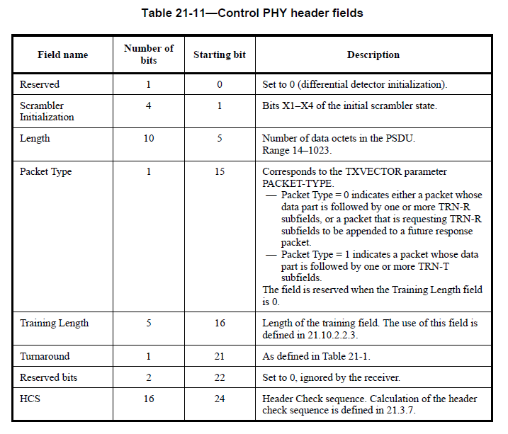
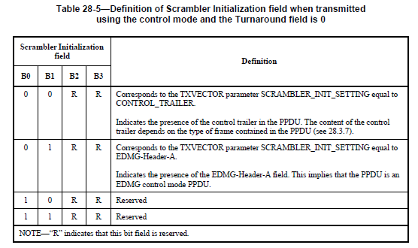
Sensing Functionality Indicator in Control Mode PPDU Header
  Option for control PHY.
  Scrambler initialization field in the L-Header of the control mode PPDU when Turnaround field is 0.
  Use the reserved bits in Scrambler Initialization field
  (in Table 28-5 in [3]) in control mode PPDU
    E.g. only use one reserved bit in the reserved value:
    101R，100R, 10R1，10R0, 111R，110R，11R0，11R0
  RA = TA for some types of frame (e.g. SSW)： Monostatic
  RA ≠ TA for some types of frame (e.g. SSW)： Bi/Multistatic
  Please note that in a EDMG control mode PPDU, B22/B23 in the L-Header shall be set 1.

Slide 8
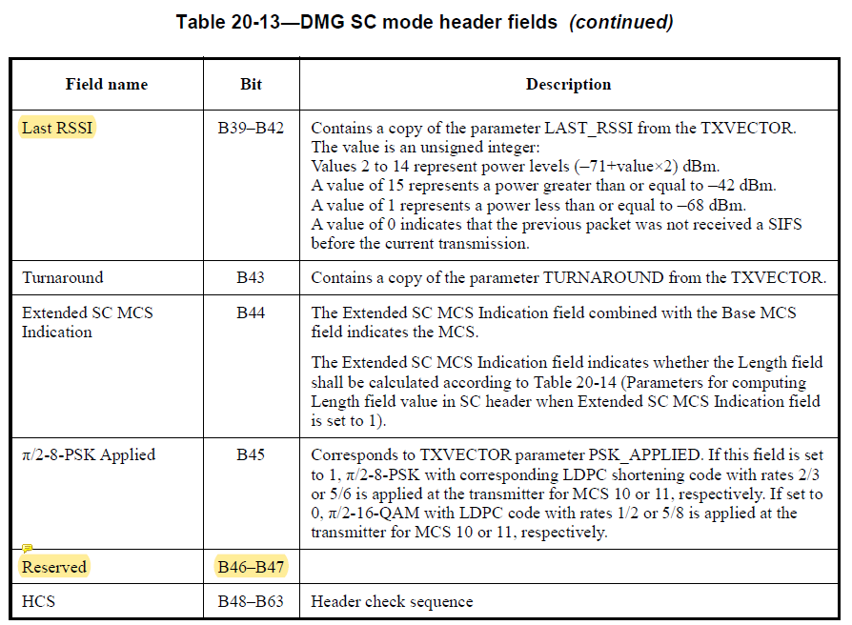
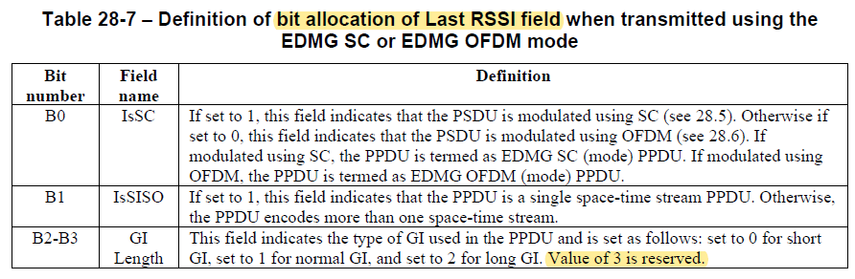
Sensing Functionality Indicator in SC/OFDM PPDU Header
  Option 1 for SC PHY.
  The reserved bit (B47) in DMG SC/OFDM mode Header can be used for sensing indication.
  Please note that the reserved bit (B46) in L-Header field of EDMG SC/OFDM mode had been used for the indication of EDMG PPDU.
  Option 2 for SC PHY.
  Use the reserved bits in Last RSSI field in L-Header of SC/OFDM PHY.
  E.g. B2 and B3 shall be both set to 1.

Slide 9
Conclusions
This contribution provides a solution to include sensing functionality in DMG/EDMG PPDU.
Compare with the scheme in [2], the proposed scheme works for both Monostatic and Bi/Multistatic configuration.

Slide 10
References
[1] 11-18-2094-00-00ay-wlan-radar.pptx
[2] 11-18-2095-00-00ay-wlan-radar-annex.docx
[3] 802.11ay-2021.pdf

Slide 11
SP1
Do you support to add the following to 11bf SFD:
Sensing functionality shall be explicitly indicated in L-Header/DMG Header.
  Yes
  No
  Abs

Slide 12
SP2
Do you support to add the following to 11bf SFD:
Use the reserved bits in Scrambler Initialization field in L-Header/DMG Header in control mode to indicate the sensing functionality (as shown in slide 8).
  Yes
  No
  Abs

Slide 13
SP3
Which option in L-Header/DMG Header (as shown in slide 8) in SC/OFDM mode do you support for the sensing functionality indication ?
Option 1 (B47)
Option 2 (reserved bits in Last RSSI field)
Abs

