Slide 1
WLAN Sensing Functionality Indicator
Date: 2022-01-10
Name | Affiliation | Address | Phone | Name
Rui Du | Huawei Technologies Co. Ltd | F3, Huawei Base, Shenzhen, China |  | ray.du@huawei.com
Yi Lv
Mengshi Hu
Yan Xin

Slide 2
Outline
Background and motivation
Dedicated explicit indication scheme
Conclusion

Slide 3
Background and motivation
Sensing is becoming a new function integrated in the WLAN communication system.
Consider different cases like Monostatic and Bistatic/multistatic sensing, here we want to give a possible solution to include the sensing functionality in WLAN and provide an explicitly indication and work for both Monostatic and Bistatic/Multistatic sensing.

Slide 4
Background and motivation
In [1, 2], radar is proposed as part of the WLAN framework, in order to achieve better Coexistence and sharing between radar function and WLAN function.
As the annex AB of 11ay amendment indicates, to implement radar functionality, a (DMG/EDMG) STA can transmit any type of PPDU with 1) valid DMG/EDMG PPDU constructed according to DMG/EDMG PHY specification and setting 2) RA=TA for some types of frame (e.g., SSW, BRP)
However, this scheme only works in the Monostatic scenario.

Slide 5
Background and motivation
Scheme in [1,2] including some modification for the Spec, which has been added as an Annex in 11ay[3] :
The DMG PHY and EDMG PHY is used to implement radar functionality
Setting RA=TA for some types of frame (e.g., SSW, BRP), and this “may” indicate for radar functionality
Adding TRN for some types of frame (e.g., SSW, BRP)
Cons
Using RA = TA is not a nature fit for implement radar functionality.
Does not support Bistatic/Multistatic radar. Since the transmitter and receiver are in different devices for Bistatic/Multistatic radar, so without explicit indication, the receivers do not know the PPDU is for radar, then do not know when to turn on/switch to radar functionality, and do not know when and where to receive the radar signal.

Slide 6
Sensing Functionality Indicator in PPDU Header
The idea of this contribution is using explicit indication in PPDU header to indicate the sensing functionality and indicate different kinds of sensing by setting RA and TA in some types of frames.
Please note that the indication bits should be selected at DMG PPDU header, so all the DMG/EDMG devices could recognize the indication correctly.

Slide 7
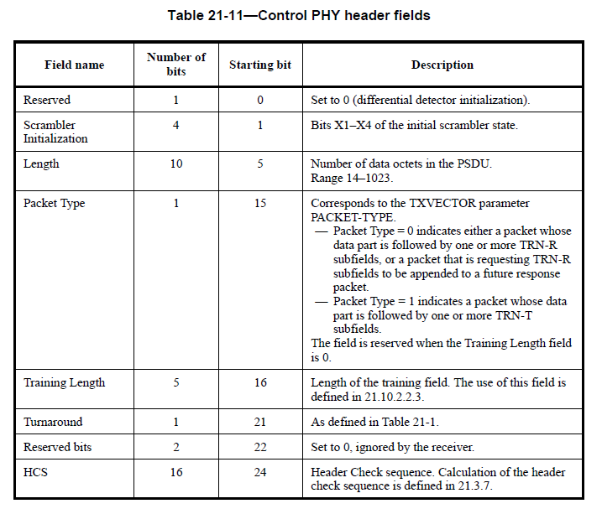
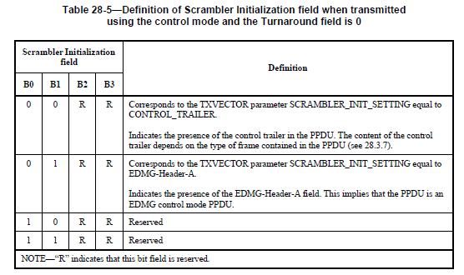
Sensing Functionality Indicator in PPDU Header
Scrambler initialization field in the L-Header of the control mode PPDU when Turnaround field is 0.
Use the reserved bits in Scrambler Initialization field
(in Table 28-5 in [3]) in control mode PPDU
E.g. only use one reserved bit in the reserved value:
101R，100R, 10R1，10R0, 111R，110R，11R0，11R0
RA = TA for some types of frame (e.g. SSW)： Monostatic
RA ≠ TA for some types of frame (e.g. SSW)： Bi/Multistatic
Please note that in a EDMG control mode PPDU, B22/B23 in the DMG Header shall be set 1.

Slide 8
Conclusions
This contribution provides a solution to include sensing functionality in DMG/EDMG PPDU.
Compare with the scheme in [2], the proposed scheme works for both Monostatic and Bi/Multistatic configuration.

Slide 9
References
[1] 11-18-2094-00-00ay-wlan-radar.pptx
[2] 11-18-2095-00-00ay-wlan-radar-annex.docx
[3] 802.11ay-2021.pdf

Slide 10
SP1
Do you support to add the following to 11bf SFD:
Sensing functionality shall be explicitly indicated in DMG Header.
Yes
No
Abs

Slide 11
SP2
Do you support to add the following to 11bf SFD:
Use the reserved bits in Scrambler Initialization field in DMG control PHY Header to indicate the sensing functionality (as shown in slide 7).
Yes
No
Abs

