Slide 1
Look ahead to next generation
Date: 2022-01-10
Authors:

Slide 2
Abstract
An encouragement to initiate the development of new PHY/MAC amendment to 802.11.
  Making Interactive Experience with Immersive and Realistic Content Possible in Wi-Fi
The target of this amendment should include the following
  Hundred Gigabit Throughput
  Low Latency Improvement
  Full Wi-Fi Coverage
  Intelligent/Capable of Machine Learning

Slide 3
Background
The first presentation for EHT in WNG was in May 2018 which was about two years earlier than the last SA Ballot of 802.11ax (HE)
802.11be (EHT) R1 is expected to be stable around March 2022
802.11be is assumed to be approved in May 2024 according to the 802.11 timeline[1]
Given the above observations, 2022 is the right time to start a discussion for next generation

Slide 4
Hundred Gigabit Throughput
Metaverse, digital twin, XR communications and high resolution wireless projection require higher and higher data rates
Video Format | application | Resolution | Color depth | Frame rate | Uncompressed rate Gbps | Uncompressed rate Gbps given that there is 20% overhead and 4/5 coding rate
4K | Wireless projection | 3840*2160 | 10 bits *3 (RGB) | 90 | 17.92 | 26.88
 | Wireless projection | 3840*2160 | 10 bits *3 (RGB) | 120 | 29.86 | 44.79
 | VR | 3840*3840 | 10 bits *3 (RGB) | 90 | 79.63 | 119.44
 | VR | 3840*3840 | 10 bits *3 (RGB) | 120 | 106.17 | 159.25
8K | Wireless projection | 7680*4320 | 10 bits *3 (RGB) | 90 | 89.58 | 134.37
 | Wireless projection | 7680*4320 | 10 bits *3 (RGB) | 120 | 119.44 | 179.16
 | VR | 7680*7680 | 10 bits *3 (RGB) | 90 | 318.50 | 477.75
 | VR | 7680*7680 | 10 bits *3 (RGB) | 120 | 424.67 | 637.01
Based on the last row of the table：
4K VR requires more than 100 Gbps
8K wireless uncompressed projection requires more than 130 Gbps

Slide 5
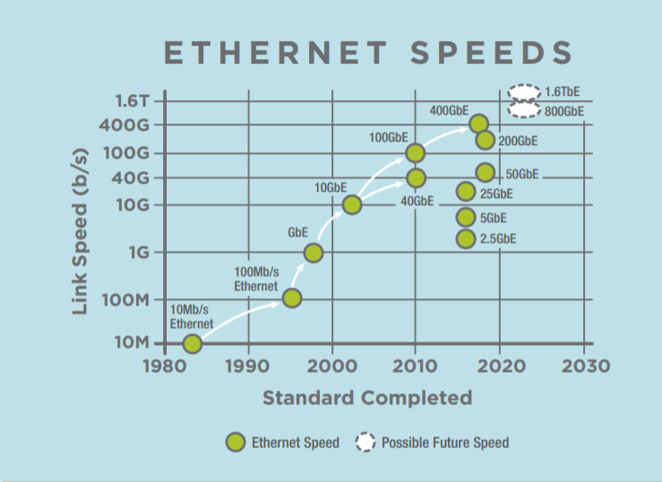
Hundred Gigabit Throughput
Wired Ethernet is Going into Terabit Territories
  The Ethernet Alliance's 2020 technology roadmap expects speeds of 800 Gbit/s and 1.6 Tbit/s to become IEEE standards after 2020, possibly between 2025 and 2030
TGbe scope is to have a mode of operation to achieve at least 30 Gbps.
  Over an order of magnitude lower than approved Ethernet standards (400 Gbps).
  Over two orders of magnitude lower than expected future evolutions.
To narrow this gap, we need to aim high for the next project (beyond 11be)
  100 Gbps WLAN was discussed in 802.11be [3], requiring about 1 GHz aggregated bandwidth
  A combination of low band (sub 7GHz) and high band (above 45 GHz) should be taken into account
[2]

Slide 6
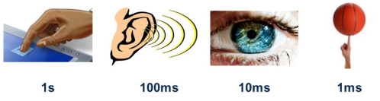
Low Latency Improvement
Human response time to sensory signals
  Latency for real-time VR gaming: < 10ms
  Latency for tactile signals: < 1ms
Requirement |  |  | illustration
Video delay |  | < 10 ms | For online video games
Precision (Sensing and measurement) | Hand gestures | <1mm and 0.01 degree | physiological activities (swallowing, mouth opening, blowing and breath)
 | Eye tracking | <1mm and 0.01 degree | 2010, eye tracking: A comprehensive guide to methods and measures
 | Behavior identification | <10 cm | physiological motions (elbow movement and knee squatting–arising)
 | Moving distance | <10 cm | 1/4 ~ 1/6 of one step distance
 | Tactile delay | <1 ms | tactile internet

Slide 7

More and More IoT Use Cases Demand Low Latency
Smart IoT in home: Distributed sharing/operation between devices
  Target: The user experience of operating multiple devices is the same as that of operating a single device, e.g., video, audio, interaction, etc.
  10ms latency is a typical value
Smart IoT in factory: robots/manufacture/warehousing
  The lower the latency, the more applications can be supported.

Slide 8
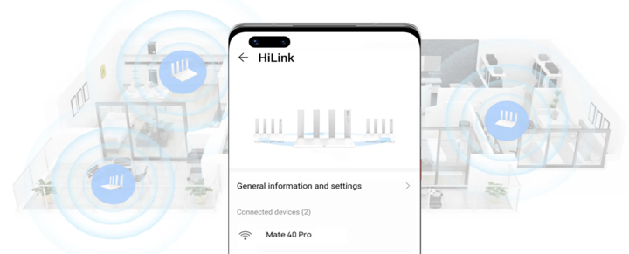
Full Wi-Fi Coverage
Reduced Wi-Fi signals or dead spots could be the result of physical obstructions.
  Obstructions like the floor, doors, and walls of your home can come between you and your router, especially if they’re made of metal, brick, or concrete
  Or perhaps the distance is simply too great in a large home
  Blanketing your home/office with Wi-Fi
  with multiple APs installed around the home/office such that to obtain solid Wi-Fi coverage from one end to the other, e.g., multi-AP collaboration
  the data rate in each corner is expected to increase significantly
  One Network and Seamless Roaming
  every component of a Wi-Fi system is working
  together and can collaborate with each other

Slide 9
  Intelligent/Capable of Machine Learning
The Wi-Fi community is currently deploying and developing, to support multi-user transmission, multi-link operation, multi-AP coordination and so on
However it makes a next-generation WLANs exceedingly complex as the dependencies, between the parameters and their joint optimization, usually have a non-linear impact on network performance.
Machine Learning [4] could handle the above complexity, improving the overall performance in dense and congested scenarios

Slide 10
Lessons Learned from P802.11be
There was not enough effort in the TIG/SG stage to agree obtain agreement on a set of features/scope that matched the agreed timeline.
  Spend more time up front (in TIG/SG) to define the project for better confidence in the timeline.
Rely on IEEE projects, not “releases” to specify features and requirements. Use letter ballots, not comment collections to stabilize the specification.

Slide 11
Way Forward
Form a TIG/SG in May or July 2022 to evaluate candidate technologies, and draft a PAR and CSD.
  PAR should focus on performance metrics, not mention technologies candidates
Learning the lessons from the past, recommend to have one year for TIG/SG to study the new requirements and the corresponding technologies
There is only one release in this TG

Slide 12
Timeline
 | 802.11ac | 802.11ax | 802.11be
First SG meeting | May 2007 | May 2013 | May 2018
PAR approved | Sep 2008 | Mar 2014 | Mar 2019
First TG meeting | Nov 2008 | May 2014 | May 2019
D0.1 | Jan 2011 | Mar 2016 | Sep 2020
D1.0 | June 2011 | Jan 2017 | May 2021
Final 802.11 WG approval | Nov 2013 | Sep 2020 | Mar 2024
  Timeline of next generation
  Need to consider the market readiness of existing 802.11ax products and proposed 802.11be products

Slide 13
References
[1] 11-20-0116-04-00be-discussion-on-timeline-for-802-11be
[2] https://ethernetalliance.org/technology/2020-roadmap/
[3] 11-19-0754-00-00be-11be-peak-data-rate-analysis
[4] WiFi Meets ML: A Survey on Improving IEEE 802.11 Performance with Machine Learning

