Slide 1
IEEE 802.11 New Members Introduction
Date: 2022-03-08
Authors:
Notes:
doc.: IEEE 802.11-06/0528r0
May 2006
Bruce Kraemer, Marvell
Page 1

Slide 2
March 2022
Welcome to IEEE 802.11 New Members Introduction
IEEE 802.11 WG Session
Last updated, March 7th, 2022
Slide 2
Adrian Stephens, Intel : Stephen McCann, Huawei
Notes:
2
2

Slide 3
Registration for the March 802.11 plenary session
This meeting is part of the March IEEE 802 plenary session
You must pay the registration fee in order to attend
If you have not already done so, you can register here or follow the registration link here https://802world.org/plenary/
If you do not intend to register for this session you must leave this meeting and, if you have logged attendance on IMAT, email the 802.11 chair or vice chairs to have your attendance cancelled

Slide 4
Where can I access important information?
The 802.11 website is your starting point for looking for information, as this links to all other relevant sources.
Bookmark this now: http://www.ieee802.org/11/
The other major information source is submissions on the 802.11 document server.
Bookmark this now: https://mentor.ieee.org/802.11/documents
Download this submission from the document server now as you may need it to follow the presentation.

Slide 5
IEEE 802.11 Presentations
There are some short educational presentations available as follows:
A description of the current projects in IEEE 802.11 and a short introduction to the IEEE standards process
A description of the completed projects in IEEE 802.11, a short introduction to the IEEE standards process and some non-project activities in IEEE 802.11
Please see http://grouper.ieee.org/groups/802/11/presentation.html for further information

Slide 6
Who we are

Slide 7

IEEE Standards Association (IEEE-SA)
Vision: To be a world-class standards-development organization
Mission: To provide a high-quality, market-relevant standardization environment, respected worldwide
20,000 STANDARDS DEVELOPERS
160⁺ COUNTRIES INVOLVED
1200⁺
ACTIVE STANDARDS
600⁺ STANDARDS UNDER DEVELOPMENT
IEEE Standards span a broad spectrum of technologies, such as:
Aerospace Electronics
Broadband Over Power Lines
Broadcast Technology
Clean Technology
Cognitive Radio
Design Automation
Electromagnetic Compatibility
Green Technology
Ethernet/WLAN
Medical Device Communications
Nanotechnology
Organic Components
Portable Battery Technology
Power Electronics
Power & Energy
Radiation/Nuclear
Reliability
Transportation Technology

Slide 8
IEEE 802 within IEEE and IEEE-SA Structure
IEEE MEMBERS
Board of Directors (BOD)
Exec Director & Staff
Publication
Activities
Technical
Activities:
many technical societies and councils
Standards Association
(IEEE SA)
Member & Geographic
Activities
Educational
Activities
IEEE Computer Society Board of Governors
IEEE SA Board of Governors
IEEE Computer Society Standards Activities Board
IEEE SA Standard Board
IEEE 802 LMSC is a Standards Committee
of the IEEE Computer Society
IEEE 802 LAN/MAN Standards Committee
750+ volunteer individual experts
5 Working Groups
2 Technical Advisory Groups
1 Executive Committee

Slide 9
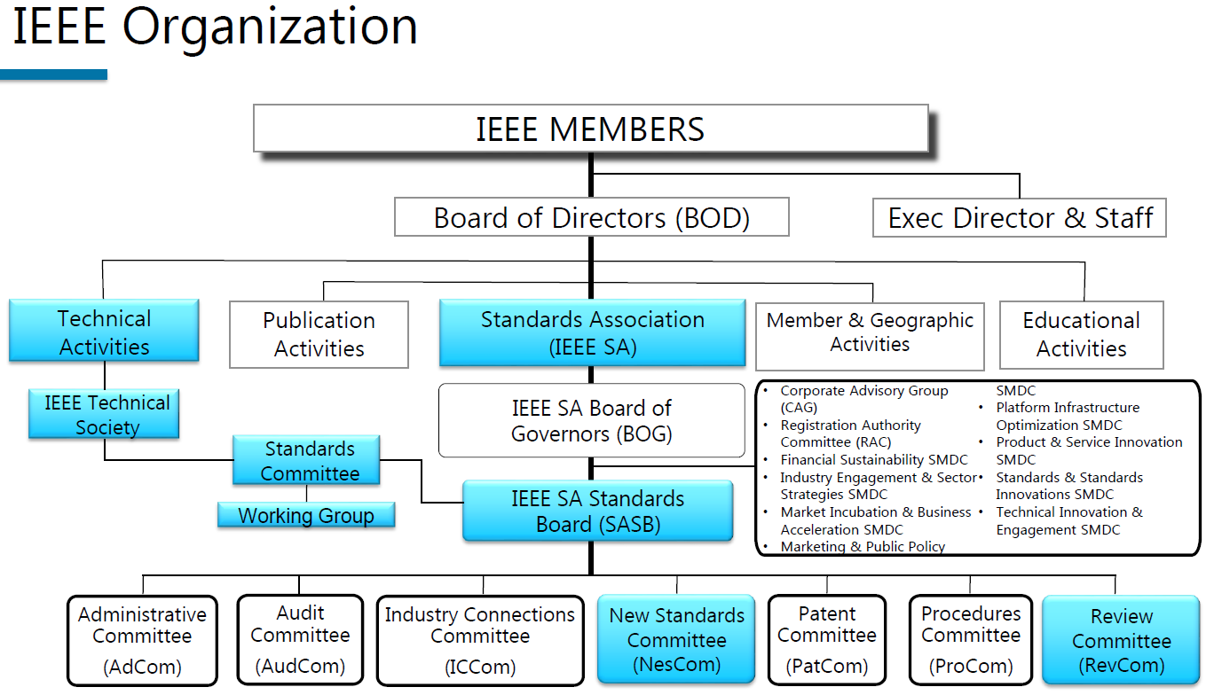
IEEE 802 within IEEE and IEEE-SA Structure (alternative)

Slide 10
Computer Society standards committees
March 2022
Cloud Computing Standards Committee: Steve Diamond (s.diamond@computer.org)
Design Automation Standards Committee: Stan Krolikoski (stanleyk@cadence.com)
Cybersecurity and Privacy Committee: Eric Hibbard (eric.hibbard@ieee.org)
Learning Technology Standards Committee: Avron Barr (avron@aldo.com)
LAN/MAN (IEEE 802) Standards Committee: Paul Nikolich (p.nikolich@ieee.org)
Microprocessor Standards Committee: Baker Kearfott (rbk@louisiana.edu)
Portable Applications Standards Committee: Joseph Gwinn (gwinn@raytheon.com)
Software & Systems Engineering Standards Committee: Paul Croll (pcroll@computer.org)
Simulation Interoperability Standards Organization Standards Committee: Katherine Morse (Katherine.Morse@jhuapl.edu)
Test Technology Standards Committee: Adam Cron (adam.cron@synopsys.com)
Slide 10
Adrian Stephens, Intel : Stephen McCann, Huawei

Slide 11
Lower-Layer Focus
Reference
Model for
End Stations
  IEEE 802 standards emphasize the functionality of the lowest two layers of the OSI reference model, and the higher layers as they relate to network management
    physical layer (PHY, Layer 1)
    data link layer (DLL, Layer 2)
  IEEE 802 divides DLL into:
    Medium Access Control (MAC)
      Multiple specifications
    Common logical link control (LLC)
  See details in IEEE Std 802
    “IEEE Standard for Local and Metropolitan Area Networks: Overview and Architecture”
Application
Presentation
Session
Transport
Network
LLC
IEEE
802
Data Link
MAC
Physical
Medium
•Copper
•Fiber
•Air
•Others?
Notes:
11
11

Slide 12
March 2022
IEEE 802 Organization
IEEE 802 Sponsor Executive Committee
Paul Nikolich, Chairman
IEEE 802.1
Bridging, Architecture
Working Group
Glenn Parsons
IEEE 802.3
Ethernet
Working Group
David Law
IEEE 802.11
Wireless LAN
Working Group
Dorothy Stanley
IEEE 802.18
Radio Regulatory
Technical Advisory Group
Jay Holcomb
IEEE 802.15
Wireless Specialty Networks Working Group
Pat Kinney
IEEE 802.19
Coexistence
Working Group
Steve Shellhammer
IEEE 802.24
Vertical Network Applications
Technical Advisory Group
Tim Godfrey
Appointed Executive Committee members:
Executive Secretary Jon Rosdahl 1st Vice Chair James Gilb
Recording Secretary John D’Ambrosia 2nd Vice Chair Roger Marks
Treasurer George Zimmerman Member Emeriti Geoff Thompson, Clint Chaplin
Hibernating Groups: 802.16 Broadband Wireless Access, 802.21 Media Independent Handover, 802.22 Wireless Regional Area Networks
Disbanded Groups: 802.2 Logical Link Control, 802.4 Token Bus, 802.5 Token Ring, 802.6 Metro Area Network, 802.7 Broadband TAG, 802.8 Fiber TAG, 802.9 Integrated Svcs LAN, 802.10 Security, 802.12 Demand Priority, 802.14 CATV Broadband, 802.17 Resilient Packet Ring, 802.23 Emergency Services
Slide 12
Adrian Stephens, Intel : Stephen McCann, Huawei
Notes:
12
12

Slide 13
March 2022
All those dots….decoder ring
802.1 Bridging and Architecture – generally the top of the link layer
802.3 Ethernet
802.11 Wireless LAN (WLAN)
802.15 Wireless Specialty Networks (WSN)
802.18 Radio Regulatory TAG
802.19 Wireless Coexistence
802.24 Vertical Applications TAG
Hibernating and Disbanded Groups
Slide 13
Adrian Stephens, Intel : Stephen McCann, Huawei
Notes:
13
13

Slide 14
March 2022
802 enabled markets/technologies
1970 to 1980 (pre IEEE 802) | Mainframe and Mini Computers (100s of thousands) Proprietary LANs and WANs (sub 10Mbps)
1980 to 1989 | Mini and Personal Computers (millions) Enterprise LANs (802.1 Bridges, 802.3 Ethernet, 802.5 Token Ring) Proprietary Leased Line WANs
1990 to 1999 | PCs, Tablets, (100s of millions) Enterprise and Home LANs—wired and wireless (802.11) Broadband Access—cable modems and Ethernet PONs (802.3) Fiber based Metro and Wide-Area Networks
2000 to 2009 | Tablets, Smart Phones (billions) Ubiquitous wireless (802.11, mobile cellular) Faster fiber and broadband access (EPONs)
2010 to 2019 | Sensors/Internet of Things (100s of billions) Automotive Networks (802.3, 802.11, mobile cellular) IoT, M2M, faster/slower, low latency, low power, more reliable, more secure, more private
2020 to 2029 | More networked devices (trillions), privacy, security, Time Sensitive Networks, faster, further Factory Automation, Autonomous Vehicles, AR/VR, Edge Computing, Gaming, Entertainment, Machine Learning and Artificial Intelligence
Slide 14
Adrian Stephens, Intel : Stephen McCann, Huawei
Notes:
14
14

Slide 15
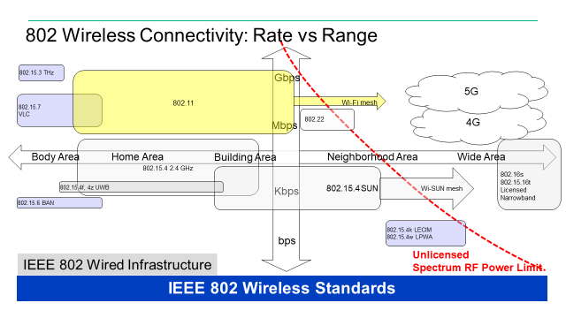
IEEE 802 Technologies
Notes:
doc.: IEEE 802.11-11/0483r0
May 2011
Bruce Kraemer (Marvell)
Page 15

Slide 16
IEEE 802.11 Revisions
802.11
-2020
802.11
-2016
802.11
-2012
802.11
-2007
802.11
-2003
11aq
Pre Association
Discovery
11aa
Video Transport
11k
RRM
11s
Mesh
11e
QoS
MAC
11u
WIEN
11v
Network
Management
11h
DFS & TPC
IEEE
Std
802.11
-1997
11ak
General Link
11ae
QoS Mgt Frames
11z
TDLS
11i
Security
11d
Intl roaming
11ai
Fast Initial Link
Setup
11w
Management
Frame
Security
11r
Fast Roam
11f
Inter AP
11n
High
Throughput
(>100 Mbps)
11ah
Sub 1 GHz
11af
TV Whitespace
11j
JP bands
11a
54 Mbps
5GHz
PHY & MAC
11aj
China millimeter
wave
11ac -VHT
>1 Gbps @ 5GHz
11p
WAVE
11y
Contention
Based
Protocol
11g
54 Mbps
2.4GHz
11b
11 Mbps
2.4GHz
11ad - VHT
>1 Gbps @ 60GHz
Notes:
doc.: IEEE 802.11-11/0483r0
May 2011
Bruce Kraemer (Marvell)
Page 16

Slide 17
IEEE 802.11 Standards Pipeline
802.11
REVme
802.11
-2020
MAC
802.11bh
RCM
802.11bc
BCS
Study
Group(s)
802.11bi
EDP
802.11az
NGP
802.11ba
WUR
ITU Liaison
(ITU) AHG
WNG
Topic
Interest
Group(s)
802.11bf
SENS
802.11bd
NGV
802.11ax
HEW
802.11be
EHT
802.11ay
NG60
MAC & PHY
802.11bb
LC
Liaison
Liaison Topics
Discussion Topics
TIG/Study
groups
TG without
Approved draft
WG
Letter Ballot
SA
Ballot
Published
Amendment
Published
Standard
17
Notes:
doc.: IEEE 802.11-11/0483r0
May 2011
Bruce Kraemer (Marvell)
Page 17

Slide 18
Life Cycle
Slide 18

Slide 19
IEEE Standards Development:
Process Flow
Decide / Choose Technology
Write / update a Draft
Letter Ballot Draft
Idea!
Resolve Comments
Done?
~ 4 years
Project Approval Process
Develop Draft Standard
(in Working Group)
Standards Association Ballot
IEEE-SA Standards Board Approval Process
Publish Standard
Revise or Withdraw Standards
Maximum of 10 years
Slide 19
Adrian Stephens, Intel : Stephen McCann, Huawei
Notes:
This chart illustrates the whole standards process in simplified form.
Idea: The idea for a standard is usually developed by a group of people, and the responsibility for the idea is assumed by the standards committee. The standards committee is usually a society or an existing standards committee.
Project Approval Process: This idea is then transferred onto a form called the Project Authorization Request (PAR) and submitted to the New Standards Committee (NesCom) for approval.
Develop draft standard: The draft is then developed and revised by the working group.
Ballot draft: When the draft work is finalized, the standards committee forms the balloting group and ballots the standard.
Standards Board Approval: After your ballot has achieved consensus, the draft then goes to the Review Committee (RevCom) and the Standards Board for approval. The amount of time from PAR to Board approval is 4 years (an extension can be made if absolutely necessary).
Publish Standard: The draft is then edited and formatted by an IEEE Project Editor and published.
The standard is valid for 10 years before it must be revised or withdrawn.

Slide 20
IEEE-SA Individual and Corporate Standards Development
Open, consensus-based process
Open – anybody can participate (payment of meeting fees may be needed)
Individual standards development
  Each individual has one vote
Corporate standards development
  One company/one vote
Results frequently adopted by national, regional, and international standards bodies
Slide 20
Adrian Stephens, Intel : Stephen McCann, Huawei

Slide 21

IEEE Standards Development: Project Authorization
A project may be started by any individual or company
Each project must be supported by a technical group in the IEEE
  Referred to as a “standards committee”
  Official developer of standard
Projects approved through document called Project Authorization Request (PAR)
  Summarizes details of project
Slide 21
Adrian Stephens, Intel : Stephen McCann, Huawei
Notes:
Approval of a PAR means that the work is authorized by the IEEE-SA Standards Board
The PAR is the means by which IEEE can extend the umbrella of indemnification (or protection) to its standards developers

Slide 22

IEEE Standards Development: Develop Draft Standard
A standard is written by a working group
  The working group consists of participants interested in creating the standard
The working group chooses a way to create the first draft document
  The group writes initial draft, or
  The draft developed from existing documents and specifications
  Make contributions that lead to consensus
Draft document are refined in the working group through multiple iterations and review
Slide 22
Adrian Stephens, Intel : Stephen McCann, Huawei
Notes:
Some tips for starting the development of your draft include the following:
• Develop an outline that will be used as key clauses.
• Divide up each topic or clause among working group members, preferably according to their experience.
• It is to your advantage to assign a working group member as a technical editor. During the development process, the technical editor will ensure consistency and can gather and incorporate all contributions and comments.
• The working group meetings should only be used for reviewing important points in the draft and resolving areas of disagreement.
• Working with an IEEE Project Editor will expedite the project since the editor can flag items that could otherwise be slowed down by the IEEE-SA Standards Board during the approval process.
• Use the IEEE Standards Style Manual as the reference for document structure.

Slide 23
IEEE Standards Development: Consensus process
Consensus is determined through a ballot
Interested individuals or organizations are invited to ballot on draft standards
A ballot group receives document, reviews it, and votes/comments on it
  Vote yes (approve), no (disapprove), abstain
  Can offer comments on document as well
Ultimate approval of standard is granted by the IEEE-SA Standards Board
Slide 23
Adrian Stephens, Intel : Stephen McCann, Huawei
Notes:
• The standards committee forms the balloting group. In some cases, this may involve using the membership of an active committee or committees; in other cases, this may involve inviting a wide variety of interested parties to participate.
• The standards committee also approves the balance of the group. No one interest group can be more than 33%.
• Once the balloting group is formed, the composition of that balloting group cannot change until the close of the ballot.
• The IEEE-SA now allows three types of ballot groups: one made up of individuals, one made up of Entities (persons who are representing an Entity), and one made up of both of these types of ballots. See the IEEE-SA Standards Board Operations Manual for details of these balloting processes.

Slide 24
Policy

Slide 25
Guiding Principles of the Standards Process
Due Process
Develop, publish and follow procedures
Openness
All materially interested parties have access to the process and information
Consensus
Goal is agreement among the majority. For technical matters this means 75%
Balance
Representation from members of all materially interested parties
Notes:
25
• Due process means developing procedures, making them publicly available, and following them. This also means that you need to know the procedures of the IEEE-SA Standards Board, your society, and your technical committee.
• Openness ensures that everyone has access to the process. This is accomplished by making sure that all interested and affected parties can participate in your working group and that all actions are publicly available.
• Consensus means the majority agrees on an issue. While mostly employed during the balloting process, consensus can also be used to help resolve contentious working group issues as well.
• Balance is used during the balloting stage of a draft standard. It is achieved by composing a balloting group that includes a balance between the basic categories of producers, users, and general interest.
• Appeals can be made at any time in the process—even after approval of the standard. In the IEEE, appeals can be technical (which is heard at the standards committee) or procedural (which is heard at the Standards Board).

Slide 26
Policies and Procedures - Intro
The operation of the 802.11 working group (WG11) is governed by a number of documents (next slide).
Matters of procedure in 802.11 (where not described by one of the higher documents in the hierarchy) are decided by the WG11 chair. These WG11 procedures are described in the WG11 operations manual.
If you are new to standards development or new to WG11, do not despair! Day to day rules can be learned by observing and participating in the WG. If you are unsure about the operation of some procedure in WG11, speak to one of the WG officers or the officers of its subgroups.

Slide 27
IEEE-SA policy documents
IEEE Code of Ethics
  http://www.ieee.org/about/corporate/governance/p7-8.html
IEEE Standards Association (IEEE-SA) Affiliation FAQ
  http://standards.ieee.org/faqs/affiliation.html
Antitrust and Competition Policy
  http://standards.ieee.org/resources/antitrust-guidelines.pdf
Letter of Assurance Form
  http://standards.ieee.org/develop/policies/bylaws/sect6-7.html#loa
  https://development.standards.ieee.org/myproject/Public//mytools/mob/loa.pdf
IEEE-SA Patent Committee FAQ & Patent slides
  http://standards.ieee.org/board/pat/faq.pdf and http://standards.ieee.org/board/pat/pat-slideset.ppt
Notes:
Agenda item 2.1.2.1

Slide 28
Current IEEE-SA Rule documents
The current version of the IEEE-SA Standards Board Bylaws is available at:
  http://standards.ieee.org/develop/policies/bylaws/index.html (HTML version)
  http://standards.ieee.org/develop/policies/bylaws/sb_bylaws.pdf (PDF version)
The current version of the IEEE-SA Standards Board Operations Manual is available at:
  http://standards.ieee.org/develop/policies/opman/index.html (HTML version)
  http://standards.ieee.org/develop/policies/opman/sb_om.pdf (PDF version)

Slide 29
IEEE-SA Patent Policy
The following 4 slides are available at https://development.standards.ieee.org/myproject/Public/mytools/mob/slideset.ppt

Slide 30
Participants have a duty to inform the IEEE
  Participants shall inform the IEEE (or cause the IEEE to be informed) of the identity of each holder of any potential Essential Patent Claims of which they are personally aware if the claims are owned or controlled by the participant or the entity the participant is from, employed by, or otherwise represents
  Participants should inform the IEEE (or cause the IEEE to be informed) of the identity of any other holders of potential Essential Patent Claims
  Early identification of holders of potential Essential Patent Claims is encouraged

Slide 31
Ways to inform IEEE
Cause an LOA to be submitted to the IEEE-SA (patcom@ieee.org); or
Provide the chair of this group with the identity of the holder(s) of any and all such claims as soon as possible; or
Speak up now and respond to this Call for Potentially Essential Patents
If anyone in this meeting is personally aware of the holder of any patent claims that are potentially essential to implementation of the proposed standard(s) under consideration by this group and that are not already the subject of an Accepted Letter of Assurance, please respond at this time by providing relevant information to the WG Chair

Slide 32
Other guidelines for IEEE WG meetings
All IEEE-SA standards meetings shall be conducted in compliance with all applicable laws, including antitrust and competition laws.
  Don’t discuss the interpretation, validity, or essentiality of patents/patent claims.
  Don’t discuss specific license rates, terms, or conditions.
    Relative costs of different technical approaches that include relative costs of patent licensing terms may be discussed in standards development meetings.
      Technical considerations remain the primary focus
  Don’t discuss or engage in the fixing of product prices, allocation of customers, or division of sales markets.
  Don’t discuss the status or substance of ongoing or threatened litigation.
  Don’t be silent if inappropriate topics are discussed. Formally object to the discussion immediately.
---------------------------------------------------------------
For more details, see IEEE-SA Standards Board Operations Manual, clause 5.3.10 and
Antitrust and Competition Policy: What You Need to Know at http://standards.ieee.org/develop/policies/antitrust.pdf

Slide 33
Patent-related information
  The patent policy and the procedures used to execute that policy are documented in the:
    IEEE-SA Standards Board Bylaws (http://standards.ieee.org/develop/policies/bylaws/sect6-7.html#6 )
    IEEE-SA Standards Board Operations Manual (http://standards.ieee.org/develop/policies/opman/sect6.html#6.3 )
  Material about the patent policy is available at
  http://standards.ieee.org/about/sasb/patcom/materials.html
  If you have questions, contact the IEEE-SA Standards Board Patent Committee Administrator at patcom@ieee.org

Slide 34
Copyright
Notes:
doc.: IEEE 802.11-06/0528r0
May 2006
Bruce Kraemer, Marvell
Page 34

Slide 35
IEEE SA Copyright Policy
By participating in this activity, you agree to comply with the IEEE Code of Ethics, all applicable laws, and all IEEE policies and procedures including, but not limited to, the IEEE SA Copyright Policy.
  Previously Published material (copyright assertion indicated) shall not be presented/submitted to the Working Group nor incorporated into a Working Group draft unless permission is granted.
  Prior to presentation or submission, you shall notify the Working Group Chair of previously Published material and should assist the Chair in obtaining copyright permission acceptable to IEEE SA.
  For material that is not previously Published, IEEE is automatically granted a license to use any material that is presented or submitted.

Slide 36
IEEE SA Copyright Policy
The IEEE SA Copyright Policy is described in the IEEE SA Standards Board Bylaws and IEEE SA Standards Board Operations Manual
  IEEE SA Copyright Policy, see
  Clause 7 of the IEEE SA Standards Board Bylaws
  https://standards.ieee.org/about/policies/bylaws/sect6-7.html#7
  Clause 6.1 of the IEEE SA Standards Board Operations Manual
  https://standards.ieee.org/about/policies/opman/sect6.html
IEEE SA Copyright Permission
  https://standards.ieee.org/content/dam/ieee-standards/standards/web/documents/other/permissionltrs.zip
IEEE SA Copyright FAQs
  http://standards.ieee.org/faqs/copyrights.html/
IEEE SA Best Practices for IEEE Standards Development
  http://standards.ieee.org/develop/policies/best_practices_for_ieee_standards_development_051215.pdf
Distribution of Draft Standards (see 6.1.3 of the SASB Operations Manual)
  https://standards.ieee.org/about/policies/opman/sect6.html

Slide 37
Participation
Notes:
doc.: IEEE 802.11-06/0528r0
May 2006
Bruce Kraemer, Marvell
Page 37

Slide 38
Participant behavior in IEEE-SA activities is guided by the IEEE Codes of Ethics & Conduct
All participants in IEEE-SA activities are expected to adhere to the core principles underlying the:
  IEEE Code of Ethics
  IEEE Code of Conduct
The core principles of the IEEE Codes of Ethics & Conduct are to:
  Uphold the highest standards of integrity, responsible behavior, and ethical and professional conduct
  Treat people fairly and with respect, to not engage in harassment, discrimination, or retaliation, and to protect people's privacy.
  Avoid injuring others, their property, reputation, or employment by false or malicious action
The most recent versions of these Codes are available at
  http://www.ieee.org/about/corporate/governance

Slide 39
Participants in the IEEE-SA “individual process” shall act independently of others, including employers
The IEEE-SA Standards Board Bylaws require that “participants in the IEEE standards development individual process shall act based on their qualifications and experience”
This means participants:
  Shall act & vote based on their personal & independent opinions derived from their expertise, knowledge, and qualifications
  Shall not act or vote based on any obligation to or any direction from any other person or organization, including an employer or client, regardless of any external commitments, agreements, contracts, or orders
  Shall not direct the actions or votes of other participants or retaliate against other participants for fulfilling their responsibility to act & vote based on their personal & independently developed opinions
By participating in standards activities using the “individual process”, you are deemed to accept these requirements; if you are unable to satisfy these requirements then you shall immediately cease any participation

Slide 40
IEEE-SA standards activities shall allow the fair & equitable consideration of all viewpoints
The IEEE-SA Standards Board Bylaws (clause 5.2.1.3) specifies that “the standards development process shall not be dominated by any single interest category, individual, or organization”
  This means no participant may exercise “authority, leadership, or influence by reason of superior leverage, strength, or representation to the exclusion of fair and equitable consideration of other viewpoints” or “to hinder the progress of the standards development activity”
This rule applies equally to those participating in a standards development project and to that project’s leadership group
Any person who reasonably suspects that dominance is occurring in a standards development project is encouraged to bring the issue to the attention of the Standards Committee or the project’s IEEE-SA Program Manager

Slide 41
Event Conduct
Notes:
doc.: IEEE 802.11-06/0528r0
May 2006
Bruce Kraemer, Marvell
Page 41

Slide 42
IEEE Event Conduct and Safety Statement
IEEE believes that science, technology, and engineering are fundamental human activities, for which openness, international collaboration, and the free flow of talent and ideas are essential. Its meetings, conferences, and other events seek to enable engaging, thought-provoking conversations that support IEEE’s core mission of advancing technology for humanity. Accordingly, IEEE is committed to providing a safe, productive, and welcoming environment to all participants, including staff and vendors, at IEEE-related events.

Slide 43
IEEE Event Conduct and Safety Statement
IEEE has no tolerance for discrimination, harassment, or bullying in any form at IEEE-related events. All participants have the right to pursue shared interests without harassment or discrimination in an environment that supports diversity and inclusion. Participants are expected to adhere to these principles and respect the rights of others.
IEEE seeks to provide a secure environment at its events. Participants should report any behavior inconsistent with the principles outlined here, to onsite staff, security or venue personnel, or toeventconduct@ieee.org.

Slide 44
Attendance
Notes:
doc.: IEEE 802.11-06/0528r0
May 2006
Bruce Kraemer, Marvell
Page 44

Slide 45
Example Online Session Graphic
Notes:
doc.: IEEE 802.11-06/0528r0
May 2006
Bruce Kraemer, Marvell
Page 45

Slide 46
Recording Attendance
It is an IEEE-SA requirement that attendees register, in order that a correct record of attendees and their disclosed affiliations can be recorded in the minutes.
You need a single IEEE-SA web account
  The IEEE-SA web account requires a working email address
  do not remove your email address from the account
Use the email address associated with that web account when registering attendance
  If you change email addresses, update the web account, don’t create a new web account, or your membership status may not be calculated properly
Notes:
doc.: IEEE 802.11-06/0528r0
May 2006
Bruce Kraemer, Marvell
Page 46

Slide 47
Attendance Procedures
Prior to or during the session:
  (one time) Get a free Web Account if you don’t already have one. Keep your contact data in this area up to date.
  (one time) Register your Interest Areas in myProject if you haven’t done so already (it’s up to you to keep this updated as needed)
During the session:
  (once per session) Register on IMAT
  (once per slot) Record attendance at a specific meeting. You will be asked for your affiliation the first time you attend a new task group.
See following slides for detailed procedure
Notes:
doc.: IEEE 802.11-06/0528r0
May 2006
Bruce Kraemer, Marvell
Page 47

Slide 48
Changing Affiliation
The IMAT attendance system keeps a record of stated affiliation per group (task group / working group).
The 802.11 membership records are updated using this information after every session.
If you change affiliation, you need to go to “MyProject” under “Manage Activities” and check/update all 802.11 groups that you have attended in the past or declared an interest in so that they have the correct affiliation.
Notifying the 802.11 officers of a change is not sufficient, as any local changes to the 802.11 membership records will get overwritten with data from MyProject after every session.
Notes:
doc.: IEEE 802.11-06/0528r0
May 2006
Bruce Kraemer, Marvell
Page 48

Slide 49
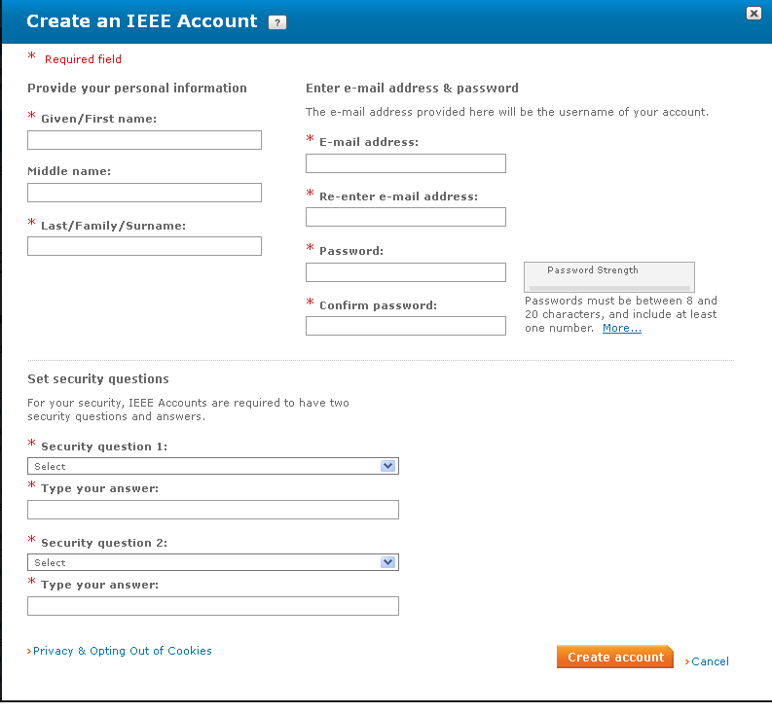
Step 1: Get a free IEEE Account
If you already have
an IEEE Account you can skip to the
next step
Otherwise log onto
http://development.standards.ieee.org and click on the link to Create an IEEE Account
Note that you must have an IEEE Web Account in order to get credit for any meetings you attend.
Notes:
doc.: IEEE 802.11-06/0528r0
May 2006
Bruce Kraemer, Marvell
Page 49

Slide 50
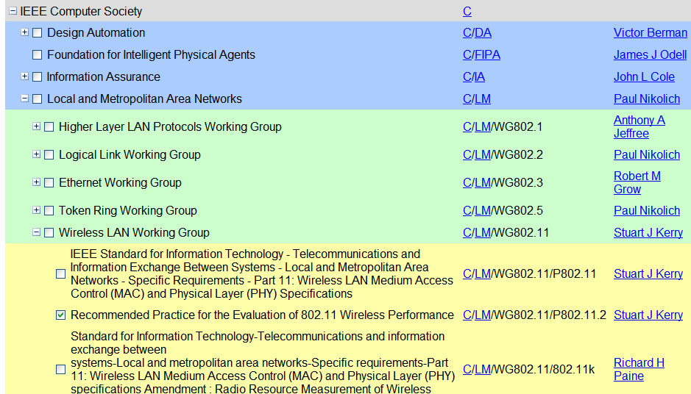
Step 2: Set your myProject Interest Areas
Go to http://development.standards.ieee.org and enter your Username (Web Account ID) and password to get into myProject
If you have already selected your Interest Areas in myProject, you may skip this step; otherwise….
Select Manage Activity Profile and drill down to select the WG and/or Project(s) in which you have an interest
For each of these you will have to specify your affiliation
Notes:
doc.: IEEE 802.11-06/0528r0
May 2006
Bruce Kraemer, Marvell
Page 50

Slide 51
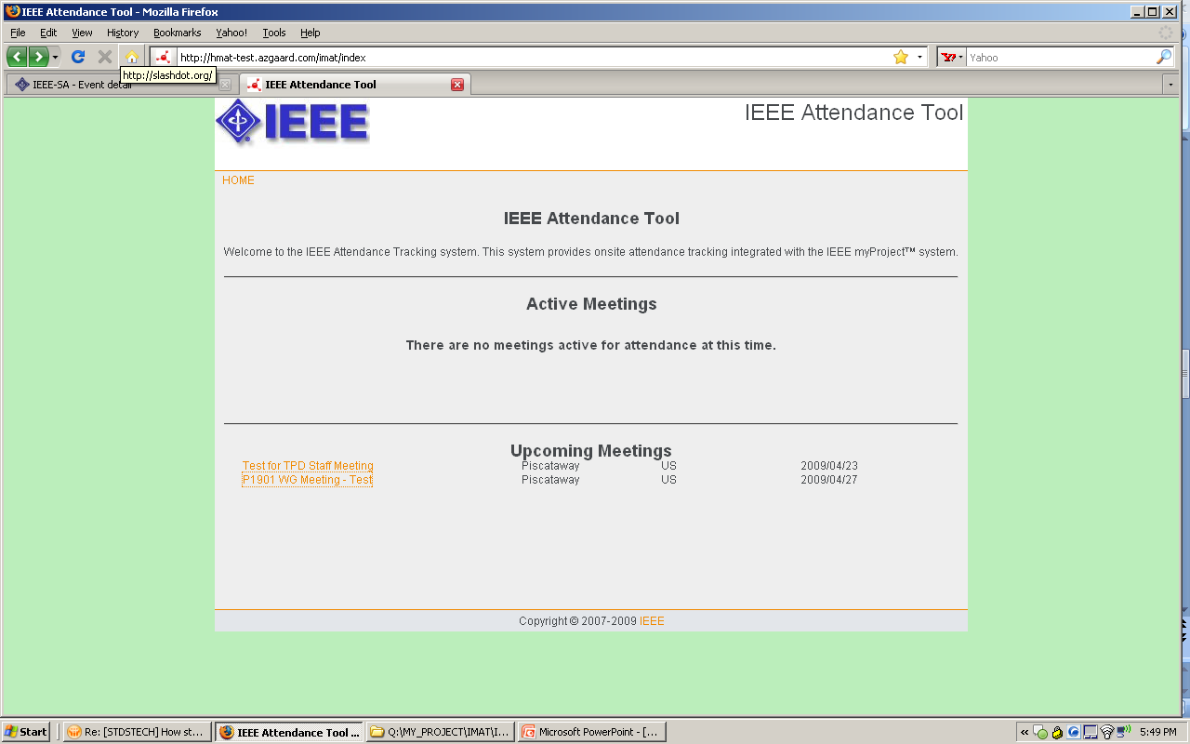
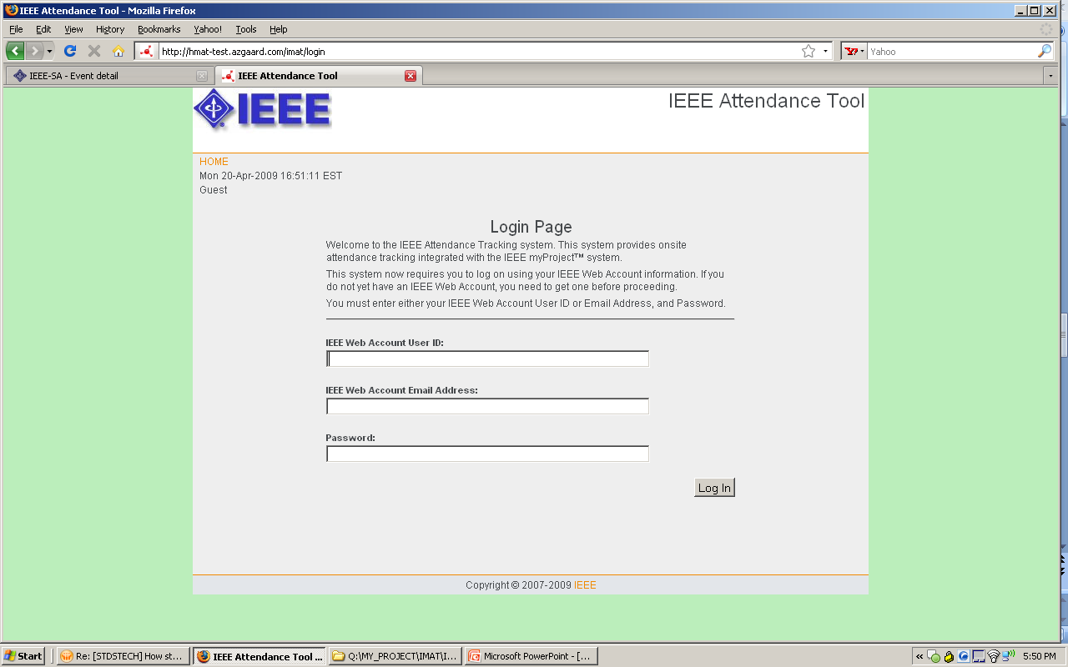
Step 3: Log onto IMAT
Make sure you have an IEEE Web Account as described in Step 1
Make sure you’ve designated your myProject Interest Areas as described in Step 2
Log into IMAT using your IEEE Web Account username and password.
The URL for the local server is:
  https://imat.ieee.org
Notes:
doc.: IEEE 802.11-06/0528r0
May 2006
Bruce Kraemer, Marvell
Page 51

Slide 52
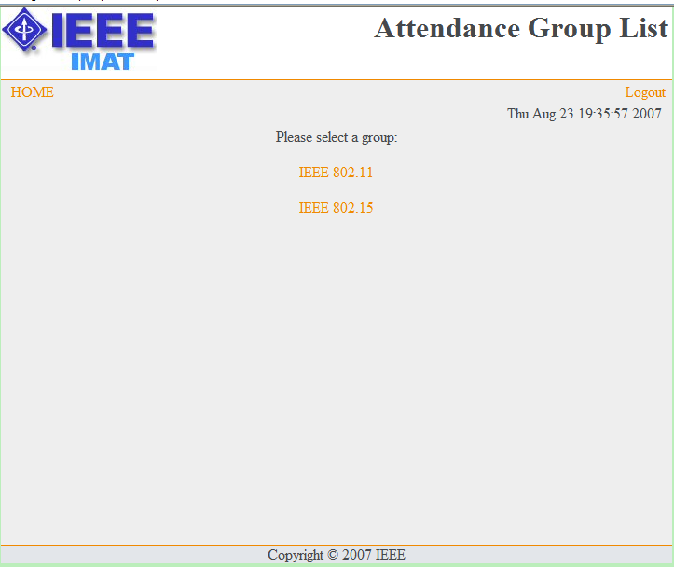
Step 4a: Register Your Attendance
Select the WG or option from the home page.
Notes:
doc.: IEEE 802.11-06/0528r0
May 2006
Bruce Kraemer, Marvell
Page 52

Slide 53
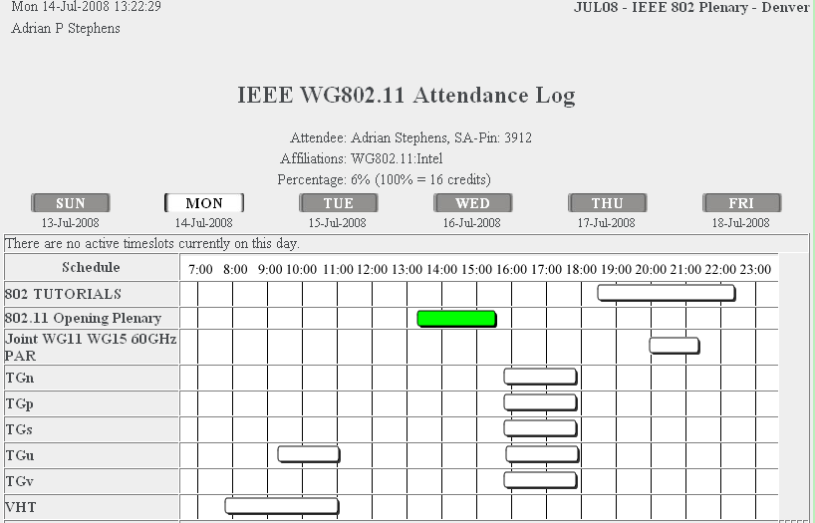
Step 4b: Select the Meeting
Select the Day and Meeting you are attending and update the screen
  Note that you will only be able to click a single button in the active timeslot column for the current day
  Once updated, the column will turn green and your selection will be locked in.
  Selections may not be changed once the timeslot closes
Repeat Step 4 for each distinct breakout you attend
Notes:
doc.: IEEE 802.11-06/0528r0
May 2006
Bruce Kraemer, Marvell
Page 53

Slide 54
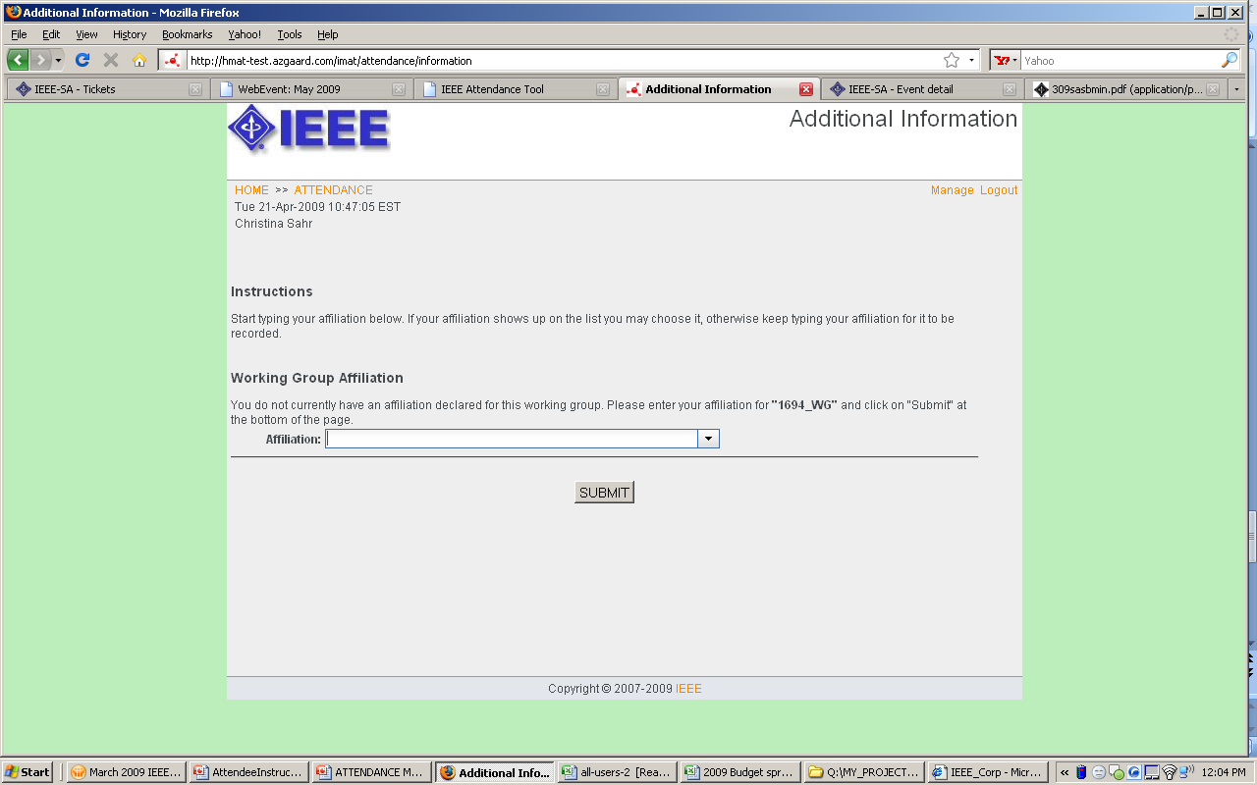
Step 4b: Supply your Affiliation
You must provide an affiliation in order to receive credit for your attendance and to record your presence for the minutes
You will be asked your affiliation once for the WG and once again for each unique TG or SG you attend. Start typing your affiliation/company name and either choose from the dropdown list or continue typing to add.
Notes:
doc.: IEEE 802.11-06/0528r0
May 2006
Bruce Kraemer, Marvell
Page 54

Slide 55
Membership
Notes:
doc.: IEEE 802.11-06/0528r0
May 2006
Bruce Kraemer, Marvell
Page 55

Slide 56
Member Status Graphic
Notes:
doc.: IEEE 802.11-06/0528r0
May 2006
Bruce Kraemer, Marvell
Page 56

Slide 57
What are my rights/obligations?
As a new participant, aspirant, potential-voter or voter
  Must record attendance and affiliation during meeting
  Can vote in Study Groups and in straw polls (i.e., informal votes) in other groups
As an aspirant, potential-voter or voter
  Can access any 802.11 WG reflector on request
  Can have access to the 802.11 member’s private area, containing drafts and balloting materials
As a voter
  Can vote in any 802.11 group, including formal motions and straw polls
  Must vote in mandatory 802.11 WG ballots

Slide 58
Website membership list
Go to http://www.ieee802.org/11/members.htm
or by “Members List” link on http://www.ieee802.org/11
Family Name | Given Name | MI | Affiliation | Status
McCann | Stephen |  | Huawei | Voter
Notes:
doc.: IEEE 802.11-06/0528r0
May 2006
Bruce Kraemer, Marvell
Page 58

Slide 59
Email Reflectors
Notes:
doc.: IEEE 802.11-06/0528r0
May 2006
Bruce Kraemer, Marvell
Page 59

Slide 60
Email Reflectors
There is an email reflector for the working group and each task group.
Write access to the reflectors allowed for those who are members with status: aspirant, nearly-voter, potential-voter, voter.
To make a request, visit the reflector request page:
http://www.ieee802.org/11/Reflector.html
  Gathers information and sends an email to Vice Chair
If you change your email address – please let the vice-chairs know. They will perform a global change to the list servers.
Public read access to all reflectors is available via the 802.11 home page http://www.ieee802.org/11 on the “WG Email” menu.

Slide 61
Documentation
Notes:
doc.: IEEE 802.11-06/0528r0
May 2006
Bruce Kraemer, Marvell
Page 61

Slide 62
Documentation Generally
Downloading Documents during a session
  All documents are updated on the local server from mentor
  When retrieving document please follow the instructions in the previous pages and obtain all documentation from the local server. This will keep traffic at a lower level on the external links.
New document numbers are obtained from the mentor web site
  Need to register on mentor to request a login
  New requests handled after the session and 75% attendance in that session is required to gain write access. If you need write access during your first session, ask a colleague to upload on your behalf.
  Login and request a document number from:
https://mentor.ieee.org/802.11/documents
Uploading Documents
  Login and upload to the mentor web site https://mentor.ieee.org/802.11/documents
Notes:
doc.: IEEE 802.11-06/0528r0
May 2006
Bruce Kraemer, Marvell
Page 62

Slide 63
Thank you for attending.
Questions ?
Notes:
doc.: IEEE 802.11-06/0528r0
May 2006
Bruce Kraemer, Marvell
Page 63

Slide 64
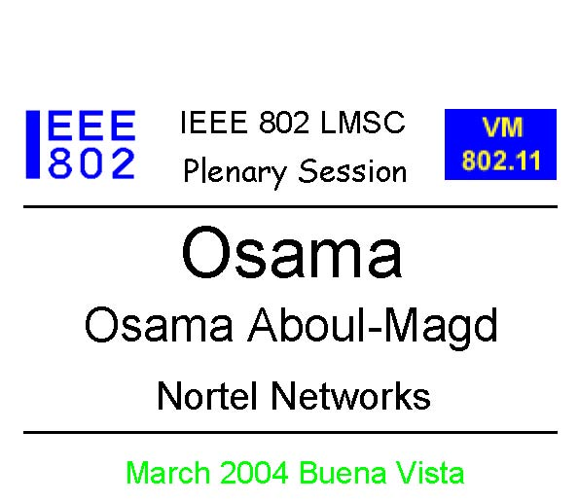
Badges
Your badge indicates:
  That you have registered and paid for the session
  Your voting status
You must wear your badge at all times while in the meeting area
Your badge is personal to you – do not lend it to anybody else
Voting members must show their voting token to the counters during a formal vote so that their voting status can be confirmed.
James
James Bond
Fleming Enterprises
VM11
Notes:
doc.: IEEE 802.11-06/0528r0
May 2006
Bruce Kraemer, Marvell
Page 64

