Slide 1
Per-Link Quantization for CSI Reporting
Date: 2021-12-29
Authors:
Name | Affiliations | email
Qinghua Li | Intel | Qinghua.li@intel.com
Hao Song |  | Hao.song@intel.com
Xiaogang Chen |  | Xiaogang.c.chen@intel.com
Cheng Chen |  | Cheng.chen@intel.com
Robert Stacey

Slide 2
2D CSI
CSI has 2 dimensions: space and frequency
For sensing
H_{1,1}(f)
For BF
H_{1,2}(f)
f

Slide 3
Channel Tap Carries Sensing Info
Channel tap is caused by reflections from the object of interest
Channel tap info is spread across frequency such that it requires gleaning info across frequency for identifying the tap
τ
H_{1,1}(f)
f

Slide 4
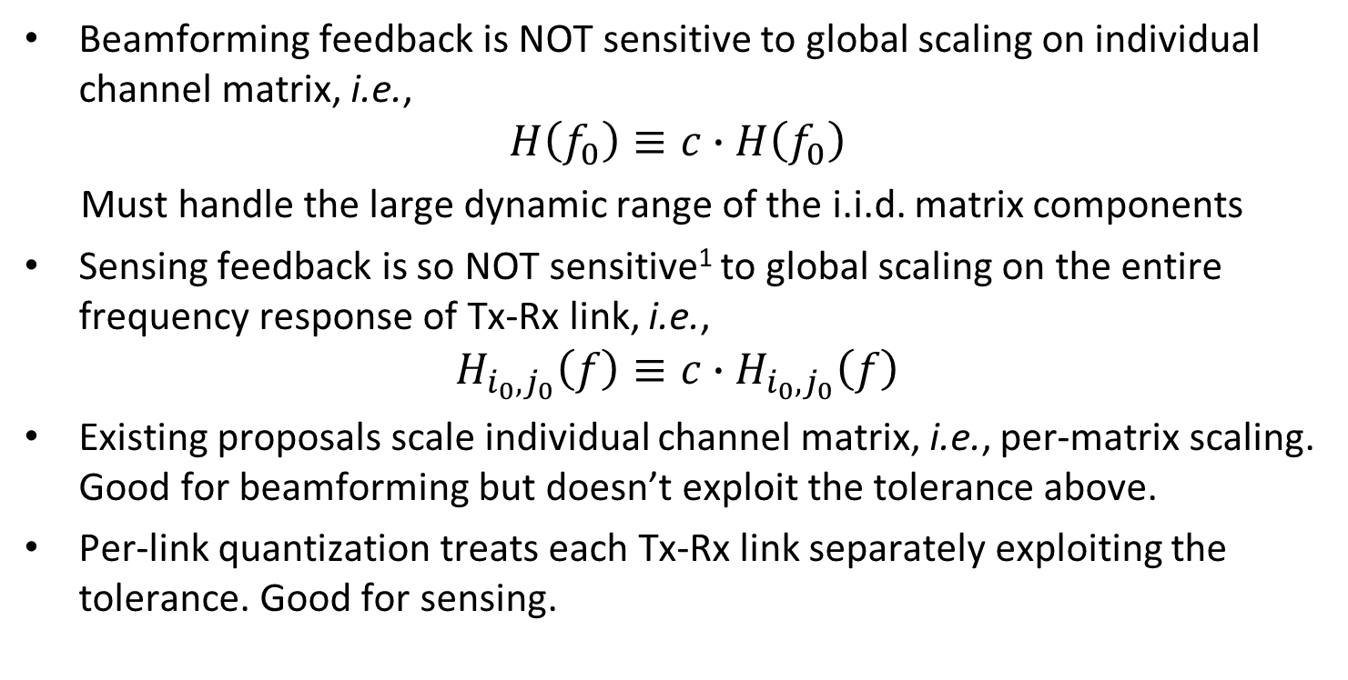
Requirements for Beamforming and Sensing are different
Beamforming feedback is NOT sensitive to global scaling on individual channel matrix, i.e.,
$$H\left(f_{0}\right)≡c∙H\left(f_{0}\right)$$
Must handle the large dynamic range of the i.i.d. matrix components
Sensing feedback is so NOT sensitive¹ to global scaling on the entire frequency response of Tx-Rx link, i.e.,
$$H_{i_{0},j_{0}}\left(f\right)≡c∙H_{i_{0},j_{0}}\left(f\right)$$
Existing proposals scale individual channel matrix, i.e., per-matrix scaling. Good for beamforming but doesn’t exploit the tolerance above.
Per-link quantization treats each Tx-Rx link separately exploiting the tolerance. Good for sensing.
1. As pointed out by Jianhan from MediaTek, sensing imping angles still requires certain accuracy in reporting the relative gains of each link.

Slide 5

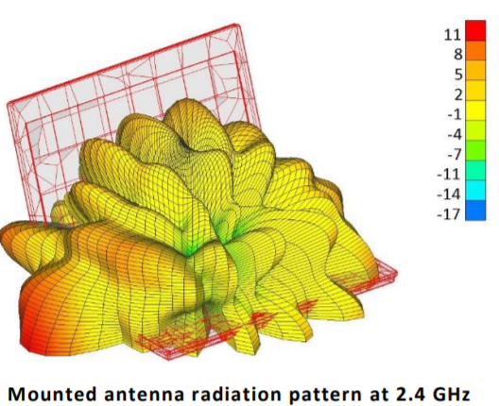
Power Imbalance across Antennas
Received signal powers of Tx-Rx links can be quite different, e.g., 10 dB, as pointed out by Christian from NXP
  Irregular antenna pattern, variations in PA gain and insertion losses, and occultation

Slide 6
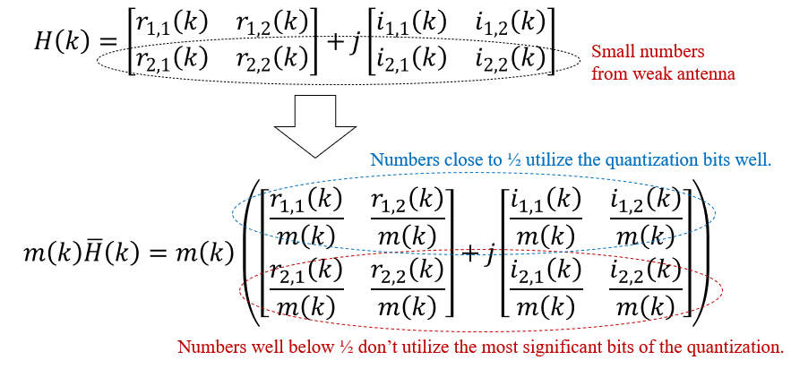
Per-matrix scaling suffers from power Imbalance.
Per-link scaling maintains the same accuracy for all Tx-Rx links
In contrast, per-matrix scaling suffers accuracy degradation for the weak links
0.1001011
0.1110101
0.0010100
0.0011100

Slide 7
Additional Downside of 11n Scaling
High complexity incurred by division operations
Poor accuracy for SISO. The largest I/R component only has 8 quantization levels and values below 0.48 are all rounded to 0.45.
Example: 0.3 + 0.2 j
0.45 + 0.3 j
50% off!
Only 8 levels
0~0.48 rounded to 0.45

Slide 8
Concentrated m(k)
The max Re/Im component of H(k), m(k), is quantized using N_{p} bits
m(k) is the order statistic of Gaussian distribution
The effective range of m(k) is less 2x for medium/large H and fits 11n m(k) codebook for small H.
m(k) doesn’t fit the power-of-2 scaling [1].

Slide 9


Straightforward Per-Link Quantization
Treating each Tx-Rx link separately, a scaling is applied to the entire band so that the weak link doesn’t suffer accuracy loss, like per-ant. AGC
Unlike per-matrix scaling, no individual scaling on each subcarrier
Per-link scaling for fully utilizing the quantization bits
Weak link:
$h_{1}\left(f\right)=m_{1} {\overline{h}}_{1}$ $\left(f\right)$
f
Strong link:
$h_{2}\left(f\right)=m_{2} {\overline{h}}_{2}$ $\left(f\right)$
f

Slide 10
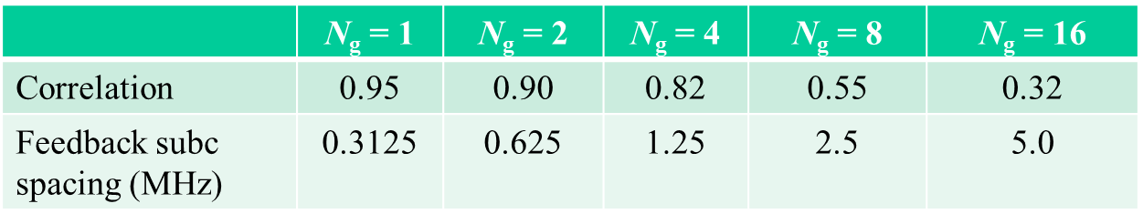
Correlation across Frequency
Channel responses of each link are correlated across frequency
The correlation decreases with Ng but it always exists thank to the dominant channel cluster
The correlation can be exploited to improve quantization accuracy
Dominant cluster provides wideband correlation.
τ
h(f)
f

Slide 11
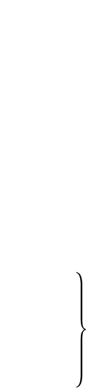



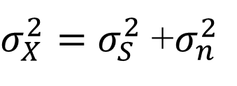








Differential Quantization
― Exploiting the correlation
Differential quantization reduces the input signal entropy by exploiting the correlation between adjacent input signals
Low complexity. No multiplication or division is needed.
$$\left\{\text{Per}\text{−}\text{link} \text{differential} \text{outperforms} \text{per}\text{−}\text{matrix} \text{scaling} \text{in} \text{terms} \text{of} \text{accuracy}\text{, }\text{complexity}\text{, }\text{and} \text{robustness} \begin{matrix} \\ \begin{matrix} \\ \\ \begin{matrix} \\ \\ \end{matrix}\end{matrix} \\ \begin{matrix} \\ \\ \end{matrix}\end{matrix}\right.$$
$$X=S+n,$$
$σ_{X}^{2}=$ $σ_{S}^{2}$+$σ_{n}^{2}$
$$σ_{n}^{2}$$
0
$${\hat{x}}_{k}$$
$$x_{k}$$
$$x_{k+1}$$
$$d_{k}$$
$$x_{k}={\hat{x}}_{k−1}+d_{k}$$
$${\hat{x}}_{k−1}$$
$$[2σ_{d},4σ_{d}]$$
$${\hat{x}}_{k}={\hat{x}}_{k−1}+{\hat{d}}_{k}$$
$$x_{k−1}$$
f

Slide 12
Simulation Configuration (1/2)
Channel D, 80 MHz, MIMO with 4 Tx and 2 Rx antennas
1x symbol, subcarrier spacing 312.5 kHz
Two schemes are simulated with N_{b} = 6 and N_{p} = 3
  Per-matrix scaling quantization, “Low Complexity Scaling and Quantization” in [1], 3+2x8x6 = 99 bits per H
  Per-link differential quantization, 2x8x6 = 96 bits per H
 | N_{g} = 1 | N_{g} = 2 | N_{g} = 4 | N_{g} = 8 | N_{g} = 16
Correlation | 0.95 | 0.90 | 0.82 | 0.55 | 0.32
Feedback subc spacing (MHz) | 0.3125 | 0.625 | 1.25 | 2.5 | 5.0

Slide 13
Simulation Configuration (2/2)
Two antenna settings
  Equal gain: all antennas have the same gain
  Power imbalance: Rx antenna 1 is 6 dB better than Rx antenna 2
CDFs of QNSR are plotted
QNSR = Quantization noise power / Signal power

Slide 14
Antennas with Equal Gains, Ng = 1
Per-link differential outperforms per-matrix by 19 dB
19 dB

Slide 15
Rx antenna gains differ by 6 dB, Ng = 1
Per-link differential outperforms per-matrix by 17 and 23 dB
Per-matrix scaling is not robust to antenna pattern. Weak antenna suffers 6 dB loss.
17 dB
6 dB

Slide 16
Antennas with Equal Gains, Ng = 2
Per-link differential outperforms per-matrix by 15 dB
15 dB

Slide 17
Rx antenna gains differ by 6 dB, Ng = 2
Per-link differential outperforms per-matrix by 12 and 18 dB
Per-matrix scaling is not robust to antenna pattern. Weak antenna suffers 6 dB loss.
12 dB
6 dB

Slide 18
Antennas with Equal Gains, Ng = 4
Per-link differential outperforms per-matrix by 8 dB
8 dB

Slide 19
Rx antenna gains differ by 6 dB, Ng = 4
Per-link differential outperforms per-matrix by 4 and 10 dB
Per-matrix scaling is not robust to antenna pattern. Weak antenna consistently suffers 6 dB loss.
4 dB
6 dB

Slide 20
Antennas with Equal Gains, Ng = 8
Even for tones 2.5 MHz apart, frequency correlation is still strong, e.g., 0.55. This enables per-link differential outperforms per-matrix by 3 dB
3 dB

Slide 21
Rx antenna gains differ by 6 dB, Ng = 8
Per-link differential outperforms per-matrix by 1 and 7 dB
Per-matrix scaling is not robust to antenna pattern. Weak antenna consistently suffers 6 dB loss.
1 dB
6 dB

Slide 22
Remarks
Per-matrix quantization is not robust to antenna deployments. Namely, the weak antenna always suffers poorer quantization accuracy in CSI report.
Per-link quantization solves this problem
Even for large spacing, 2.5 MHz with Ng = 8, frequency correlation is still strong, e.g., 0.55, and differential quantization still provides apparent gain, e.g., 3 dB

Slide 23
Conclusions
Since channel tap info is carried across frequency not antennas, instead of per-matrix, per-link scaling/quantization should be used
Frequency correlation consistently exists even for Ng=16 due to the existence of dominant cluster
Differential quantization exploits the frequency correlation with low complexity (no multiplication or division)
Per-link differential outperforms per-matrix quantization in terms of accuracy, complexity, and robustness significantly by several dBs
Per-link quantization and differential quantization should be considered for 11bf CSI report

Slide 24
Straw Poll 1
Do you support per-link quantization for 11bf CSI report?

Slide 25
Straw Poll 2
Do you support differential quantization for 11bf CSI report?

Slide 26
References
Steve Shellhammer, “Comparison of Sensing Measurement Report Approaches,” IEEE 802.11-21/xxxxr0, Dec 2021
Steve Shellhammer, et. al., “Low-Complexity Scaling and Quantization for CSI Report,” IEEE 802.11-21/1573r0, September 2021

Slide 27
Backup

