Slide 1
Agenda for IEEE 802.11 Coexistence SC virtual meeting in January 2022
21 December 2021
Authors:
Name | Company | Phone | email
Andrew Myles | Cisco | +61 418 656587 | amyles@cisco.com

Slide 2
Welcome to the 10th virtual meeting of the Coex SC in January 2022
IEEE 802.11 PDED ad hoc
1 | Warsaw | Sep 2016
2 | San Antonio | Nov 2016
3 | Atlanta | Jan 2017
4 | Vancouver | Mar 2017
5 | Daejeon | May 2017
IEEE 802.11 Coexistence SC
9 | Bangkok | Nov 2018
10 | St Louis | Jan 2019
11 | Vancouver | Mar 2019
12 | Atlanta | May 2019
13 | Vienna | Jul 2019
14 | Hanoi | Sep 2019
15 | Hawaii | Nov 2019
16 | Irvine | Jan 2020
17 | Virtual 1 | Jul 2020
18 | Virtual 2 | Sep 2020
19 | Virtual 3 | Nov 2020
20 | Virtual 4 | Jan 2021
21 | Virtual 5 | Mar 2021
22 | Virtual 6 | May 2021
IEEE 802.11 Coexistence SC
23 | Virtual 7 | Jul 2021
24 | Virtual 8 | Sep 2021
25 | Virtual 9 | Nov 2021
26 | Virtual 10 | Jan 2022
IEEE 802.11 Coexistence SC
1 | Berlin | July 2017
2 | Hawaii | Sep 2017
3 | Orlando | Nov 2017
4 | Irvine | Jan 2018
5 | Chicago | Mar 2018
6 | Warsaw | May 2018
7 | San Diego | July 2018
8 | Hawaii | Sep 2018

Slide 3
Registration is required for the IEEE 802.11 WG electronic interim session in January 2022
  This IEEE 802.11 Coex SC meeting is part of the IEEE 802.11 WG interim session in Jan 2022
  You must pay the registration fee in order to attend!
  If you have not already done so, you can register here
  If you do not intend to register for this session you must leave this meeting …
  … and, if you have logged attendance on IMAT, email the IEEE 802.11 WG Chair or Vice Chairs to have your attendance cancelled

Slide 4
Coex SC minutes today will be kept by our permanent SC secretary
  It is important to keep proper minutes of all Coexistence SC meetings …
  … and fortunately, way back in July 2017 in Berlin at a time when we actually saw each other F2F
  … Guido Hiertz (Ericsson) agreed to be appointed the IEEE 802.11 Coexistence SC’s permanent Secretary

Slide 5

The Coex SC will review the official IEEE-SA patent material for pre-PAR groups
Approved slide

Slide 6
Participant behavior in IEEE-SA activities is guided by the IEEE Codes of Ethics & Conduct
Approved slide
  All participants in IEEE-SA activities are expected to adhere to the core principles underlying the:
    IEEE Code of Ethics
    IEEE Code of Conduct
  The core principles of the IEEE Codes of Ethics & Conduct are to:
    Uphold the highest standards of integrity, responsible behavior, and ethical and professional conduct
    Treat people fairly and with respect, to not engage in harassment, discrimination, or retaliation, and to protect people's privacy.
    Avoid injuring others, their property, reputation, or employment by false or malicious action
  The most recent versions of these Codes are available at
    http://www.ieee.org/about/corporate/governance

Slide 7
Participants in the IEEE-SA “individual process” shall act independently of others, including employers
Approved slide
  The IEEE-SA Standards Board Bylaws require that “participants in the IEEE standards development individual process shall act based on their qualifications and experience”
  This means participants:
    Shall act & vote based on their personal & independent opinions derived from their expertise, knowledge, and qualifications
    Shall not act or vote based on any obligation to or any direction from any other person or organization, including an employer or client, regardless of any external commitments, agreements, contracts, or orders
    Shall not direct the actions or votes of other participants or retaliate against other participants for fulfilling their responsibility to act & vote based on their personal & independently developed opinions
  By participating in standards activities using the “individual process”, you are deemed to accept these requirements; if you are unable to satisfy these requirements then you shall immediately cease any participation

Slide 8
IEEE-SA standards activities shall allow the fair & equitable consideration of all viewpoints
Approved slide
  The IEEE-SA Standards Board Bylaws (clause 5.2.1.3) specifies that “the standards development process shall not be dominated by any single interest category, individual, or organization”
    This means no participant may exercise “authority, leadership, or influence by reason of superior leverage, strength, or representation to the exclusion of fair and equitable consideration of other viewpoints” or “to hinder the progress of the standards development activity”
  This rule applies equally to those participating in a standards development project and to that project’s leadership group
  Any person who reasonably suspects that dominance is occurring in a standards development project is encouraged to bring the issue to the attention of the Standards Committee or the project’s IEEE-SA Program Manager

Slide 9
Participants are required to adhere to the IEEE SA Copyright Policy
Approved slide
  By participating in this activity, you agree to comply with the IEEE Code of Ethics, all applicable laws, and all IEEE policies and procedures including, but not limited to, the IEEE SA Copyright Policy.
    Previously Published material (copyright assertion indicated) shall not be presented/submitted to the WG nor incorporated into a WGdraft unless permission is granted.
    Prior to presentation or submission, you shall notify the WG Chair of previously Published material and should assist the Chair in obtaining copyright permission acceptable to IEEE SA.
    For material that is not previously Published, IEEE is automatically granted a license to use any material that is presented or submitted.

Slide 10
Participants are required to adhere to the IEEE SA Copyright Policy
  The IEEE SA Copyright Policy is described in the IEEE SA Standards Board Bylaws and IEEE SA Standards Board Operations Manual
    IEEE SA Copyright Policy, see:
      Clause 7 of the IEEE SA Standards Board Bylaws
      Clause 6.1 of the IEEE SA Standards Board Operations Manual
  Other material
    IEEE SA Copyright Permission
    IEEE SA Copyright FAQs
    IEEE SA Best Practices for IEEE Standards Development
    Distribution of Draft Standards (see Clause 6.1.3 of the SASB Operations Manual)

Slide 11
The Coex SC will only meet once during the virtual IEEE 802.11 WG interim meeting in January 2022
Schedule
  Monday, 24 Jan 2022 @ 4-6pm ET
Webex details
  https://ieeesa.webex.com/ieeesa/j.php?MTID=m6604bcf2f3c0fed4df9c377f103df8e8
  Meeting number: 234 970 45245
  Meeting password: wireless

Slide 12
The Coex SC will consider a proposed agenda for its virtual meeting in Jan 2022
Proposed agenda is light ☹
  Bureaucratic stuff
    Scope of IEEE 802.11 Coexistence Standing Committee (a reminder)
    Approve minutes from Nov 2022
  What is happening this week? (in no particular order)
    Key messages
    Drivers of Coex SC work
    Coex measurement efforts
    ETSI BRAN activities
      EN 301 893 issues (5 GHz), incl.
        Coexistence challenges for 802.11be in 5 GHz
        Possible LS to TGbe/WG/WFA
      EN 303 687 issues (6 GHz), incl.
        NB FH in 6 GHz
        Specification challenges for 802.11ax/be in 6 GHz
        802.11be compatibility with EN 303 687
        C2C issues
      Future BRAN meetings
    Coex Tech Talk
    6 GHz spectrum availability
    3GPP update
    60 GHz update
    Plans for next meeting

Slide 13
  Scope of IEEE 802.11 Coexistence SC

Slide 14
The Coex SC scope was revised in Sept 2020
IEEE 802.11 Coex SC Scope
  The Coex SC shall promote, within the 802.11 WG and externally, an environment that enables IEEE 802.11 technologies to have equitable access to unlicensed spectrum globally
  The Coex SC should focus particularly on coexistence of 802.11ax & 802.11be with LAA & NR-U in the 5 GHz & 6 GHz bands globally
  The Coex SC may consider coexistence with other technologies and in other bands as directed by the Chair of the 802.11 WG
IEEE 802.11 Coex SC close down criteria
  802.11 WG Chair has authority to close down SC

Slide 15
The scope of the Coex SC was expanded in March 2021 to include 60 GHz coexistence issues
  It was noted during the March 2021 plenary that ETSI BRAN is working on 60 GHz Harmonised Standards that may impact IEEE 802.11ay coexistence
  Subsequently, the 802.11 Chair directed the Coex SC to consider 60GHz coexistence within scope
    At today's WG11 Opening Plenary, the comment was made that ETSI BRAN is also considering operational and coexistence requirements related to 57-71 GHz (60GHz) spectrum, relevant of course to 802.11ad and 11ay
    The scope of the Coex SC focuses on, "coexistence of 802.11ax & 802.11be with LAA & NR-U in the 5 GHz & 6 GHz bands globally". However, it "may consider coexistence with other technologies and in other bands as directed by the Chair of the 802.11 WG". So the Coex SC can consider 60 GHz issues if directed by the WG Chair
    I have directed the Coex SC to additionally consider coexistence topics for 60GHz operation

Slide 16
  Minutes

Slide 17
The Coex SC will consider the approval of its virtual meeting minutes from November 2021
  The draft minutes for the Coex SC at the virtual meeting in Nov 2021 are available on Mentor:
    See 11-21-1891-00
  Proposed motion:
    The IEEE 802 Coex SC approves 11-21-1891-00 as the minutes of its virtual meeting in November 2021
    Moved:
    Seconded:
    Result:

Slide 18
Coex SC
Key messages for Jan 2022

Slide 19
There are few key message for the Coex SC that arise out of today’s session
Key messages from today’s session …
  Coex with LAA is real today and not a solved problem
    Coex with NR-U is likely to have similar issues, but worse
    More measurements are required to understand scope of issues
  EN 301 893 (5 GHz) is progressing well, with a compromise in place
    But is likely to cause potential 11be/ax coex issues in Europe
    And more work in TGbe/ETSI BRAN/WFA is required to resolve
  EN 303 687 (6 GHz) is progressing well, with a compromise in place
    With NB FH resolution likely to be delayed until next revision
    And C2C becoming more contentious
    And more spec work in TGbe/Tgme may be required to ensure good coex
    There is ongoing completion for access to 6 GHz
  In multiple forums, and 3GPP
… you can leave if you are not interested in the details ☺

Slide 20
  Agenda items
  Drivers of coexistence
  Unlicensed LAA/NR-U deployment

Slide 21
There was a significant LAA deployment in
Chicago as early as Jan 2020
No update
Chicago LAA deployment (Jan 2020)
  A study in Chicago in Jan 2020 shows a significant LAA deployment … that was expanding rapidly
    In Jan 2020, AT&T mostly used channel 149 & Verizon mostly used channel 36, avoiding intra-LAA coex issues
  See Measurement-based coexistence studies of LAA & Wi-Fi deployments in Chicago
    Vanlin Sathya, Muhammad Iqbal Rochman, & Monisha Ghosh (Uni of Chicago)
AT&T
Verizon
T-Mobile

Slide 22
We have tracked the use of 5G by SPs in unlicensed bands to highlight the importance of coexistence work
No update
Tech | Stage | GSMA¹ (July ‘18) | GSA² (Oct ‘18) | GSA³ (Jan ‘19) | GSA⁴ (Jul ‘19) | GSA⁵ (Nov ‘19) | GSA⁶ (Dec ‘19) | GSA⁷ (Mar ‘20) | GSA⁸ (Aug ‘20)
LAA | Trials/plans | 23 | 22 | 26 | 29 | 30 | 29 | 29 | 28
 | Deployed | 4 | 6 | 6 | 8 | 8 | 8 | 9 | 9
eLAA | Trials/plans | ? | 1 | 1 | 1 | 1 | ? | 0 | 1
 | Deployed | ? | 0 | 0 | 0 | 0 | ? | 1 | 0
LWA | Trials/plans | ? | 2 | 2 | 2 | 2 | 2 | 2 | 2
 | Deployed | ? | 1 | 1 | 1 | 1 | 1 | 1 | 1
LTE-U | Trials/plans | ? | 8 | 8 | 8 | 8 | 9 | 9 | 9
 | Deployed | ? | 3 | 3 | 3 | 3 | 3 | 3 | 3
GSMA (July 2018)
GSA: Evolution from LTE to 5G: Global Market Status (Nov 2018)
GSA: LTE in unlicensed and shared spectrum (Jan 2019)
GSA: Evolution from LTE to 5G: Global Market Status (Aug 2019)
GSA: LTE Unlicensed - LTE in Unlicensed and Shared Spectrum (Nov 2019
GSA: LTE and 5G Market Statistics (Dec 2019)
GSA: LTE in Unlicensed Spectrum and Shared Spectrum (Mar 2020)
GSA: LTE and 5G in Unlicensed Spectrum: Trials, Deployments & Devices (Aug 2020)

Slide 23
We are now also tracking 5G clients in unlicensed bands to highlight the importance of coex work
No update
Tech | Stage | GSA⁹ (Oct ’20) | GSA¹⁰ (Jan ’21) | GSA¹¹ (Feb ’21) | GSA^{12, 13} (Mar ’21) | GSA¹⁴ (Jun ’21) | GSA¹⁵ (Aug ’21)
LAA | Trials/plans | 27 | 27 | 27 | 27 | - | 27
 | Deployed | 9 | 9 | 9 | 9 | - | 9
 | Devices | - | - | - | 247 | 329 | -
LWA | Trials/plans | 2 | 2 | 2 | 2 | - | 2
 | Deployed | 1 | 1 | 1 | 1 | - | 1
 | Devices | - | - | - | 16 | 16 | -
LTE-U | Trials/plans | 9 | 9 | 9 | 9 | - | 9
 | Deployed | 3 | 3 | 3 | 3 | - | 3
 | Devices | - | - | - | 46 | 46 | -
A new data series, focused on client devices rather than operators
GSA: LTE and 5G Market Statistics (Oct 2020)
GSA: LTE and 5G Market Statistics (Jan 2021)
GSA: Networks, Technologies & Spectrum Snapshot: LTE and 5G Market Statistics (Feb 2021)
GSA: LTE Ecosystem Status (Mar 2021)
GSA: LTE 5G Market Statistics (Mar 2021)
GSA: LTE Ecosystem Report (Status Update Jun 2021)
GSA: NTS Stats Update (Aug 2021)

Slide 24
The number planned/testing & deployed LAA SP networks globally is currently steady
No update

Slide 25
The number of devices supporting LAA globally was up by almost 200 between March & June 2021
No update

Slide 26
Does anyone have any insight on the use of
NR-U in 5 GHz or 6 GHz?
Refined from Nov 2021
  LAA is starting to appear in the same channels as Wi-Fi …
    …at least in the 5 GHz band
  … but what about NR-U?
    LAA operates in conjunction with cellular systems
    … which will often/mostly be outdoors
    … whereas Wi-Fi often/mostly operates indoors
    In contrast, NR-U (& MulteFire) operates independently of cellular
    … and so will often/mostly be indoors
    … just like Wi-Fi
    This means there is a greater potential for coexistence issues with NR-U
  Does anyone have any insight on the use of NR-U in 5 GHz or 6 GHz?
    Do we expect significant NR-U deployment in the near future?
    What is the nature of any Wi-Fi/NR-U coexistence issues?
    Are the answers different under US & European rules?

Slide 27
  Agenda items
  Coex measurements

Slide 28
The Coex SC has heard about an LAA/Wi-Fi coexistence studies in Chicago throughout 2021
Refined from
Nov 2021
  One of concerns with many of the conclusions drawn in relation to coexistence is that they are based on simulation studies …
  … which have been used over the years to provide evidence for just about any conclusion one might want to draw
  A good complement to simulation studies is measurements of actual deployments …
  … recognising they also have limitations
  During 2021, the Coex SC heard about various LAA/Wi-Fi coexistence measurements undertaken in the in the Chicago area
    See 11-20-1973 (Jan 2021)
    See 11-21-1858 (Nov 2021)

Slide 29
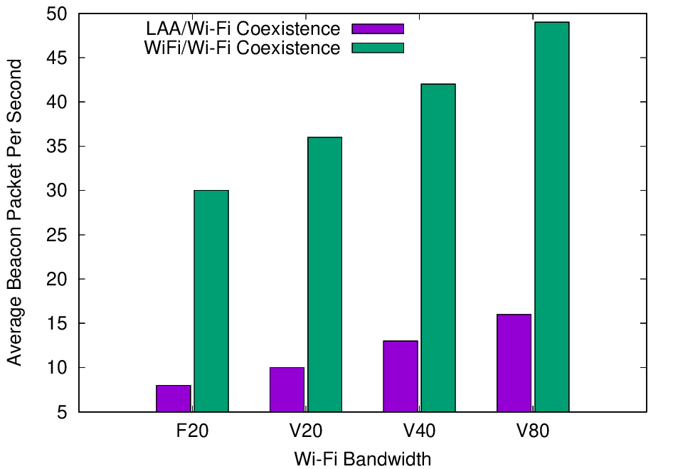
Experiments in 2020 showed LAA has a significant adverse impact on Wi-Fi Beacons
Refined from
Mar 2021
  The Uni of Chicago study investigated the effect of LAA on Wi-Fi operation in various typical configurations, including hidden nodes
  The work showed that LAA
  caused significant interference
  to Wi-Fi Beacons in the tested
  configuration
    Probably because LAA is:
      Using ED @ -72 dBm
      Rather than PD @ - 82 dBm
    Also because LAA typically uses
    long TxOPs (~8 ms)
Addition of a single LAA system to five Wi-Fi systems causes successful Beacon rate to reduce by > 75%
Pushing Wi-Fi APs into the same channel also causes successful Beacon rate to reduce, but by less than LAA

Slide 30
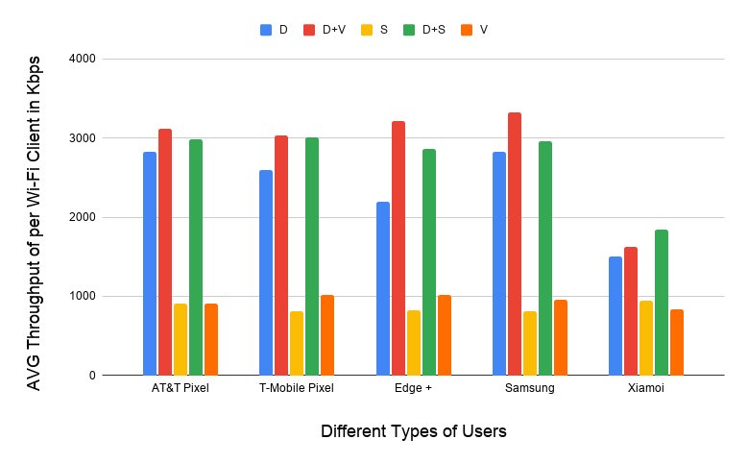
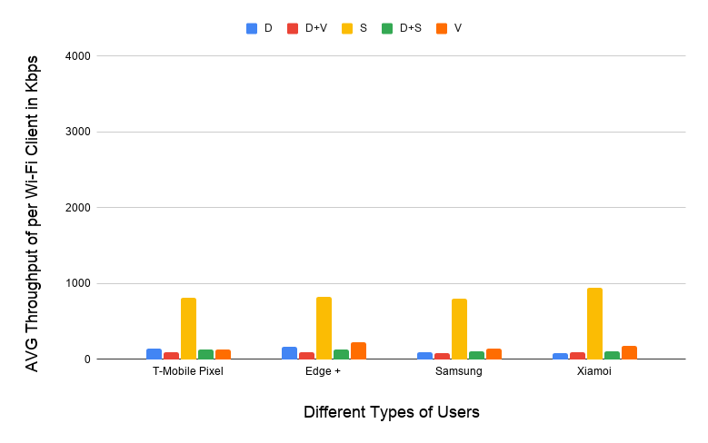
Experiments in 2020 showed LAA also has a significant adverse impact on Wi-Fi data
Refined from
Mar 2021
  The work showed that LAA caused significant interference to data traffic in the tested configuration
    Probably because LAA is using ED @ -72 dBm rather than PD @ - 82 dBm
    Also because Wi-Fi’s hidden station mitigation mechanisms based on RTS/CTS have no effect on LAA
5 Wi-Fi APs on one channel, no LAA
5 Wi-Fi APs on one channel, one LAA
11-20-1973 slide 16
All client close
to Wi-Fi APs
Addition of LAA caused all Wi-Fi traffic to collapse …
… except streaming because LAA uses licensed for streaming

Slide 31
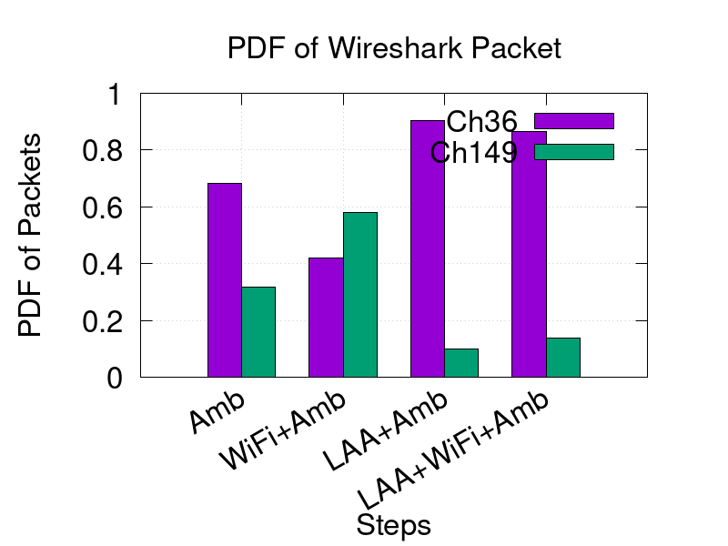
Measurements reported in Nov 2021 seem to confirm the adverse impact of LAA on Wi-Fi
Conclusions based on latest
Uni of Chicago measurements
  See 11-21-1858-01
  LAA seems to block most Wi-Fi traffic on a channel used by LAA
    The problem appears to be that LAA doesn’t back off because it is hidden from the indoor Wi-Fi APs
  It does not help that deployed LAA & Wi-Fi systems are typically quite static in their choice of channels
    Neither system are sharing by avoiding using the same channels

Slide 32
There seems to be a growing understanding that LAA/NR-U will not share well with Wi-Fi ☹
Refined from
Nov 2021
  During the BRAN discussions in October 2021 related to wideband/NB FH coexistence, the following argument was put forward:
    Wi-Fi & LAA/NR-U do not coexist very well in some scenarios .. particularly in hidden station scenarios
    If it is acceptable for LAA/NR-U to reduce Wi-Fi performance in these scenarios then it is acceptable for NB FH to reduce Wi-Fi performance too
  The basis of the argument is an apparent understanding (& acceptance!) that LAA & NR-U do not share well with Wi-Fi
    This is caused by the use of ED as the only inter-technology coexistence mechanism …
    … without the benefit of PD and MAC-level NAV protection (inc. hidden station coexistence mitigation mechanisms like RTS/CTS)

Slide 33
Further submissions are requested in relation to LAA/Wi-Fi coexistence issues
LAA/Wi-Fi coexistence questions posed on reflector in Dec 2021
  Does anyone have new measurement data related to LAA/Wi-Fi coexistence?
    The University of Notre Dame is planning to continue the Uni of Chicago work with results possibly available by about March 2022
  Are there any proposed mitigations to avoid LAA/Wi-Fi coexistence issues?
    Particularly the hidden station issues highlighted by the Uni of Chicago measurements

Slide 34
Further submissions are requested in relation to NR-U/Wi-Fi coexistence issues
NR-U/Wi-Fi coexistence questions posed on reflector in Dec 2021
  Does the likely market deployment of NR-U suggest a potential
  Wi-Fi/NR-U coexistence problem in the near future?
    Does anyone have a NR-U deployment forecast?
  Have coexistence issues between Wi-Fi/NR-U been observed in actual deployments?
    Are there any deployments?
    Is anyone undertaking or planning to undertake any measurement based studies?
  Are there any proposed mitigations to avoid NR-U/Wi-Fi coexistence issues?
    Particularly potential hidden station issues similar to those for Wi-Fi/LAA coexistence?

Slide 35
  Agenda items
  ETSI BRAN issues

Slide 36
Note that ESTI BRAN documents are available to IEEE 802.11 WG members
  Today’s material references many ETSI BRAN documents
  They are (or should be) available in the IEEE 802.11 WG members area
    See http://www.ieee802.org/11/private/ETSI_documents/BRAN

Slide 37
  Agenda items
  ETSI BRAN 5 GHz

Slide 38
The stable draft of EN 301 893 (5 GHz) includes the adaptivity compromise & associated testing
Document status after BRAN#112 (Dec 2021)
  Draft EN 301 893 v.2.1.46 (stable draft)
Discussion before & during BRAN#112
  EN 301 893 v2.1.46 was published after BRAN#112 with mostly editorial changes based on:
    BRAN(21)111029r2 – related to CAC applicability
    BRAN(21)111h003 – related to EIRP/ERP abbreviations
    BRAN(21)111h004r1 - related to use of subband terminology
    BRAN(21)111h005 - related to use of subband terminology
    BRAN(21)112022 – to reflect approved version of EC Report 330
    BRAN(21)112024r1 - related to DFS
    BRAN(21)112029 – replace compliance with conformance
  Compromise for adaptivity (and associated testing) remains, as originally agreed back in BRAN#109

Slide 39
The EN 301 893 journey has been long & interesting, achieving good sharing but with future risks for 802.11be
Refined from
Nov 2021
V1.8.1
Standard
Mar 2015
802.11a/n/ac conformant devices use access mechanisms in 802.11 standard
Other devices followed weird rules with little connection to anything
Very 802.11 focused …
… as only game in town
… but not clear there is good sharing between Wi-Fi/LAA/…
V2.1.1
Standard
May 2017
EDCA based adaptivity
  802.11a/n/ac conformant devices use EDT at -62 dBm
  Other devices use EDT @ -72 dB (scaled)
Enabled good sharing, using LBT with exponential backoff …
… but a compromise, with different thresholds for Wi-Fi & LAA/NR-U
V2.1.8
Stable draft
Sep 2018
EDCA based adaptivity
  Any devices using 802.11 defined PD may use EDT at -62 dBm
  Otherwise use EDT @ -72 dB (scaled)
Enabled any technology to use either of the two options
Assisted placement of 802.11ax on market today
V2.1.45
Stable draft
Oct 2021
EDCA based adaptivity
  802.11a/n/ac/ax conformant devices use ED @ -62 dBm (& PD @ -82 dBm)
  Other devices use ED @ -72 dB (scaled)
Required compromise to make progress
Allows traditional Wi-Fi operation …
… but forces 802.11be to use ED-only
@ -72 dBm, with potential coex issues
Close to likely end point, wrt coex
Potential coex issues

Slide 40
The EN 301 893 journey will continue, with multiple options for consideration by the Coex SC
Refined from
Nov 2021
The future?
Option 1: status quo based on v.2.1.45
Option 2: ED-only
@ -62 dBm
Option 3: ED-only
@ -72 dB
Option 4: Something else
Likely to be acceptable for next 2-3 years for reasonable coex between 802.11a/n/ac/ax & LAA/NR-U
Coex SC/TGbe will need to evaluate coex between 802.11ax & 802.11be
Very simple and flexible
Aligned with US
Coex SC/TGbe will need to evaluate:
  Effect on reuse vs interference
  Whether 802.1ax/be should use PD/ED @ -82/
  -62 dBm or ED-only @ -62 dBm when coexisting with LAA/NR-U
Attractive in that it would establish similar rules in both 5 GHz & 6 GHz
Coex SC/TGbe will need to evaluate:
  Impact on legacy
  Whether 802.11ax/be should use PD/ED @ -82/-72 dBm or ED-only @ -72 dBm when coexisting with LAA/NR-U
What?
  Focus 802.11be on 6 GHz operation
  Operate 802.11be in 802.11ax mode if coexisting with 802.11ax
  Change rules in ETSI BRAN to allow 802.11be to use the same rules as 802.11a/n/ac/ax
How significant is this problem? Do we need to solve it? How?

Slide 41
The Coex SC has started a process of evaluating the optimum path for 5 GHz (& 6 GHz) coexistence
No update from
Nov 2021
  In May 2021, two submissions started the discussions about the optimum future path for coexistence in 5 GHz …
    11-21-0705-00
      Simulation and Evaluation of the Impact of Varying ED Thresholds
      Gaurav Patwardhan (HPE), Eldad Perahia (HPE), Stuart Strickland (HPE)
      Uniform use of EDT @ -72 dBm likely to have a positive impact on sharing
      EDT @ -72 dBm in 5 GHz will sometimes disadvantage 802.11be compared to legacy using EDT @ -62 dBm, with some mitigation from RTS/CTS
      Specification work is probably required in both TGme (for 802.11ax) and TGbe
    11-21-0851-00 (Word document)
      5 GHz ED Analysis
      Menzo Wentink (Qualcomm)
      EDT @ -72 dBm in 5 GHz will sometimes disadvantage 802.11be compared to legacy
      Use of EDT @ -72 dBm limits spectral reuse
      EDT of -62 dBm may be a better long-term approach
  … suggesting more work is required!

Slide 42
The Coex SC has started a process of evaluating the optimum path for 5 GHz (& 6 GHz) coexistence
No update from
Nov 2021
  In July 2021, Stuart Strickland (HPE) presented a discussion on possible next steps in relation to 5 GHz coexistence, especially in relation to the use of 802.11be …
    11-21-1179-00
      Similar submission to 11-21-0705-00 in May 2021
      Focused on coexistence between legacy 802.11 using EDT of -62 dB & 802.11be using EDT of -72 dBm
      Concluded that ~10% of 802.11be traffic may suffer a disadvantage, compared to legacy traffic
      Noted that in managed networks a common EDT of -72 dBm may benefit both 802.11be & legacy equipment
      However, highlighted that the simulations used to draw these conclusion are relatively simple … and more work is required
  … suggesting more work is required!

Slide 43
The Coex SC will hopefully hear the results of additional work on 802.11ax/be coexistence
  It has been reported that work has been undertake to better understand the impact of additional restrictions on 802.11be
    ie, under ETSI BRAN rules that restrict 802.11be to an EDT of -72 dBm
  It was hoped that at least some of that work would be reported in Jan 2021
    The author of the submission will not be ready until at least March 2022

Slide 44
The Coex SC might consider informing TGbe/WG about 802.11ax/be coex issues in 5 GHz
IEEE 802.11 TGbe/IEEE 802.11 WG
  802.11be is currently written in a way that forces it to use
  PD/ED @ -82/-72 dBm in Europe
  This might cause 802.11be to have less access than 802.11ax
    … and NR-U/LAA
  Some questions for Coex SC/TGbe/TGme/WG are:
    Should we adapt 802.11be to the European rules in 5 GHz?
      eg ED-only @ -72 dBm
    Should we advocate changing the European rules in 5 GHz?
      eg to allow 802.11be to use same rules as 802.11ax
      eg to allow a free for all with EDT @ -62 dBm
    Should we just avoid the issue?
      eg Don’t use 802.11be in Europe in 5 GHz
  This choice could be presented to TGbe/TGme/WG in Mar 2022
    See draft

Slide 45
The Coex SC might consider informing the Wi-Fi Alliance about 802.11ax/be coex issues in 5 GHz
Wi-Fi Alliance
  Assume that 802.11ax/be coex issues are real under the European rules in 5 GHz
  The question to ask is whether it matters in practice in the market?
    Maybe Wi-Fi 7 can avoid using 5 GHz, at least in the short term …
    … with a possibility that in the long term
      The rules in Europe applying to 802.11ax are applied to 802.11be too
      The rules in Europe are loosened so that EDT @ -62 dBm applies to all
      Wi-Fi 7 operates in 2.4 GHz and 6 GHz only
      802.11be uses ED-only @ -72 dBm
      …
  A market orientated question like this could be directed to the Wi-Fi Alliance for their consideration
    See draft

Slide 46
  Agenda items
  ETSI BRAN 6 GHz issues

Slide 47
A stable draft of EN 303 687 includes the 6 GHz compromise for ED-only @ -72 dBm, & some NB FH
Document status after BRAN#112
  Draft EN 303 687 v0.0.15 (stable draft)
Discussion before and during BRAN#112
  All agreements are included in EN 303 687 v0.0.15, including:
    ED-only at -72 dBm (reflecting previously discussed compromise)
    Various editorial changes agreed during BRAN#112
    Some aspects of NB FH in 4.3.3.2 (specification) & clause 5 (testing)

Slide 48
  Coex SC
  ETSI BRAN 6 GHz issues
  NB FH update

Slide 49
Many believe NB FH systems represent a potential threat to coexistence in the 6 GHz band in Europe
Refined from
Jul 2021
  In Nov 2020, the Coex SC were made aware of two PSD limits being discussed for VLP devices in Europe:
    Default: 1 dBm/MHz
    Narrowband (NB) devices: 10 dBm/MHz with FH across at least 15 hops, with NB defined as a BW of less than 20 MHz
  Many in the Wi-Fi/NR-U/LAA industries were concerned that these NB FH systems could have an adverse affect on Wi-Fi/NR-U/LAA systems
    ie, they will randomly “stomp” on Wi-Fi (and LAA/NR-U) systems without LBT leading to poor coexistence ☹
    The concern was exacerbated by the proponents of NB FH pushing the proposal through the regulator process in Europe without the knowledge or involvement of Wideband/Broadband stakeholders

Slide 50
An ECC decision that allows NB FH requires an adequate spectrum sharing mechanism
Refined from
Nov 2021
Table 2: Very Low Power (VLP) WAS/RLAN devices
(extract from ECC Decision (20)01)
Permissible operation | Indoors and outdoors
Category of device | The VLP device is a portable device
Frequency band | 5945-6425 MHz
Channel access and occupation rules | An adequate spectrum sharing mechanism shall be implemented.
Maximum mean e.i.r.p. for in-band emissions (note 1) | 14 dBm
Maximum mean e.i.r.p. density for in-band emissions (note 1) | 1 dBm/MHz
Narrowband usage maximum mean e.i.r.p. density for in-band emissions (note 1) (note 2) | 10 dBm/MHz
Note 1: The "mean e.i.r.p." refers to the e.i.r.p. during the transmission burst, which corresponds to the highest power, if power control is implemented. Note 2: Narrowband (NB) devices are devices that operate in channels bandwidths below 20 MHz. Narrowband devices also require a frequency hopping mechanism based on at least 15 hop channels to operate at a PSD value above 1 dBm/MHz.
Requires an ETSI BRAN defined spectrum sharing mechanism …
… without defining adequate spectrum sharing
Allows operation at 10 dBm/MHz but with FH

Slide 51
An EC decision is actually more important than the ECC decision in driving EN 303 687
  In Nov 2021, the Chair commented that ECC/CEPT DEC(20)01 was driving work in ETSI BRAN related to 6 GHz (EN 303 687)
  A participant noted it is better to refer to EC 2021/1067 as driving the EN 303 687 work in ETSI BRAN
    There is a cooperation agreement between CEPT & ETSI …
    … but CEPT cannot task or instruct ETSI to develop a HS
    Only the European Commission (EC) can task ETSI to develop HSs …
    … and it has tasked ETSI to develop a HS for the 6 GHz band based on EC 2021/1067 (and not ECC/CEPT DEC(20)01)
    EC 2021/1067 and ECC/CEPT DEC(20)01 are very similar but have subtle differences

Slide 52
EC 2021/1067 and ECC/CEPT DEC(20)01 are very similar but have subtle differences
ECC (20)01
  ECC 20(10) requires:
    an adequate spectrum sharing mechanism shall be implemented for LPI devices and VLP devices (including NB FH devices)
EC 2021/1067
  ECC 2021/1067 requires:
    Techniques to access spectrum and mitigate interference that provide an appropriate level of performance to comply with the essential requirements of Directive 2014/53/EU shall be used. Where relevant techniques are described in HSs or parts thereof the references of which have been published in the OJEU in accordance with Directive 2014/53/EU, performance at least equivalent to the performance level associated with those techniques shall be ensured.
Different words but similar

Slide 53
In May 2021, the Coex SC heard about the NB FH in 6 GHz issue … with no conclusions
Refined from
Jul 2021
  The IEEE 802.11 WG has an interest in how NB FH is specified by
  EN 303 687 for 6 GHz because it may have a significant impact on Wi-Fi operation in at least some circumstances
  Several WG members interested in the coexistence issues between
  Wi-Fi & NB FH in 6 GHz provided contributions in May 2021:
    11-21-0814-00 – ETSI 6GHz Narrow Band Status - Stuart Thomas (Apple)
    11-21-0832-00 – Narrowband in 6 GHz - Menzo Wentink (Qualcomm)
  There were no conclusions or decisions from the Coex SC at the time …

Slide 54
In June 2021, at BRAN#110 there was lots of discussion about NB FH … with no consensus
From
Jul 2021
Submissions to BRAN#110 (Jun 2021)
  BRAN(21)110019 (Apple) - EN 303 687 NB Inputs
  BRAN(21)110045 (Qualcomm) - NB coexistence in 6 GHz – eDAA
  BRAN(21)110046 & BRAN(21)110047 (Facebook & HPE) - Proposal to approve EN 303 687 stable draft
Summary of presentations at BRAN#110
  Apple proposed the use of Adaptive Frequency Hopping using non-LBT based Enhanced-DAA (eDAA)
  Qualcomm asserted that eDAA causes latency issues with Wi-Fi and is inadequate for NB vs NB sharing too
    With very high latency spikes & unstable throughput
  Facebook suggested that the NB FH issue be delayed until a future WI

Slide 55
In July 2021, the Coex SC heard about issues with eDAA … but came to no conclusions
Refined from
Jul 2021
  In July 2021, Menzo Wentink (Qualcomm) provided a summary of his latest eDAA simulations & findings
    See 11-21-1191-00 - NB Coexistence in 6 GHz – eDAA
    eDAA has been proposed by Apple in ETSI BRAN as a mechanism to enable adequate spectrum sharing
    Menzo’s conclusions in relation to eDAA were:
      NB with eDAA may cause latency issues at Wi-Fi
      eDAA also appears inadequate for NB/NB sharing
      LBT shows no issues for either Wi-Fi/NB or NB/NB coexistence
      The eDAA coexistence issues pointed out in this analysis should make it unlikely that a notified body can certify 'no-LBT' NB equipment
  There were no conclusions or decisions from the Coex SC at the time …

Slide 56
In Sept 2021, BRAN#110d underlined fundamental disagreements about eDAA spectrum sharing
From
Sep 2021
Submissions
  BRAN(21)110a003 (Apple) - Spectrum sharing comparisons
  BRAN(21)110d003r1 (Qualcomm) - Response to BRAN(21)110a003
  BRAN(21)110d009 (Apple) - Inaccuracies in BRAN(21)110d003r1
  BRAN(21)110d006 (Ericsson) - Co-existence considerations for 6GHz channel access
Summary
  Lots of claims & counter claims, but still little agreement
    One side claims eDAA provides adequate spectrum sharing, is the only way to enable <10 ms latency, & causes no more problem to Wi-Fi than Wi-Fi or NR-U
    Other side claims eDAA cannot share with Wi-Fi, particularly in terms of latency, and eDAA can’t even share with eDAA
    Both sides questioned the other side’s sims & analysis

Slide 57
In Sept 2021, BRAN#110e focused on both process & technical NB FH aspects … again without consensus
From
Sep 2021
Submissions
  BRAN(21)110d004 (Rapporteur/Broadcom) - Proposal for way forward for NB in EN 303 687
  BRAN(21)110d007 (Ericsson) - Next Step for Narrowband in 6 GHz
  BRAN(21)110d005 (Apple) - Equal Treatment of Narrow Band
  BRAN(21)110e004 (Ericsson) - LBT and MU for Narrowband Frequency Hopping
  BRAN(21)110d008 (Apple) - Way forward for Narrow-band in 6GHz
  BRAN(21)110e003 (Ericsson) - Relevance of EN 300 328

Slide 58
BRAN#110e did not come to any agreement about NB FH on various process related issues
From
Sep 2021
Summary of process issues
  BRAN#110e discussed various procedural options, including:
    Include NB FH in EN 303 687 now, even if that means delay for 6 GHz
    Include NB FH in EN 303 687 as proposed, and refine in next version
    Include NB FH in next version of EN 303 687, which will mean delay for NB FH
    Develop NB FH in a parallel WI
  There was no agreement after intense discussion about:
    What is (not) allowed by rules?
      eg parallel WI’s, noting 60 GHz precedent
      eg could EN 303 687 even be a stable draft before regulations were published?
    What was (not) intended by regulators?
      eg Should Wi-Fi/NR-U have priority over NB FH, or equal treatment?
    Can Notified Bodies be informed about disagreements related to adequate sharing for NB FH?
      This is important if NB FH is not included in a Harmonised Standard soon
    …

Slide 59
BRAN#110e did not come to any agreement on issues related to adoption of EN 300 328 techniques
From
Sep 2021
Summary of EN 300 328 related issues
  In BRAN#110e, some (re)asserted that sharing techniques from
  EN 300 328 (2.4 GHz) provide:
    Adequate sharing for 6 GHz as is …
    … but refinements are possible to make sharing even better in 6 GHz
  Others disagreed (again), noting 2.4 GHz is a different band to 6 GHz, and that EN 300 328 does not even provide good sharing in 2.4 GHz
    Different goals
    Different size of band
    Different channel plan
  The bottom line in relation to NB FH sharing is:
    Some want it to be based on (a refinement of) EN 300 328 … ASAP
    Others want it to be based on LBT … after a full technical discussion

Slide 60
In Sept 2021, the Coex SC heard summaries of issues related to NB FH sharing with Wi-Fi
From
Nov 2021
  In July 2021, the Coex SC both sides of the NB FH discussion to summarise the technical issues from their perspective
    11-21-1550-00 - Narrowband coexistence issues with enhanced DAA in 6 GHz
      Menzo Wentink (Qualcomm), Stuart Strickland (HPE), Michael Tseytlin (Facebook), Xinrong Wang (Intel), Scott Blue (Microsoft)
      Summary
        Asserted that eDAA does not support coexistence with Wi-Fi, or even between eDAA systems
        Advocated the use of LBT with NB FH, rather than eDAA as defined
    11-21-1552-00 - ETSI 6GHz Narrow Band Status
      Stuart Thomas (Apple)
      Summary
        Advocated a solution that enables both NB & WB equally, based on assertion that WB does not have any priority over NB
        Also noted this may require a compromise from the WB community
        Wanted to avoid a “free for all” via Notified Bodies in the case that NB is not included in EN 303 687

Slide 61
At BRAN#111, there were more submissions on integration of NB into EN 303 687…
From
Nov 2021
Submissions
  BRAN(21)111019 (Ericsson) On equal status of NB FH
  BRAN(21)111024 (Ericsson) Maximum BW for NB frequency hopping
  BRAN(21)111025 (Ericsson) NB FH LBT Specification text
  BRAN(21)111027 (Qualcomm/HPE/Microsoft/Intel) NB normative text proposal

Slide 62
… and there was continuing contention about integration of NB into EN 303 687
From
Nov 2021
Summary
  Multiple presentations discussing various aspects of NB FH in 6 GHz, inc
    Relative priority of NB & WB
    The efficacy of LBT as used by Wi-Fi; as part of an argument that it is OK for NB to interfere with Wi-Fi because Wi-Fi interferes with Wi-Fi in hidden node environments
    How to incorporate LBT into NB operation
  Overall, there was continuing disagreement by various stakeholders on almost all aspects, including whether:
    The ECC decision needs to be followed to the letter
    It is appropriate to apply 2.4 GHz rules to 6 GHz band
    NB has equal status with WB
    Adequate spectrum sharing is required
    NB can have higher priority than WB, just like voice has priority over best effort
    …

Slide 63
The regulators finally drove a breakthrough on the NB FH issue at BRAN#111 …
Refined
from
Nov 2021
  The regulators at BRAN often tire of listening to the bickering between the industry participants … and the NB issue is no exception ☺
  A couple of regulators supported the idea that the primary purpose of the 6 GHz band was WB operation to support the Gigabit Society in Europe
    It was noted that studies supporting 6 GHz allocation were all based on WB
    Note: The Gigabit Society (COM(2016) 587 final) is referenced in EC 2021/1067, with a focus on high bandwidth applications
  All the regulators in attendance agreed it was vital to complete EN 303 687 (6 GHz) HS with WB support as soon as possible
    Even if that meant delaying NB coverage in EN 303 687
  This led to an agreement with BRAN on how to progress …

Slide 64
… with the agreed outcome based on use of current LBE & FBE adaptivity mechanisms by default
From
Nov 2021
Summary of “way forward” in BRAN(21)111033r2
  Include basic NB VLP requirements from ECC (20)01 into current EN 303 687 draft
    mean e.i.r.p density
    BW restriction ≤20MHz
    frequency hopping mechanism with minimum hop channels of 15
  Use existing adaptivity requirements (from LBE or FBE) in the current EN 303 687 draft by default in next version of EN 303 67 …
    ie LBT as currently defined in EN 303 687
  … unless an alternative NB channel access mechanism can be agreed with a particular timeframe
    The timeframe was not part of the agreement

Slide 65
The risk of NB FB coexisting poorly with Wi-Fi has diminished in at least the short term
From
Nov 2021
  The likely effect of this agreement is:
    Appropriate NB sharing mechanisms are included in the first version of EN 303 687 => good coexistence in both short & long term; OR
    Appropriate NB specific sharing mechanisms are delayed until a later version of EN 303 687 => good coexistence in short term
  A risk to this outcome is that NB vendors manage to persuade Notified Bodies that their NB FH systems have adequate spectrum sharing even though NB adaptivity is not specifically addressed in the HS…
    … but as noted by a regulator during BRAN#111, Notified Bodies don’t know what to do without a stable draft HS – not a clue!
    … and so it is unlikely this will occur in practice

Slide 66
The NB FH discussions continued in BRAN#111k & BRAN#111l without resolution …
Submissions to BRAN#111k (13 Oct) & BRAN#111l (21 Oct)
  BRAN(21)111k003r2 (Qualcomm, HPE, Facebook, Cisco, Microsoft, Intel, Nokia) - NB normative text proposal
  BRAN(21)111l003 (Ericsson) - NB FH proposal
  BRAN(21)111l004 (Broadcom) - Proposed draft update for EN 303 687
Summary
  The same old arguments continue … although in a context whereby NB FH access could be delayed until a future version of EN 303 687
    Should NB FH access be based on EN 300 328 (2.4 Ghz)?
    Can NB FH devices do 20 MHz based CCA?
    What is technology neutrality?
    Is WB more important than NB?
    …

Slide 67
…. and the discussions continued in BRAN#111e without resolution …
Submissions to BRAN#111e (23 Nov)
  BRAN(21)111e004 (Ericsson) - VLP NB Bandwidth text proposal
  BRAN(21)111e005 (Ericsson) - VLP NB PSD and FH text proposal
  BRAN(21)111k003r6 (Qualcomm et al) - NB normative text proposal
Summary
  The same old arguments continue …
    Main issue was whether the duty cycle approach in BRAN(21)111k003r6, instead of defining use of FH directly, is compatible EC 2021/1067
  … with no resolution

Slide 68
…. and the discussions continued in BRAN#111f without resolution …
Submissions to BRAN#111f (30 Nov)
  BRAN(21)111k003r6 (Qualcomm et al) - NB normative text proposal
  BRAN(21)111f003 (Huawei) - Reflecting the NB normative text in EN 303 687
Summary
  The same old arguments continue …
    Main issue continued to be whether the duty cycle approach in BRAN(21)111k003r6, instead of defining use of FH directly, is compatible EC 2021/1067
  … with no resolution

Slide 69
…. and the discussions continued in BRAN#111g without resolution
Submissions to BRAN#111g (3 Dec)
  BRAN(21)111k003r6 (Qualcomm et al) - NB normative text proposal
  BRAN(21)111g003r1 (Ericsson) - VLP NB text for EN 303 687
Summary
  The same old arguments continue …
    With two proposals for progress on table from
      BRAN(21)111k003r6: Qualcomm, HPE, Facebook, Cisco, Intel, Nokia
      BRAN(21)111g003r1: Ericsson
  … with no resolution

Slide 70
NB FH continued to be a hot topic at BRAN #112
Submissions to BRAN#112 (13-17 Dec)
  BRAN(21)111g003r2 (Ericsson) - VLP NB text for EN 303 687
  BRAN(21)111k003r6 (Qualcomm et al) - NB normative text proposal
  BRAN(21)112011 (Apple) - Narrow Band Channel Access in 6GHz
  BRAN(21)112019 (Germany, France, UK) - Outstanding points in EN 303 687
  BRAN(21)112033 (Ericsson) - VLP NB test suite for EN 303 687
  BRAN(21)112016r3 (Rapporteur) - Clause 4.3.3.2 discussion output of Dec 3 adhoc

Slide 71
DE, UK , FR admins set a direction for NB FH at BRAN #112 … that was subsequently followed
Summary
  The Germany, France, UK administrations set the direction for the NB FH discussion at BRAN#1112 in BRAN(21)112019 by noting:
    NB FH was only introduced late in the process … but it is part of regulation
    BRAN should work hard on a NB FH resolution while other issues are still open
    If a resolution is not possible then EN 303 687 should go ahead without a special NB FH access method …
    … instead using current LBE/FBE access & channelisation
    In that case, a special/new NB FH specific access method can be included in next version after further discussions
  By the end of BRAN#112, some limited NB FH requirements & testing material was included in the draft of EN 303 687

Slide 72
  During BRAN#112, limited NB FH requirements & testing material was included in EN 303 687
Enable VLP NB at LPI power levels
Table 3: Mean EIRP density limit
Frequency range (MHz) | PSD limit (dBm/MHz)
 | LPI usage | VLP usage | VLP NB usage
5 945 to 6 425 | 10 | 1 | 10 (see 4.3.3.2a)
From
BRAN(21)112016r3
4.3.3.2a VLP NB usage with a PSD above 1 dBm/MHz
The duty cycle of narrowband (NB) transmissions by a VLP device with a PSD above 1 dBm/MHz shall not exceed 1/15 on any transmission frequency.
NB devices require a frequency hopping mechanism based on at least 15 hop channels and meet the above duty cycle to operate at a PSD value above 1 dBm/MHz.
Note: Frequency hopping in the context of this standard implies the use of the channel access mechanisms and channelization as defined in the present document.
Must use LBE/FBE with 20 MHz channelisation

Slide 73
Discussion has started on a NB FH solution, either for the next version of EN 303 687 or the one beyond
  The default in the next version of EN 303 687 that NB FH uses the LBE/FBE channel access mechanisms and channelizations
  However, Apple has started discussions on an alternative for the next version of EN 303 687 or the one beyond
    See BRAN(21)112011 (Apple) - Narrow Band Channel Access in 6 GHz
  This proposal defines a variation on the previous eDAA proposal (itself derived from EN 300 328 – 2.4 GHz) with a wideband detection mechanism
  There was limited discussion of the proposal in BRAN#112, with no conclusions

Slide 74
  Coex SC
  ETSI BRAN 6 GHz issues
  Specification challenges

Slide 75
Coex SC/TGbe needs to decide how to specify 802.11ax/be in context of 6 GHz rules in Europe
  In EN 303 687, the EDT is -72 dBm for both 802.11ax & 802.11be
  This is different to traditional 802.11 operations, which generally uses an PD/ED @ -82/-62 dBm
  The Coex SC/TGbe need to decide how to handle this difference for 802.11ax/be in 6 GHz in Europe
    Use PD/ED @ -82/-72 dBm (which may disadvantage Wi-Fi compared to NR-U)
    Use ED-only @ -72 dBm (like NR-U)
    Something else
  The decision could be:
    Reflected in the standard
    Handled outside the standard
  This issue will be highlighted to TGbe/WG in March 2022
    See draft

Slide 76
Coex SC/TGbe needs to ensure operation of all 802.11be features are enabled in Europe
  Both EN 301 893 (5 GHz) and EN 303 687 (6 GHz) are based on EDCA style access, which was suitable for 802.11ax/Wi-Fi 6/6E
    Actually, given the EN 301 893 draft, anything in 802.11ax is allowed in 5 GHz
  802.11be is being developed now, with new features that might not all be aligned with the existing HS’s adaptivity assumptions
  This suggests two tasks/options for the Coex SC/TGbe
    Identify any likely 802.11be features that may not be allowed by EN 301 893
    (5 GHz) and EN 303 687 (6 GHz)
    Plan to make a case to ETSI BRAN to refine EN 301 893 (5 GHz) and EN 303 687 (6 GHz) to allow these features
  This issue will be highlighted to TGbe/WG in March 2022
    See draft

Slide 77
  Coex SC
  ETSI BRAN C2C

Slide 78
There are a variety of views on the whether C2C operations should be managed or even allowed
  Some vendors are keen on C2C operations in 6 GHz using
    VLP rules (indoor and outdoor)
    LPI rules (indoor only), by allowing C2C when a client can hear an LPI AP in any channel
  Currently in:
    US: neither VLP/LPI based C2C operation is allowed, and only VLP C2C operation is being considered, although LPI C2C operation has been proposed
    Europe: VLP/LPI C2C operation is allowed, and LPI C2C operation is being discussed in ETSI BRAN
  There are differences of opinion on unmanaged C2C operations
    Some enterprise vendors would like to manage in which channels C2C operations occur to avoid interference with managed networeks
    Some incumbents are concerned by interference from any LPI C2C operations
    Some client vendors don’t want to be subject to infrastructure management of C2C operation

Slide 79
There is ongoing disagreement on how to define C2C operation at LPI power levels in Europe
  LPI C2C operations have been agreed (BRAN(21)111023) so that a client may operate in any 6 GHz channel at LPI power levels if:
    … the client can hear an LPI AP Beacon in any 6 GHz channel
    … above a certain power level (currently in Draft EN 303 687 v0.0.15 with square brackets at -99 dBm/MHz)
    …. at least every 4 sec
  The concept is that if a client can hear an LPI AP then it is probably indoors and can operate using LPI power levels
  Ericsson previously made a counter proposal to set the threshold for C2C clients relatively high (BRAN(21)111016) …
    … thus ensuring the C2C client was very close to the LPI AP
    … and even applying a similar rule for normal clients
  Broadcom et al then proposed a solution (BRAN(21)112020) whereby the power threshold was set to -95 dBm/MHz

Slide 80
An intervention by the regulators means the next steps for C2C in 6 GHz in Europe are unclear
  The Germany, France, UK administrations also expressed a strong view in BRAN(21)112019 on the question of C2C
    They supported the concept of measures that would improve the interference-free use of the 6 GHz band and the protection of primary radio services
    However, they expressed a concern that the proposed C2C mechanism could cause interference without the knowledge of the client
    They would like BRAN to assess alternative mechanisms, possibly including some sort of power control
  As a result of this intervention, not much progress was made on how to enable C2C in 6 GHz in Europe
  The next steps are unclear …

Slide 81
  Coex SC
  Future ETSI BRAN meetings

Slide 82
ETSI BRAN has tentatively agreed its 2022 schedule based on F2F & virtual meetings
Meeting schedule for 2022
  BRAN #113
    4 Feb 2022 – 14 Feb 2022
    Virtual only
  BRAN #114
    3 Jun 2022 - 10 Jun 2022
    Virtual only?
  BRAN #115
    29 Aug 2022 until 2 Sep 2022; OR
    5 Sep 2022 until 9 Sep 2022
  BRAN #116
    17 Oct 2022 until 21 Oct 2022
  BRAN #117
    5 Dec 2022 until 9 Dec 2022
A variety of additional ad hoc’s are also likely to be scheduled

Slide 83
ETSI BRAN scheduled various virtual meetings
  BRAN #112a
    10 Jan 2022 @ 9am – 4pm
    Dedicated to EN 301 893 and EN 303 687
  BRAN #112f
    24 Jan 2022 @ 9:30am – 12:45pm
    Dedicated to EN 303 687, VLP NB, C2C, UAR, EC assessment
  BRAN #112b
    27 Jan 2022 @ 9:00am – 12:15pm
    EN 301 893

Slide 84
  Agenda items
  Coex Tech Talk

Slide 85
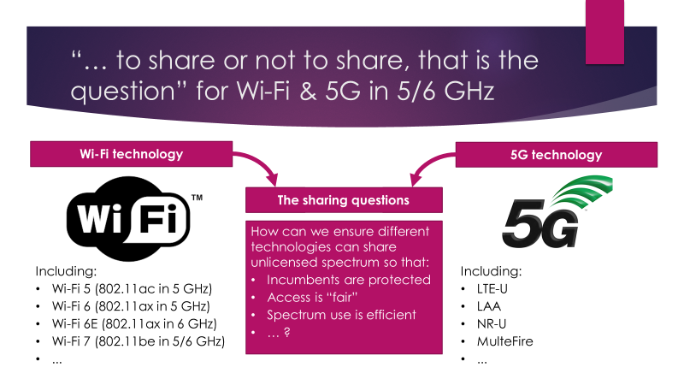
Assistance is requested for a IEEE 802 Tech Talk on coexistence in Jun 2022
IEEE 802 Tech Talks
  IEEE 802 is running a
  series of tech talks in 2022
  The last of the series is
  tentatively scheduled
  to be on coexistence
  The Coex SC Chair will
  facilitate efforts …
  …but assistance is requested from anyone who is interested in:
    Preparing
    Presenting

Slide 86
  Agenda items
  6 GHz spectrum availability

Slide 87
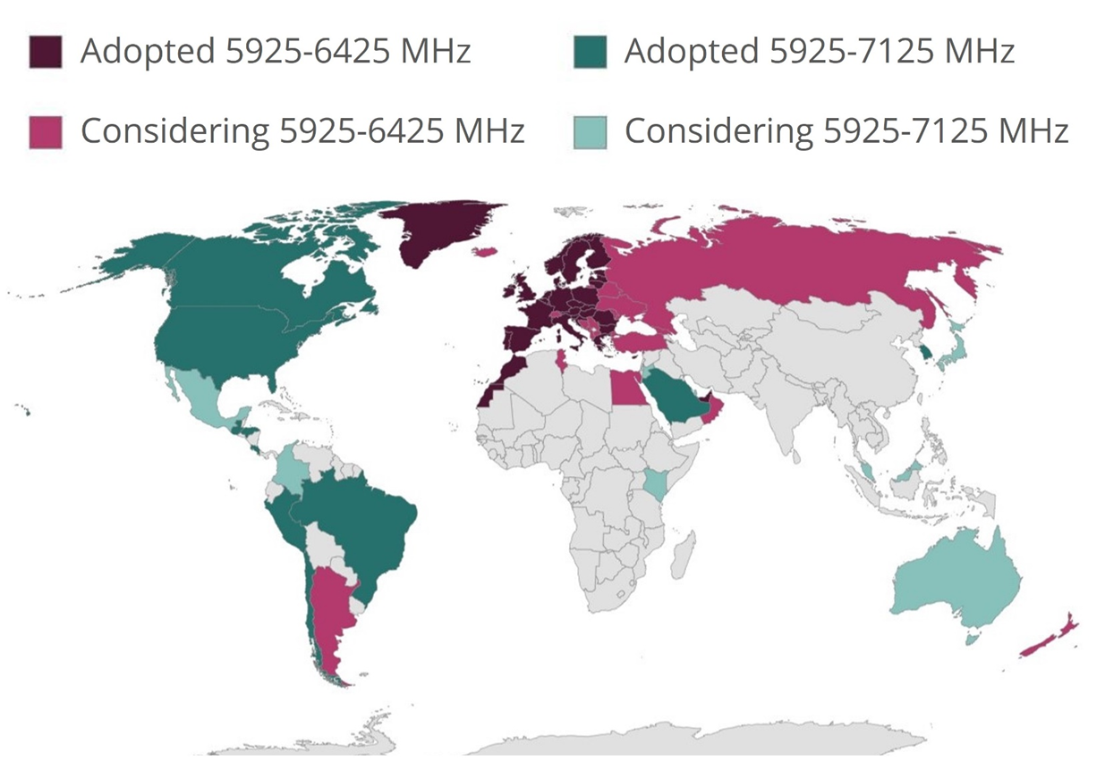
Coexistence will become increasingly important as
6 GHz spectrum opens globally for unlicenced operation

Slide 88
The battle for 6 GHz continues globally …
Refined from Sept 2021
Lower 6 GHz available in Europe
  The EC has formally released the lower 6 GHz band for unlicensed used by a formal announcement in the Official Journal of the European Union
    It is now binding for every EU member state to update their national frequency allocation plans before 1 Dec 2021
    Applies to VLP & LPI operation, without the standard power operation available in the US
GSMA advocating licensed 6 GHz
  GSMA are aggressively advocating for at least the upper 6 GHz band to be made available for licenced operation only
    GSMA with Ericsson, Huawei, Nokia & ZTE have published a joint statement advocating for licensed operation in some/all of 6 GHz
  GSMA are also urging governments to do nothing with
  6 GHz until at WRC-23
    See Vision 2030, Insights for Mid-band Spectrum Needs – GSMA - July 2021

Slide 89
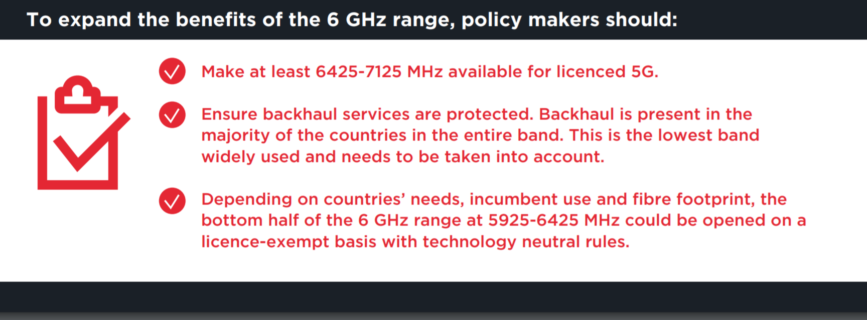
… with GSMA leading a campaign to reserve as much as 6 GHz as possible for licensed use
Refined from Sept 2021
  From https://www.gsma.com/spectrum/wp-content/uploads/2021/05/6-GHz-Capacity-to-Power-Innovation.pdf
GSMA are after as much (“at least”) of the 6GHz band as possible for licensed use

Slide 90
… but Europe is now starting to study RLAN access to the upper 6 GHz band
  The European Electronic Communications Committee (ECC) has decided to initiate studies on the Wireless Access Systems including Radio Local Area Networks (WAS/RLAN) operations in the 6425-7125 MHz band
    See decision

Slide 91
A recent seminar advocated for licensing of upper
6 GHz band in Europe
  An organisation called https://6ghzopportunity.com/ is also advocating for use of 6 GHz for licenced use:
    Hosted by Ericsson, GSMA, Huawei, Nokia, ZTE
  At recent seminar (2 Dec 2021), focused on Europe, there was a strong focus on justifying the allocation of at least the upper 6 GHz in Europe for licensed use
    See slides and recording (last hour most interesting)
  Some interesting aspects of the discussions
    Most speakers equated unlicensed with Wi-Fi ☺
    There was little mention of LAA/NR-U ☺
    The case for licensed allocation in upper 6 GHz was reliability, security, fairness/balance & to stop OTT operators from bypassing operators
    Some of the regulators in attendance were not convinced any 6 GHz spectrum should be allocated to licensed operation ☺

Slide 92
In the US, AT&T been granted an experimental license to test Wi-Fi coex with incumbents
Facts
  On 13 Dec 2021, FCC OET granted an application (exhibit) from AT&T for an experimental license to test Wi‑Fi 6E and LTE-LAA/5G NR-U in U-NII-5 & U-NII-7
  AT&T plans to test both commercially available LPI devices and “pre-AFC certified experimental” standard-power equipment
  AT&T says it will explore “the potential for interference and co-existence with incumbent licensed fixed services”
Commentary
  It seems there is still a concern among some stakeholders in relation to the ability of Wi-Fi to coexist with incumbents

Slide 93
  Agenda items
  3GPP update

Slide 94
A 3GPP participant may provide an update 3GPP RAN activities relevant to coexistence
  3GPP RAN#94e was held in mid Dec 2021
  A few issues of relevance to coexistence arose
    There was a proposal to define a WI for a side link in unlicensed spectrum
      It was unclear whether the NR-U medium access rules would be followed …
      …but later this was specified as a defauly
    There was a proposal to define licensed NR in upper 6 GHz band
      This is not something the Wi-Fi community would like to see generally ...
      … but the specific concern of a few participants is that more discussion is required
  A 3GPP participant has agreed provide an update 3GPP RAN activities relevant to coexistence
    See tbd

Slide 95
  Agenda items
  60 GHz coexistence

Slide 96
The Coex SC has previously discussed coexistence in 60 GHz …
  At the Coex SC meeting in Mar 2021 a submission was presented that provided the status of 60 GHz work in ETSI BRAN
    See 11-21-0430-00 (Assaf Kasher (Qualcomm))
  In May 2021, the Coex SC heard about Coexistence between radars and communication systems in the 60 GHz band
    See 11-21-0796-00 (Alecsander Eitan (Qualcomm) et al)
  In Jul 2021,the Coex SC heard about Coexistence between radars and communication systems in the 60GHz band – U.S. Update
    See 11-21-1089-00 (Alecsander Eitan (Qualcomm) et al)
  In Sep 2021, the Coex SC heard NPRM work was occurring in 802.18

Slide 97
… but there is not much to report to the Coex SC about 60 GHz coexistence today
  The e-mail was sent to Alecsander Eitan (Qualcomm) asking for an update on 60 GHz coexistence activities
  From Alecsander Eitan (Qualcomm)
    Unfortunately, there is nothing new that can be reported
    Many submissions have been sent to the FCC, and several comments on the other submissions have been also sent
    There are some discussions between companies on compromise ideas
  Asked for summary for Jan 2022 so we can either
    Close 60 GHz coex issue
    Do something useful

Slide 98
  Coex SC
  Plans for next meeting

Slide 99
The Coex SC will continue its normal business in March 2022
Possible agenda items
  Discuss coexistence measurement studies
  Review ETSI BRAN coex activities from Jan 2022
    EN 301 893 (5 GHz)
      Impact on 802.11be coex with 802.11ax in 5 GHz
    EN 303 687 (6 GHz)
      NB FH update
      Enabling 802.11be features in 6 GHz (& 5 GHz)
  60 GHz update
  …
Submissions are requested …

Slide 100
The IEEE 802.11 Coexistence SC virtual meeting in January 2022 is adjourned!

