Slide 1
Simulation Evaluation of Restricted TWT
Date: 2021-12-10
Name | Affiliations | Address | Phone | email
Muhammad Kumail Haider | Meta | 1 Hacker way Menlo Park, CA |  | haiderkumail@fb.com
Chunyu Hu
Chitto Ghosh
Binita Gupta
Morteza Mehrnoush
Payam Torab

Slide 2
Abstract
Restricted TWT (r-TWT) facilitates delivery of Latency Sensitive Traffic (LST) by allocating SPs with start boundary protection and prioritized delivery of QoS Data frames of TIDs setup with the r-TWT schedule.
This contribution provides simulation analysis of performance of restricted TWT under various offered load and BSS configurations

Slide 3
CID 6497
CID | Commenter | Clause # | Page.Line | Comment | Proposed Change | Resolution
6497 | Osama Aboulmagd | 35.6 | 297.57 | r-TWT is not specified enough to allow for submission of comments. Having said that the r-TWT was developed with real-time traffic in mind. However there is no single proof r-TWT provides and delay improvements. AT the same time 802.11 baseline includes HCCA mechanism which is suitable for such traffic. There is a large volume of HCCA simulation results submitted in the years 2003 and 2004 during the development of 802.11n specification. Rather than jumping to a new unproven mechanism the TG is encouraged to revisit existing mechanisms as it was done in the past. | Complete the specification of r-TWT and compare to HCCA and make a choice based on the delay enhanced performance as required. | Revised. Conducted simulation study which shows the performance improvement achieved by r-TWT. TGbe editor: No change to draft text is needed.

Slide 4
General Simulation Setup
BSS and STA configuration
Single BSS: 1AP and three types of non-AP STAs:
DUT: STA with LST traffic: 32 TUs interval, DL 80Mbps, UL 20Mbps
RS-STA: r-TWT supporting STA with non-LST traffic
NRS-STA: Non r-TWT supporting STA with non-LST traffic
MAC/PHY Parameters
BW 80MHz, NSS 2, MCS 9 for DUT, MCS 4 for RS/NRS STAs
BA window 64, max A-MSDU size: 4K bytes
R-TWT Parameters
Single r-TWT schedule with following params:
Wake Interval: 32 TUs
Duration (MinWakeDuration) = 8 TUs
Unannounced, trigger enabled
DUT operates in PS mode
Delay: measure layer-2 end-to-end delay
Queuing + medium access + TX till success

Slide 5
Set 1: Simulation Scenario/Configuration
Compare latency performance of three schemes:
DUT uses default VI, N NRS-STAs : no r-TWT
DUT uses r-TWT, N NRS-STAs. : r-TWT with all “legacy” STAs
DUT uses r-TWT, N RS-STAs : r-TWT enabled/supporting network
Traffic of NRS/RS STAs
N/2 STAs have full buffer VI UL traffic
N/2 STAs have full buffer BE UL traffic
Increase N from 0-10 in steps of 2 (1 VI + 1 BE)
No SP extension for r-TWT, BUs are only delivered within the SP

Slide 6
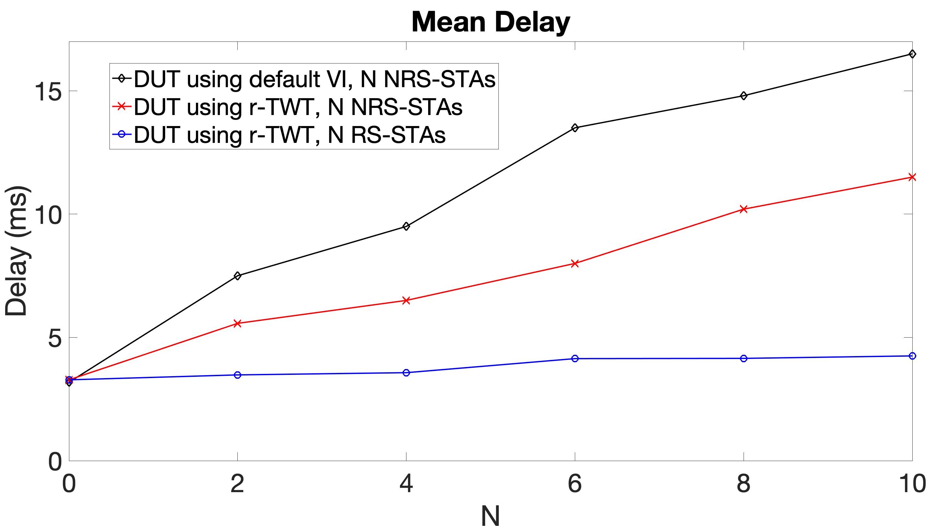
Set 1: Simulation Results (1) – Avg. Delay
Stable and predictable delay obtained by r-TWT
Observations:
When all STAs support r-TWT, DUT achieves nearly constant delay despite the presence of increasing number of other STAs
DUT’s delay is deteriorated by the presence of legacy STAs, but is still better than not using r-TWT

Slide 7
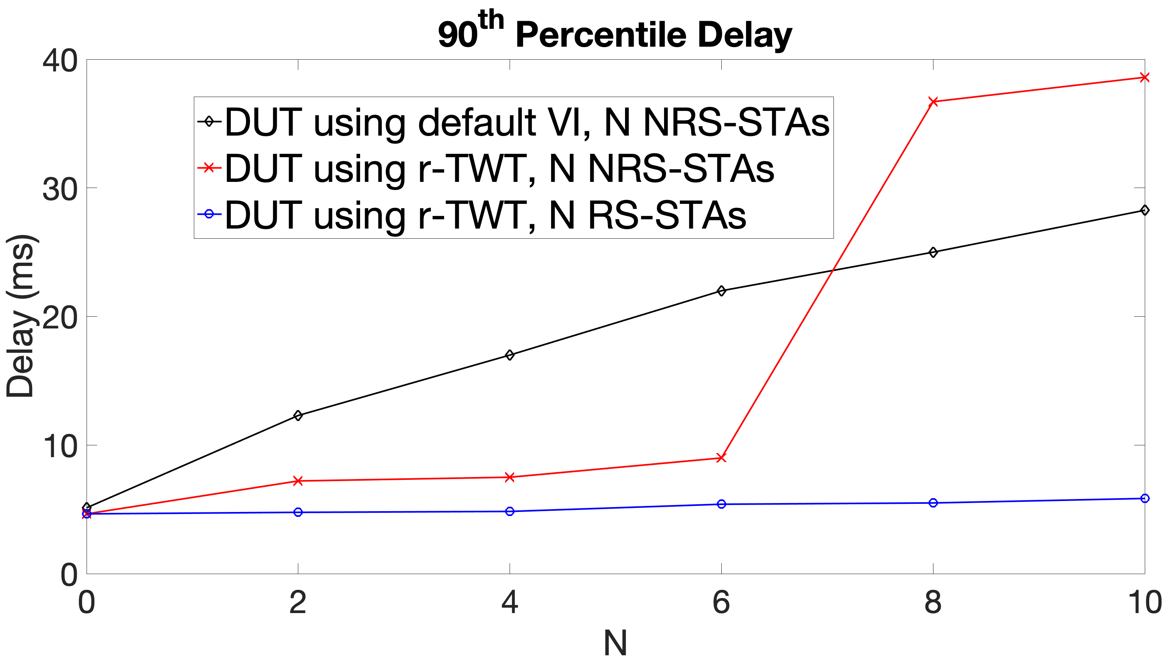
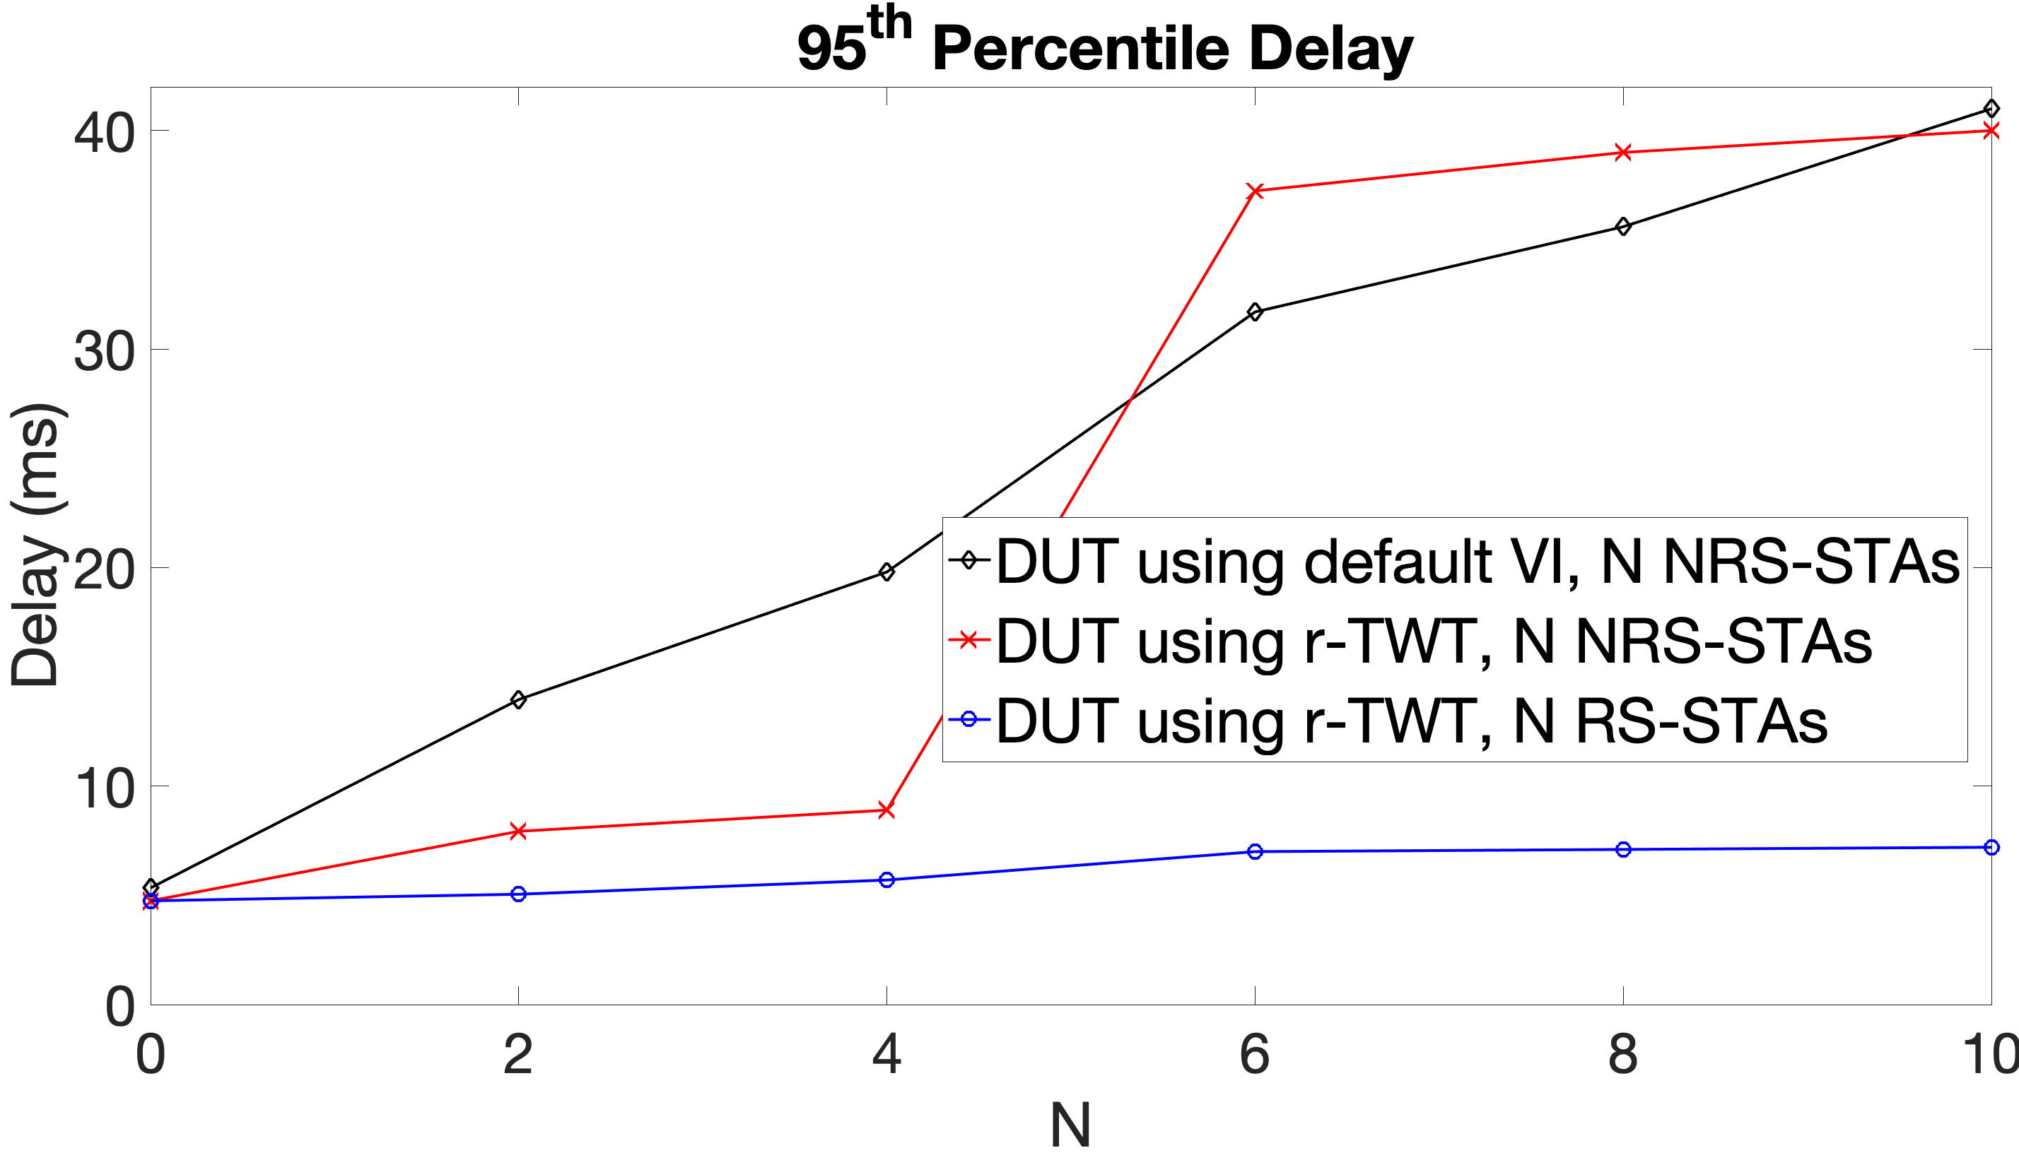
Set 1: Simulation Results (2) – 90, 95% Delay
Observations:
As the number of NRS/legacy STAs increases beyond a threshold (6 in this scenario), some LST traffic has to wait for next SP to be delivered, causing tail latency to also exceed traffic interval (32 TUs). This is reflected by the “jump” at N = 8/6 in the above 90/95 percentile delays.

Slide 8
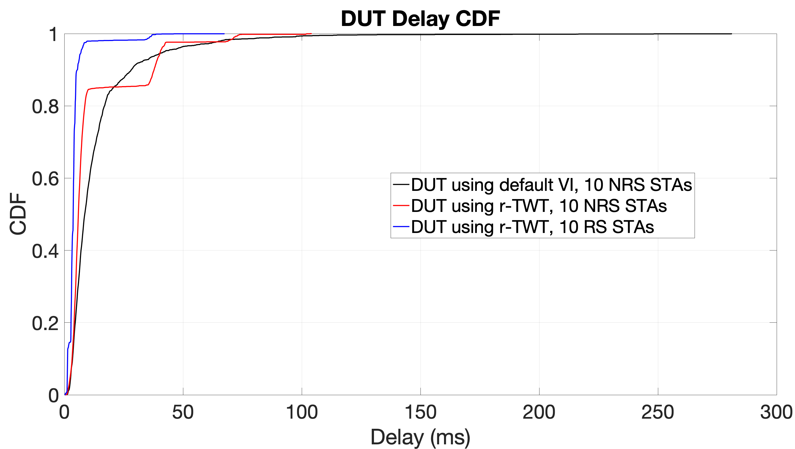
Set 1: Simulation Results (3) – Delay CDF
Delay CDF comparison at N=10:
Observations:
When all STAs are r-TWT supporting, LST is delivered within the SP for ~98% of cases
In presence of up to 10 NRS-STAs, there is a ~85% chance that LST is delivered within the SP

Slide 9
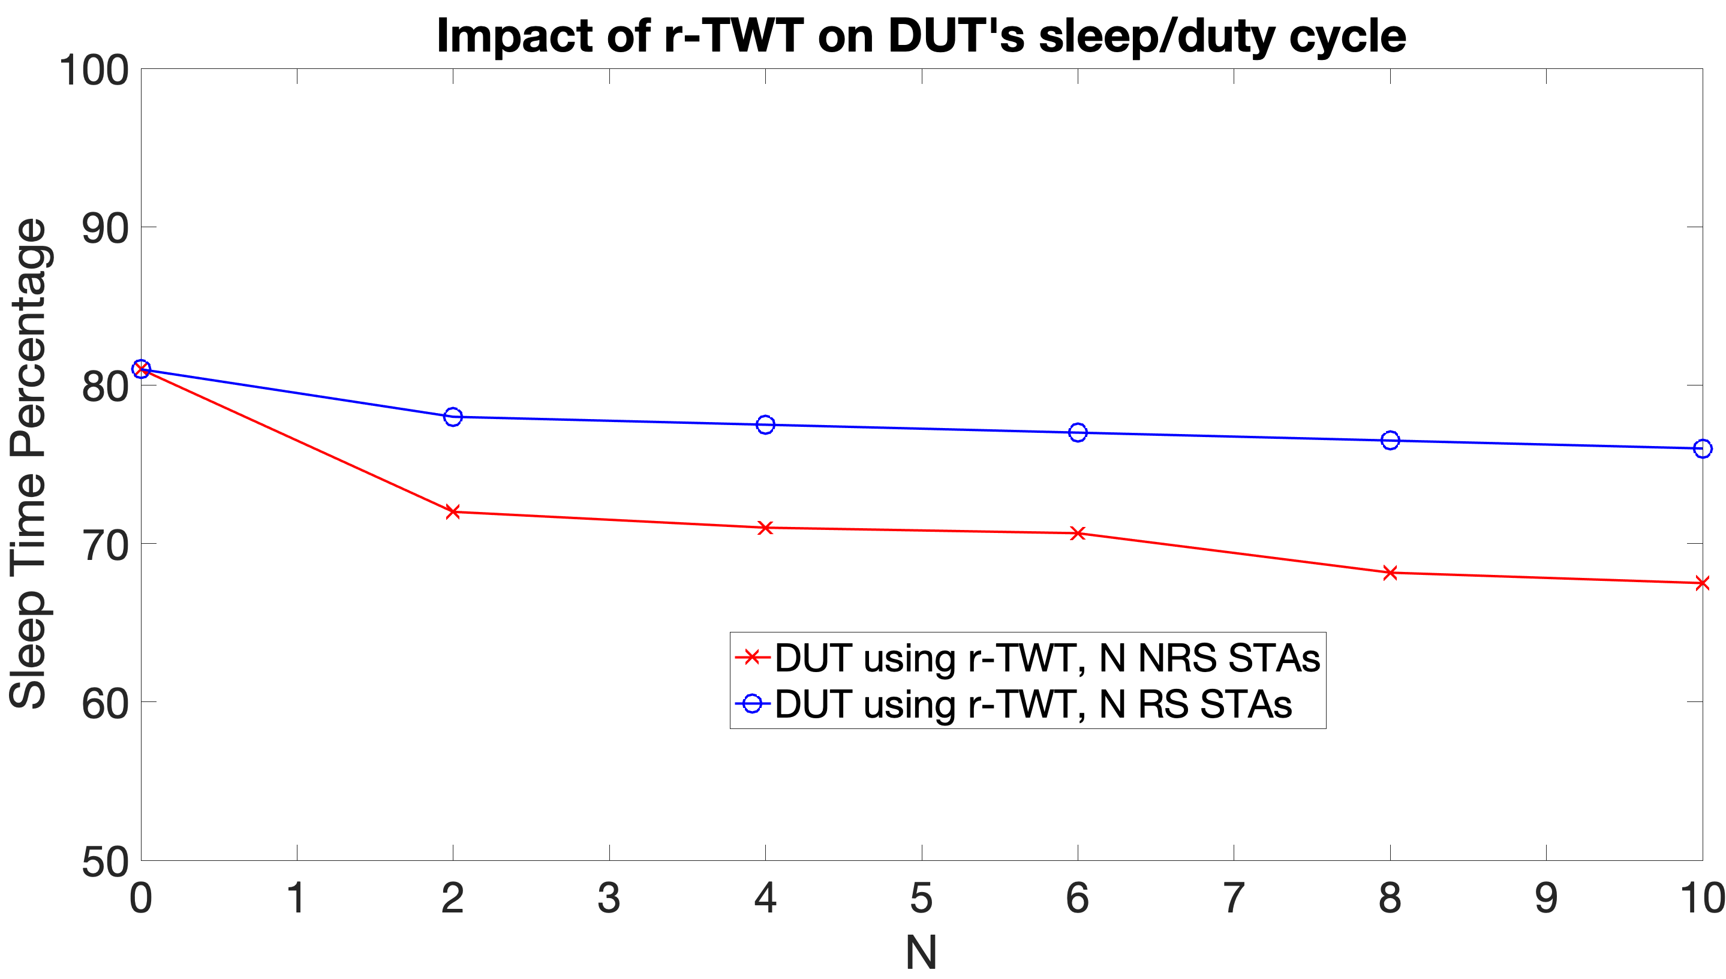
Set 1: Simulation Results (4) – Sleep duration
Impact of r-TWT on DUT’s duty cycle/power saving
Notes:
For DUT using default VI scheme we implemented, DUT stays in Active Mode 100% of time (0% sleep) since it is competing with full buffer STAs, and that graph is omitted.
DUT wakes up for beacons each BI, which accounts for 3-4% awake time in all cases.
Observations:
R-TWT can help devices lower power consumption by sleeping outside the SPs, and going to sleep within SP after delivering LST and early terminating.
Presence of NRS STAs may increase the DUT’s awake time, but DUT still achieved lower duty cycle than without r-TWT.

Slide 10
Set 2: Simulation Scenario/Configuration
Repeat Set 1 but now with r-TWT with a simple SP extension mechanism
If the intended traffic didn’t finish by end of SP, the r-TWT STA stays awake till completing traffic – not ideal, but a simple simulation study of effect
In our scenario, SP can always be extended as there is only one schedule

Slide 11
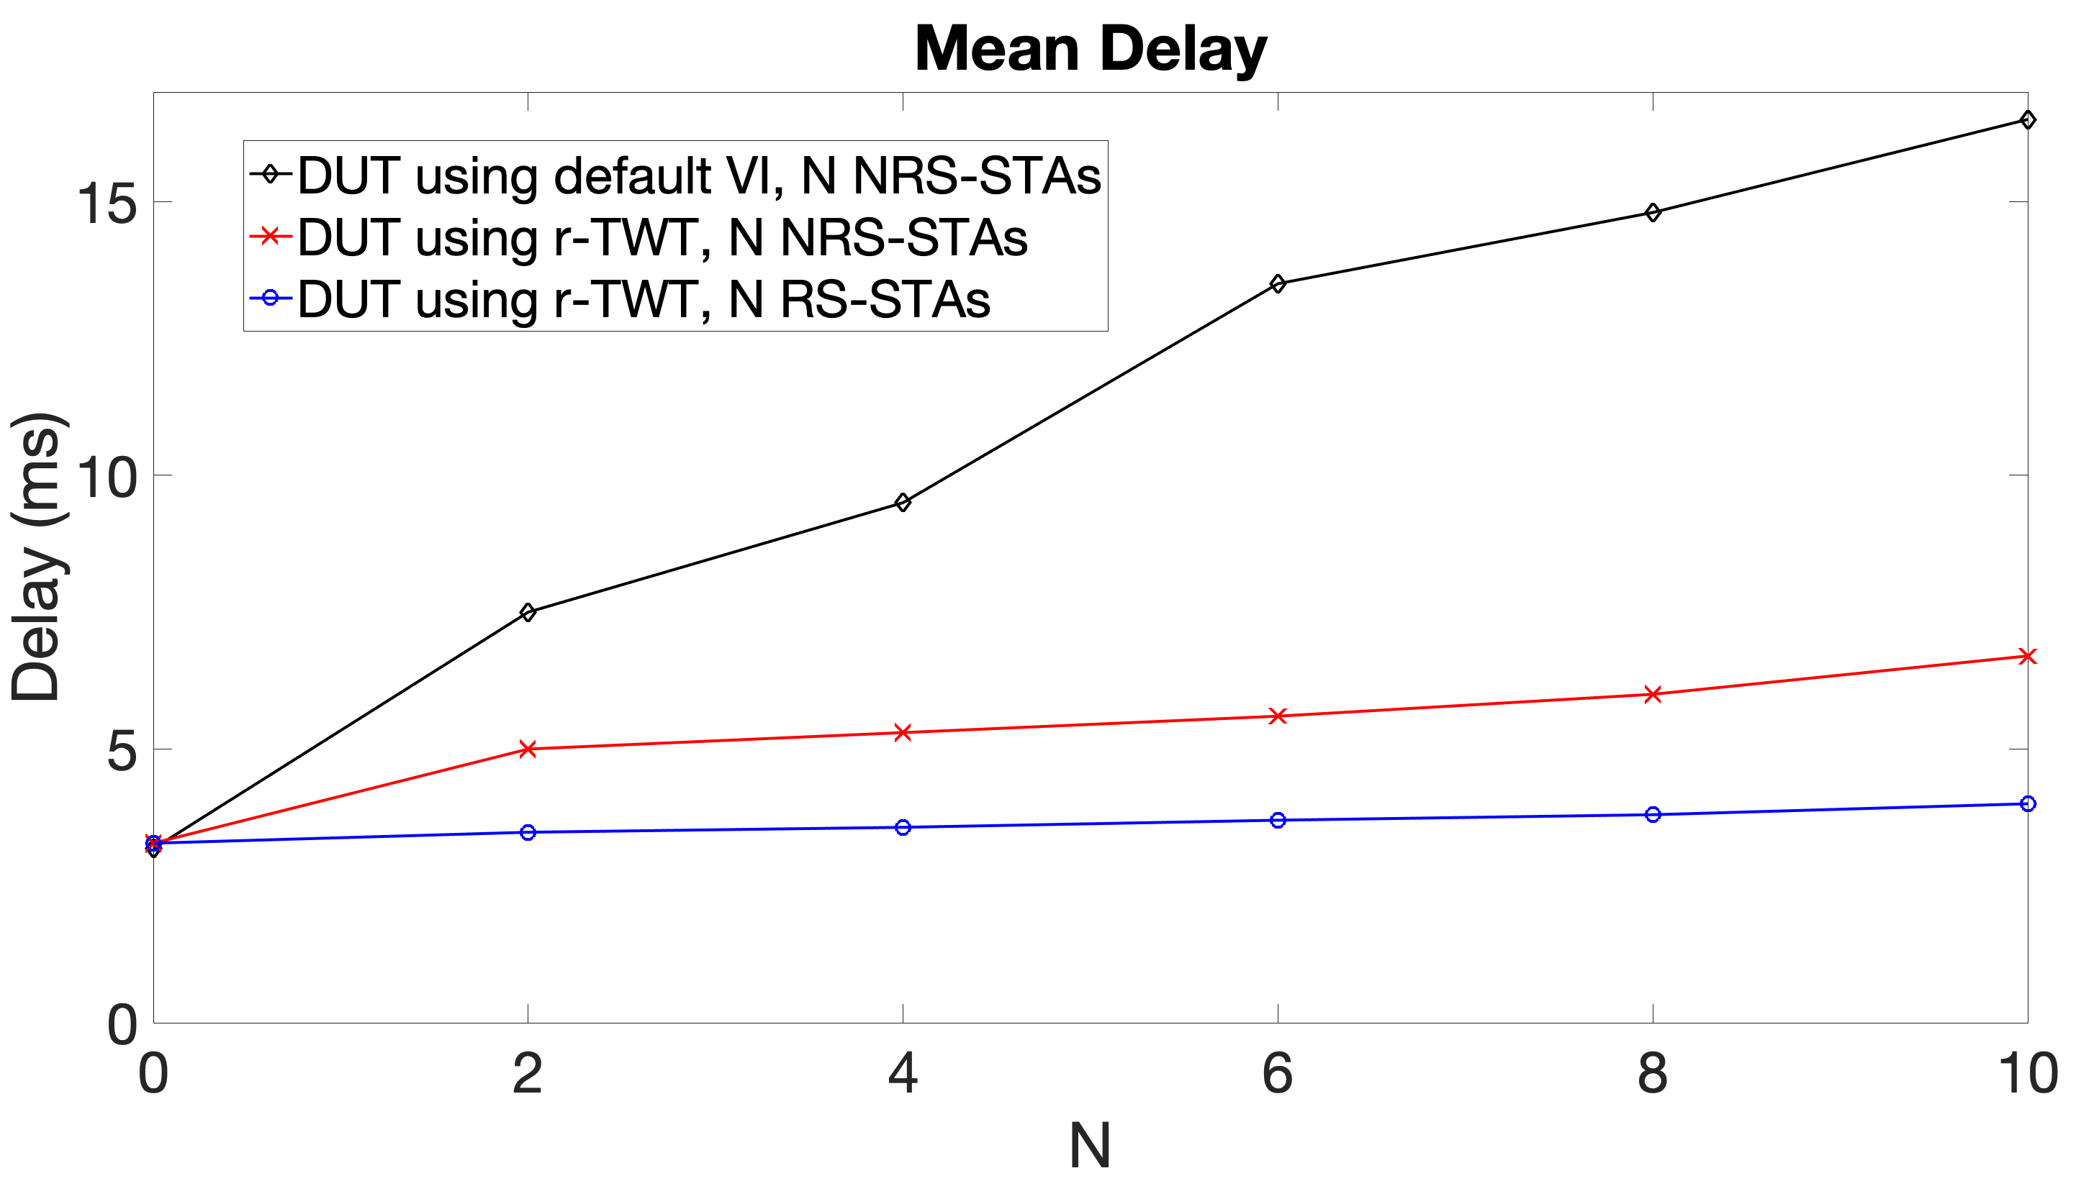
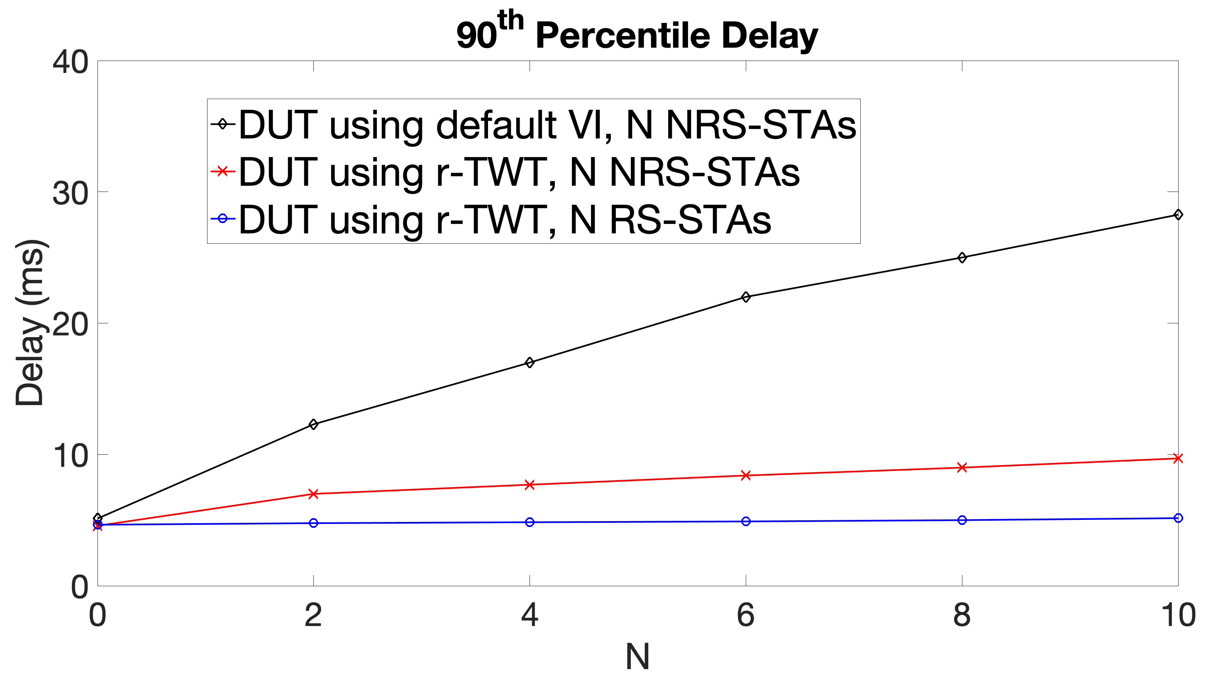
Set 2: Simulation Results (1)
Throughput
With SP extension enabled, all schemes achieve 80/20 Mbps DL/UL; graphs are omitted for brevity.
Delay:
Observation:
The negative impact of number of NRS-STAs to DUT using r-TWT is more contained (not linearly increasing as N increases)

Slide 12
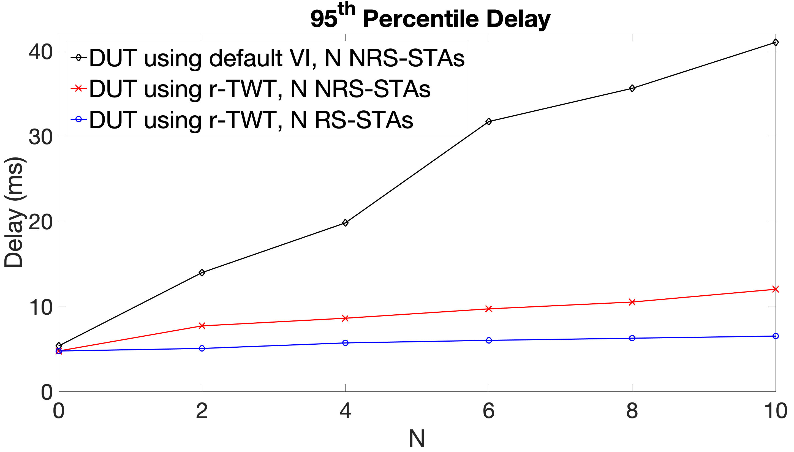
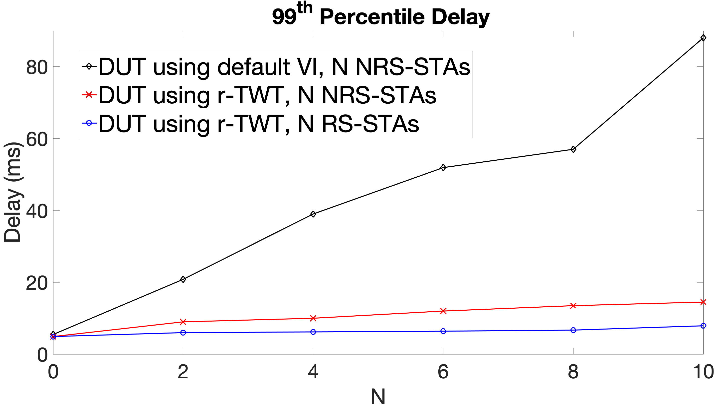
Set 2: Simulation Results (2)
Delay:
Observations:
With r-TWT extension enabled, the 95th and 99th percentile delay is within the (extended) SP (<10ms in most cases), even in presence of NRS STAs. This also points to the need and benefit of an SP extension mechanism for delivering LST reliably.

Slide 13
Simulation Set 3
Objective: Further study impact of SP boundary protection rule
Fix total number of STAs in the network: N=10
Increase percentage of NRS STAs from 0-100% in steps of 20%
20% NRS STAs means 2 out of N=10 STAs are NRS STAs
Traffic profile of non-DUT STAs
N/2 STAs have BE, N/2 STAs have VI traffic with X Mbps offered load
We consider X = [5, 10, 20] Mbps in separate experiments
NOTE: There is always an even split of traffic AC into BE/VI among RS and NRS STAs. E.g., If there are 2 RS STAs and 8 NRS STAs, then 1 RS STA and 4 NRS STAs have VI traffic and others have BE traffic

Slide 14
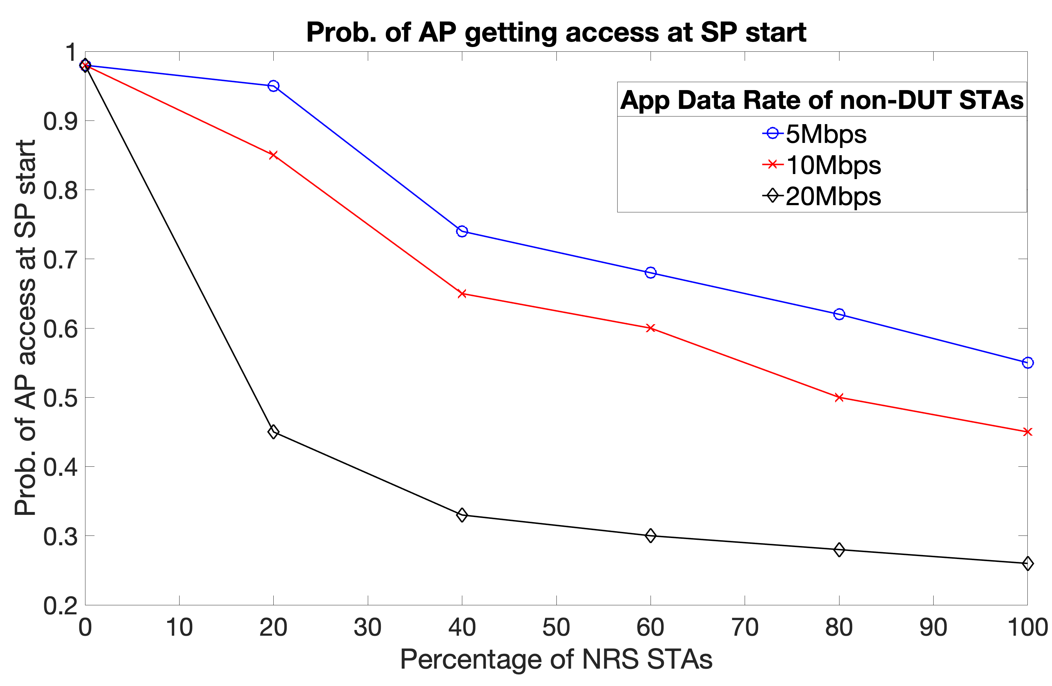
Set 3: Simulation Results (1)
Evaluate the probability that AP gains access at SP start
Observations:
When all STAs support r-TWT, AP has high chance of grabbing the medium
Note: subject to its choice of AC for trigger -- VO is used in simulation
With an increasing number of NRS STAs, the probability of AP gaining TXOP at SP start depends on both the number of NRS STAs and their traffic profile.
For NRS STAs with low-rate traffic/offered load (short TXOP), AP can gain access at SP start even when majority of STAs don’t support r-TWT
When NRS STAs have close to full-buffer traffic, even a few NRS STAs can reduce the chances of AP gaining SP at start.
Y-axis is ratio of # of SPs in which AP wins medium at SP start (medium idle at SP boundary) and the total # of SPs

Slide 15
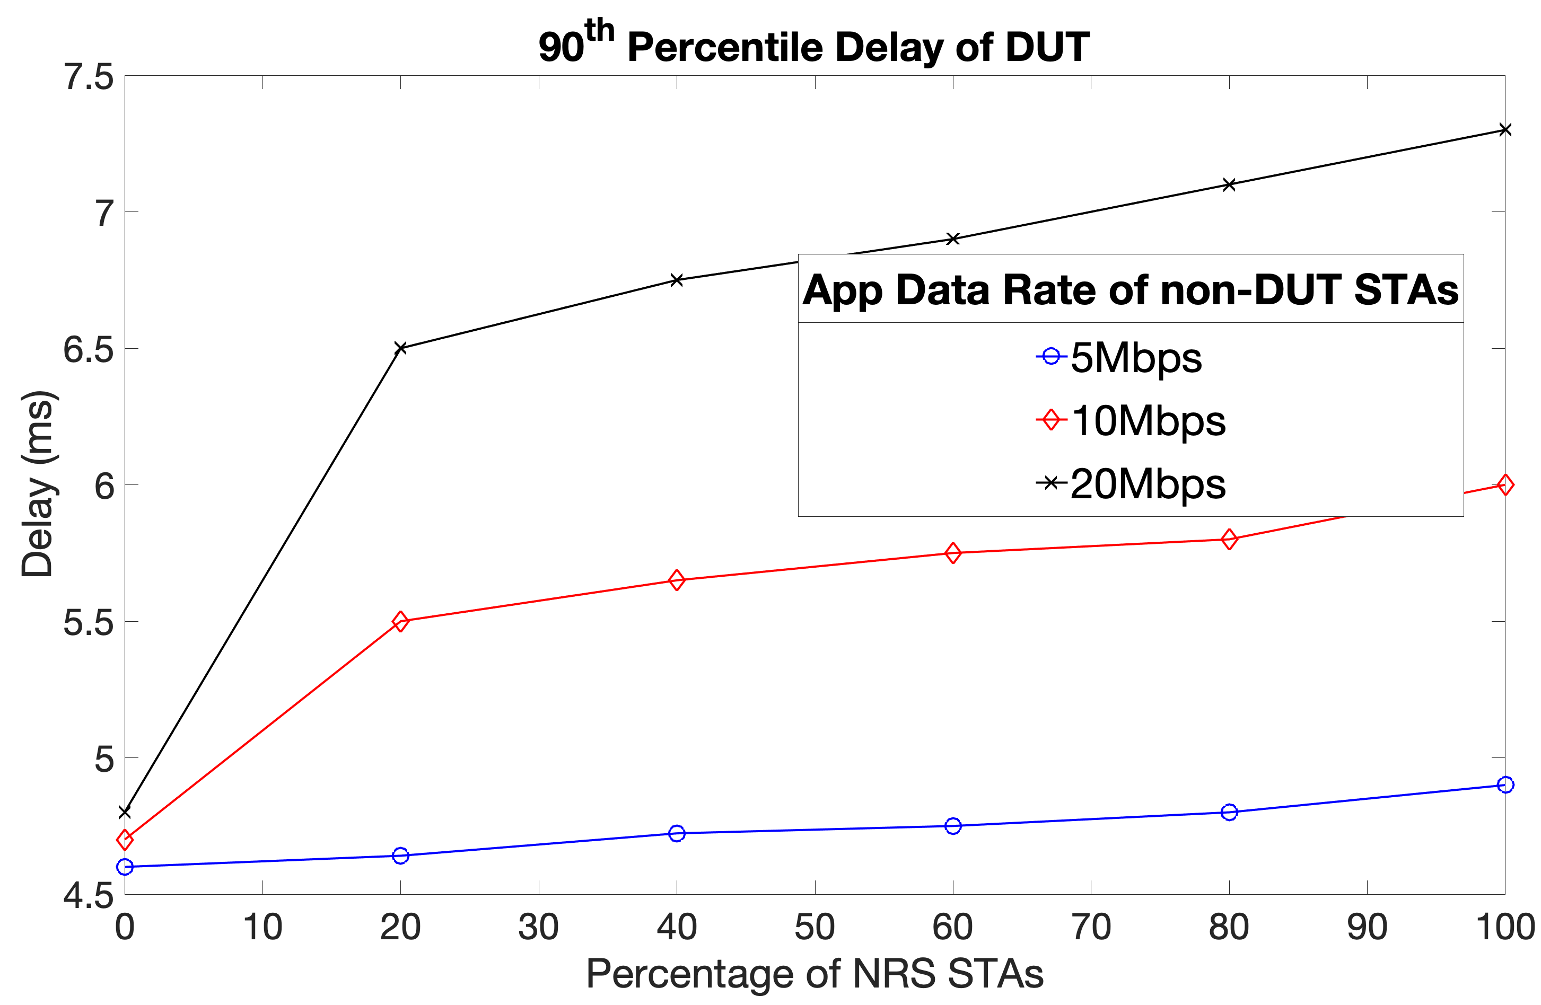
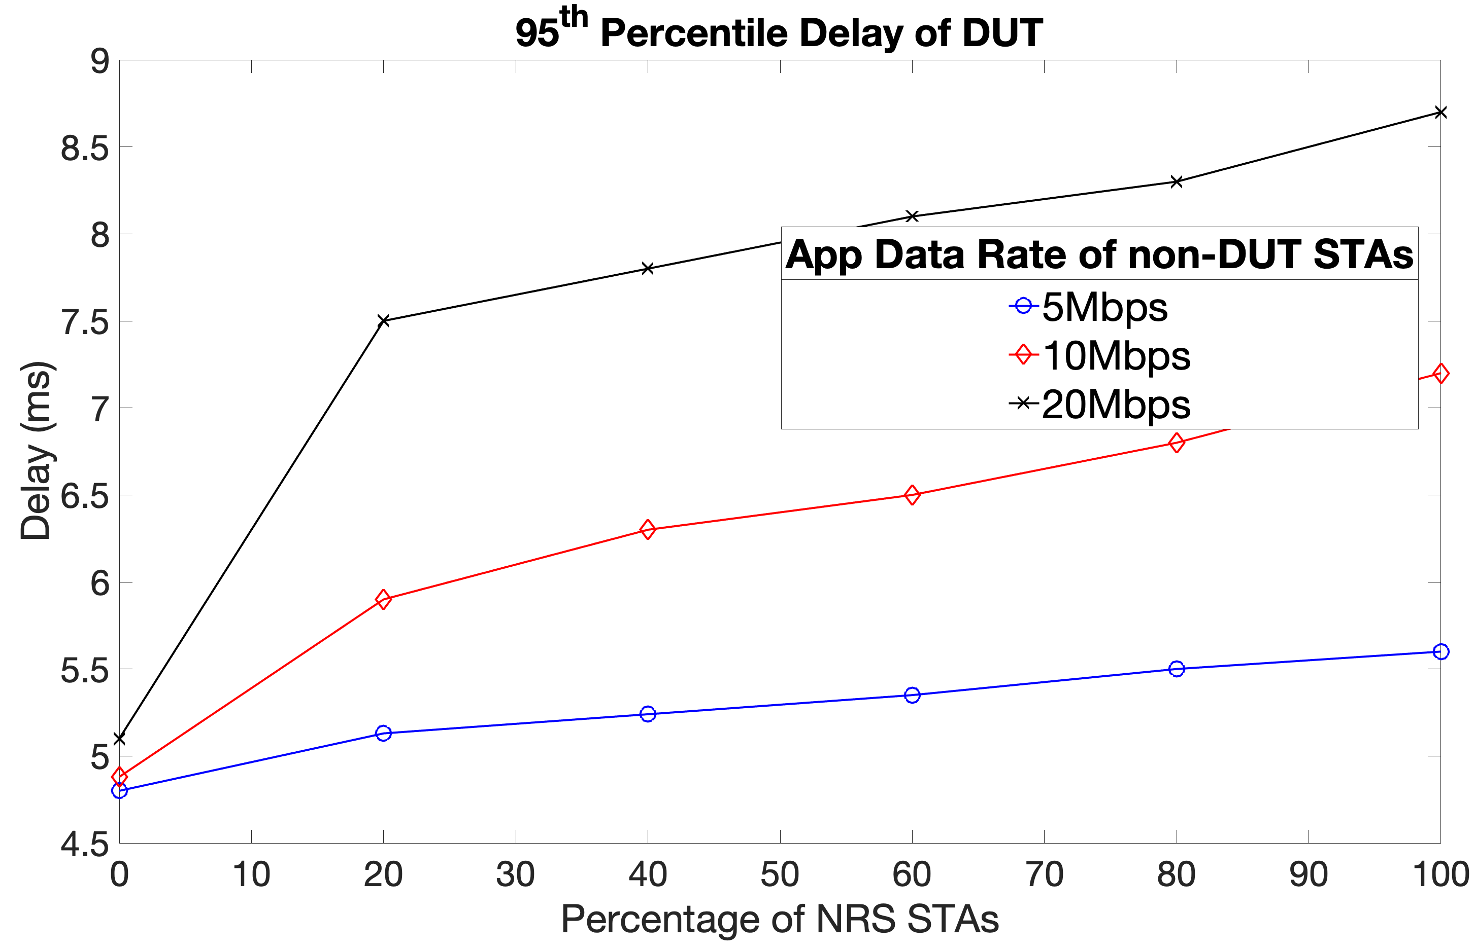
Set 3: Simulation Results (2)
Results: 90th percentile delay
Observations:
Analysis of DUT’s LST delay further illustrates the importance of SP start boundary protection rule, especially in cases where competing STAs have high traffic load/saturated traffic
Having all STAs supporting r-TWT can help reduce the mean/90th percentile delay of LST to almost ½; which is significant for applications running LST and have <5ms level delay requirements

Slide 16
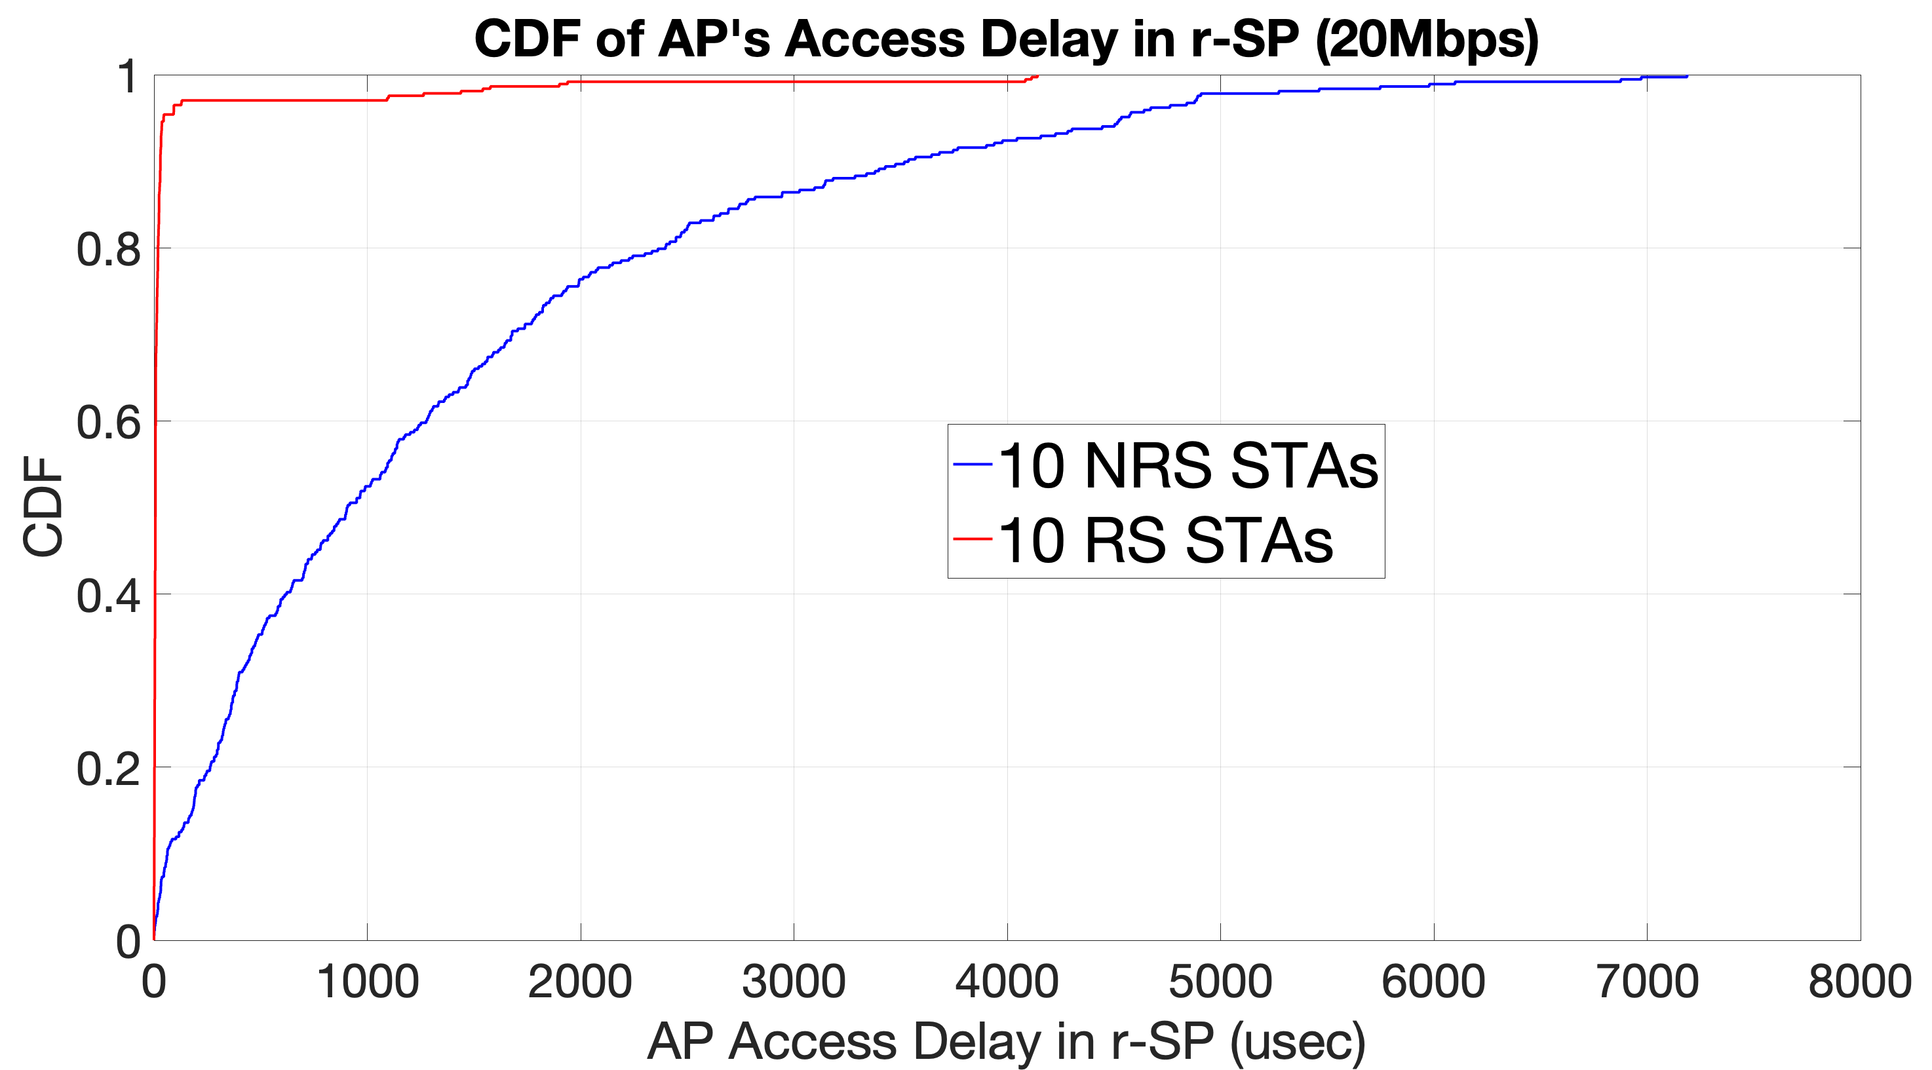
Set 3: Simulation Results (3)
Results: CDF of AP’s access delay in r-SP
Compare the CDF of time (in usec) from start of r-SP it takes the AP to grab the medium, for the case where app data rate of non-DUT STAs is 20Mbps (black curves in previous slide)
Observations:
When all competing STAs are NRS, AP’s access time into the SP depends on ending time of the TXOP by NRS STA which started before r-SP (if any). It is roughly uniformly distributed between 0 and maxPPDU length (~4.2ms for MCS 4, 64 BA). Further increase in access delay is possible due to contention or AP losing to NRS STAs.
When all competing STAs are RS STAs, AP grabs medium after SP start with high prob due to SP boundary protection and aggressive EDCA for Trigger (VO).

Slide 17
Summary
Simulation evaluation in a variety of network configurations shows that restricted TWT achieves significant improvement (2x or more) in latency for LST and power saving, and the latency is predictable despite congested network.
The latency/PS gains are most significant when all STAs in the network support r-TWT start time protection
In case of “imperfect” network condition (presence of “legacy” STAs),
The latency gains can be still preserved
Traffic prioritization in SP is important
An SP extension mechanism is needed
The negative impact on the latency depends on a few factors:
Regular traffic load, maximum TXOP (chances of the SP start time hits a long TXOP);
If AP can gain medium access immediately at SP start.

Slide 18
Backup Slides

