Slide 1
Need for an MLME SAP Interface for WLAN Sensing
Date: 2021-12-20
Authors:

Slide 2
Abstract
Our goal in this contribution is to justify the need for defining MLME primitives for WLAN sensing.
We also aim to clarify the scope of the technical work to be performed by TGbf as defined in its PAR.

Slide 3
Background
The fundamental goal of the 802.11bf amendment is to enable WLAN sensing applications to request and obtain WLAN sensing measurements ⁽¹⁾.
WLAN sensing application
Request for WLAN sensing measurements
Obtain WLAN sensing measurements
SME
To enable interoperability (between applications and silicon), the primitives used by an application to request and obtain WLAN sensing measurements must be defined in 802.11bf.
(1) P802.11bf PAR: “This amendment enables: A MAC service interface for layers above the MAC to request and retrieve WLAN sensing measurements.”

Slide 4
Requesting WLAN Sensing Measurements
Once the SME receives a request for WLAN sensing measurements, an appropriate WLAN sensing protocol is performed.
According to the PAR, measurements can be obtained using transmissions that are requested or unsolicited ⁽²⁾.
  If appropriate, the SME can trigger request and setup transmissions to be sent that allow for measurements to be performed ⁽³⁾.
Details of such procedures are currently being defined by TGbf.
(2) P802.11bf PAR: “This amendment enables: WLAN sensing measurements to be obtained using transmissions that are requested, unsolicited, or both.”
(3) P802.11bf PAR: “This amendment enables: Stations ... to request and setup transmissions that allow for WLAN sensing measurements to be performed.”

Slide 5
Obtaining WLAN Sensing Measurements
Assume that a STA receives a PPDU and makes a WLAN sensing measurement.
The measurement is passed from the PHY to the MAC (RXVECTOR parameter), and then to the SME (MLME primitive).
MAC
MLME
RXVECTOR
SME
PHY
In its simplest form, when the measurement is obtained by the same STA that requested it, the measurement is then passed to the sensing application.

Slide 6
Reporting WLAN Sensing Measurements
The 11bf SFD defines that sensing measurements may be obtained by a STA different from the one where the request originated.
In this case, the SME would have to trigger the MAC to send a “ Measurement Report frame” to the STA that requested it.
Step 1: Obtain measurements
Step 2: Report measurements
MAC
MLME
MAC
MLME
RXVECTOR
SME
TXVECTOR
SME
PHY
PHY
Whether measurement reporting (step 2 in the figure above) is an optional or mandatory feature of the 802.11bf amendment must be defined by the group.

Slide 7
Summary: Need for Interfaces
Independent of whether measurement reporting is an optional or mandatory feature, the 11bf amendment must define the interfaces necessary for the sensing application to obtain WLAN sensing measurements. Recall from previous slides:
WLAN sensing application
MAC
MLME
Request for WLAN sensing measurements
Obtain WLAN sensing measurements
RXVECTOR
SME
PHY
SME
Important to note that both interfaces, specifically the PHY service interface (RXVECTOR) ⁽⁴⁾ and the MAC service interface ⁽⁵⁾, are in scope for the project.
Please refer to backup slides for detailed examples of the use of MLME primitives.
(4) P802.11bf PAR: “This amendment defines modifications to the PHY service interface of the HT, VHT, HE and EHT PHYs.”
(5) P802.11bf PAR: “This amendment enables: A MAC service interface for layers above the MAC to request and retrieve WLAN sensing measurements.”

Slide 8
Discussion: Measurement Result Type
To enable interoperability, the amendment must also define at least one WLAN sensing measurement that 11bf capable STAs must support.
The SFD currently defines one measurement: Channel frequency response (CSI).
There is ample evidence that CSI supports a wide range of WLAN sensing applications.
  Evidence: Existing Wi-Fi sensing solutions in the market; decades of academic research
The complete signaling and definitions required for a STA to estimate CSI are found in the 802.11 standard.

Slide 9
Conclusions
11bf capable STAs must be able to request and obtain WLAN sensing measurements.
  Fundamental and mandatory feature.
The most basic specification to be defined by TGbf are the interfaces necessary for a sensing application to request and obtain measurements.
  PHY and MAC service interfaces are in scope.
TGbf must define whether measurement reporting is an optional or mandatory feature.
TGbf must also define at least one WLAN sensing measurement that 11bf capable STAs must support.

Slide 10
SP
Do you agree that the 11bf amendment shall define a new subclause under 6.3 (MLME SAP interface) that specifies request, confirm, indication, and response primitives for WLAN sensing?

Slide 11
BACKUP

Slide 12
Reference
P802.11bf PAR

Slide 13
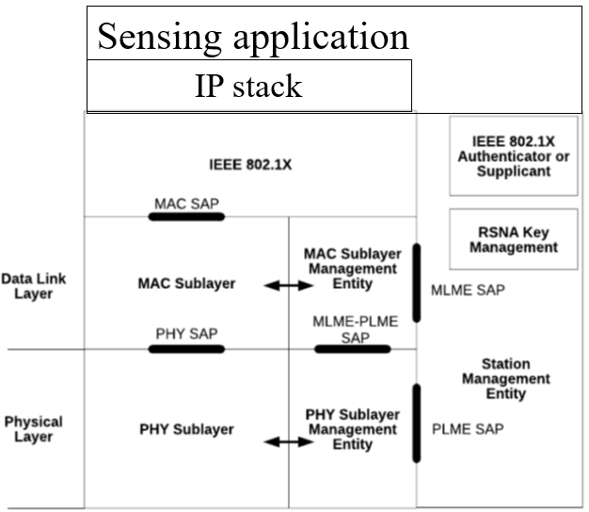
Sensing reference model on top of Figure 4-24—Portion of the ISO/IEC basic reference model covered in this standard (11-20/1960r1)

Slide 14
Measurement request—accepted (11-20/1960r1)

Slide 15
Measurement and report delivery to application (11-20/1960r1)

Slide 16
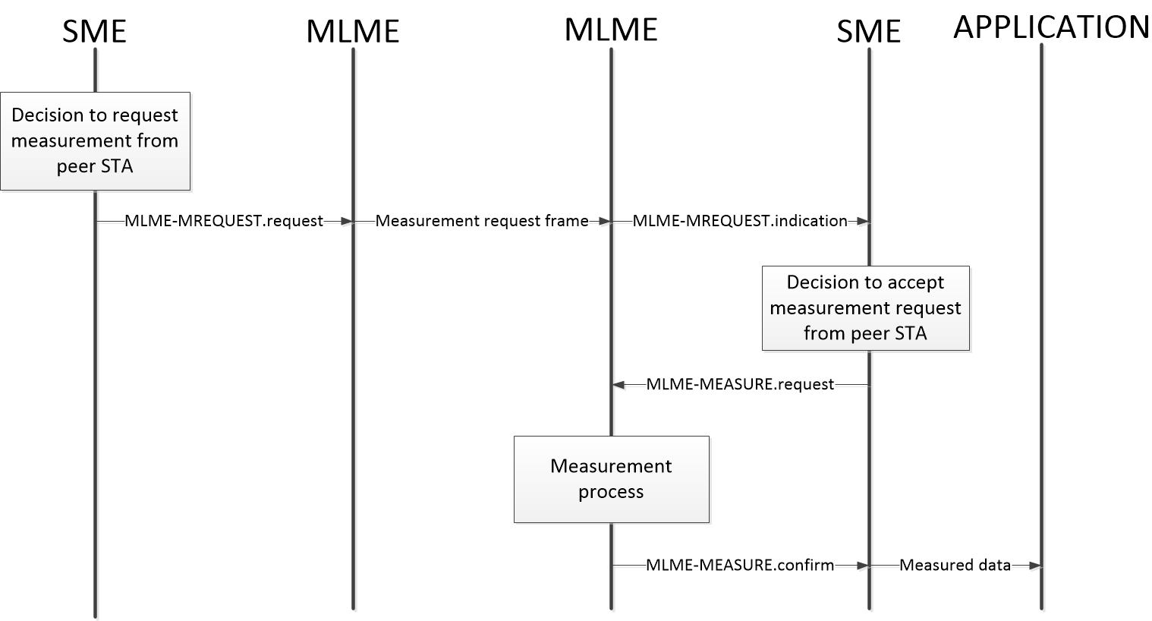
Measurement and report delivery to application (cont.) (11-20/1960r1)

