Slide 1
Issue of large BW support
Date: 2021-11-22
Authors:

Slide 2
Introduction
A non-AP EHT STA shall support the following features:
  Reception of a 160 MHz EHT MU PPDU if the non-AP EHT STA is capable of up to 80 MHz channel width and operating with 80 MHz channel width.
  Reception of a 320 MHz EHT MU PPDU if the non-AP EHT STA is capable of up to 80 MHz channel width and operating with 80 MHz channel width.
  Reception of a 320 MHz EHT MU PPDU if the non-AP EHT STA is capable of up to 160 MHz channel width and operating with 160 MHz channel width.
EHT Capabilities
  EHT-MCS Map (BW ≤ 80 MHz, Except 20 MHz-Only Non-AP STA): For a 20 MHz or 80 MHz operating non-AP STA, additionally indicates the maximum number of spatial streams supported for reception and the maximum number of spatial streams that the non-AP STA can transmit, for each MCS value, in a PPDU with a bandwidth of 160 MHz or 320 MHz.
  EHT-MCS Map(BW = 160 MHz): For a 160 MHz operating non-AP STA, additionally indicates the maximum number of spatial streams supported for reception and the maximum number of spatial streams that the non-AP STA can transmit, for each MCS value, in a PPDU with a band-width of 320 MHz.
Receiver using lower bandwidth than the PPDU transmission may cause spectral aliasing
  Degrades the RX EVM on edge subcarriers.

Slide 3
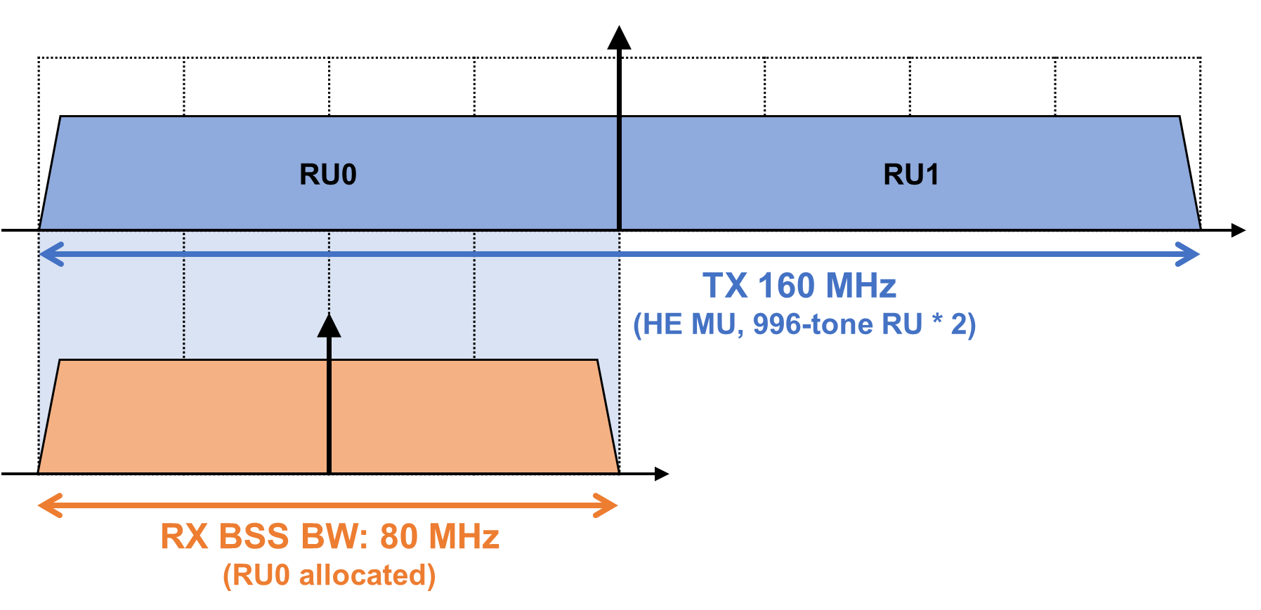
Reception of a 160 MHz MU PPDU
(80 MHz Operating STA)
Assumption
  80 MHz operating STA is allocated in a 160 MHz MU PPDU and lower 80 MHz is the primary channel.
  The ADC sample rate is 4x higher than the desired signal bandwidth for anti-aliasing.
  80 MHz operating STA sets the center frequency in the middle of the lower 80 MHz channel.
Based on this assumption, the spectrum is shown in the figure below

Slide 4
Reception of a 160 MHz MU PPDU
(80 MHz Operating STA)
Decimation
  The decimation consists of low-pass filter and down-sampling.
  The decimation of ¼ rate may require a large number of filter taps.
  Therefore, multi-stage(½ rate + ½ rate) can be considered for the decimation of ¼ rate.
  Even after low-pass filtering, residual signal may be present in the stop-band region.
    Actually, the magnitude of the residual signal depends on the sharpness of filter or the number of filter taps.
  The residual signal in the stop-band can create aliasing after decimating the signal, which may degrade the performance (e.g. Rx EVM), especially on edge subcarriers.
  Aliasing, even if small, can cause a significant problem in high MCS.

Slide 5
Example of Decimation (320 MHz → 160 MHz)
Original spectrum
Low-pass filtering
Down-sampling

Slide 6
Example of Decimation (160 MHz → 80 MHz)
Original spectrum
Low-pass filtering
Down-sampling

Slide 7
Rx EVM Results
The Rx EVM on edge subcarrier is significantly degraded because of aliasing.
Averaged Rx EVM over all subcarriers
Rx EVM on edge subcarrier

Slide 8
Discussion
We agreed that “large BW support” is a good feature to improve spectral efficiency.
However, based on our analysis, aliasing may occur, which may degrade performance for edge subcarriers.
  If more taps are used, the effect of aliasing can be reduced, but the complexity is increased.
Considering a low-cost device that supports up to 80 MHz, it's too aggressive feature to make it mandatory for all MCSs.
So, there is a need for a way to reduce the implementation burden and support this feature.

Slide 9
Candidate Solutions
Option 1: Update EHT-MCS Map(BW = 160/320 MHz) to indicate MCS MAP for 80 MHz non-AP STA receiving 160/320 MHz PPDU. And EHT-MCS Map(BW = 320 MHz) to indicate MCS MAP for 160 MHz non-AP STA receiving 320 MHz.
  This option adds more bytes in capabilities (6 B more for 80 MHz STA and 3 B more for 160 MHz STA), but consistent with 320 MHz STA reporting MCS Map.
Option 2: Add another capability which indicates maximum MCS level when receiving larger bandwidth MU PPDU.
  This one can save some overhead. But it is not consistent.
Option 3: Restricting RU and MRU for 80 and 160 MHz operation similar to “36.3.2.6 RU and MRU restrictions for 20 MHz operation”.
  There are many RUs MRUs need to be restricted. Not a preferred option.

Slide 10
Straw Poll
Which option do you support?
  Option 1: Update EHT-MCS Map(BW = 160/320 MHz) to indicate MCS MAP for 80 MHz non-AP STA receiving 160/320 MHz PPDU. And EHT-MCS Map(BW = 320 MHz) to indicate MCS MAP for 160 MHz non-AP STA receiving 320 MHz.
  Option 2: Add another capability which indicates maximum MCS level when receiving larger bandwidth MU PPDU.
  Option 3: Restricting RU and MRU for 80 and 160 MHz operation similar to “36.3.2.6 RU and MRU restrictions for 20 MHz operation”.

