Slide 1
Partial CSI Feedback
Date: 2021-11-24
Authors:
Name | Company | Address | Phone | Email
Rojan Chitrakar | Panasonic Corporation |  |  | rojan.chitrakar@sg.panasonic.com
Rajat Pushkarna
Yanyi Ding
Yoshio Urabe
Hiroyuki Motozuka

Slide 2
Background
The following is agreed in 11bf SFD [2] regarding CSI feedback in 11bf:
  CSI (that is, the channel measured during the training symbols of a received PPDU) is a type of sensing measurement result for sub-7 GHz WLAN sensing (Motion 20, 21/0908r2).
  To enable sub-7 GHz WLAN sensing, an RXVECTOR parameter CSI_ESTIMATE is defined that contains the channel measured during the training symbols of the received PPDU. The format of CSI_ESTIMATE is the same one used in the measurement report field within the Sensing Measurement Report frame. The format of CSI_ESTIMATE is TBD (Motion 21, 21/0908r2).
  A Sensing Measurement Report frame, which allows a sensing receiver to report sensing measurements, is defined. This frame contains at least the following two fields:
    Measurement report control field: Contains information necessary to interpret the measurement report field.
    Measurement report field: Carries CSI measurements obtained by a sensing receiver.
The format of the CSI feedback (quantization/scaling etc.) as well as the format of the Sensing Measurement Report frame is TBD.

Slide 3
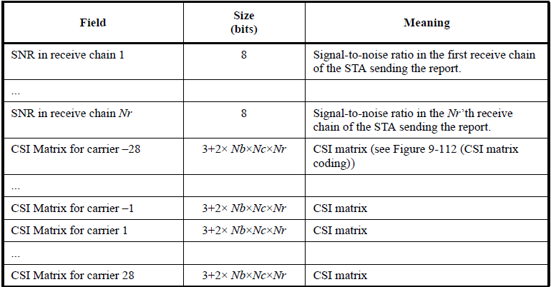
Background
The following CSI Report format is used in 802.11n to carry the CSI feedback [1]:
  The CSI matrix for each reported subcarrier requires (3 + 2 * Nb * Nc * Nr) bits.
    3 bits/carrier is for Carrier Matrix Amplitude (or the scaling ratio per subcarrier M_{H}(k)).
    One I and one Q value per subcarrier.
CSI Field Parameters | Meaning | Range of Values
Nb | Number of Bits for I or Q | {4, 5, 6, 8}
Nc | Number of Columns | 1 to 4
Nr | Number of Rows | 2 to 4 The value 0 is reserved.
Ng | Grouping | {1, 2, 4}
Table 9-56—CSI Report field (20 MHz)
The size of the CSI feedback may be reduced by using subcarrier grouping. Grouping is a method that reduces the size of the CSI Report field by reporting a single value for each group of Ng adjacent subcarriers.

Slide 4
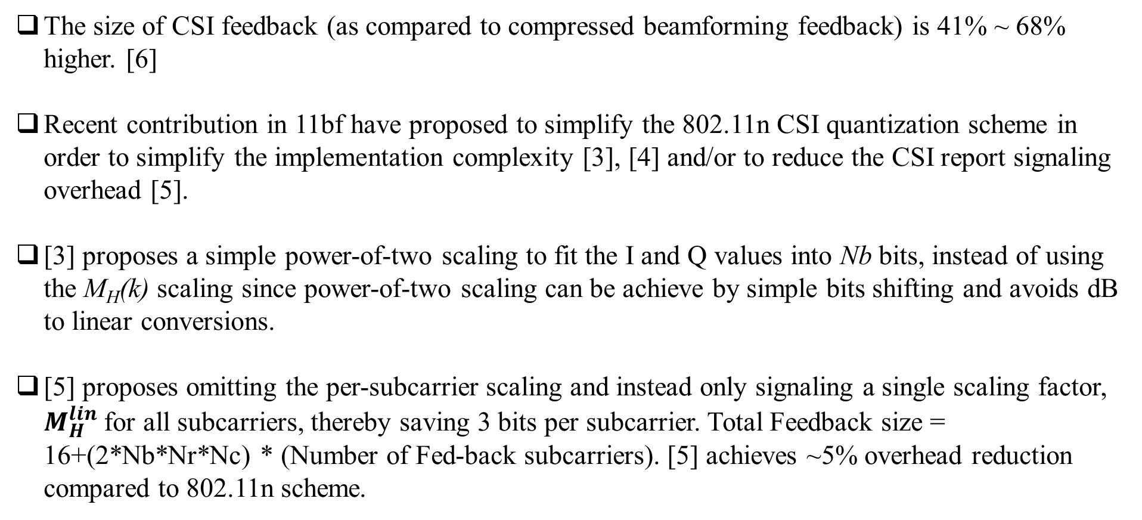
Background
The size of CSI feedback (as compared to compressed beamforming feedback) is 41% ~ 68% higher. [6]
Recent contribution in 11bf have proposed to simplify the 802.11n CSI quantization scheme in order to simplify the implementation complexity [3], [4] and/or to reduce the CSI report signaling overhead [5].
[3] proposes a simple power-of-two scaling to fit the I and Q values into Nb bits, instead of using the M_{H}(k) scaling since power-of-two scaling can be achieve by simple bits shifting and avoids dB to linear conversions.
[5] proposes omitting the per-subcarrier scaling and instead only signaling a single scaling factor, $M_{H}^{lin}$ for all subcarriers, thereby saving 3 bits per subcarrier. Total Feedback size = 16+(2*Nb*Nr*Nc) * (Number of Fed-back subcarriers). [5] achieves ~5% overhead reduction compared to 802.11n scheme.

Slide 5
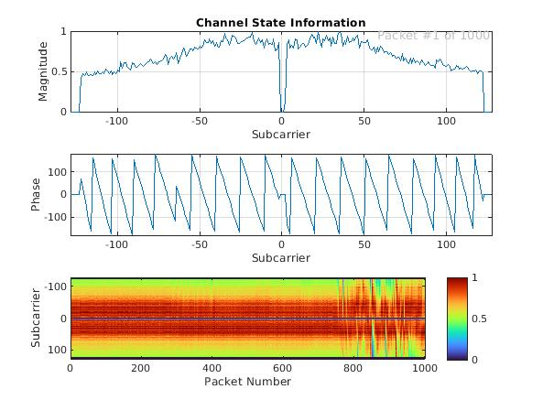
Discussions
The CSI of every subcarrier is a complex number, i.e., csi = a+bj, where a is the real part (I) and b is the imaginary part (Q). Majority of sensing applications do not directly make use of the reported I and Q values. Instead, the CSI Amplitude and CSI Phase components are extracted from the reported I and Q values and various techniques (e.g., statistical models, or Machine learning/Artificial Intelligence algorithms) are applied on them to derive sensing results. [7], [8]
In the sub-7 GHz, while some sensing applications make use of both amplitude and phase information, we have noted that a vast majority of sensing applications only use one of them, either amplitude or phase, but not both. For many sensing applications such as human presence/occupancy detection, people counting, Humidity estimation, Gesture detection etc., amplitude information is sufficient, while for some implementations of sensing applications for motion detection, fall detection etc., only phase information is used. [7], [9], [10], [11]

Slide 6
Proposal
Add options in 11bf to feedback partial CSI: either amplitude or phase. Two new measurement report types are added:
Measurement Report Types
Measurement Report Type | Meaning
0 | CSI (full)
1 | CSI_Amplitude (Only Amplitude component of CSI)
2 | CSI_Phase (Only Phase component of CSI)

Slide 7
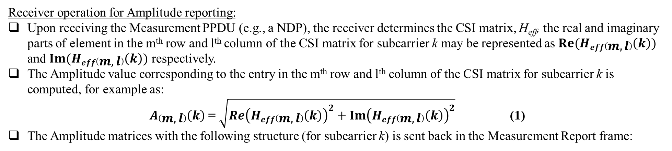
CSI_Amplitude
Receiver operation for Amplitude reporting:
Upon receiving the Measurement PPDU (e.g., a NDP), the receiver determines the CSI matrix, H_{eff}, the real and imaginary parts of element in the m^{th} row and l^{th} column of the CSI matrix for subcarrier k may be represented as$Re(Heff\left(m,l\right)\left(k\right))$ and $Im(Heff\left(m,l\right)\left(k\right))$ respectively.
The Amplitude value corresponding to the entry in the m^{th} row and l^{th} column of the CSI matrix for subcarrier k is computed, for example as:
$A\left(m,l\right)\left(k\right)$ = $\sqrt{{Re\left(Heff\left(m,l\right)\left(k\right)\right)}^{2}+{Im\left(Heff\left(m,l\right)\left(k\right)\right)}^{2}}$ (1)
The Amplitude matrices with the following structure (for subcarrier k) is sent back in the Measurement Report frame:
For each reported subcarrier k include
{
Carrier Matrix Amplitude of 3 bits (M_{H}(k))
For each of Nr rows in each Amplitude matrix in order: (1, …, Nr)
{
Include Nc amplitude values computed from the real and imaginary parts of the corresponding entry of the CSI matrix Heff; each amplitude value using Nb bits.
}
}
=> Each Amplitude matrix is encoded using 3 + Nb x Nc x Nr bits¹.
Notes:
NOTE1 – As compared to 3 + 2 x Nb x Nc x Nr bits for 802.11n encoding.

Slide 8
CSI_Amplitude
Amplitude value encoding:
Either the 802.11n CSI matrices feedback encoding scheme [1], or the encoding schemes proposed in [3] or [5] may be used.
However, from equation (1-1), it can be seen that amplitude values are always positive. As such, instead of using 2s complement encoding, the amplitude values can be encoded as unsigned integers (i.e., as positive values). This means the quantized amplitude values are normalized to the range: 0 to (2^{Nb} – 1) leading to a 1 bit resolution gain¹.
Amplitude value decoding:
Either the 802.11n CSI matrices feedback decoding scheme [1], or the decoding schemes proposed in [3] or [5] may be used except that each element of the Amplitude matrix is decoded as an unsigned integer (i.e., as positive values).
NOTE1 – As compared to 802.11n encoding rules, where the quantized I and Q values are normalized to the range: -(2^{(Nb-1)} – 1) to (2 ^{(Nb-1)} – 1). Alternatively, we can also maintain the same resolution by quantizing the amplitude values by normalizing to the range: 0 to (2^{(Nb-1)} – 1) which can lead to a further saving of 1 bit per entry² of the amplitude matrix.
Notes:
NOTE2 – In this case, 3 + (Nb -1) x Nc x Nr bits are required for each Amplitude matrix, leading to a further overhead saving at a similar resolution as the 802.11n scheme.

Slide 9
CSI_Amplitude
Simulation results for 20 MHz channel (56 subcarriers), Nc = 3, Nr = 3
Feedback Bit size (Nb) | 11n encoding |  | Our Scheme |  | Difference
Feedback Bit size (Nb) | (SQNR, dB) | Total Size of Feedback Bits (3 + 2*Nb x Nc x Nr)*Ns | (SQNR, dB) | Total Size of Feedback Bits (3 + Nb x Nc x Nr)*Ns | (SQNR gain, dB) | Feedback Bit size reduction (%)
4 | 24.759 | 4200 | 31.035 | 2184 | 6.276 | 48.00
6 | 37.739 | 6216 | 43.520 | 3192 | 5.781 | 48.65
8 | 50.359 | 8232 | 55.479 | 4200 | 5.12 | 48.98
It is observed that by only reporting the Amplitude component, we not only achieve a feedback bit size reduction of close to 50%, but also achieve 5 to 6 dB gain in SQNR compared to 802.11n.

Slide 10
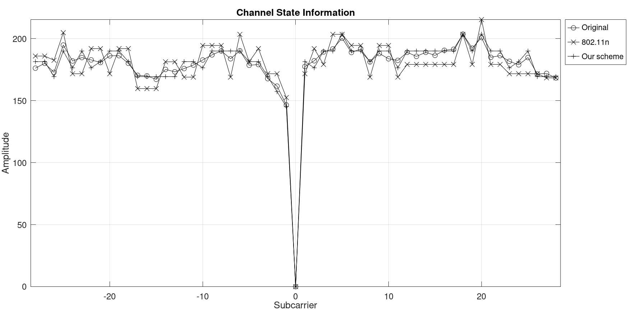
CSI_Amplitude
Simulation results for 20 MHz channel (56 subcarriers), Nc = 3, Nr = 3, Nb = 4
Our curve is closer to the Original curve compared to 802.11n scheme
In general it is noted that for a given feedback bit size, our scheme provides twice the number of bits (2*Nb) per entry compared to 802.11n scheme (Nb). E.g. for the same feedback bit size of 4200, while 802.11n uses Nb = 4 for the real and imaginary part of each entry of the CSI Matrices, our scheme can use Nb = 8 bits for each entry of the Amplitude Matrices, thereby providing 16 (= 2⁴) times increase in resolution.

Slide 11
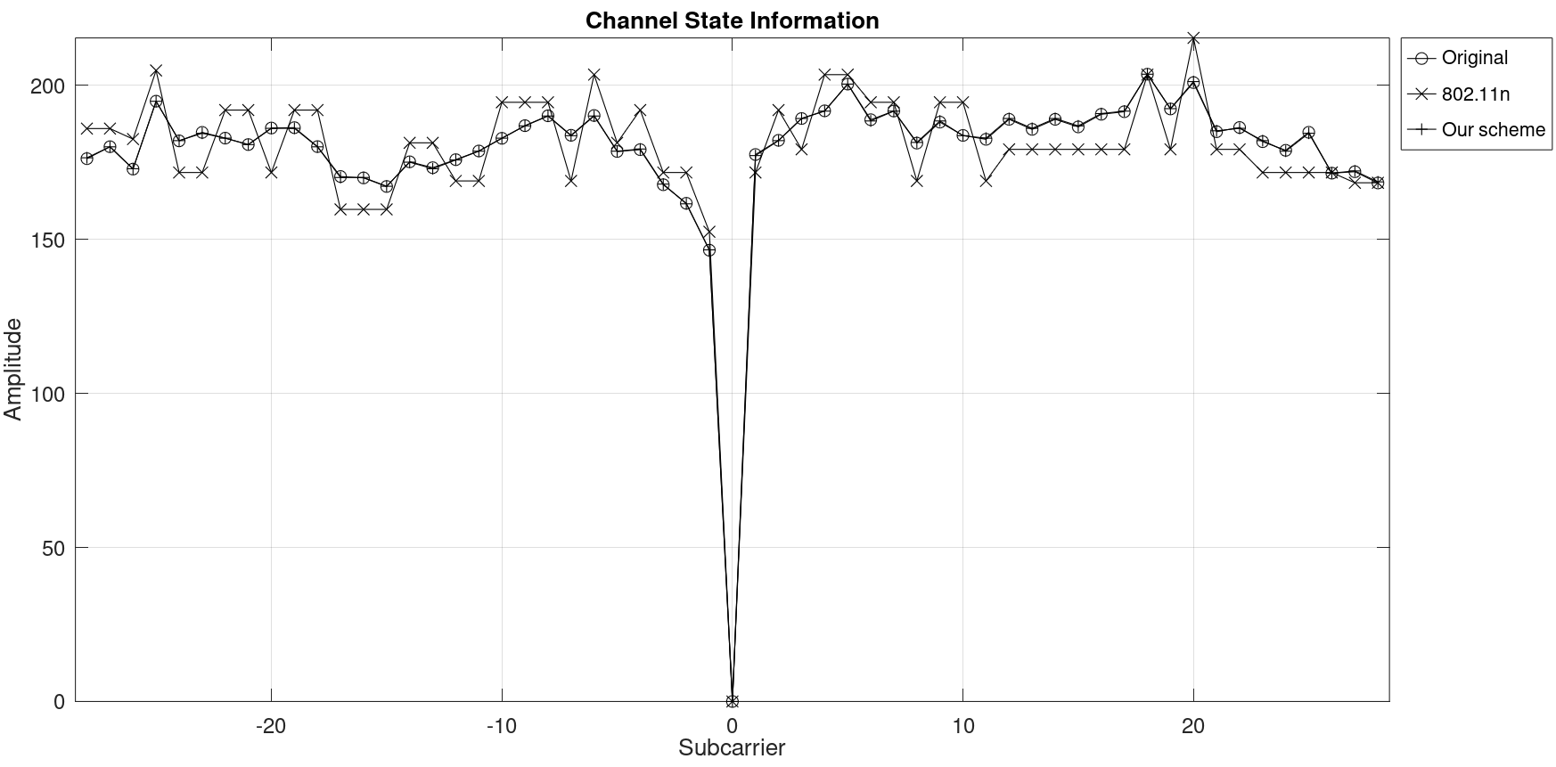
CSI_Amplitude
We note that if we increase the feedback bit size to 4200 for our scheme as well, we can use Nb = 8 for each entry.
Our curve is almost identical to the Original curve

Slide 12
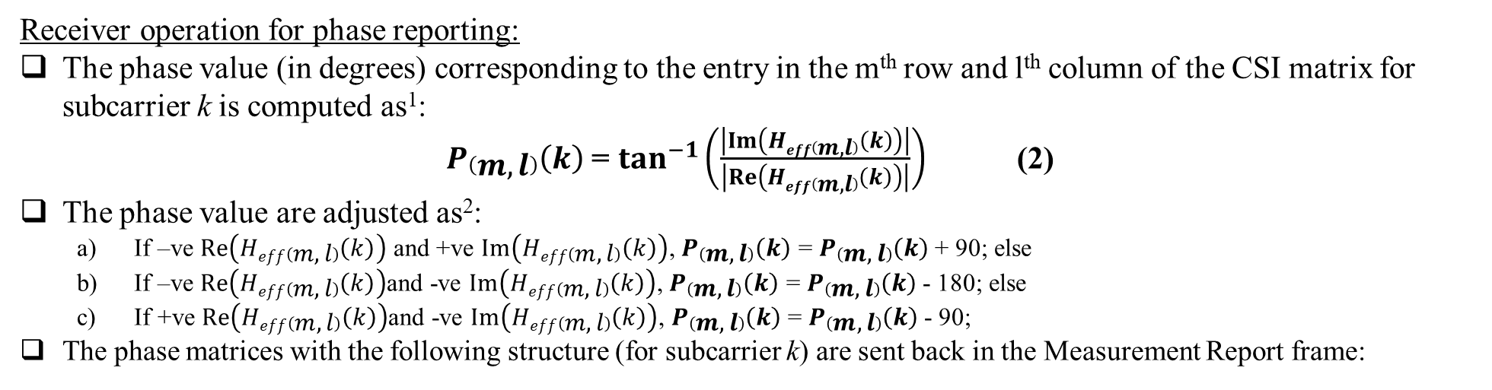
CSI_Phase
Receiver operation for phase reporting:
The phase value (in degrees) corresponding to the entry in the m^{th} row and l^{th} column of the CSI matrix for subcarrier k is computed as¹:
$P\left(m,l\right)\left(k\right)$ = $\tan^{−1}\left(\frac{\left|Im\left(Heff\left(m,l\right)\left(k\right)\right)\right|}{\left|Re\left(Heff\left(m,l\right)\left(k\right)\right)\right|}\right)$ (2)
The phase value are adjusted as²:
  If –ve $Re\left(Heff\left(m,l\right)\left(k\right)\right)$ and +ve $Im\left(Heff\left(m,l\right)\left(k\right)\right)$, $P\left(m,l\right)\left(k\right)$ = $P\left(m,l\right)\left(k\right)$+ 90; else
  If –ve $Re\left(Heff\left(m,l\right)\left(k\right)\right)$and -ve $Im\left(Heff\left(m,l\right)\left(k\right)\right)$, $P\left(m,l\right)\left(k\right)$ = $P\left(m,l\right)\left(k\right)$- 180; else
  If +ve $Re\left(Heff\left(m,l\right)\left(k\right)\right)$and -ve $Im\left(Heff\left(m,l\right)\left(k\right)\right)$, $P\left(m,l\right)\left(k\right)$ = $P\left(m,l\right)\left(k\right)$- 90;
The phase matrices with the following structure (for subcarrier k) are sent back in the Measurement Report frame:
For each reported subcarrier k include
{
Carrier Matrix Amplitude of 3 bits (M_{H}(k))
For each of Nr rows in each Phase matrix in order: (1, …, Nr)
{
Include Nc phase values computed from the real and imaginary parts of the corresponding entry of the CSI matrix Heff; each phase value using Nb bits.
}
}
=> Each Phase matrix is encoded using 3 + Nb x Nc x Nr bits.
Notes:
NOTE 1 – Alternate formulas may be used to compute the phase as well.
NOTE 2: The adjustments are required to make the phase to be in the range -180 to 180 since equation (2) returns angles in the range 0 to 90. If alternate functions are used to compute the phase instead of $\tan^{−1}$, and the return range is in -180 to 180, the phase adjustments are not required. Here, +ve means positive and -ve means negative.

Slide 13
CSI_Phase
Phase value encoding:
Either the 802.11n CSI matrices feedback encoding scheme [1], or the encoding schemes proposed in [3] or [5] may be used, except that the phase values are normalized between -180 to 180.
Phase value decoding:
Either the 802.11n CSI matrices feedback decoding scheme [1], or the decoding schemes proposed in [3] or [5] may be used.

Slide 14
CSI_Phase
Simulation results for 20 MHz channel (56 subcarriers), Nc = 3, Nr = 3
Feedback Bit size (Nb) | 11n encoding |  | Our Scheme |  | Difference
Feedback Bit size (Nb) | (SQNR, dB) | Total Size of Feedback Bits (3 + 2*Nb x Nc x Nr)*Ns | (SQNR, dB) | Total Size of Feedback Bits (3 + Nb x Nc x Nr)*Ns | (SQNR gain, dB) | Feedback Bit size reduction (%)
4 | 25.699 | 4200 | 23.262 | 2184 | -2.4376 | 48.00
6 | 38.008 | 6216 | 35.803 | 3192 | -2.2049 | 48.65
8 | 49.340 | 8232 | 47.823 | 4200 | -1.5176 | 48.98
It is observed that by only reporting the phase component, we achieve a feedback bit size reduction of close to 50%, with just a small loss in SQNR compared to 802.11n.

Slide 15
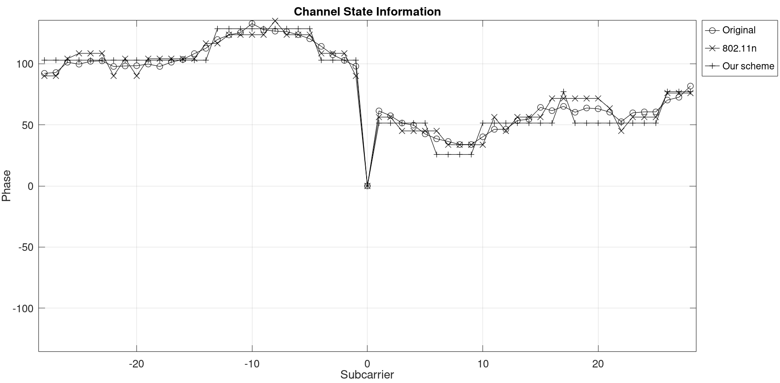
CSI_Phase
Simulation results for 20 MHz channel (56 subcarriers), Nc = 3, Nr = 3, Nb = 4

Slide 16

CSI_Phase
We note that if we increase the feedback bit size to 4200 for our scheme as well, we can use Nb = 8 for each entry.
Our curve is much closer to the Original curve.

Slide 17
An Example Overhead comparison
Feedback size (octets) for 80 MHz, Nb = 8; Ng = 4, number of reported subcarriers = 250:
Nr \ Nc | 1 | 2 | 3 | 4 | 5 | 6 | 7 | 8
2 | 1094 | 2094
 | 594 | 1094
 | 45.70% | 47.76%
3 | 1594 | 3094 | 4594
 | 844 | 1594 | 2344
 | 47.05% | 48.48% | 48.98%
4 | 2094 | 4094 | 6094 | 8094
 | 1094 | 2094 | 3094 | 4094
 | 47.76% | 48.85% | 49.23% | 49.42%
5 | 2594 | 5094 | 7594 | 10094 | 12594
 | 1344 | 2594 | 3844 | 5094 | 6344
 | 48.19% | 49.08% | 49.38% | 49.53% | 49.63%
6 | 3094 | 6094 | 9094 | 12094 | 15094 | 18094
 | 1594 | 3094 | 4594 | 6094 | 7594 | 9094
 | 48.48% | 49.23% | 49.48% | 49.61% | 49.69% | 49.74%
7 | 3594 | 7094 | 10594 | 14094 | 17594 | 21094 | 24594
 | 1844 | 3594 | 5344 | 7094 | 8844 | 10594 | 12344
 | 48.69% | 49.34% | 49.56% | 49.67% | 49.73% | 49.78% | 49.81%
8 | 4094 | 8094 | 12094 | 16094 | 20094 | 24094 | 28094 | 32094
 | 2094 | 4094 | 6094 | 8094 | 10094 | 12094 | 14094 | 16094
 | 48.85% | 49.42% | 49.61% | 49.71% | 49.77% | 49.80% | 49.83% | 49.85%
Partial CSI feedback results in 45% to 49.85% reduction in feedback size.
For each Nr, Nc pair:
1st row: 802.11n CSI feedback size
2nd row: Partial CSI feedback size
3rd row: Overhead reduction (%)
Due to the overhead reduction, partial CSI helps avoid segmentation of feedback reports in 10 out of 14 potential cases in this example.
Multiple feedback segments needed¹
A single feedback segment is enough
NOTE 1 – Assuming 11bf follows the same rule as that for compressed beamforming report: If the EHT compressed beamforming/CQI report solicited by the EHT beamformer would result in an EHT Compressed Beamforming/CQI frame that exceeds 11454 octets in length, then the EHT compressed beamforming/CQI report shall be split into up to eight feedback segments.

Slide 18
Straw Poll 1
Do you agree that the following two measurement report types are added to 11bf:
  CSI_Amplitude: Only the amplitude component of the CSI is reported.
  CSI_Phase: Only the phase component of the CSI is reported.
  Y/N/A

Slide 19
References
IEEE P802.11-2020
IEEE 802.11-21/0504r3, Specification Framework for TGbf, Claudio da Silva
IEEE 802.11-21/1573r1, Low-Complexity Scaling and Quantization for CSI Report, S. Shellhammer, et. al.,
IEEE 802.11-21/1595r0, Quantization Error Analysis for CSI Report, S. Shellhammer, et. al.,
IEEE 802.11-21/1676r0, Simplified Scaling Factor Feedback for CSI Matrices Quantization, Junghoon Suh et. al.
IEEE 802.11-10/1105r0, 11ac Explicit Sounding and Feedback, Hong Yuan Zhang et. al.
WiFi Sensing with Channel State Information A Survey, YONGSEN MA et. al.
Smart Home based on WiFi Sensing: A Survey, HONGBO JIANG et. al.
Device-Free Indoor People Counting Using Wi-Fi Channel State Information for Internet of Things, Yen-Kai Cheng et. al.
Wi-Fi Gesture Recognition on Existing Devices, Rajalakshmi Nandakumar, Washington University.
Passive WiFi CSI Sensing Based Machine Learning Framework for COVID-Safe Occupancy Monitoring, Aryan Sharma et. al.

