Slide 1
Coordination among multiple monostatic radar
Date: 06/Dec/2021
Authors:
Name | Affiliation | Address | Phone | Name
Rui Du | Huawei Technologies Co. Ltd | F3, Huawei Base, Shenzhen, China |  | ray.du@huawei.com
Yi Lv
Mengshi Hu

Slide 2
Outline
Abstract
Recap of WLAN sensing procedure
What we have in sensing instance ?
Why monostatic radar?
How monostatic radar?
Why multiple monostatic radar?
Standard support for multiple monostatic radar
Summary
References
Rui Du (Huawei)

Slide 3
Abstract
In previously contribution[1,2], monostatic radar is discussed as a potential sensing mode at 60 GHz.
This contribution focus on the discussion of multiple monostatic radar sensing at 60GHz. The advantages and feasibility is investigated initially in this contribution.
Rui Du (Huawei)

Slide 4
Recap of WLAN sensing procedure[3]
Rui Du (Huawei)

Slide 5
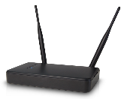




What we have in sensing instance ?
As the recap of WLAN sensing procedure shown in last slide, during the sensing instance, one to many or many to one sounding may happen[4].
In previous contribution[1,2], monostatic radar is discussed as one type of sensing mode that can be used for WLAN sensing.
Sensing PPDU transmission
Sensing Initiator
Sensing Receiver
Sensing Initiator
Sensing Transmitter
AP
AP
Sensing Responders
Sensing Transmitters
Sensing Responders
Sensing Receivers
STA1
STA2
STA3
STA4
STA1
STA2
STA3
STA4
Rui Du (Huawei)

Slide 6
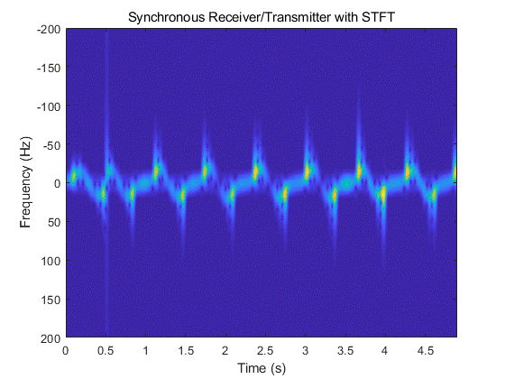
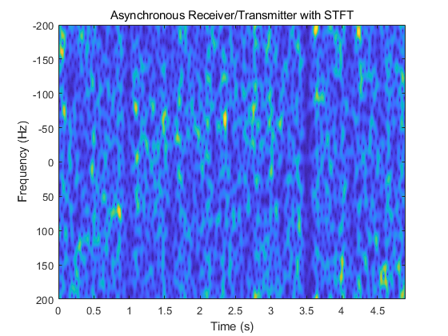
Why monostatic radar?
Compared with bistatic sensing, monostatic radar could achieve better performance because of the fully synchronization between transmitting chain and receiving chain.
An simple example is shown as follows. The transmitter and receiver are synchronized in left figure and are not fully synchronized in the right figure.
In monostatic radar, the Doppler component corresponding to the target is clear and the background noise is low.
In bistatic sensing, the background noise increases and the frequency is aliasing because of the carrier frequency offset between transmitting chain and receiving chain.
Rui Du (Huawei)

Slide 7
How monostatic radar?
As it is discussed in [5], monostatic radar could be realized with some bi-/multi- RF chains system at 60GHz.
Rui Du (Huawei)

Slide 8
Why multiple monostatic radar?
Compared with single monostatic radar, multiple monostatic radar mode provides transmitting diversity or receiving diversity which will enhance the sensing performance in different scenarios[4].
Compared with multistatic sensing mode(one to many or many to one), in multiple monostatic sensing mode, the transmitting chain and receiving chain at each individual monostatic radar node are fully synchronized and better performance usually could be achieved.
Rui Du (Huawei)

Slide 9
Standard support for multiple monostatic radar
Based on the discussion, the monostatic radar and multiple monostatic radar should be considered in WLAN sensing at 60GHz.
The coordination is needed to make multiple STAs operate in monostatic radar mode simultaneously (e.g. transmit simultaneously).
Relevant text in SFD.
In a WLAN sensing procedure, a sensing initiator might be a sensing transmitter, a sensing receiver, both or neither (Motion 10c, 21/0147r3; Motion 29, 21/1543r1).
In a WLAN sensing procedure, a sensing responder might be a sensing transmitter, a sensing receiver, or both (Motion 29, 21/1543r1).
Rui Du (Huawei)

Slide 10
Summary
In this contribution, the advantages of adopting monostatic radar in WLAN sensing is discussed.
Monostatic radar could achieve better performance because of the fully synchronization between transmitting chain and receiving chain. And multiple monostatic radar could take advantages of the monostatic radar and transmitting/receiving diversity.
In WLAN sensing, it is better to include the monostatic and multiple monostatic radar in WLAN sensing procedure.
Rui Du (Huawei)

Slide 11
Reference
[1] 11-21-0035-00-00bf-definitions-and-scenarios-of-the-wlan-sensing.pptx
[2] 11-20-1960-01-00bf-analysis-of-the-functionality-of-sensing.pptx
[3] 11-21-1321-01-00bf-wlan-sensing-procedure.pptx
[4] 11-21-0990-01-00bf-discussions-on-sensing-measurement-flows.pptx
[5] 11-19-1854-00-SENS-wlan-based-radars-in-the-60ghz-band.pptx
Rui Du (Huawei)

Slide 12
SP
Do you support monostatic and multiple monostatic radar in WLAN sensing procedure?
The details of the monostatic/multiple monostatic radar coordination are TBD.
  Yes:
  No:
  Abstain:
Rui Du (Huawei)

