Slide 1
DMG Sensing taxonomy
Date: 14-Nov-21
Authors:

Slide 2
Abstract
Introduction to the Outline of the DMG Sensing

Slide 3
DMG sensing types
# | Type | General definition | Protocol relevance | Conclusion
1 | Mono static | A device in which the transmitter and receiver are in the same STA (collocated) | 2, 3, 4, 5, 7, 8, 9 | Requires spec definition
2 | Multi Mono static | Coordination of multiple Monostatic devices | 2, 3, 4, 5, 6, 7, 8, 9 | Requires spec definition
3 | Bi static | A system comprising a transmitter and receiver that are in separate STAs. | 1, 2, 3, 4, 5, 6, 7, 8, 9 | Requires spec definition
4 | Multi static | A multistatic system is one in which there are at least three STAs - for example, one receiver and two transmitters, or two receivers and one transmitter, or multiple receivers and multiple transmitters. It is a generalization of the bistatic system | 1, 2, 3, 4, 5, 6, 7, 8, 9 | Requires spec definition

Slide 4
DMG sensing types (cont.)
# | Type | General definition | Protocol relevance | Conclusion
5 | Passive | A bistatic or multistatic system that exploits non sensing specific DMG transmissions of opportunity is termed a passive coherent location system. | 7, 8, 9 | TBD

Slide 5
Examples of the protocol features to be defined
# | Feature | Comments
1 | Unified waveform
2 | Backward compatible waveform | Coexistence, link access
3 | Initiator – responder relations to manage/maintain the measurement
4 | Setup of the measurement parameters
5 | Measurement schedule
6 | Coordination and/or synchronization between initiator and responder(s) during measurement(s)
7 | Positioning in the common coordinate system
8 | Reporting of the measurement results to the initiator
9 | Protection of the measurement setup and reporting

Slide 6
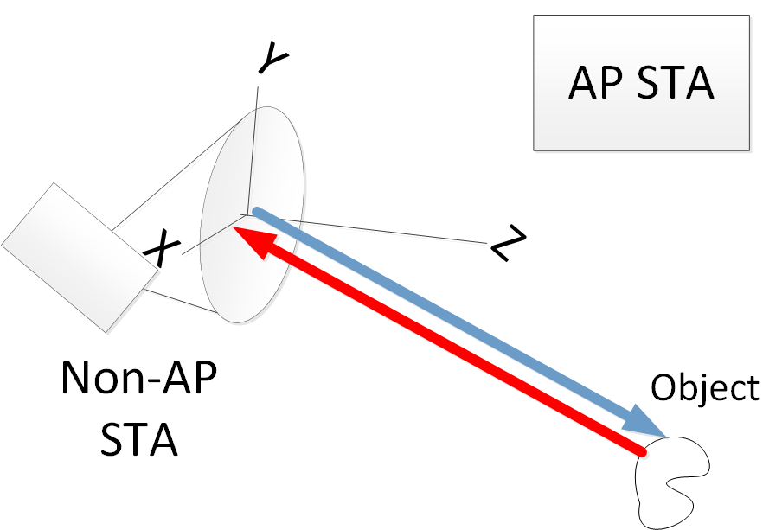
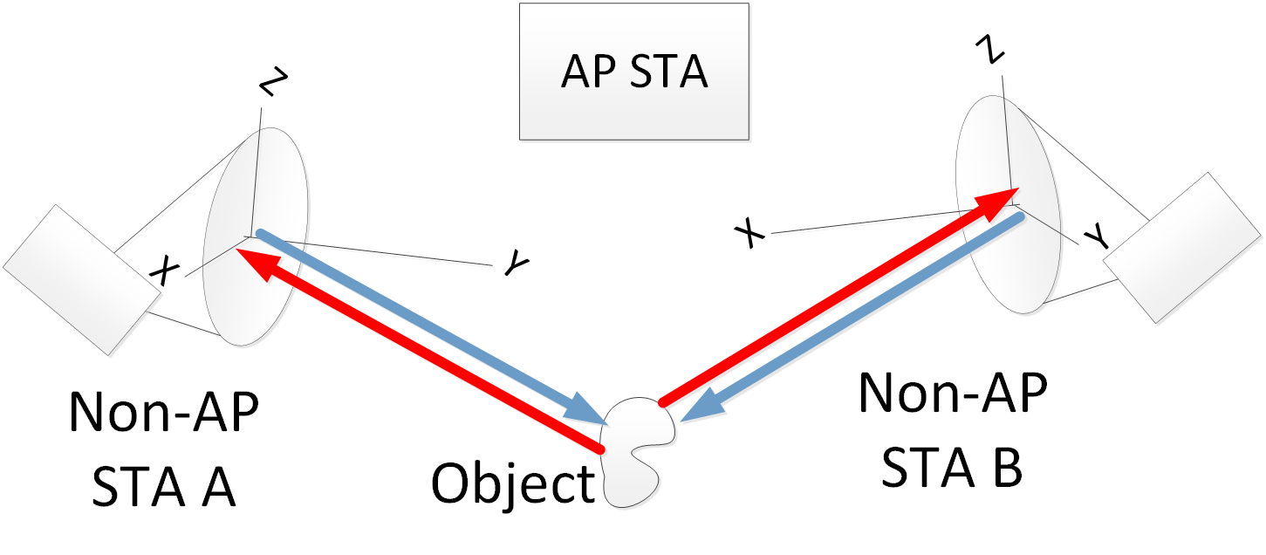
Monostatic device – TX and RX in the same STA
Multi-Monostatic system

Slide 7
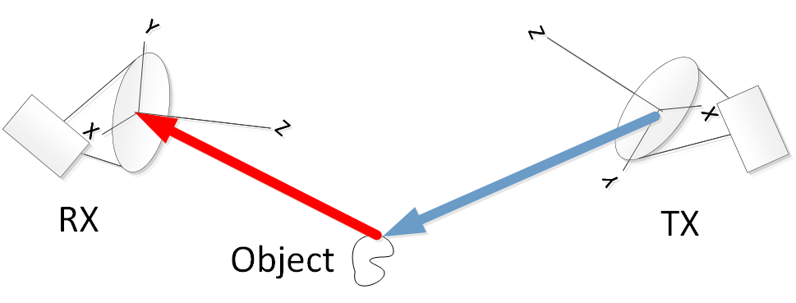
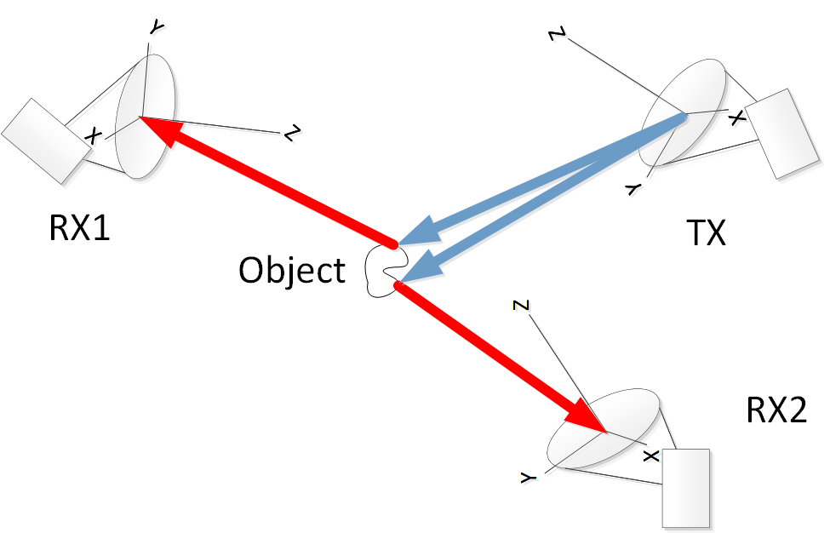
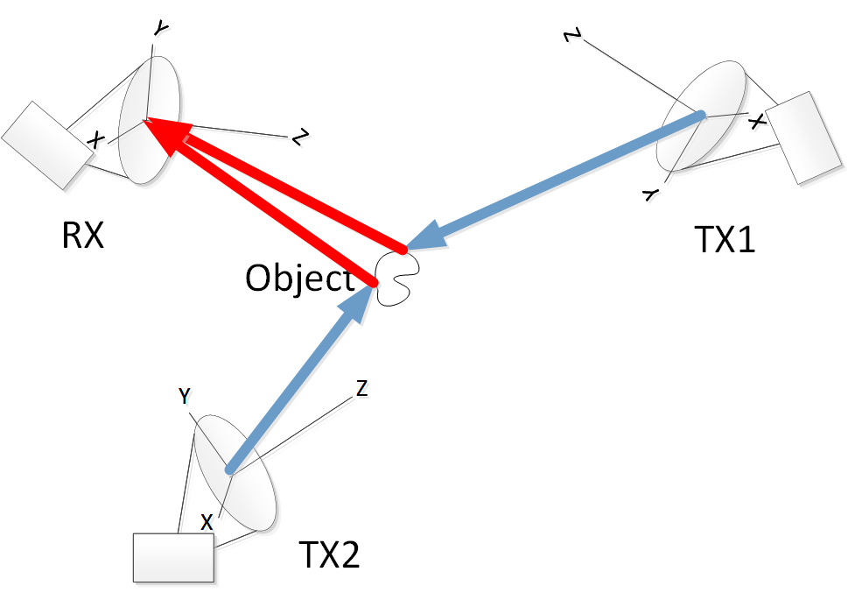
Bistatic system – one TX STA, one RX STA
Multistatic System – one TX STA, two RX STAs
Multistatic System – one RX STA, two TX STAs

Slide 8
SP1
Do you agree that the 802.11bf shall support DMG sensing systems of the types indicated in slide 3, 4?

