Slide 1
November 2021
LAA/Wi-Fi Coexistence Experiments: preliminary results
Date: 2021-11-15
Authors: Monisha Ghosh and Muhammed Iqbal Rochman
Name | Affiliations | Address | Phone | email
Monisha Ghosh | University of Chicago |  | 914-953-1800 | monisha@uchicago.edu
Muhammed Iqbal Rochman | University of Chicago |  | 773-808-4193 | muhiqbalcr@uchicago.edu
Slide 1
Monisha Ghosh, University of Chicago
Notes:
doc.: IEEE 802.11-yy/xxxxr0
Month Year
John Doe, Some Company
Page 1

Slide 2
November 2021
Abstract
In our past work on studying LAA/Wi-Fi coexistence using deployed LAA base-stations, we deployed Wi-Fi APs that could be controlled to operate on the same channel as LAA and we demonstrated significant degradations on throughput when LAA was operating. In this work we present preliminary results on experiments where we studied the effect on ambient Wi-Fi usage when LAA operates in the vicinity.
Slide 2
Monisha Ghosh, University of Chicago
Notes:
doc.: IEEE 802.11-yy/xxxxr0
Month Year
John Doe, Some Company
Page 2

Slide 3
November 2021
Recap: Hidden Node Experiments
Experiment 1, IIT: A hidden node scenario with a deployed T-Mobile LAA small cell coexisting with 5 Wi-Fi APs that we deployed to study performance in a controlled manner. We observe that the Wi-Fi clients experience association problems when they try to connect to their corresponding Wi-Fi APs. This is due to the LAA BS being unaware of the Wi-Fi AP’s transmission and transmitting with the maximum transmission opportunity time (TXOP) of 8 ms.
Experiment 2, UChicago: A hidden node scenario with a deployed AT&T LAA small cell coexisting with the 3 Wi-Fi APs that we deployed inside the UChicago bookstore in close proximity to the outdoor LAA. We present one set of results where 5 Wi-Fi clients are associated with one AP, which operates with a 80 MHz bandwidth and primary channel 157. We performed three different kinds of experiments: (i) clients midway between LAA & Wi-Fi, (ii) clients close to the Wi-Fi AP, and (iii) clients close to the LAA BS.
Slide 3
Monisha Ghosh, University of Chicago
Notes:
doc.: IEEE 802.11-yy/xxxxr0
Month Year
John Doe, Some Company
Page 3

Slide 4
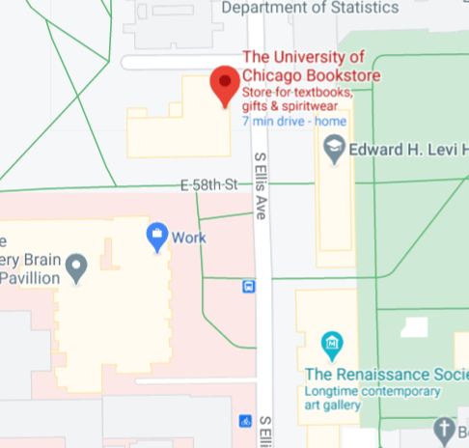
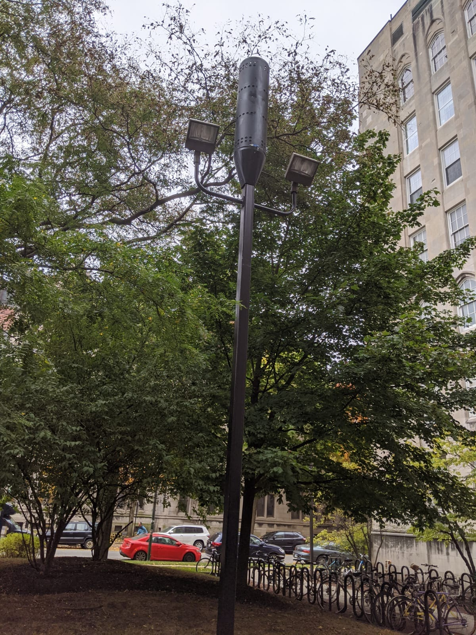
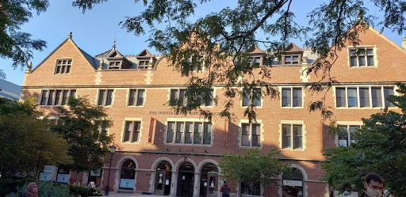
November 2021
Experiment area: UChicago Bookstore
Wi-Fi Aps
3rd floor
@
Bookstore
89.91 ft
27.4 m
AP1
Clients
Close to
Wi-Fi AP
136.96 ft
41.7 m
AP3
AP2
261.7 ft
79.8 m
Clients at
Center
Location
217.59 ft
66.3 m
Clients
Close to
LAA BS
132.90 ft
40.5 m
Wi-Fi AP Deployment
LAA BS
(outdoor)
AT&T LAA Deployment
40.12 ft
12.23 m
Note: The LAA BS operates on 3 unlicensed channels: 149, 153, and 157. Ambient Wi-Fi APs operated primarily on Channels 36 (U-NII-1), 100 (U-NII-2) and 149 (U-NII-3).
Slide 4
Monisha Ghosh, University of Chicago
Notes:
doc.: IEEE 802.11-yy/xxxxr0
Month Year
John Doe, Some Company
Page 4

Slide 5
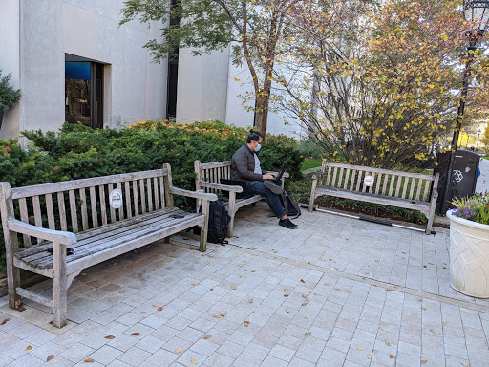
November 2021
Experiment: Wi-Fi Clients and Wireshark
3 Google Pixel 5 phones used as client devices: a Wi-Fi client, a LAA client and and idle client.
The active clients performed a background download, conducted FCC Speedtests (download, upload and latency) every minute, and ran SigCap.
The idle client just ran SigCap.
In addition, Wireshark was deployed on a laptop in the same are as the clients.
The experiment was conducted in a location close to the bookstore where a number of APs have been recently upgraded.
The primary channel chosen by these APS could not be controlled, and no other APs were deployed.
Wireshark
Area
C
D
B
A
LAA
Client
Location: close to bookstore
Slide 5
Monisha Ghosh, University of Chicago
Notes:
doc.: IEEE 802.11-yy/xxxxr0
Month Year
John Doe, Some Company
Page 5

Slide 6
November 2021
Experiment description
We assume that we are the only LAA user in the vicinity
  LAA-capable phones are new and expensive, therefore not widely used
    Confirmed by measurements showing all RBs allocated to our device.
We collected measurements for ~15 mins each in the following scenarios:
  Ambient (AMB): ambient Wi-Fi only. This was the baseline behavior in the area.
  Wi-Fi + Ambient (Wi-Fi + AMB): Our Wi-Fi client started a background download and simultaneously conducted FCC Speedtests every minute. The Wi-Fi client was connected to eduroam during this experiment and was connected to an AP with primary channel 48 (in U-NII-1) using 20 MHz.
  LAA + Ambient (LAA + AMB): The LAA client started a background download and simultaneously conducted FCC Speedtests every minute. LAA used Channels 149, 153 and 157 all through the experiment.
  LAA + Wi-Fi + Ambient (LAA + Wi-Fi + AMB): The LAA and Wi-Fi clients both started background downloads and simultaneously conducted FCC Speedtests every minute. LAA used Channels 149, 153 and 157 all through the experiment.
Slide 6
Monisha Ghosh, University of Chicago
Notes:
doc.: IEEE 802.11-yy/xxxxr0
Month Year
John Doe, Some Company
Page 6

Slide 7
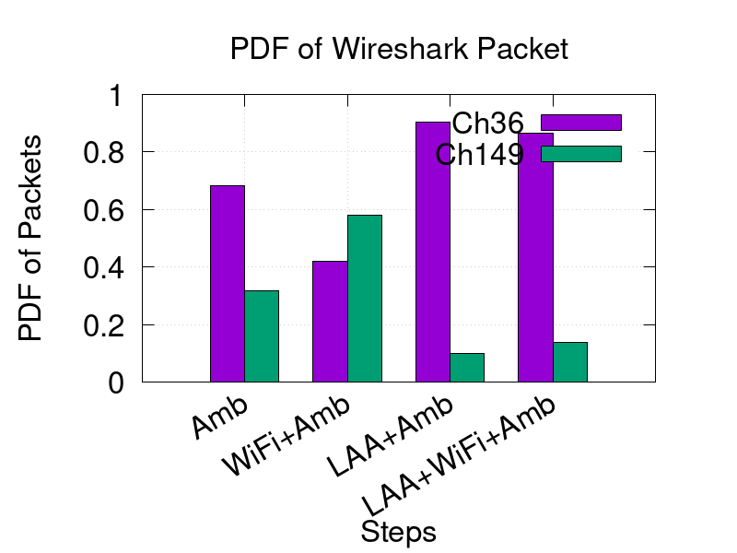
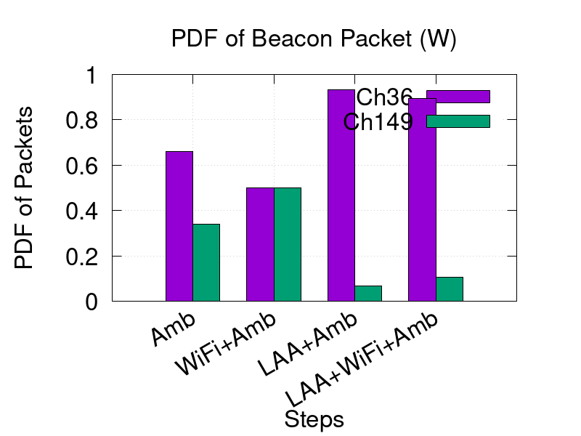
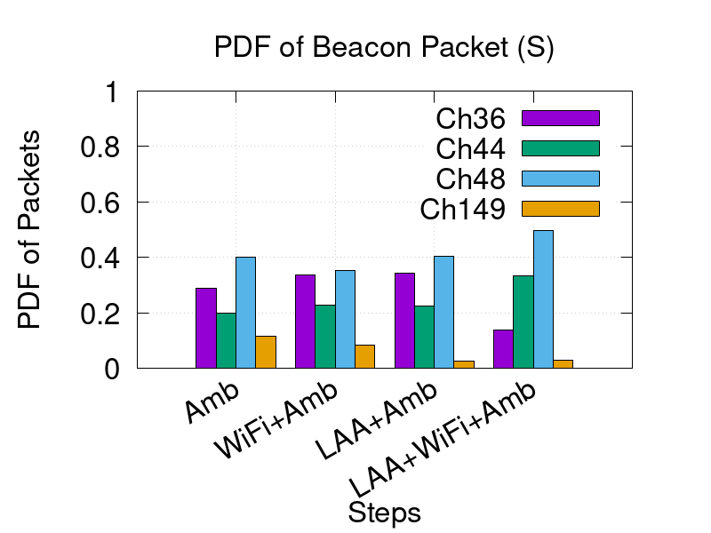
November 2021
Distribution of packets captured, Wireshark and SigCap
Wireshark, data packets
Wireshark, beacon packets
SigCap, beacon packets
The number of packets captured by Wireshark and SigCap demonstrate a trend where the number of data packets and beacons on Channel 149 decrease when LAA is activated.
Slide 7
Monisha Ghosh, University of Chicago
Notes:
doc.: IEEE 802.11-yy/xxxxr0
Month Year
John Doe, Some Company
Page 7

Slide 8
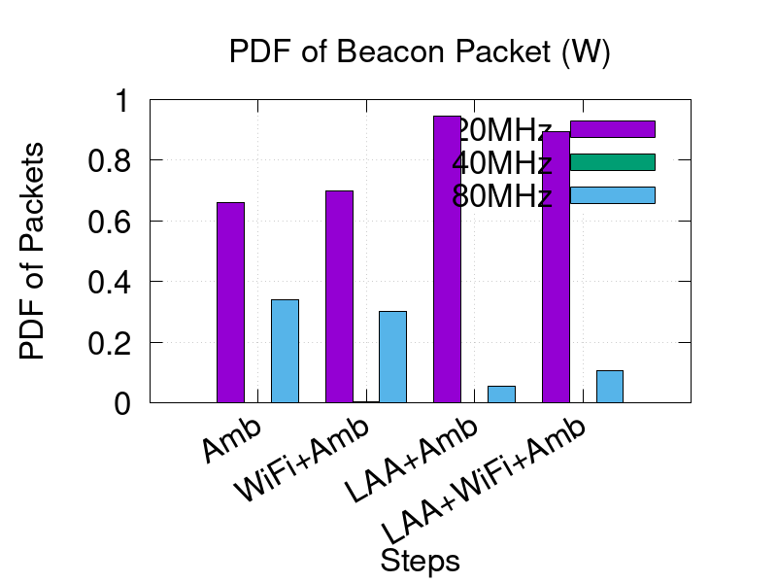
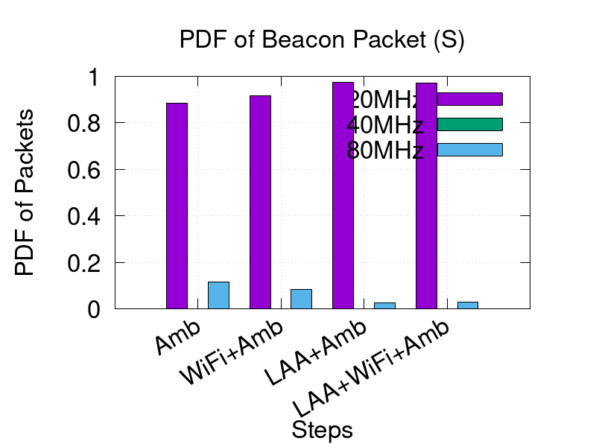
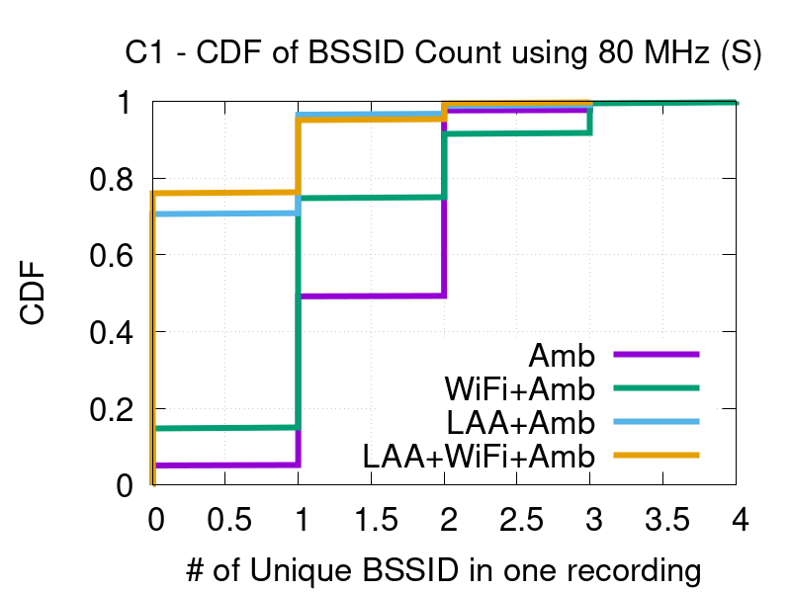
November 2021
Distribution of BW used, Wireshark and SigCap
Wireshark, beacon packets
SigCap, beacon packets
SigCap, BSSID distribution
80 MHz usage decreases once LAA is activated, since LAA uses 3 channels in U-NII-3
Slide 8
Monisha Ghosh, University of Chicago
Notes:
doc.: IEEE 802.11-yy/xxxxr0
Month Year
John Doe, Some Company
Page 8

Slide 9
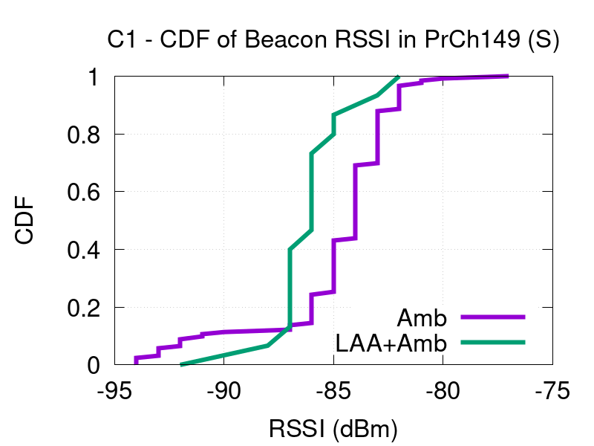
November 2021
Distribution of Beacon RSSI on Channel 149, SigCap
Degradation of beacon RSSI on Channel 149 when LAA is activated: effect of LAA not backing off due to being hidden from the indoor Wi-Fi APs.
Slide 9
Monisha Ghosh, University of Chicago
Notes:
doc.: IEEE 802.11-yy/xxxxr0
Month Year
John Doe, Some Company
Page 9

Slide 10
November 2021
Key takeaways and ongoing work
    It appears from these measurements that the deployed Wi-Fi APs are quite static in the choice of primary channel: there seems to be room to improve coexistence performance by switching channels.
      LAA too is quite static in choice of channels.
      There are Wi-Fi beacons on U-NII-2 channels, and even a handful of 160 MHz channels are seen, but no data packets. And LAA does not seem to use U-NII-2 at all.
  Ongoing experiments with different locations, multiple devices etc.: welcome feedback on scenarios of interest.
Slide 10
Monisha Ghosh, University of Chicago
Notes:
doc.: IEEE 802.11-yy/xxxxr0
Month Year
John Doe, Some Company
Page 10

