Slide 1
p2p Support in Restricted TWT: Use Cases and Signaling Design Discussion
Date: 2021-11-11
Authors:
Name | Affiliations | Address | Phone | email
Muhammad Kumail Haider | Meta | 1180 Discovery Wy, Sunnyvale, CA |  | kumail.lums@gmail.com
Chunyu Hu
Chitto Ghosh
Binita Gupta
Morteza Mehrnoush
Payam Torab

Slide 2
Abstract
Discuss restricted TWT (r-TWT) use for peer-to-peer (p2p) communication
  An example of p2p use-case
  Proposed signaling design
  Example scenario with the new signaling

Slide 3
Background
Several comments in D1.0 CC36 regarding p2p support in r-TWT feature (#4778, #6408)
21/1224 proposed adding a new Broadcast Recommendation value for p2p support in r-TWT. However, the resolution of p2p related CIDs was deferred pending further discussion. Key comments:
  Clarify with examples of use-case and signaling
  Clarify distinction between Recommendation Values 4 and 5
  MU RTS TXS Trigger scheduling provisions for p2p need further clarification; also specify both AP and STA support the feature
This document follows up on the discussion to address aforementioned comments.

Slide 4




Use Case Example
AP
STA2 connecting to cloud via STA1 on tethered link
  Link 1: between AP and STA1 in an infrastructure BSS
  Link 2: p2p link between STA 1 and STA 2.
  Assumptions:
    Link 1 and Link 2 are on the same channel (in congested scenarios p2p link may have to be co-channel with BSS)
    Traffic over Link2 is not necessarily forwarded from Link1 (e.g. STA1 does rendering computation for STA2)
    STA 2 may not be associated with the AP or in range of the AP. STA 2 may be in range of other STAs in the BSS.
  Objective: Provide support in r-TWT for STA1’s Latency Sensitive Traffic (LST) with STA 2.
    p2p traffic also benefits from r-TWT SP start boundary protection
    Some LST on p2p link may be to/from cloud (e.g., cloud gaming or various VR applications) and going through STA1. As such, using a single r-TWT SP for UL/DL + p2p traffic is a huge plus for STA1’s power saving and overall latency performance of application
Link1
STA 2
Link2
tethered link
STA 1

Slide 5
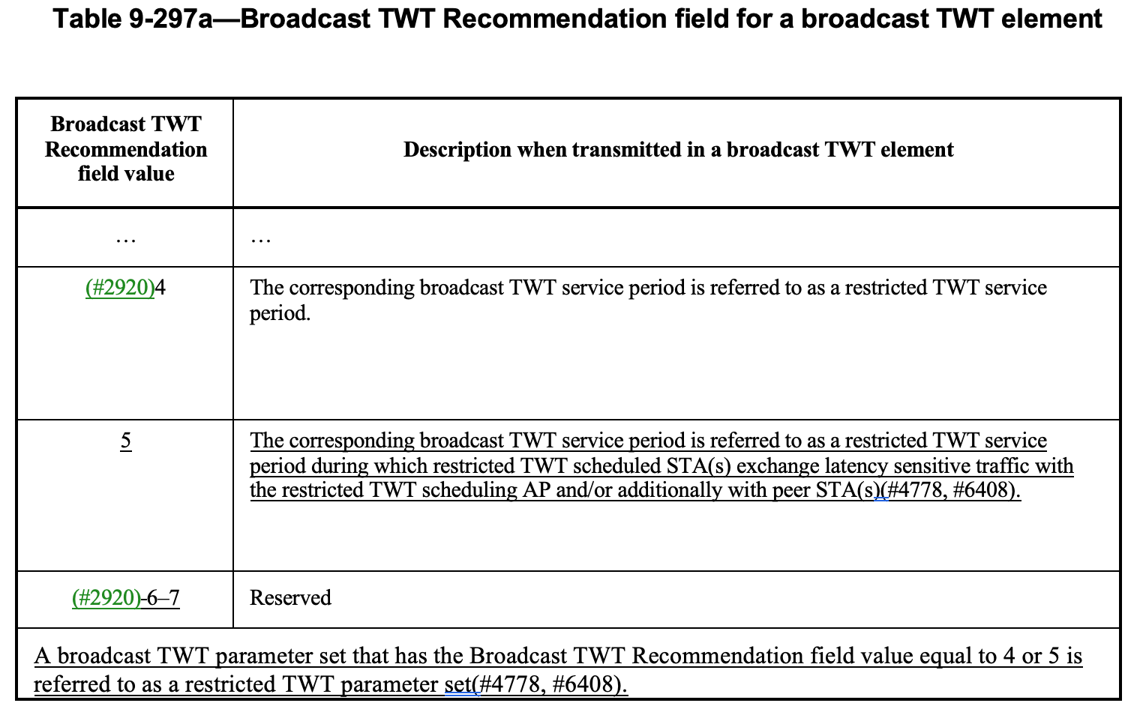
r-TWT support for p2p: Signaling
Proposed to use new Broadcast TWT Recommendation value 5 in 21/1224
  Recommendation value 5 explicitly indicates both UL/DL and p2p exchanges are allowed in SP
  Benefits of explicitly signaling in separate Recommendation Value
    In announcements, AP can specifically advertise schedule(s) during which it is willing to support p2p traffic
    During r-TWT setup, STA can explicitly convey its intention to use SP for its p2p traffic, and also optionally get resources from AP (see next slide)

Slide 6
r-TWT support for p2p: Optional TXOP sharing
Proposed text in 35.7.4.1:
  “If both the r-TWT scheduling AP and r-TWT scheduled STA have the Triggered TXOP Sharing Support subfield in EHT Capabilities element to 1, and if Trigger frame(s) are addressed to the r-TWT scheduled STA by the AP in a trigger-enabled restricted TWT service period negotiated with the STA with Broadcast TWT Recommendation field equal to 5, then at least one Trigger frame shall be an MU RTS TXS Trigger frame with TXOP Sharing Mode subfield equal to 2. The r-TWT scheduling AP is not expected to schedule for transmission MU RTS TXS Trigger frames with TXOP Sharing Mode subfield to 2 that are addressed to an r-TWT scheduled STA which establishes membership in one or more r-TWT schedule(s) with Recommendation value 5 outside of the corresponding TWT SPs.”
  Above statement doesn’t preclude EDCA based access if the STA doesn’t support TXOP sharing
  Advantages for STA to get AP’s assistance with TXOP sharing vs contending for its p2p traffic :
    STA is allocated time in TXOP for its p2p traffic each SP without contention
    Allocation of MU RTS TXS Trigger gives incentive to STA(s) to wait until trigger to deliver p2p traffic
    AP can manage p2p transmissions on the same channel by controlling when TXOPs are allocated, and reduce interference

Slide 7
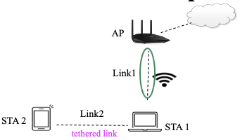
Example usage scenario of proposed signaling
TWT IE indicates bTWT ID i with Recom. value 5
R-TWT SP (bTWT ID i)
Beacon
TWT Resp
Basic Trig
MU RTS
TXS Trig
TXOP sharing mode 2
BA
Link 1
AP
STA1
CTS
TWT Req
TB PPDU
STA establishes mem in schedule with bTWT ID i with Recom. value 5
TXOP used for p2p traffic
DATA
BA
Link 2
STA1
STA2
BA
DATA
  AP advertises p2p support in r-TWT schedule with bTWT ID i by indicating Recommendation value 5 in corresponding restricted parameter set field of TWT IE in beacon
  STA1 sends a TWT request frame and includes a restricted TWT parameter set field with bTWT ID 5 and Recom value 5. It indicates TID t in UL as well, and indicates its resource requirements (SP duration, interval) via TWT parameters. It optionally includes TSPEC(s) to describe traffic’s QoS characteristics
  AP sends TWT Response frame with ACCEPT TWT
  At r-TWT SP start, AP first solicits STA1’s UL traffic of TID t using Basic Trigger frame (could trigger multiple STAs)
  AP then sends an MU RTS TXS Trigger to STA1 with TXOP Sharing Mode 2
  STA1 uses allocated TXOP to exchange LST on Link2 with STA2.

Slide 8
Recommendation Value Setting Possibilities
Below table gives further examples of possible Recommendation value settings in announcements and TWT negotiations
  The possible values are indicated inside a restricted TWT parameter set in Broadcast TWT Recommendation subfield
  For simplicity, we show the Recommendation Value in the initial TWT Request frame, and the final TWT Response frame with ACCEPT TWT; the negotiation may comprise multiple frame exchanges
Scenario ID | Announcement (Beacons) | TWT Request | TWT Response | R-TWT SP Traffic Type Allowed for member STA
1 | 5 | 5 | 5 | UL/DL + p2p
2 | 5 | 4 | 4 | UL/DL
3 | 4 | 5 | 4 | UL/DL
4 | 4 | 5 | 5 | UL/DL + p2p

Slide 9
Summary
Discuss signaling design for p2p support in r-TWT and clarify/extend rules for using MU RTS TXS Trigger with TXOP Sharing Mode 2 for p2p traffic
Example use case scenario and how the proposed signaling may be used
p2p support in r-TWT can help latency sensitive traffic on p2p link benefit from start boundary protection and scheduling of r-TWT, and can help improve overall latency for several applications and use cases where p2p traffic is involved

