Slide 1
November 2021 802.19 Liaison Report
Date: 2021-11-08
Authors:
Notice: This document has been prepared to assist IEEE 802.19. It is offered as a basis for discussion and is not binding on the contributing individual(s) or organization(s). The material in this document is subject to change in form and content after further study. The contributor(s) reserve(s) the right to add, amend or withdraw material contained herein.

Slide 2
Voters and Voting Rights
IEEE 802.19 has 51 voting members
This meeting provides attendance credit towards voting rights
Future Electronic Interims are likely to provide attendance credit for voting rights
You must pay the registration fee in order to attend
If you have not already done so, you can register here or follow the registration link here http://802world.org/plenary/
If you do not intend to register for this session you must leave this meeting and, if you have logged attendance on IMAT, email the 802.19 chair or vice chair to have your attendance cancelled

Slide 3
Current ePoll
The following ePoll is running during the IEEE 802 Electronic Plenary session
“If the 2022 March 802 Plenary session is held in-person, will you attend?”
The IEEE 802 Executive Committee will meet on December 7 and at that time will decide if the March Plenary session will be held in-person

Slide 4
IEEE 802 Frequency Tables – Activity
IEEE 802.18 and 802.19 continue to jointly develop a Spreadsheet for IEEE 802 Frequency Table providing information about the Frequency Bands used by various 802 Standards/Amendments
Steve Shellhammer has been the 802.19 representative
The group has agreed on the format of the Frequency Table
Refinements have been made over the last few meetings
Recently Steve S. and Eduard Au providing input on the various 802.11 PHY Amendments
  Detailed Frequency Bands for each PHY is under development
The latest working version of the Frequency Table document is available on Mentor,
  https://mentor.ieee.org/802.18/dcn/21/18-21-0036-07-0000-frequency-table-template.xlsx
Anyone who wants to participate please reach out to Jay or Steve

Slide 5
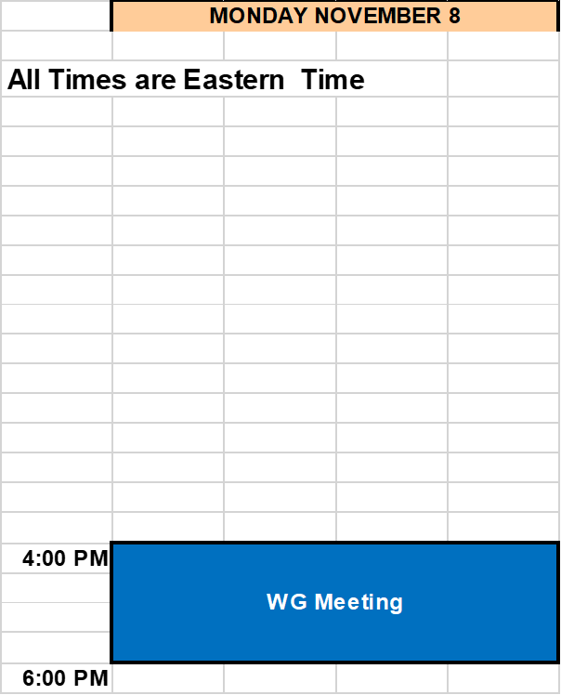
Schedule

