Slide 1
OpenRoamingTM Tutorial
IEEE 802 Plenary, November 2021
Date: 2021-11-08
Author:

Slide 2
Abstract
OpenRoaming Tutorial
This tutorial covers the current issues with public Wi-Fi connectivity and provides details on how OpenRoaming enables “One Global Wi-Fi Network” with simple, seamless, and secure connections to public Wi-Fi networks all around the world.

Slide 3
Outline
Opportunities with public Wi-Fi networks
Challenges with public Wi-Fi connection
Standards work
OpenRoaming Federation
OpenRoaming architecture
Future work and capabilities needed from IEEE 802.11

Slide 4
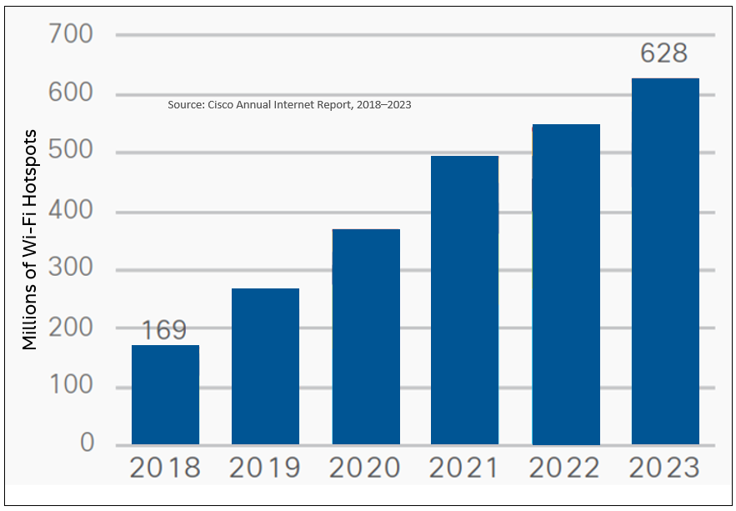
Opportunity: Global Wi-Fi Hotspots
Hundreds of millions of public Wi-Fi networks to connect to around the world
Notes:
Public Wi-Fi Networks are everywhere coffee shops, hotels, trains….. Wi-Fi use is growing fast.

Slide 5
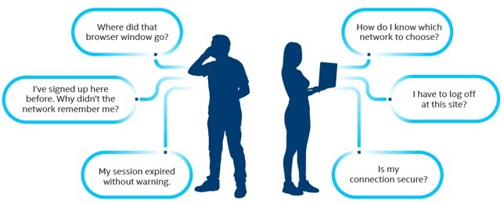
Friction at Public Wi-Fi Connections
Click on Wi-Fi icon
Figure out the SSID
Launch a web browser
Accepts terms and conditions
Enter credentials - if any
How will my email to be used?
Security!!!!
Not connecting!

Slide 6
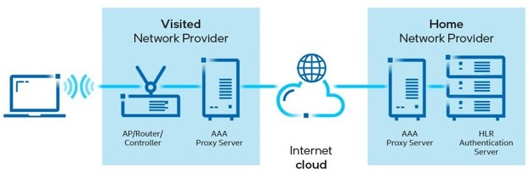
What is Behind the Wi-Fi Connectivity Problem?
  Fragmentation and friction
    Captive portals, different mechanisms to sign up, inconsistent experiences – shared keys, non-secure open networks, email, phone number, room number, airport coupon, ask password of provider, Passpoint networks…..
  Challenges with enabling global Wi-Fi roaming
    Bilateral roaming agreement is a long and
    tedious process involving technical,
    business, financial and legal steps.
    Millions of Wi-Fi hotspots available globally
    by different providers - operators, venues,
    public spaces, enterprises, cities and others
    It is not easy to establish global Wi-Fi roaming
    network because of the fragmentation.

Slide 7
Previous Standards Work
IEEE 802.11u – Interworking with External Networks
Defined network discovery capabilities
Generic Advertisement Service frames
Access Network Query Protocol (ANQP)
Roaming Consortium element
NAI Realm
Venue type
Access Network type
Others…
Wi-Fi Alliance® (WFA)
Passpoint – based on IEEE 802.11u
Launched in 2012
Wireless Broadband Alliance (WBA)
Next Generation Hotspots with Passpoint + Wireless Roaming Intermediary eXchange (WRIX) framework

Slide 8
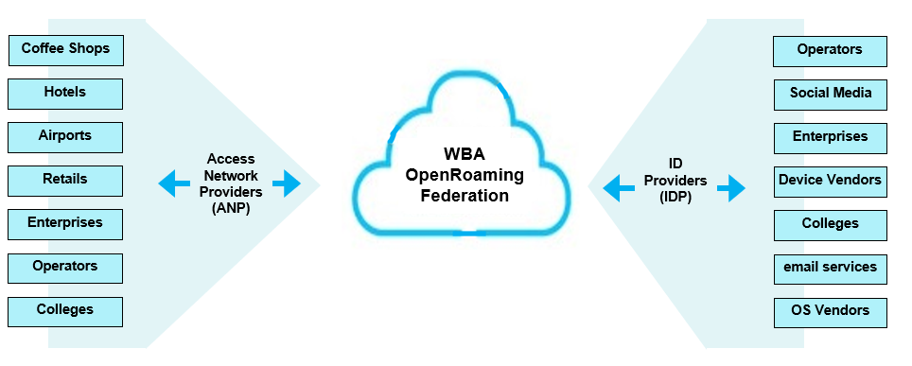
OpenRoaming Federation – Game Changer!
Slide 8
Notes:
OpenRoaming brings together a federation of networks and identity providers, allowing users to join any network managed by a federation member.

Slide 9


OpenRoaming: Creates a ubiquitous blanket of Wi-Fi coverage around the globe!
        Framework to interconnect Wi-Fi networks globally
        Addresses roaming issues
        Enables seamless and secure public Wi-Fi network connection
Slide 9
Necati Canpolat (Intel)

Slide 10
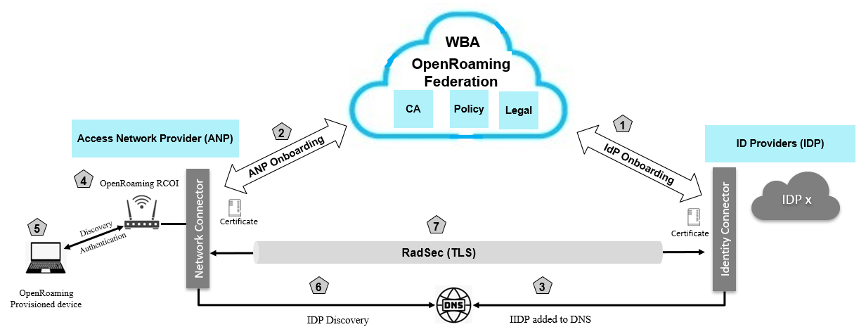
OpenRoaming – How it works?
Network Access:
  Device is provisioned with OpenRoaming profile
  ANP AP advertises “Federated Roaming RCOI in the beacon.
  Device discovers OpenRoaming network
  Device attaches ANP AP using OpenRoaming profile.
  ANP finds IDP in DNS
  Secure and authenticated tunnel establishment
Onboarding ANPs and IDPs:
  ANPs and IDPs registers with OpenRoaming Federation
  OpenRoaming Federation verifies them and issues certificates and WBAID
  IDPs are added to OpenRoaming DNS
Slide 10
Necati Canpolat (Intel)
Notes:
RadSec provides a means of securing the communication between two RADIUS peers.

Slide 11
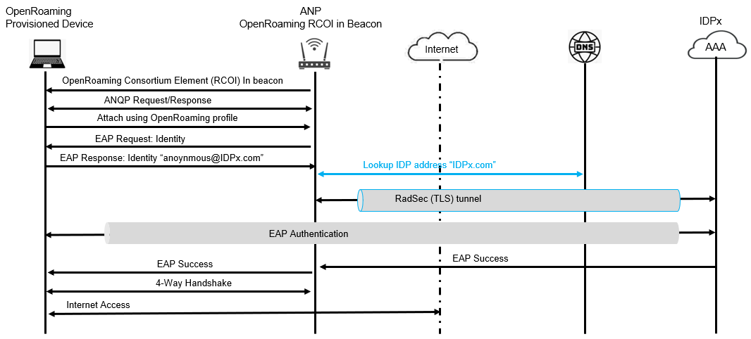
OpenRoaming Discovery and Authentication Flow
Slide 11
Necati Canpolat (Intel)

Slide 12
OpenRoaming – Specification Timelines
Release 1
  June 2020
  Architecture framework
  Legal framework
  Database automation
  CA & PKI
  Settlement free focus
Release 2
  June 2021
  Settled Access
  SLAs
Release 3
  2022
  Automated tools
  Private 5G/3GPP
  IoT
Slide 12
Necati Canpolat (Intel)

Slide 13
IEEE 802.11 Future Support for OpenRoaming
Currently uses IEEE 802.11u defined:
Roaming Consortium element
ANQP elements
Additional ANQP elements are needed:
Realm (NAI) exclusion list
Service Level Agreements (SLAs)
Credential types
Submitted to REVme and to be approved
Slide 13
Necati Canpolat (Intel)

Slide 14
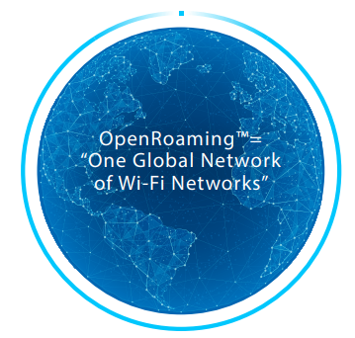
Simple, Seamless and Secure public Wi-Fi connectivity with global scale
Slide 14
Necati Canpolat (Intel)
Notes:
Connect to public Wi-Fi networks seamlessly and securely – globally!
Trains, hotels, cafes, airport, colleges….
No searching for networks
No sharing passwords
No multi steps manual process for registration to get onto network
No open unsecure public Wi-Fi networks - Fully secure – privacy protected
Just connect!
Based on the industry approved standards!
- Passpoint, secure PKI based framework and cloud based federation, identity management for ANPs and IDPs with unique WBAID to guarantee security, OR Privacy policy restricts the usage of personal information

Slide 15
Resources
Intel OpenRoaming Whitepaper:
OpenRoaming: One Global Network of Wi-Fi Networks
WBA OpenRoaming
https://wballiance.com/openroaming/
Cisco Annual Internet Report 2020, https://www.cisco.com/c/en/us/solutions/executive-perspectives/annual-internet-report/index.html
Slide 15
Necati Canpolat (Intel)

Slide 16
Thank You!

