Slide 1
Imaging Radar data report
Date: 08-Nov-21
Author:
Name | Affiliation | Address | Phone | Email
Alecsander Eitan | Qualcomm |  |  | eitana@qti.qualcomm.com
Assaf Kasher | Qualcomm |  |  | akasher@qti.qualcomm.com
Solomon Trainin | Qualcomm |  |  | strainin@qti.qualcomm.com

Slide 2
Agenda
This presentation introduces the Imaging Radar
We present the typical processing of an Imaging Radar
Discuss the report options and evaluate them

Slide 3
Imaging Radar
Imaging Radar provides “image” of the scene
The image is:
2D (Az, Range or Az, El or Range, Doppler)
3D (Az, El, Range or Az, Range, Doppler)
4D (Az, El, Range, Doppler)
Typical Imaging Radar processing block diagram
Notes:
2D is a two-dimensional data, 3D is a three-dimensional data and 4D is a four-dimensional data
Az and El are Azimuth and Elevation
CFAR is - “Constant False Alarm Rate”. CFAR detection refers to a common form of adaptive algorithm used in radar systems to detect target returns against a background of noise, clutter and interference)

Slide 4
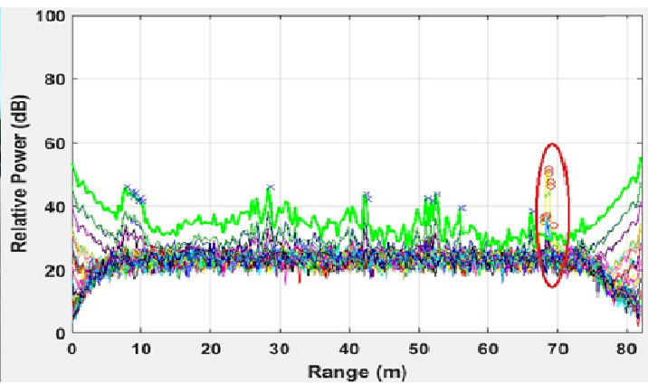
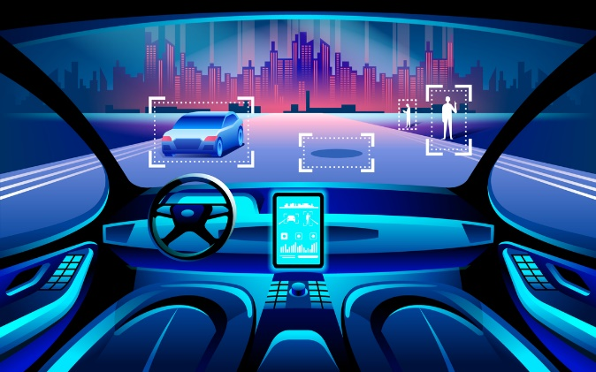
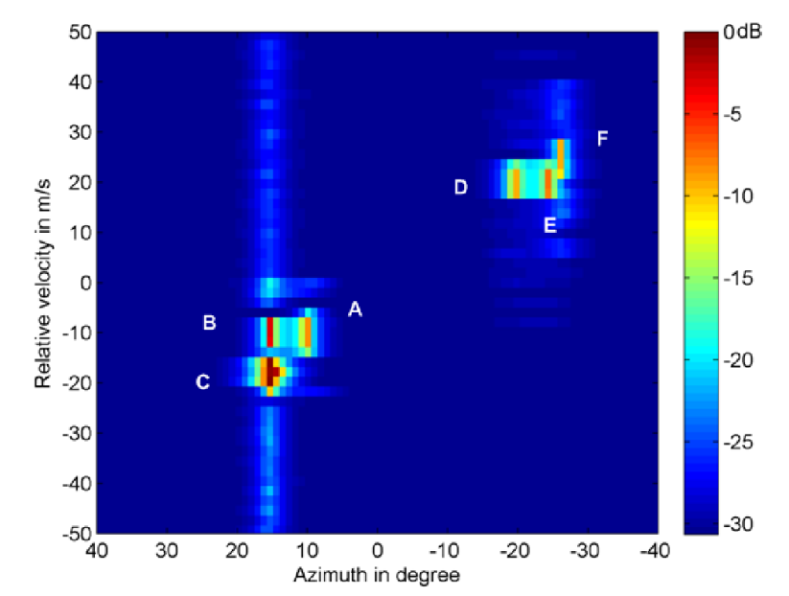
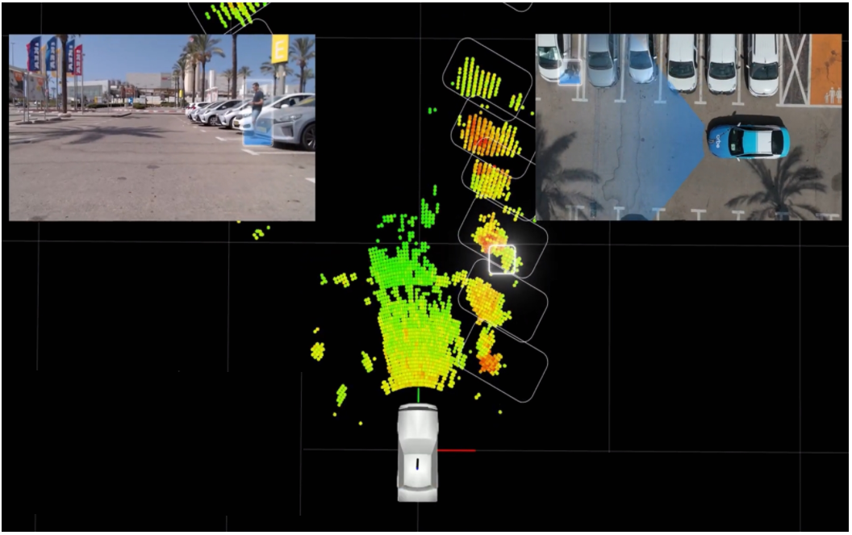
Imaging Radar Data

Slide 5
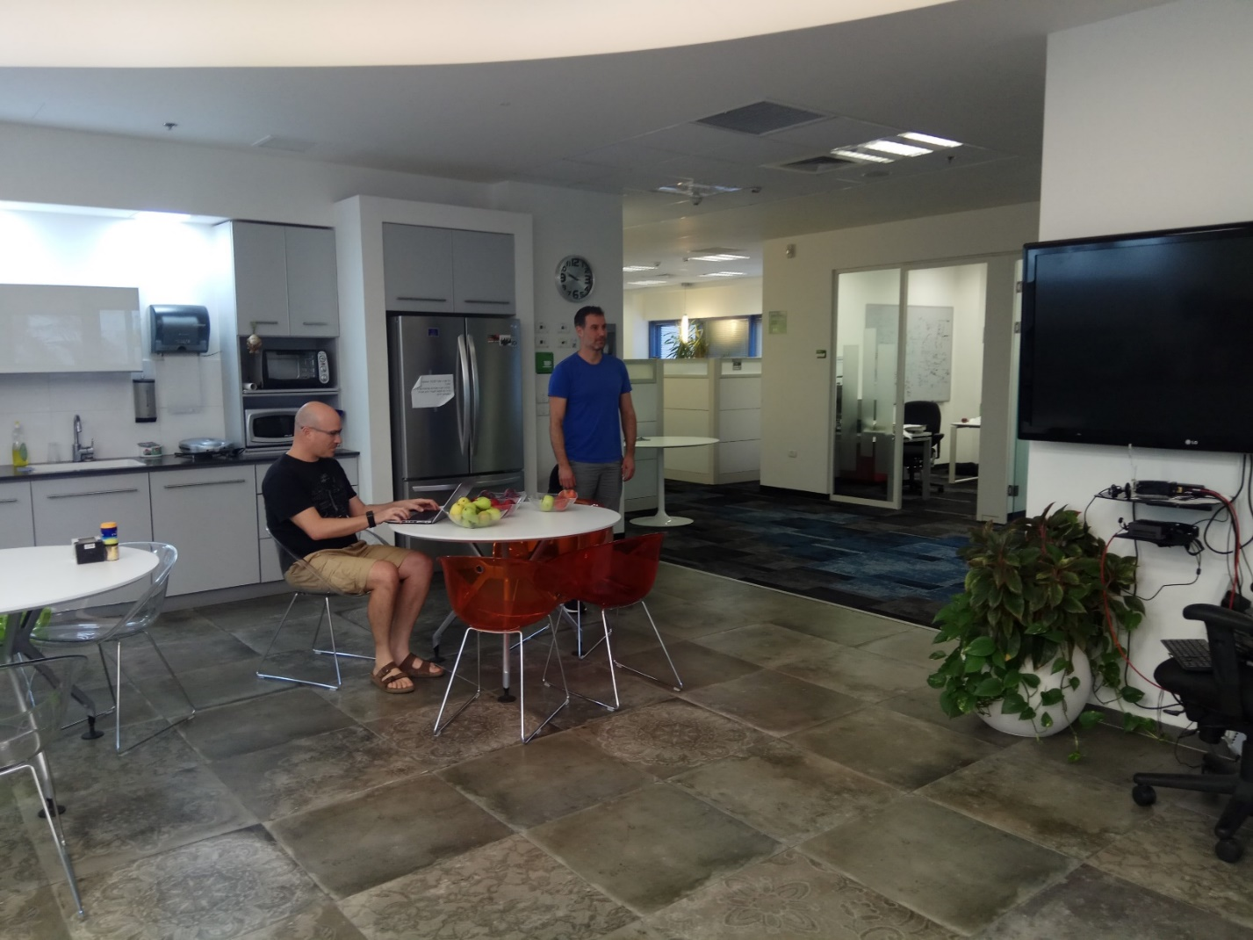
Imaging Radar Data

Slide 6
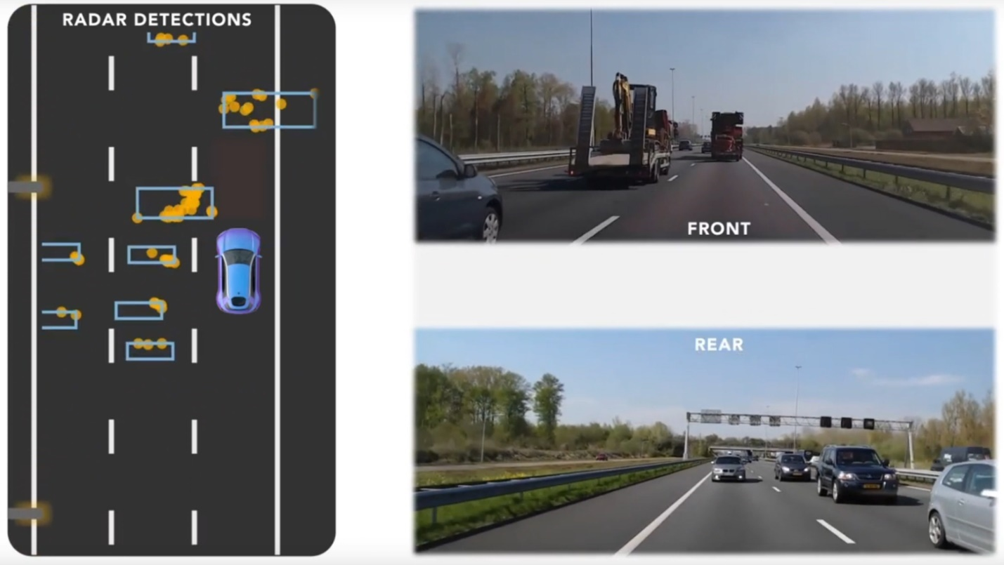
Imaging Radar Data
Snapshot from a nice video from NXP

Slide 7
Imaging Radar Data
Time Domain (CSI): 24 bit per sample -> Huge size
(12x2xTmeas)
2D/3D/4D: -> Huge size
2D/3D/4D Filtered: -> Large size
Targets: -> Compact

Slide 8
Conclusions
Reporting Time-domain data is very ineffective for imaging Radar, and requires the recipient to perform processing, like AoA (which requires knowledge known only at the receiver)
Reporting Unfiltered 2D/3D/4D map is very ineffective for imaging Radar.
Reporting Filtered 2D/3D/4D map is practical
Reporting Targets is the most efficient method

Slide 9
SP #1
Do you agree to add the following to 11bf SFD:
  The 11bf amendment shall define one or more report methods for 2D, 3D and 4D filtered maps.
  SP results (Nov 23 2021): 8/4/21

Slide 10
Motion #1
Move to add the following to the TGbf SFD:
  The 11bf amendment shall define at least one measurement report type for 2D, 3D and 4D filtered maps, for DMG/EDMG.
  This measurement report type is an optional feature.
  Supporting 2D, 3D and 4D are each optional feature
  The details of the measurement report format is TBD
  2D is a two-dimensional map, where the two dimensions are any from: Range, Azimuth, Elevation & Doppler.
  3D is a three-dimensional map, where the three dimensions are any from: Range, Azimuth, Elevation & Doppler.
  4D is a four-dimensional map, where the four dimensions are: Range, Azimuth, Elevation & Doppler.

Slide 11
SP #2
Do you agree to add the following to 11bf SFD:
  The 11bf amendment shall define one or more report methods for targets.
  (“Target” is a detected object. e.g. with a 3D size and specific doppler)
  SP results (Nov 23 2021): 8/10/16

Slide 12
Motion #2
Move to add the following to the TGbf SFD:
  The 11bf amendment shall define at least one measurement report type for targets, for DMG/EDMG.
  (“Target” is a detected object)
  This measurement report type is an optional feature.
  The details of the measurement report format is TBD

