Slide 1
Non-TB Measurement for Sensing
Date: 2021-11-23
Authors:

Slide 2
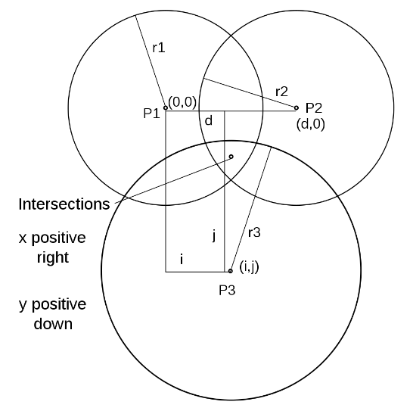
Overview of 11az Ranging
STA centric
  Application/service runs on STA
  STA (initiator) measures distance to multiple (3-4) APs (responder) of known locations
Consequences
  STA not associated to all APs (1 at most)
  STA controls measurement frequency

Slide 3
Comparison of Non-TB and TB Ranging in 11az
Non-TB (Medium access via EDCA)
Works one STA to one AP
STA controls
  Measurement timing / frequency
  Measurement bandwidth / streams
AP negotiates max/min values
STA in full control
TB Ranging (Medium access)
Works one AP with many STAs
AP controls
  Offered measurement frequency
  Measurement bandwidth / streams
STA negotiates max/min values
STA can lower measurement frequency by CTS “opt in”
AP/STA hybrid control

Slide 4
11bf Use Cases
STA centric
  One STA to many APs/STAs
  Needs to support un-associated
  STA-to-STA needs scheduling / discovery (NAN?)
Non-TB has been proposed
AP centric
  One AP to many STAs
  Important use case for home
  Could rely on association
  Could support STA centric via proxy
TB / Non-TB / new protocol?

Slide 5
Non-TB for Sensing

Slide 6
Non-TB for Sensing
NDP-A
  Sent whenever channel is free and responder available
  Announces NDP and parameters (bw/streams/repetition)
  Can include I2R (UL) NDP Tx power and requested R2I (DL) NDP Tx power
11az includes UL/DL NDPs
LMR
  Reports measurements (could add CSI Report element)
  FCS is useful to determine success of sequence
  Can include R2I (DL) NDP Tx power and requested I2R (UL) NDP Tx power
  Carries secure LTF parameters

Slide 7
TB for Sensing

Slide 8
TB for Sensing
Current deficits
  STAs ultimately control measurement frequency
  There is no way to communicate R2I (DL) NDP Tx power
  STA is mandated to measure pathloss (noisy) and adjust Tx power of I2R (UL) TB NDP (!!)
  Does not take advantage of association (AP knows when associated STAs are awake)
Remedies
  Invert STA/AP control of measurement participation
    Mandate that STAs “show up” at each scheduled measurement instance
    AP decides if to poll, STA must follow
  Add Tx Power field to NPD-A for R2I (DL) NDP
  Add explicit Tx Power field to TF Sounding for I2R (UL) NDP
  Allow AP to skip polling, jump right into sounding (?)

