Slide 1
EHT Sounding Enhancements
Date: February 1st, 2022
Authors:
Name | Affiliation | Address | Phone | Email
Arik Klein | Huawei Technologies |  |  | Arik.Klein@huawei.com
Shimi Shilo |  |  |  | Shimi.Shilo@huawei.com
Ross Jian Yu |  |  |  | ross.yujian@huawei.com

Slide 2
Introduction
  EHT Sounding is described in 802.11be D1.4.
  One of the new features in 802.11be is preamble puncturing
    Preamble puncturing has an impact on the EHT Sounding procedure
  In this contribution we want to raise several concerns / open issues that need to be addressed in the EHT Sounding procedure to fully support the required use cases with punctured PPDUs
    This contribution addresses issues related to CID4318 (CC36), and includes other issues that are related to the combination of EHT sounding procedure with preamble puncturing.
    The comment raised in CID4318 is discussed in Problem #3 presented hereinafter.
  This contribution focuses only on the EHT Sounding procedure: Data PPDUs and their properties (e.g. definition of Multi-RUs, puncturing) are beyond the scope of this contribution

Slide 3
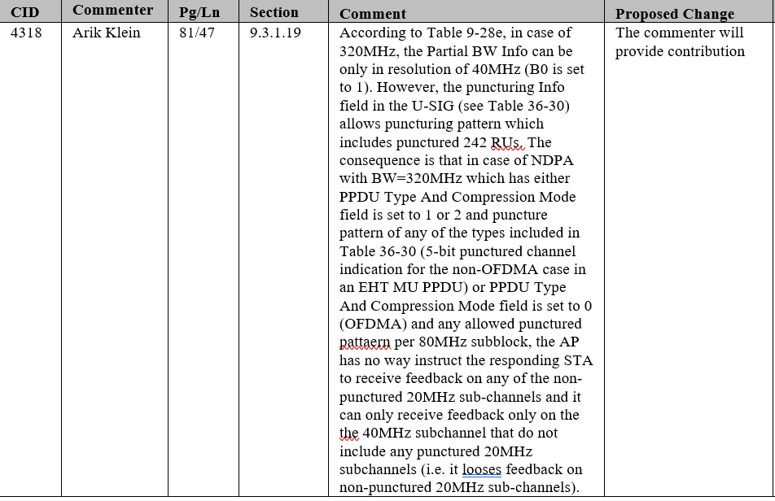
CID 4318

Slide 4
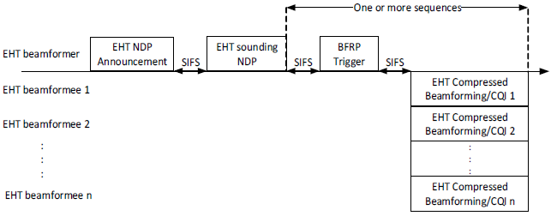
Sounding Overview
  The sounding procedure, defined in the 802.11 be spec, consists of multiple frames depicted in the following diagram:
  The sounding procedure may be used for multiple purposes, such as:
    Beamforming – the beamformee feedbacks the beamforming weights that the beamformer may use for its transmission(s); the respective SNR is also fed-back
    Scheduling – in order to determine where (in frequency) is the best RU to allocate a specific STA in a MU transmission, and with what parameters (MCS, Nss etc.) to allocate, an AP may initiate a sounding procedure in response, the STA feedbacks CQI for the requested RUs or the entire BW

Slide 5
Puncturing in 11be
  The 802.11be D1.4 spec currently supports the following puncturing patterns:
    EHT MU (non-OFDMA) – a single ‘hole’ in the used bandwidth; there are 45 supported patterns defined by the 5-bit punctured channel indication in the U-SIG field
    EHT MU (OFDMA) – any one of 7 puncturing patterns is supported for each 80MHz subblock (‘0111’,’1011’,’1101’,’1110’,’0011’,’1001’,’1100’) by using 4 of 5 bits of the punctured channel indication in the U-SIG field
  An AP may use the Disabled Subchannel Bitmap to indicate to all STAs which subchannels should not be used for all PPDU exchanges on this operating channel in this EHT BSS
    The Disabled Subchannel Bitmap shall correspond to one of the non-OFDMA puncturing patterns
    In both MU and non-HT Duplicate PPDUs, a STA may puncture other subchannels in addition to those indicated in the Disabled Subchannel Bitmap
      In other words, the Disabled Subchannel Bitmap defines the allowed 20MHz subchannels, and additional
      per-PPDU puncturing can be used to (dynamically) use fewer 20MHz subchannels
  The feedback resolution for 320MHz BW is 40MHz, as defined in both the NDP Announcement and the EHT MIMO Control field– irrespective of the puncturing resolution being used

Slide 6
Sounding & Puncturing in 11be
  As a result of the puncturing rules defined in 11be, there are several severe inefficiencies that come up in the context of the sounding procedure
  In particular, the following three problems are observed:
    Excessive BW reduction for sounding PPDUs
    Limitation on EHT sounding for scheduling (due to Sounding NDP); this also applies to sounding for BF
    Mismatch between actual feedback report size and size derived from the MIMO Control field for the 320MHz BW case
  In the next slides we give more details about these problems

Slide 7
Problem #1 – Excessive BW Reduction
  As mentioned in the previous slide, the Disabled Subchannel Bitmap (as defined today) must correspond to a non-OFDMA puncturing pattern
  Let us consider an AP which wants to transmit on 160MHz and senses two 20MHz subchannels as busy (e.g. due to interference of incumbent users) - as shown in the figure below - and wants to mark these subchannels as disabled
  The AP wants to set a Disabled Subchannel Bitmap which ensures all STAs refrain from any frame exchange on these interfered subchannels
  The only non-OFDMA puncturing pattern that is suitable in this scenario is a single 20MHz ‘hole’ in the primary 80MHz BW - therefore, the actual BW in which the frame exchange is allowed has to be reduced from 160MHz to 80MHz (giving up
  the S80 channel
  for any frame
  exchange)

Slide 8
Problem #1 – Excessive BW Reduction
  What does that mean for the Sounding procedure?
    In case of multiple punctured subchannels that do not conform to a non-OFDMA puncturing pattern, all the sounding PPDUs will be required to reduce the effective BW used, implying reduced BW for the entire Sounding procedure
  In the example below, the actual BW of all sounding PPDUs will reduce to 160MHz
Other cases may occur
as well (e.g. puncturing
40MHz or 80MHz in
320MHz BW even if the
interference occupies
only a 20MHz
subchannel or a 60 MHz
subchannel)

Slide 9
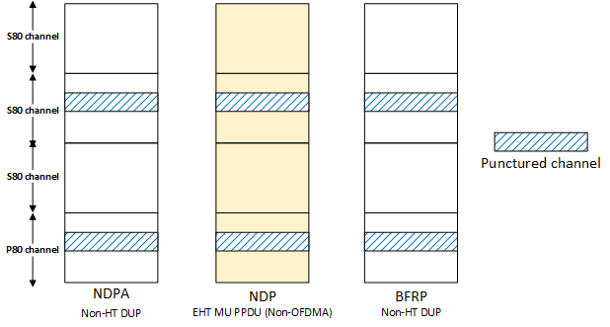
Problem #2 – Punctured Sounding NDP for Scheduling
  When sounding is used for scheduling purposes, the AP may request a STA to provide feedback information respective to the entire (or large portions of the) BW so that the AP can choose where to allocate the STA (e.g. what RU to use)
  Transmitting data in an EHT MU PPDU is very flexible in terms of puncturing (e.g. different puncturing in each 80MHz subblock)
    However, this flexibility is severely limited by the constrained puncturing support in the preceding non-OFDMA punctured frames (sounding NDP) and the defined feedback resolution/coverage
  The following figure depicts
  an example where OFDMA
  could be used with 320MHz
  in the DL with per-80MHz
  puncturing, but is limited
  to 160MHz because of the
  sounding NDP frame (in
  yellow) using non-OFDMA
  puncturing
  Therefore, OFDMA puncturing patterns in Sounding NDP are required

Slide 10
Problem #3 –Feedback & Puncturing Mismatch
  The beamformer (e.g. AP) instructs the beamformee (e.g. STA) for which subcarriers it should feedback information via the Partial BW Info subfield
    The beamformer includes this subfield in the NDP Announcement, and the beamformee responds with this subfield in the MIMO Control field
  The feedback resolution for BW up to 160MHz is 20MHz.
  In case of 320MHz BW, the Partial BW Info is in resolution of 40MHz, irrespective of the puncturing being actually used – which may be in resolution of 20MHz (if previous problems are solved)
  This creates two different problems:
    20MHz granularity for NDP-A and NDP, but 40MHz granularity for the feedback (see more information in the Appendix)
    The AP cannot instruct the non-AP STA to provide feedback on specific non-punctured 20MHz subchannels – only in coarse steps of 40MHz – which may lead to non-negligible overhead
  Therefore, the option of requesting (and reporting) a channel feedback in resolution of 20MHz subchannel for BW greater than 160MHz should be added.

Slide 11
Conclusions
  We described several scenarios where the puncturing rules existing in 11be severely restrict the employment of sounding
    This is true for both OFDMA and non-OFDMA transmissions, and for beamforming and scheduling purposes
  It is our view that 802.11be should address these issues

Slide 12
SP1
  Do you support to modify the EHT Sounding procedure in 802.11be R1 to address the following problem:
    Support OFDMA puncturing patterns in Disabled Channels bitmap
  Yes / No / Abstain

Slide 13
SP2
  Do you support to modify the EHT Sounding procedure in 802.11be R1 to address the following problem:
    Support OFDMA puncturing patterns in Sounding NDP
  Yes / No / Abstain

Slide 14
SP3
  Do you support to modify the EHT Sounding procedure in 802.11be R1 to address the following problem:
    Support 20 MHz subchannel resolution for channel feedback when Sounding NDP BW is greater than 160MHz (both in NDPA and in BFR (in MIMO Control field)).
  Yes / No / Abstain

Slide 15
References
  [1] IEEE P802.11be D1.4, January 2022 (amendment to IEEE 802.11-2020 standards)

Slide 16
Appendix 1 (Problem #3) –Feedback & Puncturing Mismatch
  Assuming we solve problems #1 and #2, the NDPA and NDP frames may be transmitted with a 20MHz puncturing granularity
  However, the MIMO Control field is still limited to 40MHz granularity
    This will create a mismatch between actual report size and the size reported in the header, and therefore an error in decoding
  An example for 320 MHz BW with two 20 MHz punctured subchannels is given in the next slide; we assume the following:
    320MHz BW used for the sounding frames
    Two 20MHz subchannels are punctured, one in each 160MHz, therefore STA needs to provide feedback for 320-2x20=280MHz
    BFR is transmitted in 80MHz (996-tone RU)

Slide 17
Appendix 1 (Problem #3) –Feedback & Puncturing Mismatch
  An example for 320 MHz BW with two 20 MHz punctured subchannels is given below

