Slide 1
TSN QoS for Enterprise Use Cases
Date: 2021-11-02
Authors:

Slide 2
CID 4662

Slide 3
TSN QoS for Enterprise Use Cases
Situation
  Assisted by wired/wireless TSN, Wi-Fi is finding increasing use in the enterprise for automation
  There is a groundswell of interest around AR/VR
  Automation and AR/VR have very stringent QoS requirements
  TSN QoS is achieved when each STA defines when service is needed, and the system ensures that the medium is available for exclusive use during those service periods
  Viable use cases have some level of failsafe and/or error tolerance built in; and accept “four/five/six 9s” of reliability
  Other wireless technologies claim they provide a low latency solution – but end users are taking a second look at 802.11 when reality doesn’t meet the claims.
Problem
  Unlicensed spectrum makes guarantees hard (but absolute guarantees are not required)
  802.11 networks are converged (service for all devices and flows)
Solution
  Multiple layers of resiliency and redundancy
  Including OBSS and same-BSS mitigations
  With agreeable trade-offs for uninvolved STAs so they can still achieve high quality connectivity

Slide 4
Canonical Scenarios
Manufacturing (Industrial IOT)
  Plant with 100-ton metal pressing machine controlled by wireless remote safety switch
  The control traffic is sent using 802.11 wireless
  Control packets are sent every 1 ms; target is bounded latency and low/no jitter
  If 5 frames in a row are lost, the machine is shut down
  Shutdowns need to occur less than once per year
Education (AR/VR/XR):
  A room of school children enjoy a shared learning experience in immersive VR headsets
  Pose/head-position updates are sent every 1-5ms
  Video/audio frames are rendered in response and must be delivered back in <10ms
  Any packet jitter introduced degrades the immersive experience and must be minimized

Slide 5
Problems
Primary Users of Spectrum (DFS, AFC)
can force a BSS off the channel it was occupying
Non-Wi-Fi Interference,
such as point-to-point TDMA and LAA/LTE-U/NR-U systems, can share badly
Unmanaged OBSS,
such as neighboring tenants in a multitenant tower building, mobile hotspots, etc., can start a 10msec TXOP at AIFS~PIFS
Managed OBSS
can start a multi-msec TXOP just when critical traffic was scheduled
Legacy associated clients,
being incapable of both Triggered Access and RTWT, can start a multi-msec TXOP just when critical traffic was scheduled
Low capability or disinterested EHT associated clients,
might assert UL MU Disable and/or not respect RTWT service periods, and can start a multi-msec TXOP just when critical traffic was scheduled
Uplink and Peer-to-peer traffic of interested associated EHT clients,
might be delayed due to insufficient triggers

Slide 6
Sidebar: Safehaven Channels from
Radio Resource Management (RRM)
Today enterprise
RRM defines two
classes of channels:
Excluded (DFS event,
or not allowed by AFC)
Shared
Enterprise RRM allocates a site’s APs to all Shared channels
Unmanaged devices use
Shared channels too
High-QoS Enterprise RRM defines four classes of channels:
Excluded (DFS event, or not allowed by AFC)
Safehaven
Shared
Unmanaged
Enterprise RRM causes site APs to use Safehaven and Shared channels only. Association on the Safehaven channels is only accepted from clients with critical QoS traffic and well-behaved# clients. Other associated clients are well serviced on the Shared channels (recall dual-5GHz radios are routine for enterprise APs).
Enterprise RRM offers a quid pro quo: site APs advertise which channels are Safehaven and which are Unmanaged. In exchange for not assigning site APs to the Unmanaged channels, the site expects unmanaged APs to avoid the Safehaven channels (i.e., use the Unmanaged and/or Shared channels instead)
#Well-behaved = supports
Triggered Access / respects advertised RTWT
service periods,
with triggered
TXOP sharing
for co-channel
P2P traffic
Triggered
Access =
invariably
using MU EDCA
parameters; so UL
transmissions only
occur when triggered by
AP; with BSS steering if oversubscribed
Shared
Safehaven
Excl
Shared
Safe
Unmanaged
Shared
DFS spectrum
E.g., 5GHz

Slide 7
Solutions
Primary Users of Spectrum (DFS, AFC)
Zero Wait DFS/AFC
Seamless channel switching
Non-Wi-Fi Interference
Physical controls where possible and respected
Manual frequency coordination where possible
Interference classification
Zero Wait DFS/AFC
Seamless channel switching
Unmanaged OBSS
Physical controls where possible and respected
Manual frequency coordination where possible
Zero Wait DFS/AFC and seamless channel switching
Safehaven channels on DFS channels and/or 6 GHz
Safehaven/Unmanaged channel quid pro quo*
Managed OBSS
RRM ensures cochannel Safehaven APs are well spaced
Legacy associated clients
BSS membership selector*
Low capability or disinterested EHT associated clients
BSS membership selector*
BTM
Uplink and Peer-to-peer traffic of interested associated EHT clients
Scheduled according to need based on BSRs and/or TSPEC-lite (i.e., SCS)
Transmits its peer-to-peer traffic co-channel via Triggered TXOP sharing, or on Unmanaged channels
*EHT protocol work defined in this deck

Slide 8
Protocol Work for EHT
New BSS Membership Selectors (or similar)
  EHT
  Triggered Access Required (i.e., HE or higher; AP triggers for UL only; STA must roam before any untriggered transmission or asserting UL MU Disable)
  RTWT SP Start Time Respect Required (i.e., must respect other STAs’ RTWT service period Start Times advertised by the AP) (other efforts here too)
Channel Quid Pro Quo
  APs can advertise a list of Safehaven and Unmanaged channels in Beacons, PrResp and (Re)Assoc
  Associated behaviors:
    APs shall not advertise a list of Safehaven and Unmanaged channels for a band unless they are part of an ESS whose BSSs occupy >50% of the band, and would occupy 100% if wider channels were selected
    APs should provide as much bandwidth for Unmanaged channels as for Safehaven channels whenever the 802.11 duty cycle on the Unmanaged channels exceeds the managed 802.11 duty cycle on the Safehaven channels (minus any P2P traffic there) or Shared channels.
    A co-hosted device associated to an AP (tethering) shall be well behaved on Safehaven channels or completely avoid the Safehaven channels
    Sidebar: due to primary users and non-Wi-Fi interference, it may be impossible for a large deployment to advertise a uniform set of Safehaven and Unmanaged channels across a site. At boundaries where advertisements change, devices receive inconsistent information.
    … then, while a device not associated with an AP that advertises Safehaven and Unmanaged channels receives Safehaven and Unmanaged channel advertisements from nearby APs, the device should not transmit on the Safehaven channels advertised by the strongest AP (after excluding any distrusted APs)
    STAs should passively scan Safehaven channels at 2.4 and 5 GHz; STAs shall passively scan Safehaven channels in 6 GHz once Safehaven channel information is learnt from any source (e.g., RNR)

Slide 9
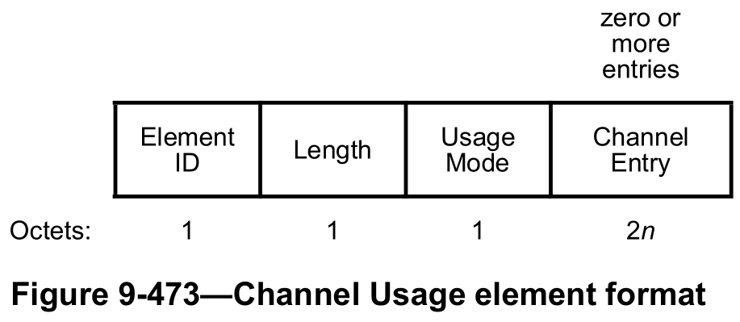
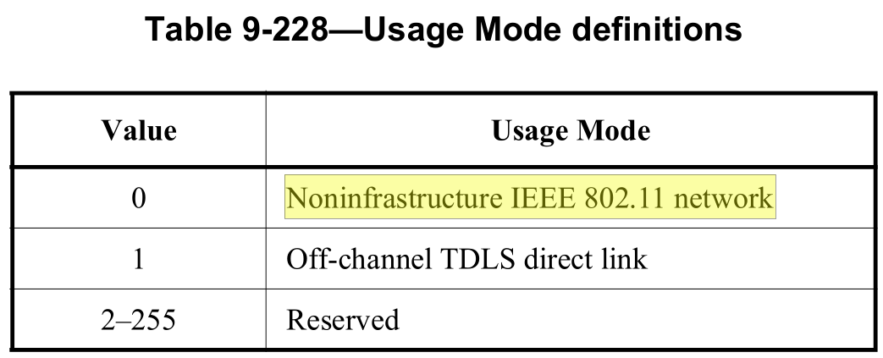
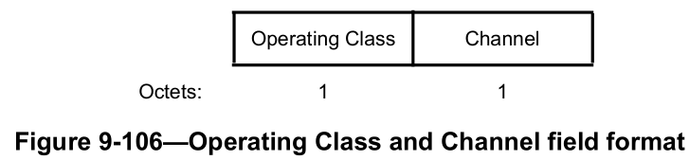
Safehaven and Unmanaged Channel Advertisement
Unmanaged channels can be advertised by the existing Channel Usage element:
Safehaven channels can be advertised by a new Safehaven element, with exactly& the same format but with a new element ID (Extension) and with safehaven semantics
  &Apart from the insertion of an Element ID Extension field, and no Usage Mode field.

Slide 10
End Result
Characteristics on the safehaven channel:
  Almost always there is no non-Wi-Fi interference
  Almost always there is no unmanaged OBSS
  Almost always each Safehaven AP is relatively isolated from all other co-channel APs
  Almost always clients associated with the Safehaven AP perform triggered access, triggered TXOP sharing and/or respect RTWT service periods (according to AP scheduling)
Almost always the medium is idle exactly when critical transmissions need to be sent
Lowest possible latency, lowest possible jitter and highest possible reliability are achieved on the safehaven channel
  Suited to automation, AR/VR, etc
  Ensures 802.11 can meet or outperform the latency and jitter performance of other wireless technologies
Infrastructure connectivity of other clients is provided on a mix of a) Safehaven channels, for well-behaved clients, and b) Shared channels, for all clients
  Recall enterprise APs often have dual 5 GHz radios, so the experience on Shared channels is also excellent
  Connectivity across channels can be achieved via MLO as one would expect
Almost always other (e.g., P2P) connectivity occurs on:
  Unmanaged channels
  Safehaven and Shared channels using triggered TXOP sharing
  Shared channels using CSMA/CA

