Slide 1
Legacy Support in 11bf – Next Steps
Date: 2021-11-01
Authors:
Name | Company | Address | Phone | Email
Rojan Chitrakar | Panasonic Corporation |  |  | rojan.chitrakar@sg.panasonic.com
Rajat Pushkarna
Yanyi Ding
Yoshio Urabe
Hiroyuki Motozuka
Xiandong Dong | Xiaomi Inc.

Slide 2
Overview
In 21/1047r1 we proposed that 11bf should be supported on devices with legacy PHYs (11n, 11ac) and that such devices can participate in WLAN Sensing. The corresponding straw poll indicated high level of interest on the topic:
Do you agree that 11bf Task group should investigate supporting devices with legacy PHYs (11n, 11ac) and that such devices can participate in WLAN Sensing?
  78Y/14N/18A
In this contribution we explore two options to achieve support for pre-HE STAs (11n, 11ac) in 11bf. Other options may also be possible, and it is not our intention to rule them out.

Slide 3
Assumptions/Focus
WLAN Sensing procedure may comprise of several phases [2]:
Assumptions:
Session/Measurement Setup and corresponding Termination happens in the MAC layer and pre-HE STAs can be upgraded to support them.
Sensing Measurement is PHY dependent, and special considerations may be required for pre-HE STAs.
Focus:
This contribution focuses on how to realize Sensing Measurements for pre-HE STAs.
Sensing Initiator
Sensing Responder
Sensing Session Setup
Sensing Measurement Setup
Sensing Measurement Instances
Sensing Measurement Setup Termination
Sensing Session Termination

Slide 4
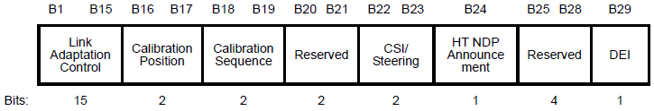
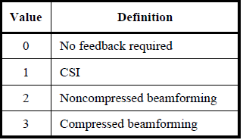
1. Using baseline explicit beamforming feedback
When the Sensing Responder is an 11n STA:
The 11n device, if capable of explicit CSI feedback, can be made to provide CSI feedback by transmitting an HT NDPA¹ and HT NDP to it.
NOTE 1 - HT NDPA is any HT frame that carries an HT variant HT Control field.
Slide 4
Notes:
We could also consider the option of extending the CSI feedback option for VHT PPDUs even for bandwidths > 40MHz. This would require changes in the baseline specification though.

Slide 5
1. Using baseline explicit beamforming feedback
When the Sensing Responders are 11ac STAs:
One or more 11ac devices can be made to provide compressed beamforming feedback by transmitting a VHT NDPA and VHT NDP. The beamforming feedback matrix (V) can be used as representative of the channel [3]. However, beamforming feedback matrix (V) doesn’t represent all dimensions of the channel and may not be suitable for all sensing applications.
Slide 5

Slide 6
1. Using baseline explicit beamforming feedback
What support is required from 11bf to enable feedback-based sensing for pre-HE STAs?
For pre-HE Sensing Responders, this will be treated as beamforming feedback, so no changes are required.
Pre-HE non-AP Responder
Slide 6

Slide 7
1. Using baseline explicit beamforming feedback
For pre-HE Sensing Initiators, since the sounding sequence is meant for sensing and not for transmit beamforming, new MLME primitives are needed to:
  allow upper layer to trigger transmission of NDPA, NDP.
  To pass the channel measurement feedback to upper layer.
Pre-HE Initiator
Slide 7

Slide 8
1. Using baseline explicit beamforming feedback
This may be considered a simple extension of the NDPA sounding (with beamforming feedback reporting) to support pre-HE STAs:
SFD already allows the NDPA Sounding for pre-HE STAs, however it is currently under the TB sensing measurement Instance:
7.1.4.2 TB sensing measurement instance
  (Motion 25c, 21/0990r2; Motion 26c, 21/1015r2) The NDPA sounding phase consists of
  The transmission of an NDP Announcement (NDPA) frame by an AP; and
  The transmission of an NDP by an AP SIFS after the transmission of the NDPA frame.
  Note: NDPA sounding may be used by pre-HE STAs (i.e., its use is not limited to HE and/or EHT STAs).
For pre-HE STAs, the NDPA Sounding will be followed immediately (i.e., within SIFS) by the corresponding beamforming feedback report.
Slide 8

Slide 9
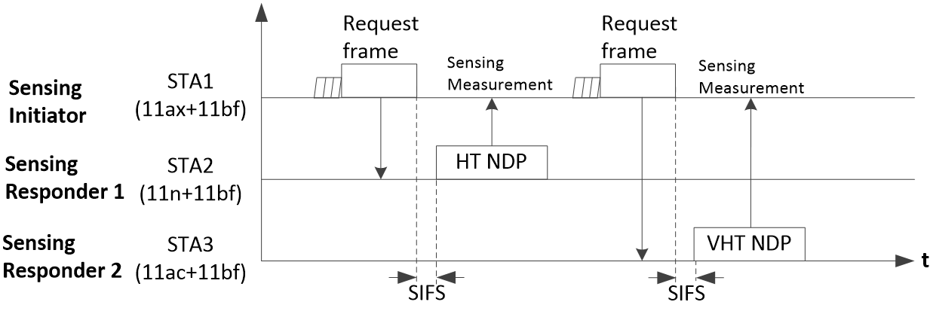
2. Using solicited NDP
In Sensing using solicited NDP, the NDP is solicited by the Sensing Initiator. This mode is highly desirable due to the significant reduction in feedback overhead.
However, for pre-HE STAs the requirement to transmit the NDP within SIFS of reception of the Request frame may be a concern.
Slide 9

Slide 10
Proposal
Enable Sensing using Solicited NDPA Sounding:
For a Sensing Responder that is a pre-HE AP:
  The pre-HE AP supports transmission of NDPA Sounding PPDUs upon reception of a Request frame.
  The pre-HE AP may transmit the solicited NDPA Sounding (i.e., NDPA + NDP) in a delayed manner, i.e., it need not respond within SIFS of receiving the Request frame. E.g., the NDPA, NDP may be transmitted in their own TXOP (instead of the Initiator’s TXOP).
Slide 10

Slide 11
Proposal
2. For a Sensing Initiator that is a pre-HE non-AP STA:
  The pre-HE STA supports transmission of a Request frame to solicit NDPA Sounding.
  The pre-HE STA supports passing the Sensing measurements (from the solicited NDPA Sounding) to upper layers.
Slide 11

Slide 12
2. Using solicited NDPA Sounding
What support is required from 11bf?
For a Sensing Responder that is a pre-HE AP:
  Reception of the Request frame needs to be supported.
  PHY primitive to trigger transmission of NDPA, NDP.
Pre-HE Responder
Slide 12

Slide 13
2. Using solicited NDPA Sounding
What support is required from 11bf?
For a Sensing Initiator that is a pre-HE non-AP STA:
  Transmission of the Request frame needs to be supported.
  MLME primitive to pass the channel measurement feedback to upper layer.
Pre-HE Initiator
Slide 13

Slide 14
2. Using solicited NDPA Sounding
What support is required from 11bf?
Format of the Request frame is TBD. Few options can be considered:
  Design a new Request frame (e.g., an Action frame) customized for the use of pre-HE STAs.
  Use the same Sensing Trigger frame designed for other 11bf STAs, but with customization for pre-HE STAs, e.g.:
    Triggering a single STA¹ (i.e., with a single User Info field).
    Indication that delayed response is allowed (i.e., the NDPA/NDP may be transmitted after a delay).
The Request frame needs to carry all necessary parameters for the receiving STA to correctly prepare the NDPA+NPD. E.g., bandwidth, number of spatial streams, sounding dialog token, PPDU type (HT/VHT etc.), AID12 etc.
NOTE 1 – 11az, 11be already support such single STA trigger frames. However, in this case the receiver STA may also be an AP.
Slide 14

Slide 15
Straw Poll 1
Do you agree that for pre-HE 11bf STAs, the NDPA Sounding will be followed by the corresponding feedback report?
  Y/N/A
Slide 15

Slide 16
Straw Poll 2
Do you agree that 11bf supports soliciting NDPA Sounding from pre-HE STAs?
  The NDPA Sounding need not be transmitted within SIFS of the Request frame that solicits it.
  Frame type/Format of the Request frame that solicits the NDPA Sounding is TBD.
  Y/N/A
Slide 16

Slide 17
Straw Poll 3
Do you agree that pre-HE 11bf STAs may transmit a Request frame to solicit NDPA Sounding?
  Frame type/Format of the Request frame that solicits the NDPA Sounding is TBD.
  Y/N/A
Slide 17

Slide 18
References
21/1047r1, Legacy Support in 11bf, Rojan Chitrakar et. al.
21/0504r3, Specification Framework for TGbf, Claudio da Silva et. al.
Beamforming Feedback-based Model-driven Angle of Departure Estimation Toward Firmware-Agnostic WiFi Sensing, Sohei Itahara et. al.
Slide 18

