Slide 1
Legacy Support in 11bf – Next Steps
Date: 2021-11-01
Authors:
Name | Company | Address | Phone | Email
Rojan Chitrakar | Panasonic Corporation |  |  | rojan.chitrakar@sg.panasonic.com
Rajat Pushkarna
Yanyi Ding
Yoshio Urabe
Hiroyuki Motozuka
Xiandong Dong | Xiaomi Inc.

Slide 2
Overview
In 21/1047r1 we proposed that 11bf should be supported on devices with legacy PHYs (11n, 11ac) and that such devices can participate in WLAN Sensing. The corresponding straw polled indicated high level of interest on the topic:
Do you agree that 11bf Task group should investigate supporting devices with legacy PHYs (11n, 11ac) and that such devices can participate in WLAN Sensing?
78Y/14N/18A
In this contribution we explore various options to achieve support for pre-HE STAs (11n, 11ac) in 11bf.

Slide 3
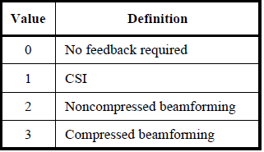
1. Using baseline explicit beamforming feedback
When the Sensing Responder is an 11n device:
The 11n device, if capable of explicit CSI feedback, can be made to provide CSI feedback by transmitting an HT NDPA¹ and HT NDP to it.
NOTE 1 - HT NDPA is any HT frame that carries an HT variant HT Control field.
Slide 3
Notes:
We could also consider the option of extending the CSI feedback option for VHT PPDUs even for bandwidths > 40MHz. This would require changes in the baseline specification though.

Slide 4
1. Using baseline explicit beamforming feedback
When the Sensing Responder(s) is an 11ac device:
One or more 11ac devices can be made to provide compressed beamforming feedback by transmitting a VHT NDPA and VHT NDP. The beamforming feedback matrix (V) can be used as representative of the channel. However, beamforming feedback matrix (V) doesn’t represent all dimensions of the channel and may not be suitable for sensing applications.
Slide 4

Slide 5
1. Using baseline explicit beamforming feedback
What support is required from 11bf to enable feedback-based sensing for pre-HE STAs?
For pre-HE Sensing Responders, this will be treated as beamforming feedback, so no changes are required.
Pre-HE Responder
Slide 5

Slide 6
1. Using baseline explicit beamforming feedback
For pre-HE Sensing Initiators, since the sounding sequence is meant for sensing and not for transmit beamforming, new MLME primitives are needed to:
allow upper layer to trigger transmission of NDPA, NDP.
To pass the channel measurement feedback to upper layer.
Pre-HE Initiator
Slide 6

Slide 7
1. Using baseline explicit beamforming feedback
This may be considered a simple extension of the NDPA sounding (with beamforming feedback reporting) to support pre-HE STAs:
SFD already allows the NDPA Sounding for pre-HE STAs, however it is currently under the TB sensing measurement Instance:
7.1.4.2 TB sensing measurement instance
(Motion 25c, 21/0990r2; Motion 26c, 21/1015r2) The NDPA sounding phase consists of
The transmission of an NDP Announcement (NDPA) frame by an AP; and
The transmission of an NDP by an AP SIFS after the transmission of the NDPA frame.
Note: NDPA sounding may be used by pre-HE STAs (i.e., its use is not limited to HE and/or EHT STAs).
For pre-HE STAs, the NDPA Sounding will be followed immediately (i.e., within SIFS) by the corresponding beamforming feedback report.
Slide 7

Slide 8
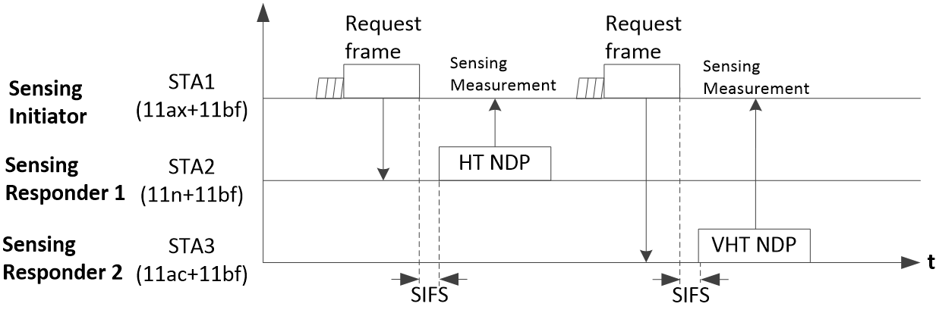
2. Using solicited NDP
In Sensing using solicited NDP, the NDP is solicited by the Sensing Initiator. This mode is highly desirable due to the significant reduction in feedback overhead.
However, for pre-HE STAs the requirement to transmit the NDP within SIFS of reception of the Request frame may be a concern.
Slide 8

Slide 9
Proposal
Enable Sensing using Solicited NDP sequence^{1,2} for a Sensing Responder STA that is a pre-HE STA.
The STA is allowed to transmit the solicited NDP Sequence (NDPA + NDP) in a delayed manner, i.e., it need not respond within SIFS of receiving the Request frame.
E.g., the NDPA, NDP may be transmitted in their own TXOP (instead of the Initiator’s TXOP).
NOTE 1 – A NDP sequence is defined in baseline as a PPDU carrying a NDPA frame followed within SIFS by a NDP.
NOTE 2 – If the Request frame is a Trigger frame, this could be seen as a delayed version of the TF Sounding in SFD.
Slide 9

Slide 10
2. Using solicited NDP
What support is required from 11bf?
For pre-HE STAs, reception (possibly also transmission) of the Request frame needs to be supported.
Pre-HE Responder
Slide 10

Slide 11
2. Using solicited NDP
What support is required from 11bf?
Format of the Request frame is TBD. Few options can be considered:
Design a new Request frame (e.g., an Action frame) customized for the use of pre-HE STAs.
Use the same Sensing Trigger frame designed for other 11bf STAs, but with customization for pre-HE STAs, e.g.:
Triggering a single STA¹ (i.e., with a single User Info field).
Indication that delayed response is allowed (i.e., the NDPA/NDP may be transmitted after a delay).
NOTE 1 – 11az, 11be already supports such single STA trigger frames.
Slide 11

Slide 12
Straw Poll 1
Do you agree that 11bf supports pre-HE STAs (11n, 11ac) to participate in sensing measurements by using explicit beamforming feedback?
Y/N/A
Slide 12

Slide 13
Straw Poll 2
Do you agree that 11bf supports soliciting a NDP Sequence (NDPA + NDP) from pre-HE STAs (11n, 11ac)?
The NDP sequence (NDPA + NDP) need not be transmitted within SIFS of the Request frame that solicits it.
Type/Format of the Request frame that solicits the NDP sequence is TBD.
Y/N/A
NOTE – A NDP sequence here refers to a PPDU carrying a NDPA frame followed within SIFS by a NDP.
Slide 13

Slide 14
References
21/1047r1, Legacy Support in 11bf, Rojan Chitrakar et. al.
21/0504r3, Specification Framework for TGbf, Claudio da Silva et. al.
Slide 14

