Slide 1
Opportunistic WLAN Sensing
Date: 2021-10-19
Authors:
Name​ | Company​ | Address​ | Phone​ | Email​
Rajat Pushkarna​ | ​ Panasonic​ Corporation | ​202, 1 Bedok South Avenue, Singapore | ​ | rajat.pushkarna@sg.panasonic.com
Rojan Chitrakar |  | ​ | ​
Yoshio Urabe​ |  | ​ | ​

Slide 2
Background
The P802.11bf PAR[1] defines that the amendment enables a “WLAN sensing measurements to be obtained using transmissions that are requested, unsolicited, or both.”
[2] Motion 22 states, “Measurement phase of sensing session, the NDP can be used for the channel measurement (e.g., CSI) between sensing transmitter and sensing receiver(s) in sub 7Ghz band.”
[3] Motion 20 states, “CSI (that is, the channel measured during the training symbols of a received PPDU) is a type of sensing measurement result for sub-7 GHz WLAN sensing.”
In this contribution, we discuss about the regular PPDU (A ‘regular PPDU’ is defined as any PPDU which is not an NDP for sensing) exchange which can be utilized to perform sensing measurement and obtain CSI for sub-7GHz.

Slide 3
Proposal
802.11bf should allow ‘opportunistic’ channel measurement based on PPDUs other than NDP for WLAN Sensing.
The following equations provides an insight of the overhead related to sensing related frame exchange,
NDPA = 24+CEILING( 21×8+4×8×numUsers,24 )/24×4​
NDP = 36+16×numHeltfSymbol​
Explicit Feedback = 40+16×numHeltfSymbol+700÷4×numStream(=4)​
  Control time = NDPA + SIFS = (approx. 60us for MCS 0)
  Feedback time = SIFS+explicit feedback = (approx. 88us for MCS 0)
Opportunistic WLAN Sensing has already been proposed in [4]. Sensing overhead can be reduced for some cases if we enable ‘opportunistic’ channel measurement by PPDUs other than NDPs(for example, data frames).
Control Time
Feedback Time
STA 1
STA 2
Ongoing regular communication
Sensing related frame exchange
Opportunistic Sensing
Sensing using NDP

Slide 4
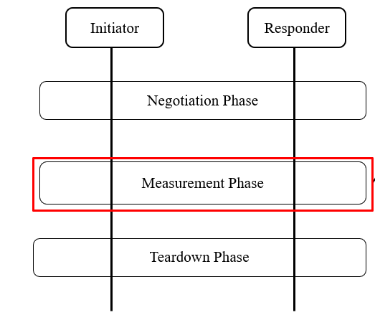
Sensing Protocol
For WLAN Sensing protocol, three phases can be considered [2]:
Measurement phase comprise of:
  Channel measurement
  Feedback(optional)

Slide 5
Channel Measurement based on Regular PPDU - 1
During the measurement session setup phase, capabilities like, transmit periodicity, measurement session setup ID etc are negotiated.
The channel can be measured by STA receiving the PPDU using the Long Training Field present in the PHY preamble of the received PPDU.
PHY Header
MAC Header
Regular PPDU
Regular PPDU
Regular PPDU
STA 1 (responder/transmitter)
Sensing measurement setup Phase
Teardown
ACK
ACK
STA 2 (initiator/receiver)
Measurement Phase

Slide 6
Regular PPDUs to be considered for WLAN Sensing - 1
Beacon frames:
AP as sensing initiator can make use of Beacon frames to perform channel measurements.
The advantage of using Beacon frames for WLAN Sensing is that beacon frames are transmitted every Beacon Interval. Therefore, it can help achieve periodic sensing.
Beacon frames are transmitted at 20MHz bandwidth and at a lower MCS providing robust transmission therefore can the chances of failure are very less.
The disadvantage of using beacon frames for WLAN sensing is that only a part of full bandwidth can be sensed, the transmission interval is fixed and are transmitted with a single LTF.
[5] provides examples of WLAN sensing using beacon frames.

Slide 7
Regular PPDUs to be considered for WLAN Sensing - 2
Data frames:
The preferred option of channel measurement using PPDUs other than NDP are Data frames.
The advantage of using Data frames for channel measurement is that it does not require transmission of frames exclusively for sensing.
Data PPDUs are transmitted at higher bandwidth, can carry more LTFs and, thus it can sense a significant part of the channel.
We performed experiments using Data frames for presence detection at 80MHz and achieved accuracy of around 94%. Therefore, for certain application we can consider using data frames for channel measurement.

Slide 8
Signalling the Tx parameters
The transmit parameters can be indicated by the transmitter in subsequent PPDUs if the transmitter changes the transmit parameters.
The transmitter can indicate the change in transmit parameters as follows:
  The transmitter after beamforming shall indicate the receiver about the change in transmit parameters if any, e.g., using an indication in the MAC header of the PPDU. The actual indication can be discussed.
  A new management frame can be defined which may be transmitted by the transmitter upon change in Tx parameters. The format of the management frame is TBD.

Slide 9
Signalling Tx Parameters
Motion 24 describes that, “The Measurement Setup ID may be used to identify attributes of the sensing measurement instances.”

Slide 10
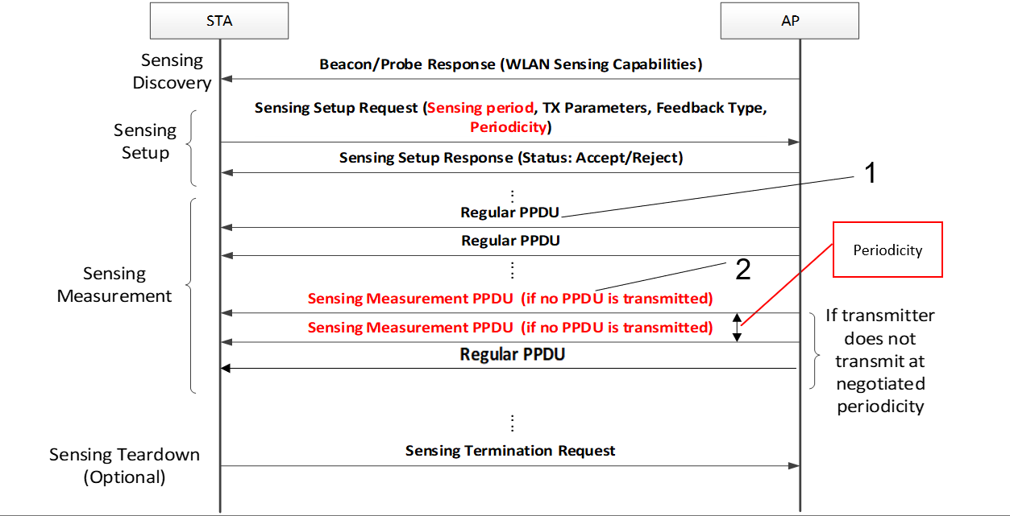
When WiFi traffic is not available
Sensing measurement PPDUs can be for example, QoS Null Data frames

Slide 11
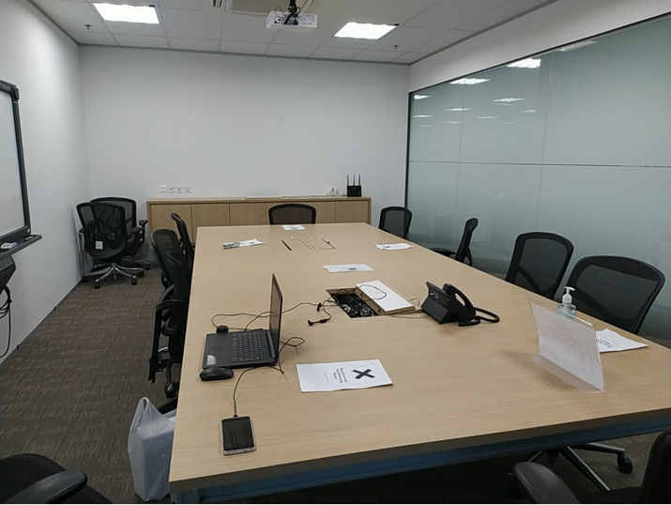
Simulation Scenario
We performed experimentation using PPDUs carrying data frames for WLAN Sensing.
The simulation scenario was as follows:
Simulation Scenario:
Distance: 5 meters
PPDU: PPDUs carrying data frames.
Bandwidth for packet transmission: 80MHz
Transmitter: 802.11ac capable.
Receiver: Nexus handphone
Transmitter
Receiver

Slide 12
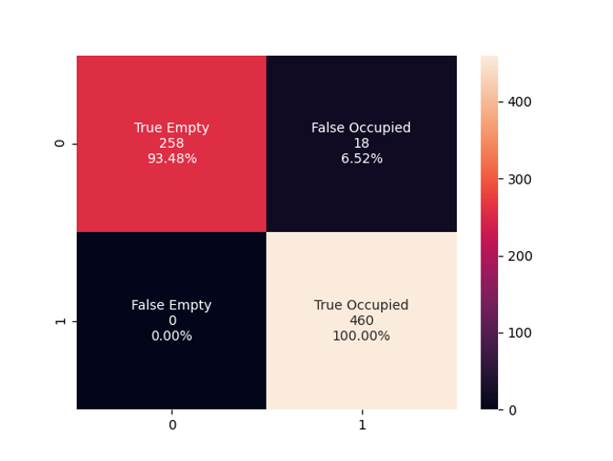
Experimentation Results
The achieved results were able to achieve an accuracy of more than 90% and could be used for various applications, like people counting, presence detection, motion detection etc[6].
Detection using Regular PPDU

Slide 13
Conclusion
In this contribution we propose an ‘opportunistic’ way to measure the channel between an initiator and responder using regular PPDU.
The advantage of using regular PPDU for channel measurement is that, it can be done simultaneously with data communication and may help in reducing sensing related overhead.

Slide 14
Straw Poll
SP : Do you support that PPDUs other than NDP may be used for channel measurement for WLAN Sensing?
  Note: (PPDU type/format is TBD)
Yes/No/Abstain

Slide 15
References
[1] 11-19/2103r12, 802.11 SENS SG Proposed PAR, Claudio da Silva.
[2] 11-21/419r1, Sensing Measurement sequence of 11bf, Dongguk Lim.
[3] 11-21/0908r2, Sensing Measurements: Interfaces and Reporting, Claudio DaSilva.
[4] 11-21/1581, Opportunistic WLAN Sensing, Chris Beg.
[5] Wi-ESP – A tool for CSI-based Device-Free Wi-Fi Sensing., Muhammad Atif, Journal of Computational Design and Engineering.
[6] WiFi Sensing, WiFi Alliance Whitepaper.

