Slide 1
Role Negotiation in WLAN Sensing Procedure
Date: 2021-11-09
Authors:
Name | Affiliation | Address | Phone | Email
Insun Jang | LG Electronics | 19, Yangjae-daero 11gil, Seocho-gu, Seoul 137-130, Korea |  | insun.jang@lge.com
Jinsoo Choi |  |  |  | js.choi@lge.com
Dongguk Lim |  |  |  | dongguk.lim@lge.com
Sang Kim |  | 10225 Willow Creek Rd, San Diego, CA, USA |  | sanggook.kim@lge.com

Slide 2
Introduction
According to [1], we’ve agreed regarding Sensing Roles
  “A sensing initiator is a STA that initiates a WLAN sensing procedure. A sensing responder is a STA that participates in a WLAN sensing procedure initiated by a sensing initiator. A sensing transmitter is a STA that transmits PPDUs used for sensing measurements in a WLAN sensing procedure. A sensing receiver is a STA that receives PPDUs sent by a sensing transmitter and performs sensing measurements in a WLAN sensing procedure”
  “A STA can assume multiple roles in a WLAN sensing procedure. In a WLAN sensing procedure, a sensing initiator might be a sensing transmitter, a sensing receiver, both or neither. In a WLAN sensing procedure, a sensing responder might be a sensing transmitter, a sensing receiver, or both”
  “…. The operational attributes may include initiator’s and responder’s roles, measurement report types, and other operational parameters
However, when and how to determine the roles of sensing initiator and responder(s) (i.e., transmitter and/or receiver) are not clarified exactly yet, which will be addressed in this contribution

Slide 3
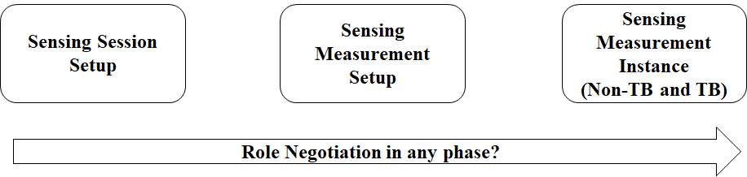
Possible Role-related phases
[1] mentioned that the operational attributes may include initiator’s and responder’s roles, …..
  However, we need to think about that, carefully, when and how exactly?
Roles are highly related to sensing measurement and can be different depending on sensing measurement instance
  Therefore, before a sensing measurement setup, it is not necessary to determine roles of STAs (during a sensing session setup)
?

Slide 4
Role Negotiation in Sensing Measurement Setup and Measurement Instance
During sensing measurement setup, a measurement setup ID is assigned, with which several operational attributes (to be defined) will be associated
  If we use the ID in any measurement instance (e.g., in NDPA, Polling frame), a STA that receives the ID can recognize the roles as one of operational attributes without any additional signaling regarding roles
  Can we change the roles per ID?
    It may make measurement instances too complicated with additional signaling
    If we just have multiple IDs, multiple different roles can be supported
We should clarify some points related to roles
  The roles shall be determined during a sensing measurement setup
  The roles does not change per a measurement setup ID

Slide 5
Possible Type of Roles (To be Negotiated)
During a measurement setup, Type of Roles of a STA are as determined (after session setup)
  Sensing Receiver
    E.g., NDPA (DL) sounding: the STA shall be a receiver only after the measurement setup
  Sensing Transmitter
    E.g., TF (UL) sounding: the STA shall be a transmitter only after the measurement setup
  Sensing Transmitter and Receiver
    E.g., Sensing responder can be sensing receiver and/or transmitter, it can be picked in a measurement instance (e.g., using STA ID in NDPA, Polling frame)
    If NDPA sounding and TF sounding in TB measurement instance happens sequentially, the STA may participate both of them or either
  NOTE: We may need to consider Proxy initiator [2], [3]. If we define Proxy initiator is not a sensing initiator, the STA requesting a measurement setup can be Proxy initiator or a sensing initiator that doesn’t query to a Proxy initiator
In SFD
1) a sensing initiator might be a sensing transmitter, a sensing receiver, both or neither
2) a sensing responder might be a sensing transmitter, a sensing receiver, or both

Slide 6
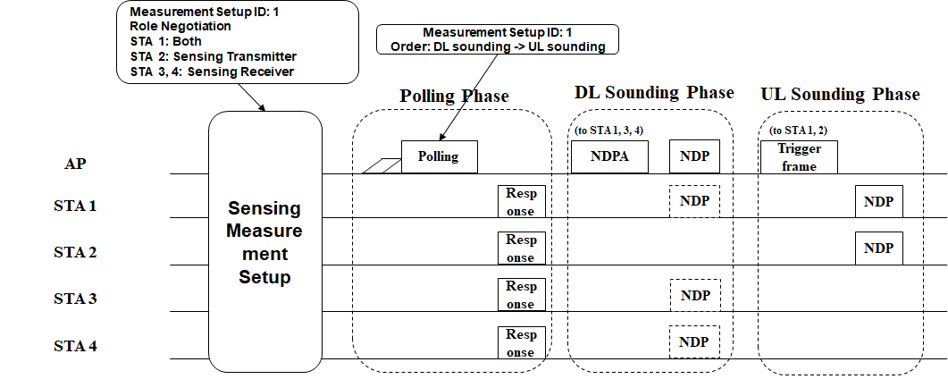
Example
Depending on some factors, e.g., whether DL/UL sounding happens and its order, STA ID, the roles in a measurement instance can be determined
  Order signaling may happen before measurement instance

Slide 7
Conclusion
Based on several observations, we clarified some points related to roles
  The roles shall be determined during a sensing measurement setup
  The roles do not change per a measurement setup ID
The type of roles of a STA can be negotiated during a sensing measurement setup, as follows
  Sensing Receiver
  Sensing Transmitter
  Sensing Transmitter and Receiver

Slide 8
SP #1
Do you agree that during a sensing measurement setup between STAs the roles of the STAs shall be determined?

Slide 9
SP #2
Do you agree that during a sensing measurement setup between STAs, the type of roles of the STA shall be negotiated as one of the followings
  Sensing Receiver
  Sensing Transmitter
  Sensing Transmitter and Receiver
    It means that the STA can be a sensing transmitter and/or a sensing receiver in different measurement instances corresponding to the same measurement setup ID

Slide 10
SP #3
Do you agree that the roles of a STA associated with a sensing measurement setup shall be fixed?

Slide 11
References
[1] 21/504r3, Specification Framework for TGbf
[2] 21/1684r0, Proxy for non-AP Initiator
[3] 21/1692r0, Enhancing Client-based Sensing: Sensing by Proxy

