Slide 1
Procedure of Sensing Measurement Setup
Date: 2021-11-09
Authors:
Name | Affiliation | Address | Phone | Email
Insun Jang | LG Electronics | 19, Yangjae-daero 11gil, Seocho-gu, Seoul 137-130, Korea |  | insun.jang@lge.com
Jinsoo Choi |  |  |  | js.choi@lge.com
Dongguk Lim |  |  |  | dongguk.lim@lge.com
Sang Kim |  | 10225 Willow Creek Rd, San Diego, CA, USA |  | sanggook.kim@lge.com

Slide 2
Introduction
According to [1], we’ve agreed
  Sensing Measurement Setup
    “An optional negotiation process in the sensing measurement setup is defined that allows for a sensing initiator and a sensing responder to exchange and agree on operational attributes associated with a sensing measurement instance”
However, how to perform the measurement setup is not specified yet, which needs to be designed
  In this contribution, we propose mechanisms to achieve the goal as the first step

Slide 3
Design Principles
Basically, a sensing measurement setup should be “pairwise” based on previous discussions
  Especially, in SFD “An optional negotiation process in the sensing measurement setup is defined that allows for a sensing initiator and a sensing responder to exchange and agree on operational attributes associated with a sensing measurement instance”
  It follows the concept a lot of setup/agreement/negotiation procedures in 802.11 by utilizing Request/Response frame as MGMT frame (mainly, Action frame)
    E.g., Association, TWT, BlockAck, …
  Therefore, The Sensing Measurement Setup would be, e.g.,
  After a sensing session setup, a STA, which intends to initiate a sensing measurement, first will request the setup (using a request frame) to another STA with which it wants to perform the WLAN sensing
  That STA, which receives the request, determines whether it accept the request or not and then shall transmit a response frame

Slide 4
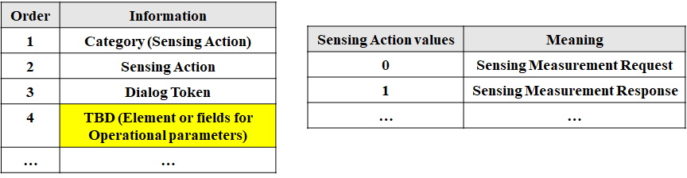
Considerations: Frame Exchange
We need new Action frames to achieve the approach
  Basically, it is individually addressed between an initiator and a responder
  It can be categorized as Sensing Action field
    Or we may differentiate them in a frame as types
Example

Slide 5
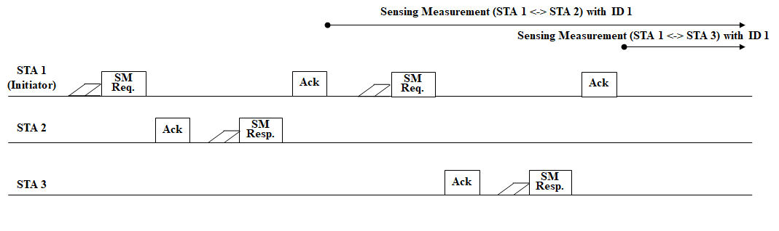
Considerations: Frame Exchange Example
For Measurement Setup ID 1
  STA 1 (as sensing initiator) <-> STA 2, STA 1 <-> STA 3

Slide 6
Discussion: Response frame
A responding STA responds to the request using, e.g.,
  Simple Ack,
  Response frame (not Ack) including specific information like in Request frame and intention (e.g., Status Code)
Simple Ack
  The requester STA only has the right to determine operational attributes, which may not be a negotiation; and also, the responding STA cannot deliver any intention (e.g., accept/reject) and suggested operational attributes
Therefore, the response frame should include the Status Code depending on operational attributes the requesting STA suggests, e.g., accept, reject, or suggest
  The responding STA may suggest operational attributes it prefer instead of reject to accelerate for the sensing measurement setup

Slide 7
Discussion: MU (Trigger)-based Approach
We may consider MU-based measurement setup (see Appendix), but expect that it will not work well, as follows
Basically, it is natural to follow the concept of baseline negotiation mechanisms
Capabilities
  It requires at least 11ax capabilities while non-TB can be used as an unified approach regardless of the standard
Pairwise
  It may not be proper in terms of pairwise
Response
  In terms of TB, it requires immediate responses, which may make it difficult due to receiver’s capabilities (e.g., processing time)

Slide 8
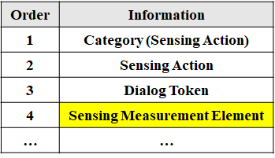
Considerations: Information
We need a container, i.e., an element (e.g., called Sensing Measurement IE (TBD) to exchange operational attributes to be negotiated during frame exchange related to measurement setup
Note: The element basically includes the Request/Response frames which can be defined in previous slides. Maybe, it could be done during Association by including the element

Slide 9
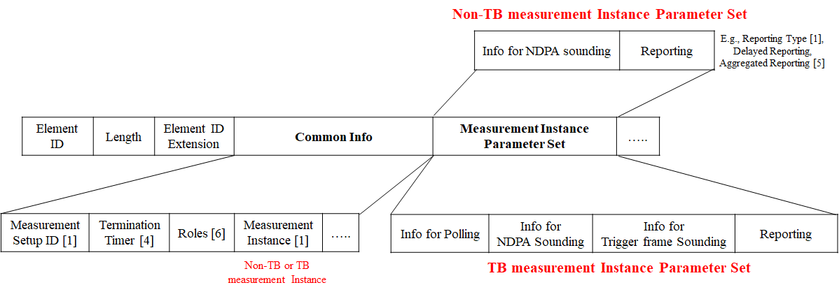
Considerations: Element Example
The element can include operational attributes we’ve agreed before and we will discuss/agree later
For example,
  It may have Common Info which can be applied regardless of measurement instance type and differentiate the type of parameter set for TB and non-TB
  Good to have the same length of each Parameter set (or can be unified)
  Whether each Info is needed or not needs to be discussed

Slide 10
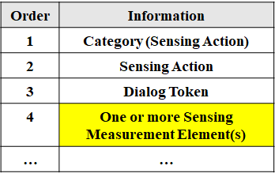
Discussion: Multiple elements
We may allow to setup multiple measurement setups simultaneously for a pair of STAs (with different IDs)
  To this end, we may need to include more than one sensing measurement elements
  It can reduce measurement setup time/overhead, but we have to check the use case/issues

Slide 11
Summary
We addressed a sensing measurement setup procedure and provided the concept of frame exchange and a container
  Sensing Measurement Request/Response frame as Action
  Sensing Measurement Element included in the frames
Overall, based on some discussion points, we prefer
  Not to MU (Trigger)-based measurement setup approach
  Response frame includes Status Code to deliver an intention of a responding STA

Slide 12
SP #1
Do you support to add to the 11bf SFD that sensing measurement request and response frames, which allow to perform a sensing measurement setup, are defined, and the following mechanism is enabled?
  A STA transmits a sensing measurement request frame to another STA with which it intends to perform a sensing measurement setup
  That STA, which receives the request frame successfully, shall transmit a sensing measurement response frame to the STA which transmitted the request frame
  The type of sensing measurement request response frames are Action and those are individually addressed
  Name and the details of the sensing measurement request and response frames are TBD

Slide 13
SP #2
Do you support to add to the 11bf SFD that a sensing measurement element to include and exchange operational attributes during a sensing measurement setup is defined?
  The name and detailed design of the sensing measurement element is TBD

Slide 14
References
[1] 21/504r3, Specification Framework for TGbf
[2] 20/1804r1, Discussion on WLAN Sensing Procedure
[3] 21/370r1, Considerations of sensing negotiation
[4] 21/1701r0, Measurement setup termination
[5] 21/1438r1, Discussion on reporting procedure
[6] 21/1736r0, Role Negotiation in WLAN Sensing Procedure

Slide 15
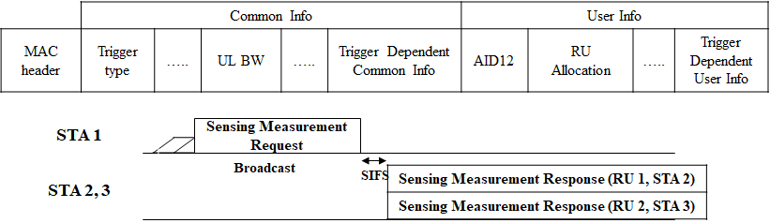
Appendix: MU(Trigger)-based Approach
Generally, it can be a variant of Trigger frame as the request frame to support multiple STAs simultaneously
  But, the response frame needs to be designed as a new frame or can be existing frames (e.g., CTS)
  To include operational attributes/parameters (to be defined), it can use a few reserved bits and Dependent fields in Common/User Info fields
    Note that if we define a new response frame, it requires the information of TB PPDU
  Based on the aspect of TB, it requires an immediate response

Slide 16
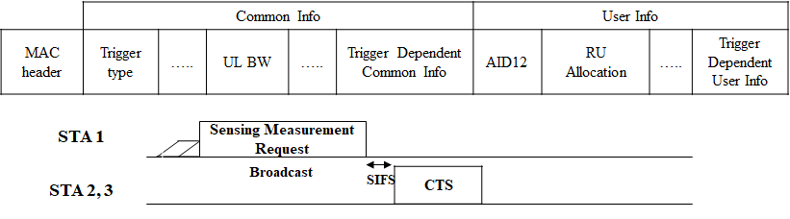
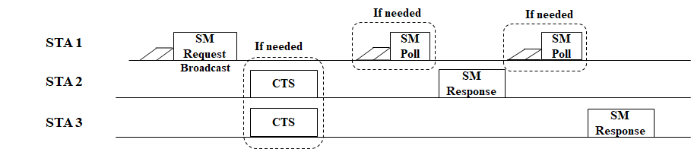
  Appendix: Alternative to TB Approach
  MU-RTS like TB has many reserved bits which can be utilized
However, the CTS response only says “Successful reception”
  The STA, which transmits an SM Request frame and does not receive any response frame, cannot understand whether the receiver intends to reject or the transmission fails
  Moreover, it is not easy to distinguish STAs are transmitting CTS in the same BW
  As an alternative,
  the response frame may be delayed
  - It reduces the advantages of TB

