Slide 1
Calculation of the Scaling Factor in the Sensing CSI Report
Date: 2021-10-28
Authors:
Name | Affiliations | email
Steve Shellhammer | Qualcomm | shellhammer@ieee.org

Slide 2
Introduction
In [1] power-of-two scaling was proposed in the construction of the Sensing CSI Report
That presentation [1] described the selection of the scaling factor but did not provide a specific equation for the scaling factor
Here we provided two methods of calculating the scaling factor
  First method is useful in Matlab
  Second method is useful in a low-complexity implementation
[1] S. Shellhammer, et. al., “Low-Complexity Scaling and Quantization for CSI Report,” IEEE 802.11-21/1573r1, October 2021

Slide 3
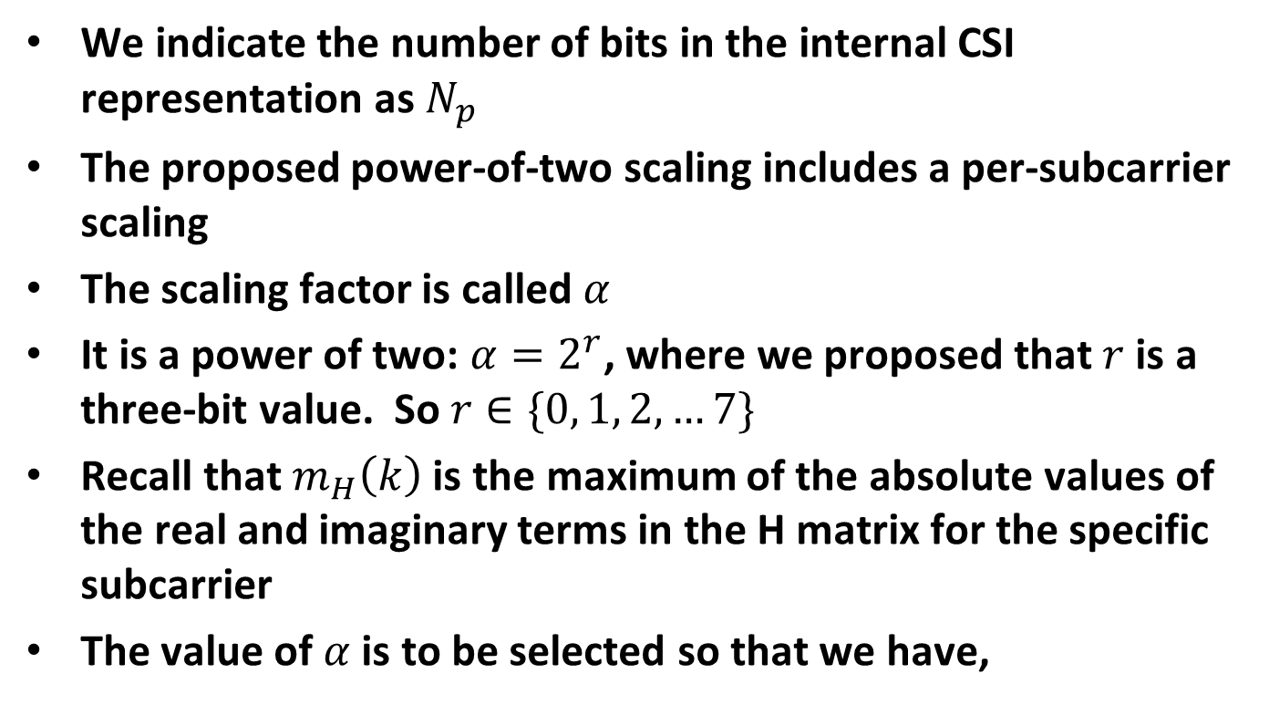
Background
We indicate the number of bits in the internal CSI representation as $N_{p}$
The proposed power-of-two scaling includes a per-subcarrier scaling
The scaling factor is called $α$
It is a power of two: $α=2^{r}$, where we proposed that $r$ is a three-bit value. So $r∈\{0, 1, 2, …7\}$
Recall that $m_{H}\left(k\right)$ is the maximum of the absolute values of the real and imaginary terms in the H matrix for the specific subcarrier
The value of $α$ is to be selected so that we have,
$${(2}^{(N_{p}−1)}−1)≥α m_{H}\left(k\right)≥2^{(N_{p}−2)}$$

Slide 4
Method #1 – Equation
The following is an equation for $r$,
$$r=\min\left(7, \left\lfloor Log_{2}\left(2^{{(N}_{p}−1)}−1\right)−Log_{2}\left(m_{H}\left(k\right)\right)\right\rfloor \right)$$
The scaling factor is given by $α=2^{r}$
This is clearly a good equation to use in a Matlab simulation but maybe it is not so great for a low-complexity implementation
Next, we will look at a low-complexity method

Slide 5

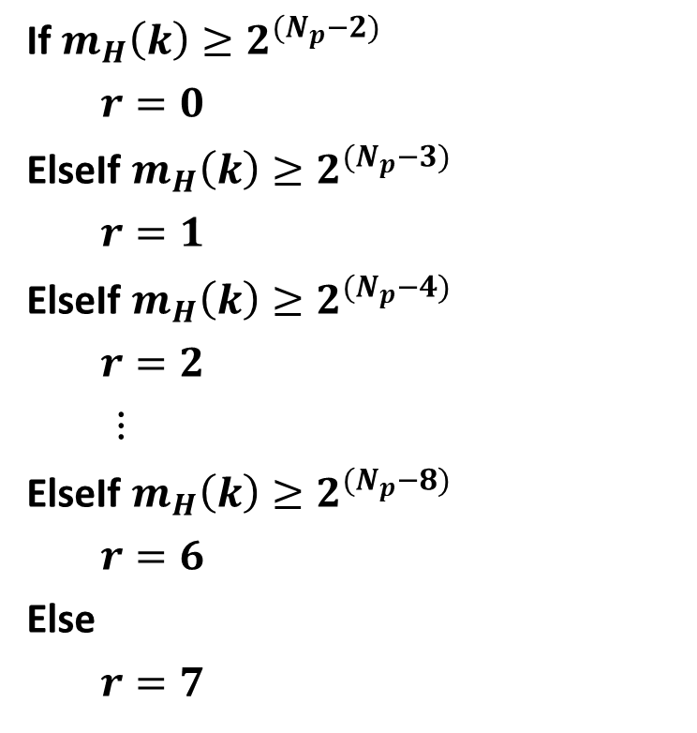

Method #2 – If/Then/Else
If $m_{H}\left(k\right)≥2^{{(N}_{p}−2)}$
$r=0$
ElseIf $m_{H}\left(k\right)≥2^{{(N}_{p}−3)}$
$r=1$
ElseIf $m_{H}\left(k\right)≥2^{{(N}_{p}−4)}$
$r=2$
$⋮$
ElseIf $m_{H}\left(k\right)≥2^{{(N}_{p}−8)}$
$r=6$
Else
$r=7$
Here we have provided some pseudo code to find $r$
Most of the time, one of the first few comparisons will pass, and the code will end after a few comparisons
The scaling factor is given by $α=2^{r}$

Slide 6
Summary
We have provided two methods of calculating the scaling factor for the Low-Complexity Scaling and Quantization
  Method #1 – Equation (Useful in simulations)
  Method #2 – Low-complexity method for implementations

