Slide 1
MAC Privacy and PMKSA Caching
Date: 2021-10-21
Authors:

Slide 2
Abstract
When dot11MACPrivacyActivated is equal to True, a STA cannot change its MAC address without all state with a BSS, including the security state.
This contribution provides a means for a STA to maintain a PMKSA while allowing its MAC address to be changed.

Slide 3
High Level Solution Description
The model for association is as follows:
STA associates to a BSS with a first random MAC address and establishes an SA
As part of the security association, a PMKID is generated.
STA disassociates from network
STA changes MAC address to new random address.
STA attempts to associate to BSS with cached PMK and the PMKID.
AP recognizes the PMKID and STA establishes a new SA (and generates a new PMKID)
Note that any network state associated with the old MAC address would be lost.

Slide 4
Requirements
The AP and STA would advertise/negotiate an association with this capability.
A new PMKID will be generated for each subsequent association (to prevent tracking)
The STA and AP generate a new PMKID (rPMKID) each association
The feature expedites the establishment of a security association – changing the MAC address will affect bridging and higher layer communications.
The solution will work for any AKM.

Slide 5
Solution
AP advertises support for rPMKSA caching in Extended RSNE
STA associates and signals intention to use rPMKSA caching
A new PMKID will be generated for each subsequent association (to prevent tracking)
The STA and AP generate a new PMKID (rPMKID) each association
If this feature is supported by both STA and AP, the STA includes the rPMKID in the PMKID List field at Association.
NOTE: The feature expedites the establishment of a security association – changing the MAC address will affect bridging and higher layer communications.

Slide 6
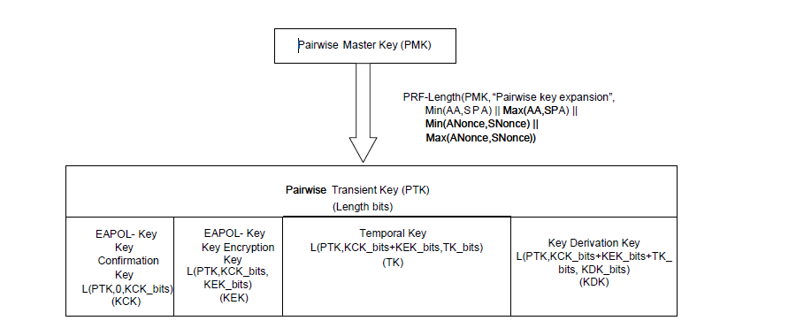
rPMKID derivation
Recently, TGaz and TGbe provided a generalized scheme for deriving new keying material from the PTK.
The rPMKID is derived from the PTK (KDK) for each association:
(NOTE: FT and FILS have different PTK derivations)

Slide 7
rPMKID Derivation Options
Adopt an approach using the KDK based on TGba D8.0 and TGaz D2.6:
Option 1. Using IEEE 802.11 KDF
rPMKID = L(0, 128, HMAC-HASH(KDK, "rPMKID expansion")
Option 2. Using IETF RFC 5869
rPMKID-PRK = HKDF-Extract(current PMKID, KDK)
rPMKID = HKDF-Expand(rPMKID-PRK, "rPMKID expansion", 16)

Slide 8
Next Steps
Include as an issue for P802.11bi
Use Case
Provide a mechanism for a STA to use a cached PMK while changing its MAC address
STA associates to AP and generates PMKSA/PMKID
STA disassociates or loses connectivity
STA changes MAC address
STA associates to AP with new MAC address and cached PMK

