Slide 1
Enhancing Client-based Sensing: Sensing by Proxy
Date: 2021-10-22
Authors:

Slide 2
Abstract
In this presentation, we discuss a possible approach to enable a client (that is, a non-AP STA) to obtain sensing measurements using multiple radio links (multistatic sensing).
Main idea is to allow for a client to request an AP to obtain sensing measurements for itself (“on its behalf”). The AP obtains measurements and reports them to the requesting client.
  The considered approach fits within the 802.11 architecture, makes use of definitions already found in the 11bf SFD, and does not contradict the 11bf SFD.

Slide 3
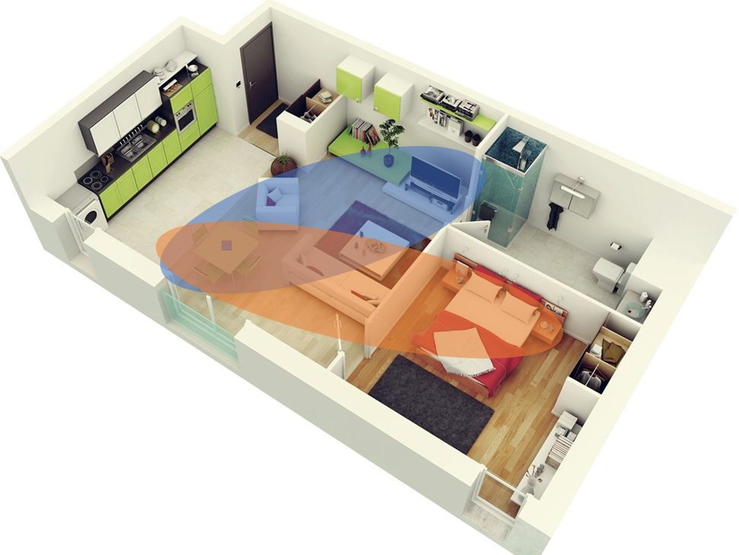
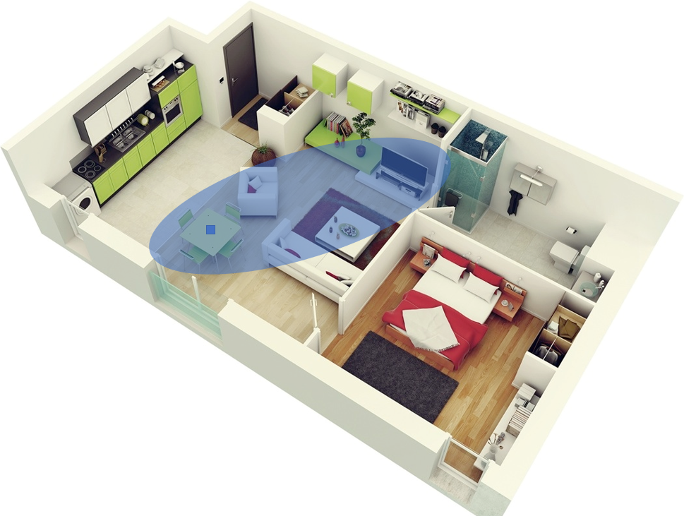
Background: Bistatic and Multistatic Sensing
Bistatic
Multistatic
Sensing “… comprising a transmitter and receiver that are separated by a distance comparable to the expected target distance.”
Relatively narrow sensing area. Likely would cover only part of a house.
Poor resolution. For example, likely unable to locate where motion/changes happened.
Potentially unreliable. Resulting performance, is a function of the position of just two devices, which can vary and be poor at times.
Sensing comprising “… multiple spatially diverse monostatic radar or bistatic (sensing) components with a shared area of coverage.”
Wider sensing area, potentially covering an entire house or a floor in an enterprise environment.
Improved resolution. For example, as shown next, possibility of locating where motion/changes happened.
Robustness may be significantly higher than that of the bistatic case as it makes use of signals transmitted/received by spatially diverse devices.

Slide 4
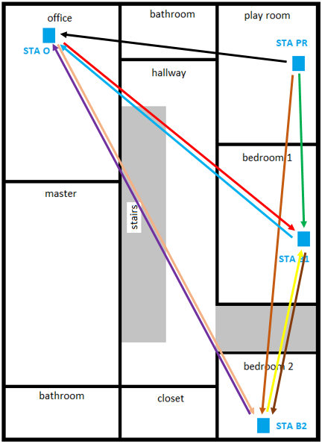
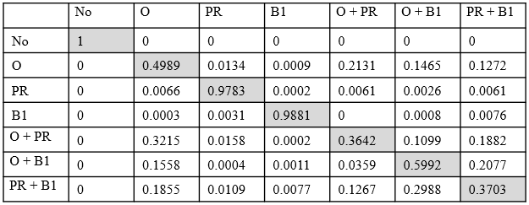
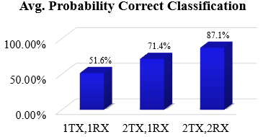
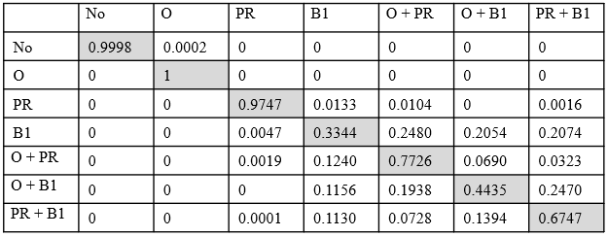
Background: Transmit and Receiver Diversity
Results of an extensive measurement campaign to evaluate the need for “collaboration” in WLAN sensing were presented in 11-19/1416r0.
Goal: Detect motion and identify where (e.g., in which room) it happens using “legacy” Wi-Fi devices.
Confusion matrix when STA O is sensing receiver.
Combining information from multiple sensing transmitters and sensing receivers may lead to improved performance:
Confusion matrix when STA B1 is sensing receiver.
Reference: "Wi-Fi sensing: Cooperation and standard support," doc. IEEE 802.11-19/1416r0.

Slide 5
Client-based Sensing 1/3
Significant number, if not most, of sensing solutions currently found in the market have the AP as the sensing initiator.
In this case, the application has access to measurements obtained with one or more clients associated with the AP – in other words, we have multistatic sensing.
  Improved coverage area, resolution, and robustness.
At the same time, by the nature of the 802.11 architecture, a client, in principle, would perform sensing only with the AP to which it is associated with.
This leads to bistatic sensing, which, as previously discussed, has significant drawbacks when compared to multistatic sensing.
  To an extent, bistatic sensing can be enhanced, for example, with the use of MIMO. However, transmitter diversity and/or receiver diversity is key.

Slide 6
Client-based Sensing 2/3
Enabling a client to perform sensing by using measurements of multiple links (multistatic sensing) is necessary to enable and enhance a wide range of sensing applications.
  Which applications? Generally speaking, all sensing applications that are hosted in everyday electronic devices (such as laptop computers, smartphones, and digital home assistants) and require sensing information about the environment in which they operate.
  Example: Digital assistant (or smart thermostat) that controls heating/AC in a house by relying, at least in part, on activity level inside a house obtained with WLAN sensing.
    Low-overhead, low-duty cycle application that fundamentally requires multistatic sensing.

Slide 7
Client-based Sensing 3/3
How can a client perform multistatic sensing?
It could use APs to which it is not associated with.
  In principle, this case will be supported automatically by 11bf with the use of 11az features (PASN).
  While this option may be viable in an enterprise environment, unfortunately, viability in home environments is questionable in the near future.
Perform sensing with a peer.
  In principle, this case will be supported automatically by 11bf with the use of TDLS.
    Drawbacks include overhead and required support of TDLS specification.
  Other configurations have been proposed to 11bf (such as the collaborative approach proposed in 11-21/0145).
Enabling a client to request an AP to serve as a “proxy sensing initiator.”
  Focus of this contribution.

Slide 8
Sensing by Proxy
Basic concept is to:
  Enable a client to request an AP to obtain sensing measurements.
  AP performs sensing with one or more clients.
  AP reports obtained sensing measurements to the client that requested them.
A couple of notes:
  Proposed procedure fits in a traditional 802.11 architecture (for example, no peer-to-peer connection).
  SFD already defines some necessary basic definitions (such as delayed feedback).
  No contradictions with SFD.

Slide 9
Sensing by Proxy – Overview
Basic Sensing by Proxy (SBP) concept is to:
  Enable a client to request an AP to obtain sensing measurements acting as a proxy-initiator for the requesting client. (green)
  AP performs sensing with one or more clients. (blue)
  AP reports obtained sensing measurements to the client that requested them. (purple)
Establishes “proxy”
Client 0
SBP requesting STA
AP
Establishes session
Measurement instance
Reports measurements
NDP
trigger
Client 1
Client 2

Slide 10
Sensing by Proxy (SBP) – Step 1
Step 1: Initial setup
  Goal is to enable a client to request an AP to obtain sensing measurements with other STAs.
Basic concepts:
  Client requests an AP to perform a WLAN sensing procedure.
    Client sends a TBD Request frame to the AP and indicates its intent for the AP to serve as the proxy-initiator for the client to perform sensing measurements with other STAs.
    Client may request some fundamental sensing parameters, such as measurement type and number of STAs.
    Client is denoted by “SBP requesting STA”.
  AP has control over parameters/configurations used when measurements are obtained.
    AP determines, for example, scheduling and which clients would use to obtain measurements with.

Slide 11
Sensing by Proxy (SBP) – Step 2
Step 2: Measurements
  Goal: AP performs WLAN sensing procedure(s) with one or more clients.
Basic concepts:
  This would be a “conventional” sensing procedure between an AP and one or more clients: Establishes sensing session, establishes sensing measurement setup, schedule measurement instance, obtains measurement results.
  Potential configuration: AP serves as the sensing receiver (avoids frame retransmission and report forwarding).

Slide 12
Sensing by Proxy (SBP) – Step 3
Step 3: Measurement reporting
  Goal: AP reports measurements to the client that requested them.
Basic concepts:
  SFD already enables the reporting of measurements. Difference here is that the frame(s) that include(s) the measurement reports would be addressed to the client that requested them.

Slide 13
Conclusions
Enabling a client to perform sensing by using measurements of multiple links (multistatic sensing) is necessary to enable and enhance a wide range of sensing applications.
We discuss a possible approach to enable a client (that is, a non-AP STA) to obtain sensing measurements using multiple radio links (multistatic sensing).
  The proposed approach fits within the 802.11 architecture, makes use of definitions already found in the 11bf SFD, and does not contradict the 11bf SFD.
If needed, to keep complexity at bay, a limited set of configurations may be defined.

Slide 14
SP
Do you agree to add the following text to the SFD:
A sensing by proxy (SBP) procedure is defined in which:
An “SBP request” consists of a non-AP STA sending an SBP Request frame to an SBP-capable AP STA.
  An STA that sends an SBP Request frame to invoke SBP (and, as a result, WLAN sensing) is denoted by “SBP requesting STA”.
  The format and contents of the SBP Request frame are TBD.
A STA that receives an SBP request shall send to the SBP requesting STA an SBP Response frame to accept or reject the request.
  The format and contents of the SBP Response frame are TBD.
A STA that accepts an SBP request shall initiate WLAN sensing procedure(s) with one or more non-AP STAs using operational parameters derived from those indicated within the SBP Request frame.
Measurement results obtained in WLAN sensing procedure(s) resultant from an SBP request shall be reported to the SBP requesting STA.

