Slide 1
Extended RSN Capabilities Issues in IEEE 802.11ay-2021
Date: 2021-October-14
Authors:

Slide 2
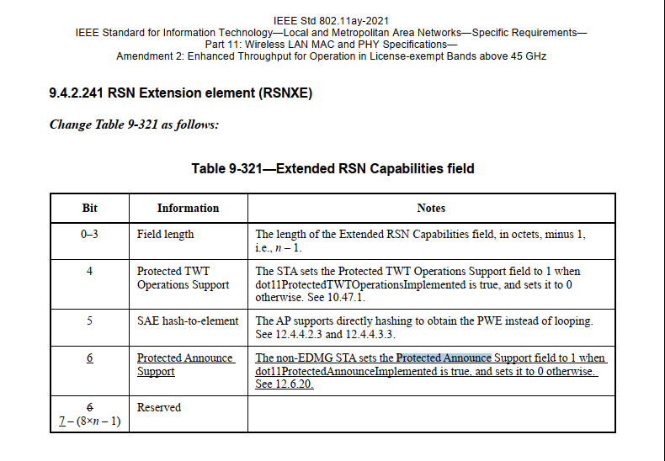
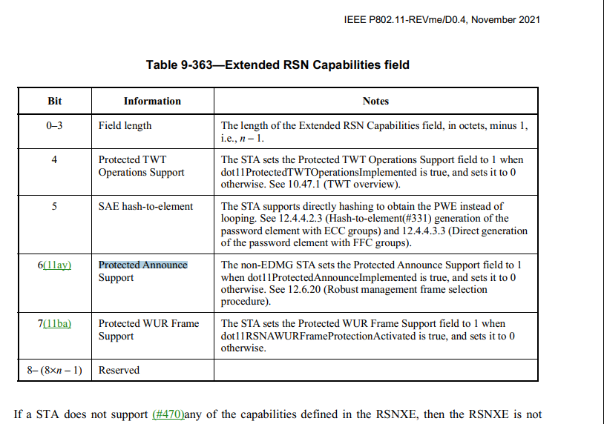
Problem Statement
There is an error in published standard IEEE 802.11ay-2021. In 9.4.2.241 Table 9-321 of 11ay, bit 6 has been assigned to “Protected Announce Support”.

Slide 3
Problem Statement (2)
However, in the ANA database (see https://mentor.ieee.org/802.11/dcn/11/11-11-0270-56-0000-ana-database.xls Extended RSN Capabilities tab), bit 6 is assigned to WFA and used by existing 802.11 implementations.

Slide 4
Proposed Solution
ANA assigns a different number for 11ay
  This might affect 11ay implementations. Any product with this implementation in the field?
  If agreed, REVme will update the draft with the new assignment.
  Do we need to revised the published standard IEEE 802.11ay-2021?
Any other options?

