Slide 1
Simplified Scaling Factor Feedback for CSI Matrices Quantization
Date: 2021-10-12
Authors:
Name | Affiliation | Address | Phone | Email
Junghoon Suh | Huawei |  |  | junghoon.suh@huawei.com
Yan Xin
Osama AboulMagd
Edward Au

Slide 2
Background
802.11n Specification provides the detail CSI matrices quantization procedure [1]
We examined the 11n based CSI matrices quantization with simulations
The procedure of scaling factor computation in 11n specification seems quite complicated by repeating the linear to dB and dB to linear conversion
We propose a simplified scaling factor computation procedure and check the performance based on the simplified scaling factor computation

Slide 3
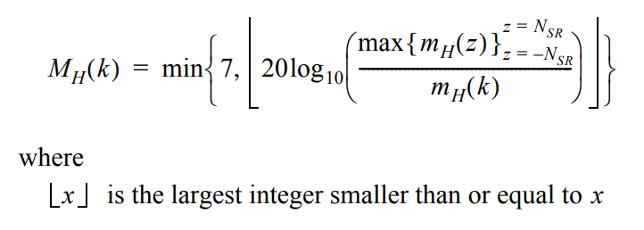
802.11n CSI matrices quantization procedure [1]
The maximums of the real and imaginary parts of each element of the matrix in each subcarrier are found as following
The scaling ratio is calculated and quantized to 3 bits as following

Slide 4
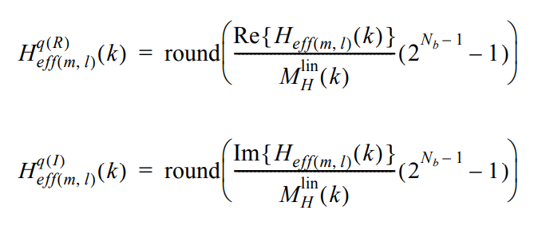
802.11n CSI matrices quantization procedure continues [1]
3. Linear Scaler of step 2 is given as following
4. The real and imaginary parts of each element in the matrix $H_{eff(m,l)}$(k) are quantized to N_{b} bits in twos complement encoding as defined by following
N_{SR} indicates the half the size of
Subcarriers per symbol excluding Nulls
k is the subcarrier index
R represents real component
I represents imaginary component

Slide 5
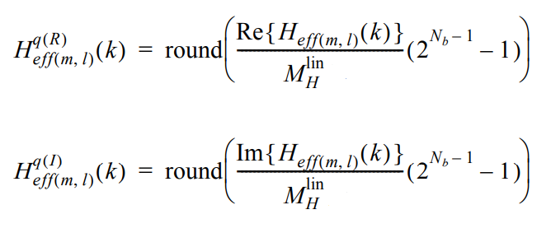
Simplified Scaling Factor based CSI matrices quantization
The maximums of the real and imaginary parts of each element of the matrix in each subcarrier are found as following
Choose the scaling factor, $M_{H}^{lin}$ as following, (now $M_{H}^{lin}$ is not a function of subcarrier)
$${M_{H}^{lin}=max\left\{m_{H}\left(k\right)\right\}}_{k=−N_{SR}}^{k=N_{SR}}$$
3. The real and imaginary parts of each element in the matrix $H_{eff(m,l)}$(k) are quantized to N_{b} bits in twos complement encoding as defined by following

Slide 6
How to recover the CSI matrices in the Initiator
${\tilde{H}}_{eff(m,l)}^{q(R)}\left(k\right)={\hat{H}}_{eff(m,l)}^{q(R)}\left(k\right)$ * $M_{H}^{lin}$ / $\left(2^{N_{b}−1}−1\right)$
Where ${\tilde{H}}_{eff(m,l)}^{q(R)}\left(k\right)$ is the recovered CSI per subcarrier, per a spatial stream, and per Real (Imag) component
Where${\hat{ H}}_{eff(m,l)}^{q(R)}\left(k\right)$ is the quantized CSI fed-back per subcarrier, per a spatial stream, and per Real (Imag) component
$M_{H}^{lin}$ is the scaling factor in case of our proposed simplified scaling factor
For 11n based CSI quantization, $M_{H}^{lin}$ becomes $M_{H}^{lin}$(k)

Slide 7
Quantization of scaling factor ($M_{H}^{lin}$)
The range of scaling factor can be any number beyond 0, usually ranged between 1 and 16
Channel Normalization is applied to the estimated CFR so the scaling factor can be ranged between 0 and 15 or 1 and 16
This scaling factor is quantized once per sensing frame, and without being fed-back per each sub-carrier
The scaling factor can be any real number greater than 0, so we propose to quantize the Decimal number and the fractional value below decimal point separately.
We assign M bits for the decimal number, and assign K bits for the value below the decimal points
E.g. M is 4 bits, and K is 12 bits. Then, M bits represent the decimal points from 1 to 16, and K bits provide 2¹² , 4096 quantization steps between 0 and 1
For the scaling factor 4.7125762 as an e.g., the decimal number is 0100, and the fractional value below decimal point is quantized by choosing an 12 digit index closest to .7125762

Slide 8
Simulation
80 MHz (11ax SU-PPDU Tone Plan), 2X2 MIMO
Hence, there are 8 CSI matrices values to feedback per sub-carrier
The number of subcarriers to feedback depends on Ng size, we used Ng=1 for simulation, but for total bit size analysis, Ng=2 assumed
20 MHz (11ax SU-PPDU Tone Plan), 1X1
There are 2 CSI matrices values to feedback per sub-carrier
Tested over 100 different TGn-D channel realizations
Performance metric
Source to Quantization Noise Ratio (SQNR) : 10log(E(x²)/E(q²)) (dB), where x is the source data (raw CSI) and q is the quantization noise (difference between the raw CSI in the responder and the recovered quantized CSI feedback in the initiator)

Slide 9
Simulation Results
FB Bit size (Nb) | 11n based (SQNR, dB) | Total Size of FB Bits | Steve’s Low complexity Scaling [2] (=SQNR, dB) | Total Size of FB Bits | Our proposed Simplified Scaling Factor (SQNR, dB) | Total Size of FB Bits
4 | 23 | 15120 | 21 | 15120 | 18 | 13840
6 | 36 | 22032 | 33 | 22032 | 31 | 20752
8 | 48 | 28944 | 45 | 28944 | 43 | 27664
10 | 60 | 35856 | 57 | 35856 | 55 | 34576
12 | 72 | 42768 | 69 | 42768 | 67 | 41488
Total FB size is (3+2*Nb*Nr*Nc)*(Number of Fed-back subcarriers) for 11n based CSI Quantization, and Steve’s Low complexity scaling method (Not clear 3 bits of scaling factor is fed-back in [2] but assumed to be 3 bits here)
Total FB size for our proposed Simplified Scaling Factor method is 16+(2*Nb*Nr*Nc) * (Number of Fed-back subcarriers) ← 16 is from M =4 and K is 12 according to slide 7
For the analysis of the total FB Bit size, 80 MHz with Ng=2 is assumed for the Number of Fed-back subcarriers, 432
Our proposed Simplified Scaling Factor method shows about 1500 total bits smaller than 11n based method which is about 0.5 bit save per Nb size, that is about 3 SQNR dB save.

Slide 10
20 MHz Sim Results
The degradation of our proposed Simplified Scaling Factor method is reduced to 4 dB, compared to the 11n based in 20 MHz 1X1
FB Bit Size | 11n based (SQNR) | Our proposed Simplified Scaling Factor (SQNR)
4 | 36 | 32
6 | 49 | 45
8 | 61 | 57
10 | 73 | 69
12 | 85 | 81

Slide 11
Summary
We proposed a simplified scaling factor method to improve the 11n based CSI matrices quantization procedure
Now, we do not have to convert the linear scale factor to dB, and dB to linear anymore
Performance degradation is only 2dB worse than 11n based method for 80 MHz, 2x2 Ng=2 CSI feedback case, in consideration of the total FB Bit size in each CSI report time

Slide 12
Reference
[1] 802.11-2012.pdf, page 1731
[2] S. Shellhammer, et. al., “Quantization Error Analysis for CSI Report”, TGbf, 21/1595

