Slide 1
NIST mmWave Phased-Array Channel Sounder for Human Sensing
Authors:
Date: 2021-10-12

Slide 2
Abstract
We present our 28 GHz phased-array channel sounder for human tracking. The sounder extracts the (co-polarized and cross-polarized) complex power, delay, and AZ/EL AoA of resolvable paths scattered from the human body, in real time and with high precision. We present preliminary results that detect the periodic behavior of hand waving. We also present preliminary results that discriminate slow breathing from fast breathing, from the chest and from the abdomen. Measurements have also been collected in bistatic scenarios and will be presented in a future contribution.

Slide 3
Outline
Description of Channel Sounder
No Hand vs. Hand Waving Scenarios
Slow Breathing vs. Fast Breathing Scenarios
Future Scenarios
Conclusions

Slide 4
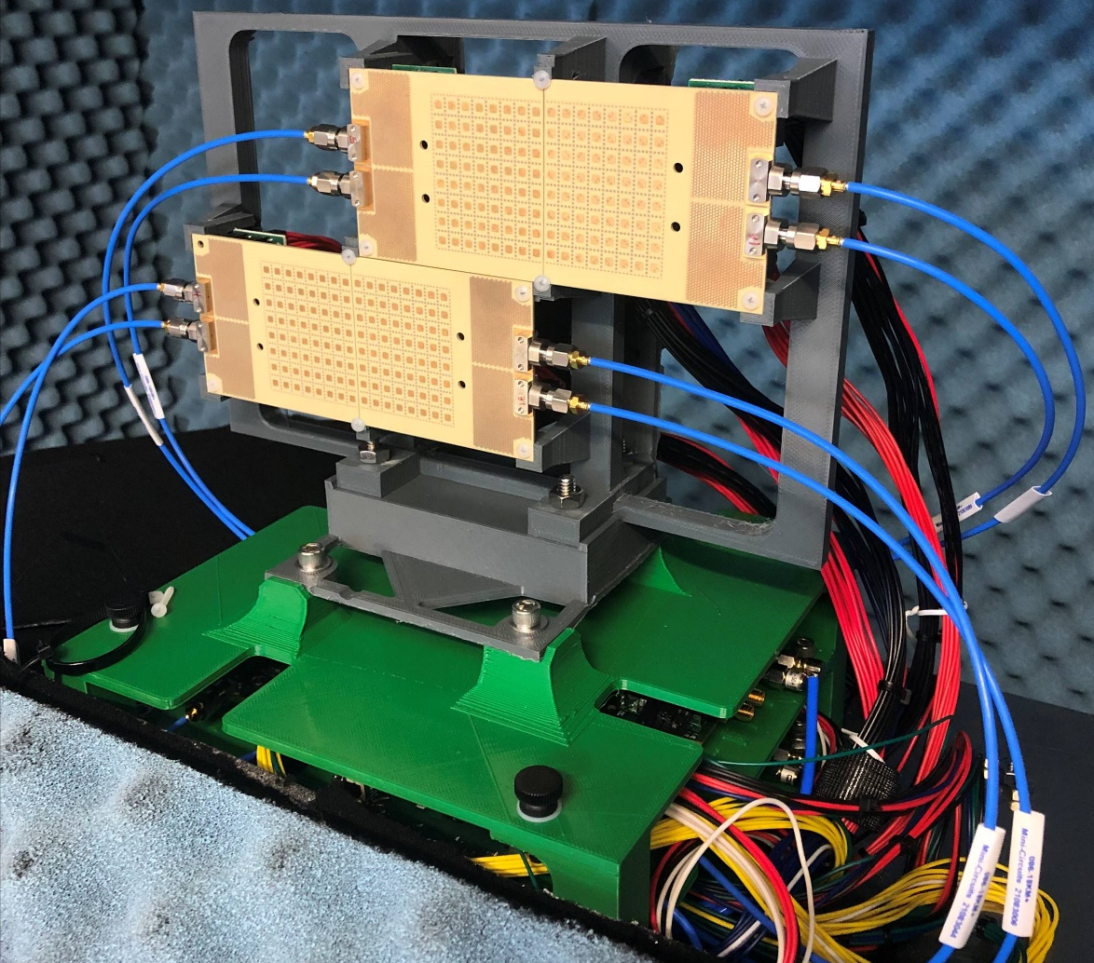
Description of Channel Sounder
RX Assembly
RX has four 8x8 dual-polarized phased-array antenna boards (shown) that are stacked side-by-side (two on top, two on bottom) to extend the horizontal/vertical aperture lengths, improving the beamwidth resolution to 3.8º in AZ and 6.7º in EL
RX digitizer has eight channels, one per board per polarization
TX has dual-polarized, omnidirectional antennas (not shown)
The 256 RX antennas are scanned sequentially and beamformed in post-processing, requiring only 1.04 ms seconds per scan [1].
System bandwidth = 2 GHz (15 cm delay resolution)
System measures the (co-polarized and cross-polarized) complex power, delay, and AZ/EL AoA of resolvable paths, with average errors of 0.48 dBm, 0.18 ns, and 0.47º respectively [1].

Slide 5
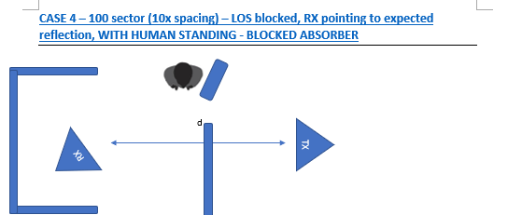
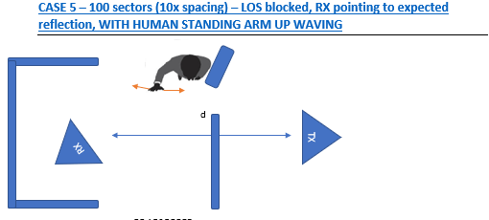
No Hand vs. Hand Waving Scenarios
No Hand
Hand Waving
HUMAN
ABSORBER TO
BLOCK HUMAN
HAND WAVING
ABSORBER TO
BLOCK LoS PATH
SEMI-ANECHOIC
CHAMBER
Current (bistatic angle = 180º) scenarios were to facilitate recalibration when debugging the system, but future scenarios have bistatic angle = 45º
Total recording time for both scenarios is 2.6 s in 100 frames (26 ms sampling rate)

Slide 6
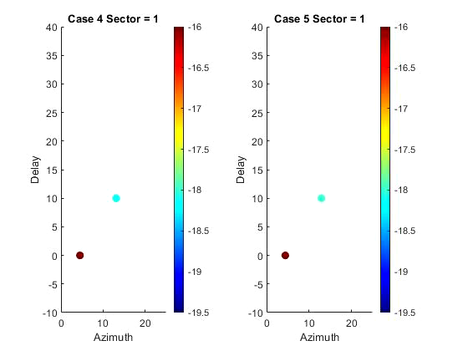
Path Properties: No Hand vs. Hand Waving
No Hand
Hand Waving
Time Index
Time Index
Two scatter centers are resolved in both scenarios, one diffracted from the human absorber (+hand in Hand Waving) and one diffracted from the LoS absorber
The power / delay / AZ AoA of the LoS absorber are stable over time in both scenarios (see video)
While the power / delay / AZ AoA of the human absorber are stable in No Hand, they vary notably over time for the human absorber + hand in Hand Waving (see video)
HUMAN ABSORBER
HUMAN ABSORBER
+ HAND
Delay (ns)
Power (dBm)
Delay (ns)
Power (dBm)
LoS ABSORBER
LoS ABSORBER
AZ AoA (deg.)
AZ AoA (deg.)

Slide 7
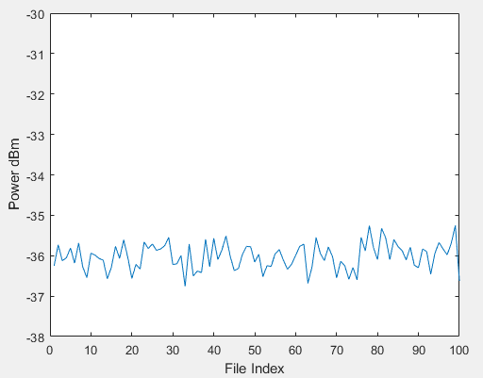
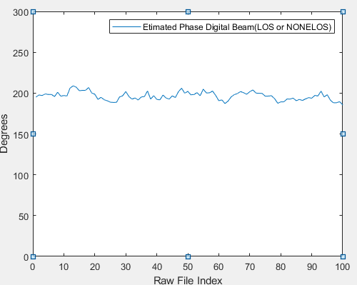
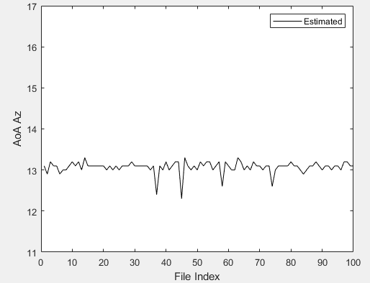
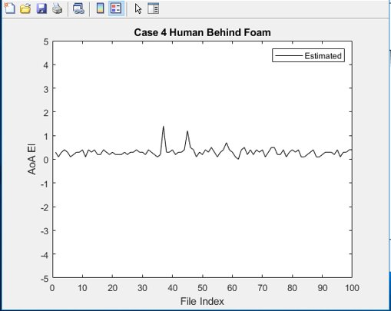
Properties of Human Absorber: No Hand
Power (dBm)
Phase (deg.)
The power / phase / AZ AoA / EL AoA of the human absorber are very stable over time in No Hand
Time
Time
AZ AoA (deg.)
EL AoA (deg.)
Time
Time

Slide 8
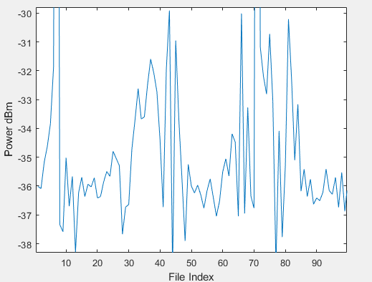
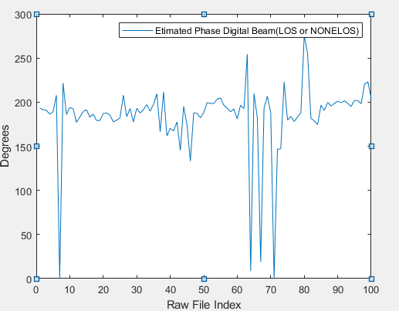
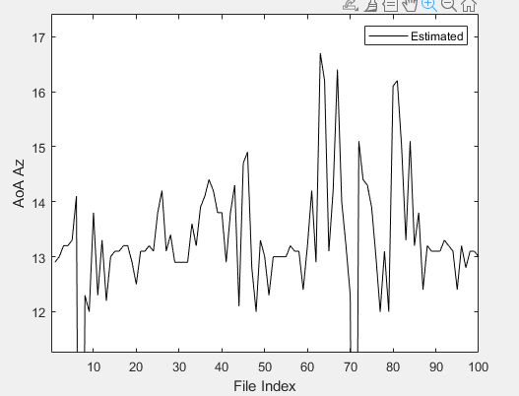
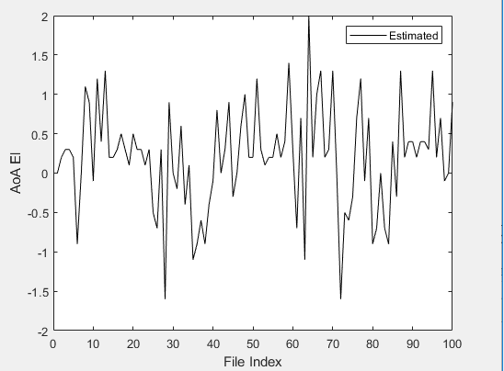
Properties of Human Absorber + Hand: Hand Waving
Power (dBm)
Phase (deg.)
The power / phase / AZ AoA / EL AoA of the human absorber + hand varies notably over time in Hand Waving
The power, in particular, exhibits a periodicity that corresponds to the periodicity of the hand motion (2.5 cycles)
Time
Time
AZ AoA (deg.)
EL AoA (deg.)
Time
Time

Slide 9
Slow Breathing vs. Fast Breathing Scenarios
Slow Breathing
Fast Breathing
HUMAN
ABSORBER TO
BLOCK LoS PATH
SEMI-ANECHOIC
CHAMBER

Slide 10
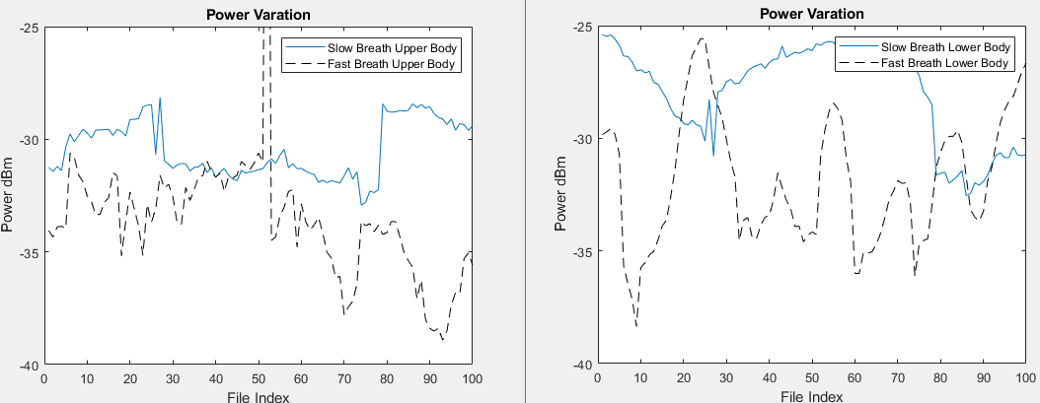
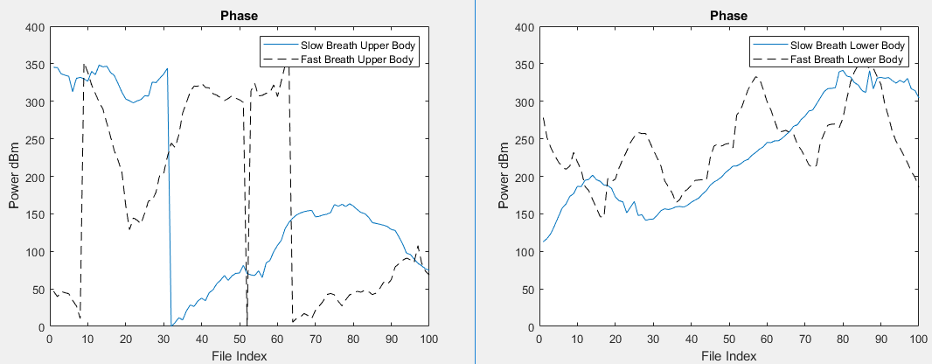
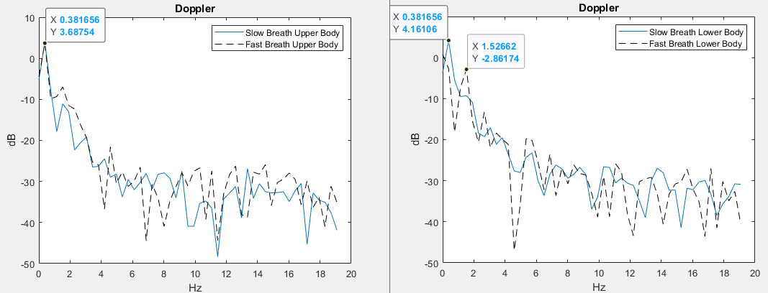
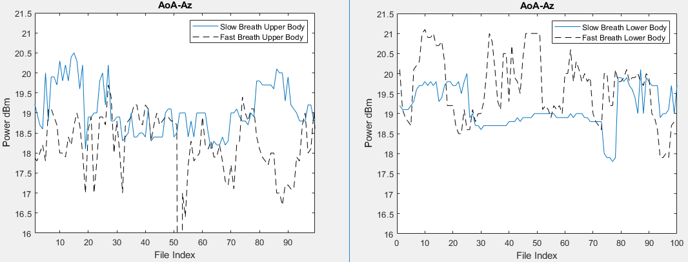
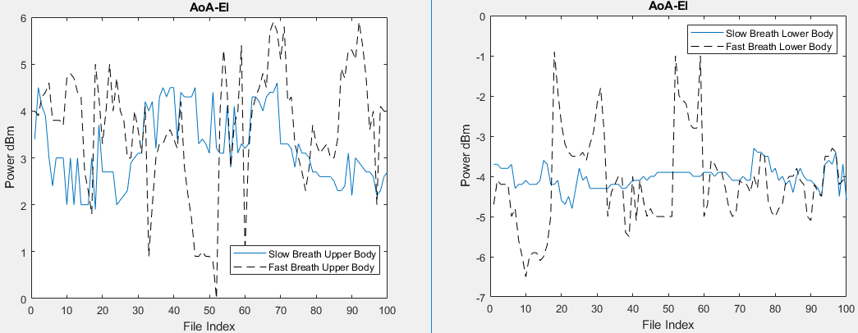
Abdomen Scatter Center
Power (dBm)
Phase (deg.)
Power (dBm)
Time
Time
Doppler Frequency (Hz)
Three scatter centers are resolved in both the Slow and Fast Breathing scenarios: one diffracted from the LoS Absorber, one from the Abdomen (negative EL AoA), and one from the Chest (positive EL AoA)
The period of Slow Breathing is clearly much longer than Fast Breathing for power / phase / AZ AoA / EL AoA of the Abdomen
The Doppler power spectrum of Fast Breathing also exhibits a stronger peak at a higher Doppler frequency compared to Slow Breathing for the Abdomen
AZ AoA (deg.)
EL AoA (deg.)
Time
Time

Slide 11
Chest Scatter Center
Power (dBm)
Phase (deg.)
Power (dBm)
Time
Time
Doppler Frequency (Hz)
For the Chest, there is little variation in all the properties over time in both scenarios, so the differences between the two scenarios are muted and no periodicity is apparent
AZ AoA (deg.)
EL AoA (deg.)
Time
Time

Slide 12
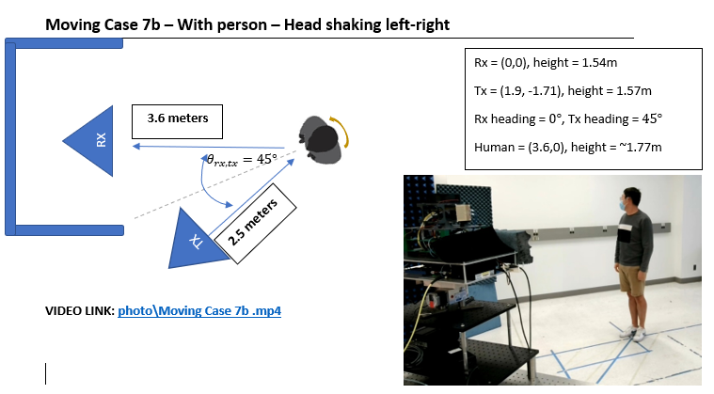
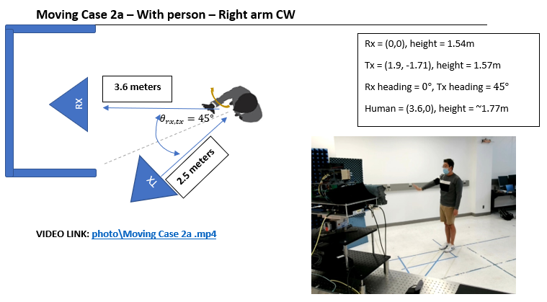
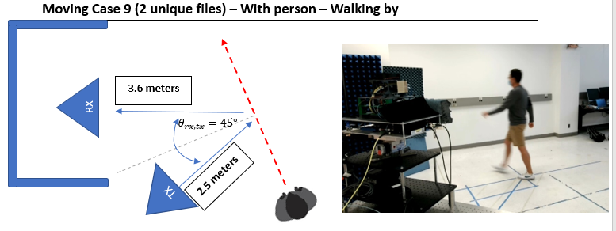
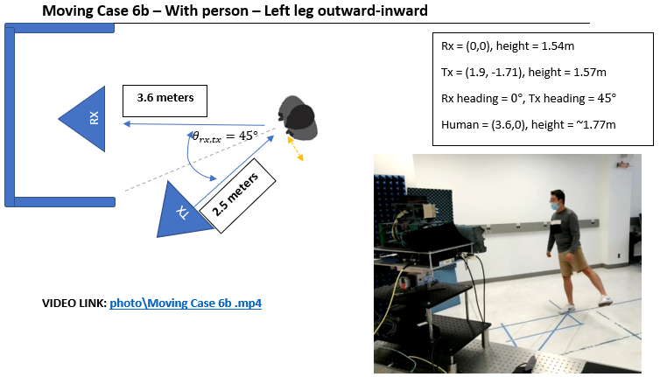
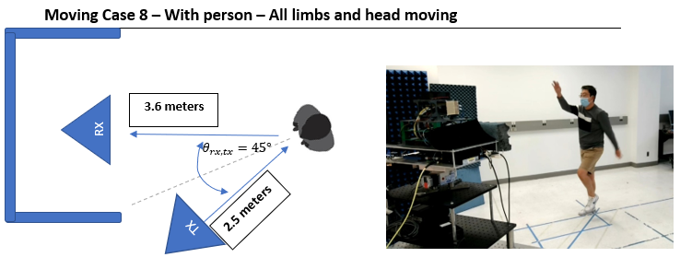
(Sample of) Future Scenarios

Slide 13
Conclusions
Preliminary measurements indicate that the resolvable static paths (i.e., LoS) are stable over time and that the motion of the resolvable dynamic paths (i.e., Hand, Chest, Abdomen) follow the motion of the respective scatterer
High angular precision of channel sounder allows to resolve different paths in 3D AoA (in addition to delay)
Fast acquisition speed of channel sounder allows for real time sounding

Slide 14
References
[1] D. Caudill, J. Chuang, S. Y. Jun, C. Gentile and N. Golmie, "Real-Time mmWave Channel Sounding Through Switched Beamforming With 3-D Dual-Polarized Phased-Array Antennas," in IEEE Transactions on Microwave Theory and Techniques, doi: 10.1109/TMTT.2021.3104278.

