Slide 1
Primary and Secondary User in R-TWT
Date: 2021-10-08
Authors:
Name | Affiliations | Address | Phone | email
Thomas Handte | Sony Group Corporation |  |  | Thomas.Handte (at) sony.com
Dana Ciochina |  |  |  | Dana.Ciochina (at) sony.com
Daniel Verenzuela |  |  |  | Daniel.Verenzuela (at) sony.com
Yusuke Tanaka |  |  |  | Yusuke.YT.Tanaka (at) sony.com

Slide 2
Introduction
Low latency service is an important application scenario for 11be
TGbe introduced R-TWT as a protected period for STAs to deliver low-latency data [1, 2]
Within a R-TWT service period (SP)
the AP may select the STAs that are eligible to transmit
the start time is often guaranteed
Interference of legacy STAs may be reduced by use of overlapping quiet element
While R-TWT framework is good for low latency traffic, the impact to non-low latency traffic should be considered too
Even with R-TWT in place, by the nature of operation in unlicensed bands, there is some variance of end-to-end transmission delay caused by
Channel access delay
Transmit time (e.g. by MCS change)
Retransmission time (e.g. retransmission of PPDUs or fraction of it)
Therefore, a R-TWT would often be designed with a margin to cover exceptional cases
The margin covers delays that exceed the “typical“ transmission delay
However, R-TWT SPs designed with a margin are harmful to BSS throughput, because the margin may often be non-used

Slide 3
Related submissions and CIDs
Some related submissions [3, 4, 5] address similar aspect
Transmit latency sensitive data first among any other traffic
Indication sent by STAs that they are ready for SP termination
Terminate R-TWT SP when there is no more LL-traffic [4, 5]
Automatically terminate an SP when channel is idle [5]
AP to perform prioritization by trigger frame in trigger enabled TWT SP [3]
CIDs 5875, 6866, and 7471 [6] address the issue of under utilization of R-TWT SP

Slide 4
Issue
R-TWT SP duration is designed with some margin
Target: Successful data delivery is achieved in most cases within R-TWT SP duration
Nominal TXOP and contention duration is baseline
E.g. based on avg. MCS, MSDU size, contention delay, …
A reasonable margin is added to the baseline duration depending on statistics
E.g. based on 90%-ile of contention delay, retransmission probability, max. TXTIME, …
The margin may be often unused
The higher the margin, the more R-TWT SP duration is mostly unused

Slide 5
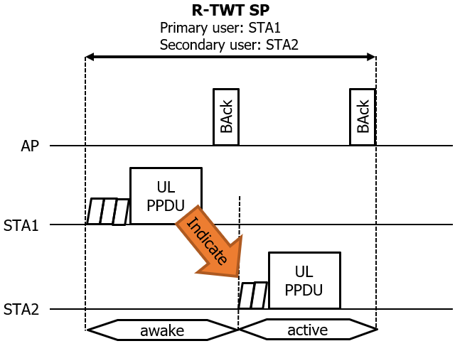
Proposal – Concept
In R-TWT setup
A primary and secondary user set are defined
Classification into the two sets may be TID specific
Any other STA should not access the R-TWT SP
A primary user
can contend for channel access right after the R-TWT SP begins
shall indicate to secondary users that it finished data transfer
e.g. empty queue for specified TID
shall not transmit once it issued the indication to secondary users
Unless it is a secondary user too
A secondary user
can contend for channel access after having received a release indication

Slide 6
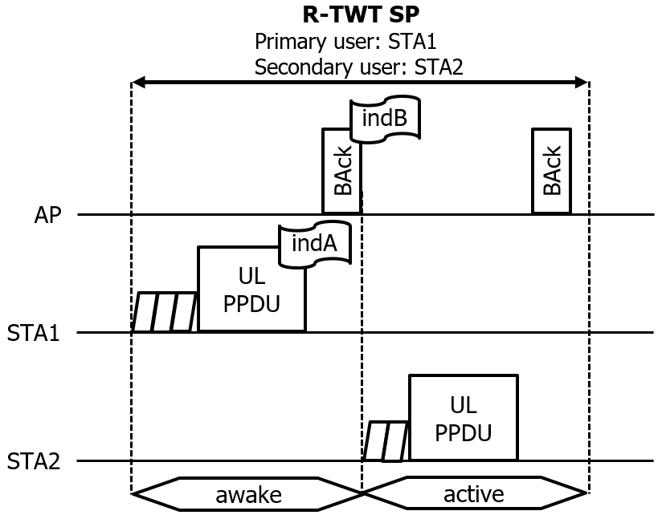
Proposal – Details
Design of the R-TWT SP release indication
A 2-step approach is preferable in which the AP releases the R-TWT SP
Primary user STA1 indicates to AP that it finished its data transfer
The indication (indA) may reside in a subfield (TBD)
E.g. queue size = 0 in QoS Control subfield or a reserved bit in CAS Control subfield
AP collects STAs’ indication and transmits a release indication (indB) once all primary user STAs successfully finished their data transfer
The indication may be conditional to BAck/Ack response status
i.e. indB is only included if BAck indicates success
The release indication (indB) may reside in BAck frame (e.g. BA Control field) or in a separate frame (TBD)

Slide 7
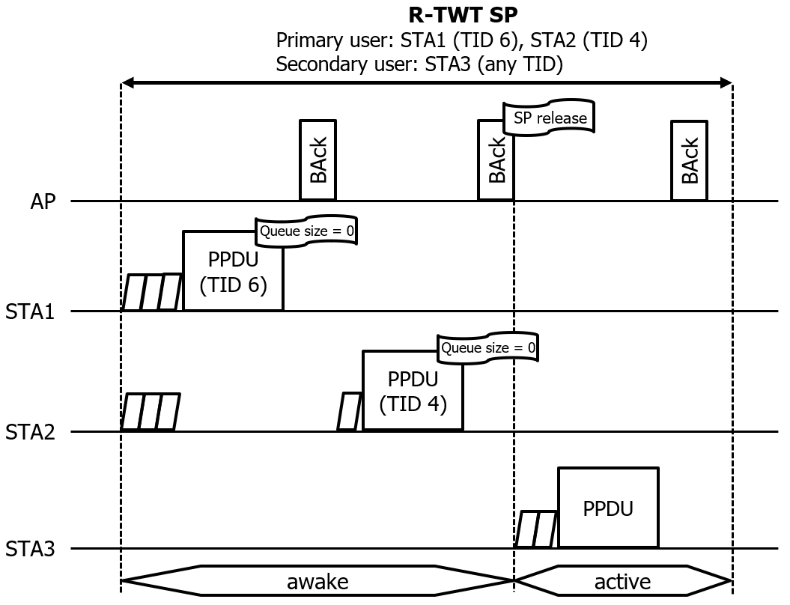
Example
R-TWT setup
Primary user: STA1 (TID 6), STA2 (TID 4)
Both STAs may transfer low-latency data under these TIDs
Secondary user: STA3 (any TID)
A secondary user STA may rarely obtain a TXOP
Therefore, the traffic of a secondary user should not be of type low-latency but rather best effort
Operation
Each STA indicates with “queue size=0” of QoS data frame for the respective TID that no more data is pending for transmission
If BAck is success, the AP considers the R-TWT SP as released from the particular STA
If BAck indicates an error, the AP considers the R-TWT SP as not released from the particular STA
Once all primary user STAs indicated that their queue size is zero, the AP releases to SP to secondary users
The BAck comprising the SP release may be a multi-STA BAck

Slide 8
Special Role of AP
The AP is neither a primary nor secondary user
It shall collect indications by primary user STAs and release the R-TWT SP
It may use EDCA at any time under the following guidelines
Any PPDU should only be transmitted to STAs that are either primary or secondary user
Downlink BUs for secondary user STAs should only be transmitted once the R-TWT SP is released
Trigger frames that trigger secondary user STAs should only be transmitted when the R-TWT SP has been released
We believe that guidelines are more appropriate than strict rules, because the AP has all knowledge that it needs for not harming any uplink traffic from a primary user of its BSS
The AP should have the flexibility to allocate unused resources to secondary user STAs although the R-TWT SP has not been released

Slide 9
Benefits
The proposed mechanism allows R-TWT to be flexibly and fairly used
1st priority is successful transmission of high priority (low latency) traffic
2nd priority is to utilize remaining duration of R-TWT SP
The secondary user set identifies which STAs are eligible to transmit after a release indication and provides the following benefits over SP termination
Enhanced contention control
After a release indication, the set of STAs that can access the channel is limited to the secondary users
In contrast to SP termination, the number of STAs contending for channel access after the release indication can be controlled
Enhanced protection of upcoming R-TWT SPs
After a SP termination, a non-R-TWT-compliant STAs (e.g. HE STA) may obtain TXOPs
Those TXOPs may extend beyond start of next R-TWT SP
Enhanced power save
STAs that don’t belong to primary or secondary user group may be in doze state during the SP
No need to listen for TWT SP termination

Slide 10
Application to time sensitive networking (TSN)
Frame Preemption as defined in 802.3br and 802.1Qbu [7]
“Express frames suspend the transmission of preemptable frames”
Source or destination of express frames define primary user STAs of a R-TWT SP
Source or destination of preemptable frame define secondary user STAs of a R-TWT SP
Example: BSS with 3 STAs
STA1 and STA2 schedule periodically express frames (e.g. low latency traffic) to be delivered to AP
AP, STA1, STA2, STA 3 have preemptable frames (e.g. best effort traffic) queued, too
Two persistent R-TWT SPs (#1 and #2)

Slide 11
Conclusion
R-TWT SP may be often underused
A significant margin needs to be added to the nominal duration due to the nature of unlicensed bands
Proposal
R-TWT SP setup defines primary and secondary users
Primary users may transmit first
Once a primary user finished data transfer, it transmits an indication to AP
AP collects all indications and transmits a release indication to all secondary users
A secondary user may transmit after having received a release indication by the AP
Benefits
The R-TWT SP is flexibly and fairly used
The secondary user group clearly defines STAs which can expect to receive a release indication
Beneficial for contention control, R-TWT protection, and power safe

Slide 12
SP #1
Do you agree that:
TGbe defines a mechanism which allows the remaining time of an R-TWT SP to be used by other STAs once all intended STAs finished their frame exchanges
An intended STA is a non-AP STA that may use the R-TWT SP starting from its beginning

Slide 13
SP #2
Do you agree that:
In setup of an R-TWT SP differentiates two user groups
A primary user may use the R-TWT SP starting from its beginning
A secondary user may use the R-TWT SP once it received a release indication

Slide 14
SP #3
Do you agree that:
Within an R-TWT SP that differentiates primary and secondary user groups
A primary user STA shall indicate to an AP that it finished its data transfer
An AP shall collect all indications from primary users and transmit a release indication to secondary users once all indications have been received

Slide 15
References
[1] 11-20/1046r12 Protected TWT Enhancement for Latency Sensitive Traffic
[2] Draft P802.11be D1.2
[3] 11-21/1020r0 Handling Fairness Issue in Restricted TWT
[4] 11-21/1115r0 CC36-CR-35.6 Traffic Prioritization During Restricted TWT SPs
[5] 11-21/1358r0 Restricted TWT Termination
[6] 11-21/1018r14 IEEE 802.11be CC36 comments
[7] 11-18/2027r0 Overview of IEEE 802.1 TSN and IETF DetNet

