Slide 1
Agenda for IEEE 802.11 Coexistence SC virtual meeting in Nov 2021
11 November 2021
Authors:
Name | Company | Phone | email
Andrew Myles | Cisco | +61 418 656587 | amyles@cisco.com

Slide 2
Welcome to the 9th virtual meeting of the Coex SC in November 2021
IEEE 802.11 PDED ad hoc
1 | Warsaw | Sep 2016
2 | San Antonio | Nov 2016
3 | Atlanta | Jan 2017
4 | Vancouver | Mar 2017
5 | Daejeon | May 2017
IEEE 802.11 Coexistence SC
9 | Bangkok | Nov 2018
10 | St Louis | Jan 2019
11 | Vancouver | Mar 2019
12 | Atlanta | May 2019
13 | Vienna | Jul 2019
14 | Hanoi | Sep 2019
15 | Hawaii | Nov 2019
16 | Irvine | Jan 2020
17 | Virtual 1 | Jul 2020
18 | Virtual 2 | Sep 2020
19 | Virtual 3 | Nov 2020
20 | Virtual 4 | Jan 2021
21 | Virtual 5 | Mar 2021
22 | Virtual 6 | May 2021
IEEE 802.11 Coexistence SC
23 | Virtual 7 | Jul 2021
24 | Virtual 8 | Sep 2021
25 | Virtual 9 | Nov 2021
IEEE 802.11 Coexistence SC
1 | Berlin | July 2017
2 | Hawaii | Sep 2017
3 | Orlando | Nov 2017
4 | Irvine | Jan 2018
5 | Chicago | Mar 2018
6 | Warsaw | May 2018
7 | San Diego | July 2018
8 | Hawaii | Sep 2018

Slide 3
Registration is required for the IEEE 802.11 WG electronic interim session in Nov 2021
  This IEEE 802.11 Coex SC meeting is part of the IEEE 802.11 WG plenary session in Nov 2021
  You must pay the registration fee in order to attend!
  If you have not already done so, you can register here or follow the registration link for this session here
  If you do not intend to register for this session you must leave this meeting …
  … and, if you have logged attendance on IMAT, email the IEEE 802.11 WG Chair or Vice Chairs to have your attendance cancelled

Slide 4
Coex SC minutes today will be kept by our permanent SC secretary
  It is important to keep proper minutes of all Coexistence SC meetings …
  … and fortunately, Guido Hiertz (Ericsson) agreed in Berlin (way back in July 2017 at a time when we actually saw each other F2F) to be appointed the IEEE 802.11 Coexistence SC’s permanent Secretary

Slide 5

The Coex SC will review the official IEEE-SA patent material for pre-PAR groups
Approved slide

Slide 6
Participant behavior in IEEE-SA activities is guided by the IEEE Codes of Ethics & Conduct
Approved slide
  All participants in IEEE-SA activities are expected to adhere to the core principles underlying the:
    IEEE Code of Ethics
    IEEE Code of Conduct
  The core principles of the IEEE Codes of Ethics & Conduct are to:
    Uphold the highest standards of integrity, responsible behavior, and ethical and professional conduct
    Treat people fairly and with respect, to not engage in harassment, discrimination, or retaliation, and to protect people's privacy.
    Avoid injuring others, their property, reputation, or employment by false or malicious action
  The most recent versions of these Codes are available at
    http://www.ieee.org/about/corporate/governance

Slide 7
Participants in the IEEE-SA “individual process” shall act independently of others, including employers
Approved slide
  The IEEE-SA Standards Board Bylaws require that “participants in the IEEE standards development individual process shall act based on their qualifications and experience”
  This means participants:
    Shall act & vote based on their personal & independent opinions derived from their expertise, knowledge, and qualifications
    Shall not act or vote based on any obligation to or any direction from any other person or organization, including an employer or client, regardless of any external commitments, agreements, contracts, or orders
    Shall not direct the actions or votes of other participants or retaliate against other participants for fulfilling their responsibility to act & vote based on their personal & independently developed opinions
  By participating in standards activities using the “individual process”, you are deemed to accept these requirements; if you are unable to satisfy these requirements then you shall immediately cease any participation

Slide 8
IEEE-SA standards activities shall allow the fair & equitable consideration of all viewpoints
Approved slide
  The IEEE-SA Standards Board Bylaws (clause 5.2.1.3) specifies that “the standards development process shall not be dominated by any single interest category, individual, or organization”
    This means no participant may exercise “authority, leadership, or influence by reason of superior leverage, strength, or representation to the exclusion of fair and equitable consideration of other viewpoints” or “to hinder the progress of the standards development activity”
  This rule applies equally to those participating in a standards development project and to that project’s leadership group
  Any person who reasonably suspects that dominance is occurring in a standards development project is encouraged to bring the issue to the attention of the Standards Committee or the project’s IEEE-SA Program Manager

Slide 9
Participants are required to adhere to the IEEE SA Copyright Policy
Approved slide
  By participating in this activity, you agree to comply with the IEEE Code of Ethics, all applicable laws, and all IEEE policies and procedures including, but not limited to, the IEEE SA Copyright Policy.
    Previously Published material (copyright assertion indicated) shall not be presented/submitted to the WG nor incorporated into a WGdraft unless permission is granted.
    Prior to presentation or submission, you shall notify the WG Chair of previously Published material and should assist the Chair in obtaining copyright permission acceptable to IEEE SA.
    For material that is not previously Published, IEEE is automatically granted a license to use any material that is presented or submitted.

Slide 10
Participants are required to adhere to the IEEE SA Copyright Policy
  The IEEE SA Copyright Policy is described in the IEEE SA Standards Board Bylaws and IEEE SA Standards Board Operations Manual
    IEEE SA Copyright Policy, see:
      Clause 7 of the IEEE SA Standards Board Bylaws
      Clause 6.1 of the IEEE SA Standards Board Operations Manual
  Other material
    IEEE SA Copyright Permission
    IEEE SA Copyright FAQs
    IEEE SA Best Practices for IEEE Standards Development
    Distribution of Draft Standards (see Clause 6.1.3 of the SASB Operations Manual)

Slide 11
The Coex SC will only meet once during the virtual IEEE 802 plenary meeting in November 2021
Schedule
  Monday, 15 November 2021 @ 4-6 pm ET
Webex details
  https://ieeesa.webex.com/ieeesa/j.php?MTID=mcd68e17de7dcc1bb63675f8b92bfa4bf
    Meeting number: 233 850 61204
    Meeting password: wireless

Slide 12
The Coex SC will consider a proposed agenda for its virtual meeting in Nov 2021
Proposed agenda is light ☹
  Bureaucratic stuff
    Scope of IEEE 802.11 Coexistence Standing Committee (a reminder)
    Approve minutes from Sept 2021
  What is happening this week? (in no particular order)
    Drivers of Coex SC work
    Coex measurement efforts
      Uni of Chicago
    ETSI BRAN activities
      EN 301 893 issues (5 GHz), incl.
        Coexistence challenges for 802.11be
      EN 303 687 issues (6 GHz), incl.
        NB FH in 6 GHz
        Specification challenges for 802.11ax/be
      Future BRAN meetings
    6 GHz spectrum availability
    60 GHz update
    Plans for next meeting

Slide 13
  Scope of IEEE 802.11 Coexistence SC

Slide 14
The Coex SC scope was revised in Sept 2020
IEEE 802.11 Coex SC Scope
  The Coex SC shall promote, within the 802.11 WG and externally, an environment that enables IEEE 802.11 technologies to have equitable access to unlicensed spectrum globally
  The Coex SC should focus particularly on coexistence of 802.11ax & 802.11be with LAA & NR-U in the 5 GHz & 6 GHz bands globally
  The Coex SC may consider coexistence with other technologies and in other bands as directed by the Chair of the 802.11 WG
IEEE 802.11 Coex SC close down criteria
  802.11 WG Chair has authority to close down SC

Slide 15
The scope of the Coex SC was expanded in March 2021 to include 60 GHz coexistence issues
  It was noted during the March 2021 plenary that ETSI BRAN is working on 60 GHz Harmonised Standards that may impact IEEE 802.11ay coexistence
  Subsequently, the 802.11 Chair directed the Coex SC to consider 60GHz coexistence within scope
    At today's WG11 Opening Plenary, the comment was made that ETSI BRAN is also considering operational and coexistence requirements related to 57-71 GHz (60GHz) spectrum, relevant of course to 802.11ad and 11ay
    The scope of the Coex SC focuses on, "coexistence of 802.11ax & 802.11be with LAA & NR-U in the 5 GHz & 6 GHz bands globally". However, it "may consider coexistence with other technologies and in other bands as directed by the Chair of the 802.11 WG". So the Coex SC can consider 60 GHz issues if directed by the WG Chair
    I have directed the Coex SC to additionally consider coexistence topics for 60GHz operation

Slide 16
  Minutes

Slide 17
The Coex SC will consider the approval of its virtual meeting minutes from September 2021
  The draft minutes for the Coex SC at the virtual meeting in Sept 2021 are available on Mentor:
    See 11-21-1639-00
  Proposed motion:
    The IEEE 802 Coex SC approves 11-21-1639-00 as the minutes of its virtual meeting in September 2021
    Moved:
    Seconded:
    Result:

Slide 18
Coex SC
Key messages for Nov 2021

Slide 19
There are few key message for the Coex SC that arise out of today’s session
Key messages from today’s session …
  There is still work to be done to understand Wi-Fi coexistence with LAA/NR-U in real environments
  EN 301 893 (5 GHz) is progressing well …
    … but work is required to understand 802.11ax/be coex in Europe
  EN 303 687 (6 GHz) is progressing well …
    … but ongoing work is required to ensure good coexistence between Wi-Fi & NB FH systems
    … and to understand & enable operation of new 802.11be features in 5/6 GHz in Europe
… you can leave if you are not interested in the details ☺

Slide 20
  Agenda items
  Drivers of coexistence
  Unlicensed LAA/NR-U deployment

Slide 21
There was a significant LAA deployment in
Chicago as early as Jan 2020
No update
Chicago LAA deployment (Jan 2020)
  A study in Chicago in Jan 2020 shows a significant LAA deployment … that was expanding rapidly
    In Jan 2020, AT&T mostly used channel 149 & Verizon mostly used channel 36, avoiding intra-LAA coex issues
  See Measurement-based coexistence studies of LAA & Wi-Fi deployments in Chicago
    Vanlin Sathya, Muhammad Iqbal Rochman, & Monisha Ghosh (Uni of Chicago)
AT&T
Verizon
T-Mobile

Slide 22
We have tracked the use of 5G by SPs in unlicensed bands to highlight the importance of coexistence work
No update
Tech | Stage | GSMA¹ (July ‘18) | GSA² (Oct ‘18) | GSA³ (Jan ‘19) | GSA⁴ (Jul ‘19) | GSA⁵ (Nov ‘19) | GSA⁶ (Dec ‘19) | GSA⁷ (Mar ‘20) | GSA⁸ (Aug ‘20)
LAA | Trials/plans | 23 | 22 | 26 | 29 | 30 | 29 | 29 | 28
 | Deployed | 4 | 6 | 6 | 8 | 8 | 8 | 9 | 9
eLAA | Trials/plans | ? | 1 | 1 | 1 | 1 | ? | 0 | 1
 | Deployed | ? | 0 | 0 | 0 | 0 | ? | 1 | 0
LWA | Trials/plans | ? | 2 | 2 | 2 | 2 | 2 | 2 | 2
 | Deployed | ? | 1 | 1 | 1 | 1 | 1 | 1 | 1
LTE-U | Trials/plans | ? | 8 | 8 | 8 | 8 | 9 | 9 | 9
 | Deployed | ? | 3 | 3 | 3 | 3 | 3 | 3 | 3
GSMA (July 2018)
GSA: Evolution from LTE to 5G: Global Market Status (Nov 2018)
GSA: LTE in unlicensed and shared spectrum (Jan 2019)
GSA: Evolution from LTE to 5G: Global Market Status (Aug 2019)
GSA: LTE Unlicensed - LTE in Unlicensed and Shared Spectrum (Nov 2019
GSA: LTE and 5G Market Statistics (Dec 2019)
GSA: LTE in Unlicensed Spectrum and Shared Spectrum (Mar 2020)
GSA: LTE and 5G in Unlicensed Spectrum: Trials, Deployments & Devices (Aug 2020)

Slide 23
We are now also tracking 5G clients in unlicensed bands to highlight the importance of coex work
No update
Tech | Stage | GSA⁹ (Oct ’20) | GSA¹⁰ (Jan ’21) | GSA¹¹ (Feb ’21) | GSA^{12, 13} (Mar ’21) | GSA¹⁴ (Jun ’21) | GSA¹⁵ (Aug ’21)
LAA | Trials/plans | 27 | 27 | 27 | 27 | - | 27
 | Deployed | 9 | 9 | 9 | 9 | - | 9
 | Devices | - | - | - | 247 | 329 | -
LWA | Trials/plans | 2 | 2 | 2 | 2 | - | 2
 | Deployed | 1 | 1 | 1 | 1 | - | 1
 | Devices | - | - | - | 16 | 16 | -
LTE-U | Trials/plans | 9 | 9 | 9 | 9 | - | 9
 | Deployed | 3 | 3 | 3 | 3 | - | 3
 | Devices | - | - | - | 46 | 46 | -
A new data series, focused on client devices rather than operators
GSA: LTE and 5G Market Statistics (Oct 2020)
GSA: LTE and 5G Market Statistics (Jan 2021)
GSA: Networks, Technologies & Spectrum Snapshot: LTE and 5G Market Statistics (Feb 2021)
GSA: LTE Ecosystem Status (Mar 2021)
GSA: LTE 5G Market Statistics (Mar 2021)
GSA: LTE Ecosystem Report (Status Update Jun 2021)
GSA: NTS Stats Update (Aug 2021)

Slide 24
The number planned/testing & deployed LAA SP networks globally is currently steady
No update

Slide 25
The number of devices supporting LAA globally was up by almost 200 between March & June 2021
No update

Slide 26
Does anyone have any insight on the use of NR-U in 5 GHz or 6 GHz?
  LAA is starting to appear in the same channels as Wi-Fi …
    At least in the 5 GHz band
  … but what about NR-U?
    LAA operates in conjunction with cellular systems
    … which will often/mostly be outdoors
    … whereas Wi-Fi often/mostly operates indoors
    In contrast, NR-U (and MulteFire) operates independently of cellular
    … and so will often/mostly be indoors
    … just like Wi-Fi
    This means there is a greater potential for coexistence issues as NR-U use expands
  Does anyone have any insight on the current or future use of NR-U in 5 GHz or 6 GHz?
    Do we actually have a coexistence problem?

Slide 27
  Agenda items
  Coex measurements

Slide 28
The Coex SC heard about an LAA/Wi-Fi coexistence study in Chicago in Jan 2021
Refined from
Mar 2021
  One of concerns with many of the conclusions drawn in relation to coexistence is that they are based on simulation studies …
  … which have been used over the years to provide evidence for just about any conclusion one might want to draw
  A good complement to simulation studies is measurements of actual deployments …
  … recognising they also have limitations
  In early 2021, the Coex SC heard from one of the authors of the Chicago Wi-Fi deployment study noted in previous meetings
    See 11-20-1973

Slide 29
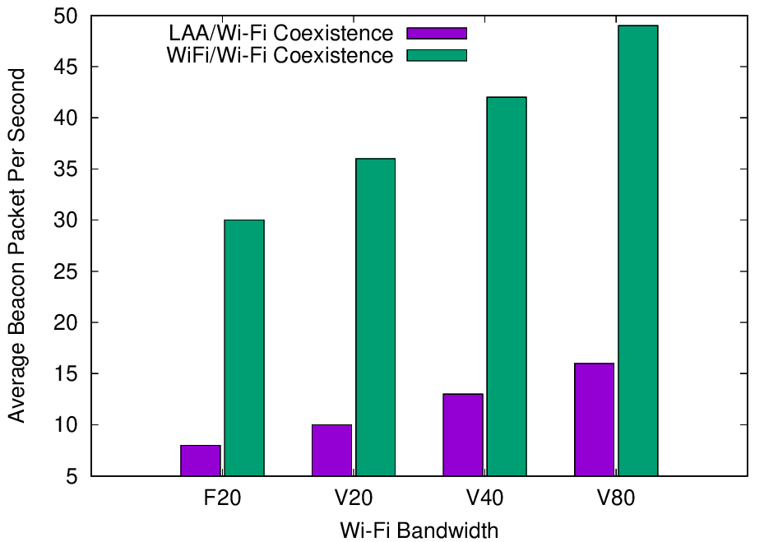
Experiments with deployed systems show LAA has a significant adverse impact on Wi-Fi Beacons
Refined from
Mar 2021
  The Uni of Chicago study investigated the effect of LAA on Wi-Fi operation in various typical configurations, including hidden nodes
  The work showed that LAA
  caused significant interference
  to Wi-Fi Beacons in the tested
  configuration
    Probably because LAA is:
      Using ED @ -72 dBm
      Rather than PD @ - 82 dBm
    Also because LAA typically uses
    long TxOPs (~8 ms)
Addition of a single LAA system to five Wi-Fi systems causes successful Beacon rate to reduce by > 75%
Pushing Wi-Fi APs into the same channel also causes successful Beacon rate to reduce, but by less than LAA

Slide 30
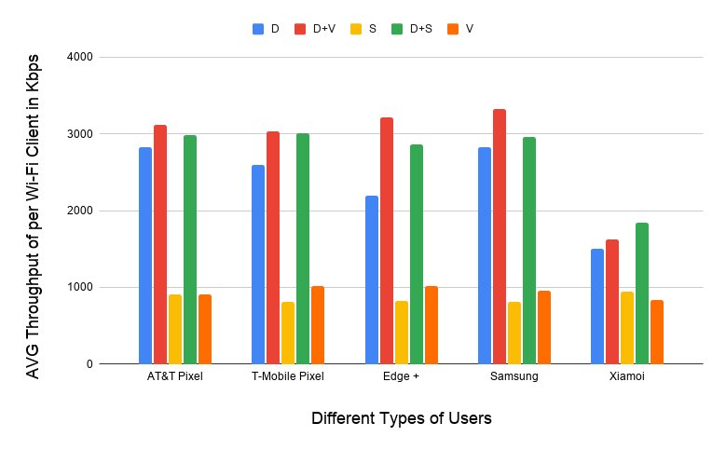
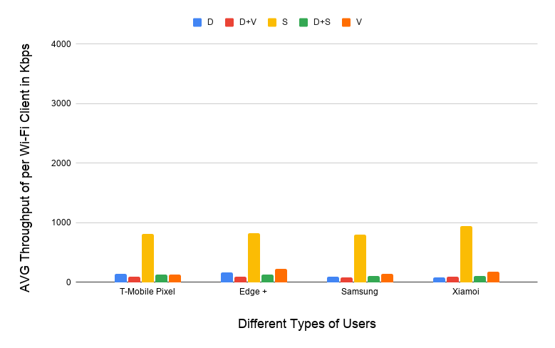
Experiments with deployed systems show LAA also has a significant adverse impact on Wi-Fi data
Refined from
Mar 2021
  The work showed that LAA caused significant interference to data traffic in the tested configuration
    Probably because LAA is using ED @ -72 dBm rather than PD @ - 82 dBm
    Also because Wi-Fi’s hidden station mitigation mechanisms based on RTS/CTS have no effect on LAA
5 Wi-Fi APs on one channel, no LAA
5 Wi-Fi APs on one channel, one LAA
11-20-1973 slide 16
All client close
to Wi-Fi APs
Addition of LAA caused all Wi-Fi traffic to collapse …
… except streaming because LAA uses licensed for streaming

Slide 31
There seems to be a growing understanding that LAA/NR-U will not share well with Wi-Fi ☹
  During the recent BRAN discussions related to wideband/NB FH coexistence, the following argument was put forward
    Wi-Fi & LAA/NR-U do not coexist very well in some scenarios .. particularly pointing out hidden station scenarios
    If it is acceptable for LAA/NR-U to reduce Wi-Fi performance in these scenarios then it is also acceptable for NB FH to reduce Wi-Fi performance too
  The scary point here is an apparent understanding (& acceptance!) that LAA/NR-U do not share well with Wi-Fi
    This is caused by the use of ED as the only inter-technology coexistence mechanism …
    … without the benefit of the Preamble detection, MAC-level NAV protection & hidden station coexistence mitigation mechanisms like RTS/CTS

Slide 32
The SC may hear a brief outline on ongoing
LAA/Wi-Fi coexistence measurements (& sims)
  Monisha Ghosh (University of Chicago) has notified the Chair that her group at the University is continuing their Wi-Fi/LAA coexistence work
  She has volunteered to present a report on LAA/Wi-Fi Coexistence Experiments: preliminary results to the Coex SC today
    In our past work on studying LAA/Wi-Fi coexistence using deployed LAA base-stations, we deployed Wi-Fi APs that could be controlled to operate on the same channel as LAA and we demonstrated significant degradations on throughput when LAA was operating. In this work we present preliminary results on experiments where we studied the effect on ambient Wi-Fi usage when LAA operates in the vicinity.
    See 11-21-1858-00

Slide 33
  Agenda items
  ETSI BRAN issues

Slide 34
Note that ESTI BRAN documents are available to IEEE 802.11 WG members
  Today’s material references many ETSI BRAN documents
  They are (or should be) available in the IEEE 802.11 WG members area
    See http://www.ieee802.org/11/private/ETSI_documents/BRAN

Slide 35
  Agenda items
  ETSI BRAN 5 GHz

Slide 36
The stable draft of EN 301 893 (5 GHz) includes the adaptivity compromise & associated testing
Document status after BRAN#111 (Sept/Oct 2021)
  Draft EN 301 893 v.2.1.45 (stable draft) – as 9 Nov 2021
Discussion before BRAN#111
  EN 301 893 v2.1.45 was published after BRAN#111, including
    Variety of editorial issues & other issues with less relevance to coexistence
    Compromise for adaptivity (and associated testing) remains, as originally agreed back in BRAN#109
      The adaptivity requirements most relevant to Wi-Fi equipment are the requirements in clause 4.2.7.3.2 (Load Based Equipment (LBE))
        … and sub-clauses
        … particularly 4.2.7.3.2.5 (Energy Detection Threshold (EDT) level)
      The associated testing procedures most relevant to Wi-Fi equipment are the procedures in clause 5.4.9.3.2 (Conducted measurements)
        … and sub-clauses

Slide 37
The EN 301 893 journey has been long & interesting, achieving good sharing but with future risks for 802.11be
Refined from
Sep 2021
V1.8.1
Standard
Mar 2015
802.11a/n/ac conformant devices use access mechanisms in 802.11 standard
Other devices followed weird rules with little connection to anything
Very 802.11 focused …
… as only game in town
… but not clear there is good sharing between Wi-Fi/LAA/…
V2.1.1
Standard
May 2017
EDCA based adaptivity
  802.11a/n/ac conformant devices use EDT at -62 dBm
  Other devices use EDT @ -72 dB (scaled)
Enabled good sharing, using LBT with exponential backoff …
… but a compromise, with different thresholds for Wi-Fi & LAA/NR-U
V2.1.8
Stable draft
Sep 2018
EDCA based adaptivity
  Any devices using 802.11 defined PD may use EDT at -62 dBm
  Otherwise use EDT @ -72 dB (scaled)
Enabled any technology to use either of the two options
Assisted placement of 802.11ax on market today
V2.1.45
Stable draft
Oct 2021
EDCA based adaptivity
  802.11a/n/ac/ax conformant devices use EDT at -62 dBm
  Other devices use EDT @ -72 dB (scaled)
Required compromise to make progress
Allows traditional Wi-Fi operation …
… but forces 802.11be to use ED-only
@ -72 dBm, with potential coex issues
Close to likely end point, wrt coex
Potential coex issues

Slide 38
The EN 301 893 journey will continue, with multiple options for consideration by the Coex SC
Refined from
Sep 2021
The future?
Option 1: status quo based on v.2.1.45
Option 2: ED-only
@ -62 dBm
Option 3: ED-only
@ -72 dB
Option 4: Something else
Likely to be acceptable for next 2-3 years for reasonable coex between 802.11a/n/ac/ax & LAA/NR-U
Coex SC/TGbe will need to evaluate coex between 802.11ax & 802.11be
Very simple and flexible
Aligned with US
Coex SC/TGbe will need to evaluate:
  Effect on reuse vs interference
  Whether 802.11 should use PD/ED @ -82/-62 dBm or ED-only @ -62 dBm when coexisting with LAA/NR-U
Attractive in that it would establish similar rules in both 5 GHz & 6 GHz
Coex SC/TGbe will need to evaluate:
  Impact on legacy
  Whether 802.11 should use PD/ED @ -82/-72 dBm or ED-only @ -72 dBm when coexisting with LAA/NR-U
What?
  Focus 802.11be on 6 GHz operation
  Operate 802.11be in 802.11ax mode if coexisting with 802.11ax
  Change rules in ETSI BRAN to allow 802.11be to use the same rules as 802.11a/n/ac/ax
How significant is this problem? Do we need to solve it? How?

Slide 39
The Coex SC has started a process of evaluating the optimum path for 5 GHz (& 6 GHz) coexistence
Refined from
Jul 2021
  In May 2021, two submissions started the discussions about the optimum future path for coexistence in 5 GHz …
    11-21-0705-00
      Simulation and Evaluation of the Impact of Varying ED Thresholds
      Gaurav Patwardhan (HPE), Eldad Perahia (HPE), Stuart Strickland (HPE)
      Uniform use of EDT @ -72 dBm likely to have a positive impact on sharing
      EDT @ -72 dBm in 5 GHz will sometimes disadvantage 802.11be compared to legacy using EDT @ -62 dBm, with some mitigation from RTS/CTS
      Specification work is probably required in both TGme (for 802.11ax) and TGbe
    11-21-0851-00 (Word document)
      5 GHz ED Analysis
      Menzo Wentink (Qualcomm)
      EDT @ -72 dBm in 5 GHz will sometimes disadvantage 802.11be compared to legacy
      Use of EDT @ -72 dBm limits spectral reuse
      EDT of -62 dBm may be a better long-term approach
  … suggesting more work is required!

Slide 40
The Coex SC has started a process of evaluating the optimum path for 5 GHz (& 6 GHz) coexistence
Refined from
Sep 2021
  In July 2021, Stuart Strickland (HPE) presented a discussion on possible next steps in relation to 5 GHz coexistence, especially in relation to the use of 802.11be …
    11-21-1179-00
      Similar submission to 11-21-0705-00 in May 2021
      Focused on coexistence between legacy 802.11 using EDT of -62 dB & 802.11be using EDT of -72 dBm
      Concluded that ~10% of 802.11be traffic may suffer a disadvantage, compared to legacy traffic
      Noted that in managed networks a common EDT of -72 dBm may benefit both 802.11be & legacy equipment
      However, highlighted that the simulations used to draw these conclusion are relatively simple … and more work is required
  … suggesting more work is required!

Slide 41
The Coex SC has started a process of evaluating the optimum path for 5 GHz (& 6 GHz) coexistence
Refined from
Sep 2021
  As of Nov 2021, it appears others are undertaking additional work to understand the impact of restricting 802.11be (under ETSI BRAN rules in Europe) to EDT of -72 dBm
    The Chair is aware of at least one study underway that suggests 802.11be is severely disadvantaged in some 802.11ax/be 5 GHz sharing scenarios
    The people undertaking the work were planning present to the Coex SC in Sep 2021 and then Nov 2021 …
    … but have now decided to delay until Jan 2021 to give them more time to understand their results and possible next steps
    … so watch this space!
  … but “more work” and submissions are welcome from ANYONE!

Slide 42
There is clearly work to be done before we come to a conclusion on how to handle 802.11be in 5 GHz
Refined from
Sep 2021
Possible questions for Coex SC/TGbe …
  Is there a problem?
    Probably … at least in some environments!
  What should we do about it?
    Which of the three options (and any sub-options) should be chosen as an alternative to status quo where 802.11be access is different from 802.11ax access?
  How should be handle the uncertainty while we decide what to do?
    Keep the standard flexible, especially in terms of EDT’s & PDT’s?
    Keep implementations flexible, so they can handle changing rules and different rules in different countries?
  … does TGbe need a presentation to highlight the 5 GHz issue?
  … should we send a LS to WFA asking about the market risk to Wi-Fi 7 in 5 GHz in Europe if Wi-Fi 6 and Wi-Fi 7 operate under different rules?

Slide 43
  Agenda items
  ETSI BRAN 6 GHz issues

Slide 44
A stable draft of EN 303 687 includes the 6 GHz compromise for ED-only @ -72 dBm, but not NB FH
Document status after BRAN#111
  Draft EN 303 687 v0.0.14 (stable draft) – as of 9 Nov 2021
Discussion after BRAN#111
  All agreements are included in EN 303 687 v0.0.14, including:
    ED-only at -72 dBm (reflecting previously discussed compromise)
    Variety of editorial issues & issues with less relevance to coexistence
  The primary topic not included in EN 303 687 v0.0.14 is NB FH access
    Previous topics of contention (synchronous access, wideband access & LBT mechanisms) and have not been mentioned since before BRAN#110

Slide 45
  Coex SC
  ETSI BRAN 6 GHz issues
  NB FH update

Slide 46
Many believe NB FH systems represent a potential threat to coexistence in the 6 GHz band in Europe
Refined from
Jul 2021
  In Nov 2020, the Coex SC were made aware of two PSD limits being discussed for VLP devices in Europe:
    Default: 1 dBm/MHz
    Narrowband (NB) devices: 10 dBm/MHz with FH across at least 15 hops, with NB defined as a BW of less than 20 MHz
  Many in the Wi-Fi/NR-U/LAA industries were concerned that these NB FH systems could have an adverse affect on Wi-Fi/NR-U/LAA systems
    ie, they will randomly “stomp” on Wi-Fi (and LAA/NR-U) systems without LBT leading to poor coexistence ☹
    The concern was exacerbated by the proponents of NB FH pushing the proposal through the regulator process in Europe without the knowledge or involvement of Wideband/Broadband stakeholders

Slide 47
The ECC decision that allows NB FH requires ETSI BRAN to agree on a spectrum sharing mechanism
Refined from
Sep 2021
Table 2: Very Low Power (VLP) WAS/RLAN devices
(extract from ECC Decision (20)01)
Permissible operation | Indoors and outdoors
Category of device | The VLP device is a portable device
Frequency band | 5945-6425 MHz
Channel access and occupation rules | An adequate spectrum sharing mechanism shall be implemented.
Maximum mean e.i.r.p. for in-band emissions (note 1) | 14 dBm
Maximum mean e.i.r.p. density for in-band emissions (note 1) | 1 dBm/MHz
Narrowband usage maximum mean e.i.r.p. density for in-band emissions (note 1) (note 2) | 10 dBm/MHz
Note 1: The "mean e.i.r.p." refers to the e.i.r.p. during the transmission burst, which corresponds to the highest power, if power control is implemented. Note 2: Narrowband (NB) devices are devices that operate in channels bandwidths below 20 MHz. Narrowband devices also require a frequency hopping mechanism based on at least 15 hop channels to operate at a PSD value above 1 dBm/MHz.
Requires an ETSI BRAN defined spectrum sharing mechanism …
… without defining adequate spectrum sharing
Allows operation at 10 dBm/MHz but with FH

Slide 48
In May 2021, the Coex SC heard about the NB FH in 6 GHz issue … with no conclusions
Refined from
Jul 2021
  The IEEE 802.11 WG has an interest in how NB FH is specified by
  EN 303 687 for 6 GHz because it may have a significant impact on Wi-Fi operation in at least some circumstances
  Several WG members interested in the coexistence issues between
  Wi-Fi & NB FH in 6 GHz provided contributions in May 2021:
    11-21-0814-00 – ETSI 6GHz Narrow Band Status - Stuart Thomas (Apple)
    11-21-0832-00 – Narrowband in 6 GHz - Menzo Wentink (Qualcomm)
  There were no conclusions or decisions from the Coex SC at the time …

Slide 49
In June 2021, at BRAN#110 there was lots of discussion about NB FH … with no consensus
From
Jul 2021
Submissions to BRAN#110 (Jun 2021)
  BRAN(21)110019 (Apple) - EN 303 687 NB Inputs
  BRAN(21)110045 (Qualcomm) - NB coexistence in 6 GHz – eDAA
  BRAN(21)110046 & BRAN(21)110047 (Facebook & HPE) - Proposal to approve EN 303 687 stable draft
Summary of presentations at BRAN#110
  Apple proposed the use of Adaptive Frequency Hopping using non-LBT based Enhanced-DAA (eDAA)
  Qualcomm asserted that eDAA causes latency issues with Wi-Fi and is inadequate for NB vs NB sharing too
    With very high latency spikes & unstable throughput
  Facebook suggested that the NB FH issue be delayed until a future WI

Slide 50
In July 2021, the Coex SC heard about issues with eDAA … but came to no conclusions
Refined from
Jul 2021
  In July 2021, Menzo Wentink (Qualcomm) provided a summary of his latest eDAA simulations & findings
    See 11-21-1191-00 - NB Coexistence in 6 GHz – eDAA
    eDAA has been proposed by Apple in ETSI BRAN as a mechanism to enable adequate spectrum sharing
    Menzo’s conclusions in relation to eDAA were:
      NB with eDAA may cause latency issues at Wi-Fi
      eDAA also appears inadequate for NB/NB sharing
      LBT shows no issues for either Wi-Fi/NB or NB/NB coexistence
      The eDAA coexistence issues pointed out in this analysis should make it unlikely that a notified body can certify 'no-LBT' NB equipment
  There were no conclusions or decisions from the Coex SC at the time …

Slide 51
In Sept 2021, BRAN#110d underlined fundamental disagreements about eDAA spectrum sharing
From
Sep 2021
Submissions
  BRAN(21)110a003 (Apple) - Spectrum sharing comparisons
  BRAN(21)110d003r1 (Qualcomm) - Response to BRAN(21)110a003
  BRAN(21)110d009 (Apple) - Inaccuracies in BRAN(21)110d003r1
  BRAN(21)110d006 (Ericsson) - Co-existence considerations for 6GHz channel access
Summary
  Lots of claims & counter claims, but still little agreement
    One side claims eDAA provides adequate spectrum sharing, is the only way to enable <10 ms latency, & causes no more problem to Wi-Fi than Wi-Fi or NR-U
    Other side claims eDAA cannot share with Wi-Fi, particularly in terms of latency, and eDAA can’t even share with eDAA
    Both sides questioned the other side’s sims & analysis

Slide 52
In Sept 2021, BRAN#110e focused on both process & technical NB FH aspects … again without consensus
From
Sep 2021
Submissions
  BRAN(21)110d004 (Rapporteur/Broadcom) - Proposal for way forward for NB in EN 303 687
  BRAN(21)110d007 (Ericsson) - Next Step for Narrowband in 6 GHz
  BRAN(21)110d005 (Apple) - Equal Treatment of Narrow Band
  BRAN(21)110e004 (Ericsson) - LBT and MU for Narrowband Frequency Hopping
  BRAN(21)110d008 (Apple) - Way forward for Narrow-band in 6GHz
  BRAN(21)110e003 (Ericsson) - Relevance of EN 300 328

Slide 53
BRAN#110e did not come to any agreement about NB FH on various process related issues
From
Sep 2021
Summary of process issues
  BRAN#110e discussed various procedural options, including:
    Include NB FH in EN 303 687 now, even if that means delay for 6 GHz
    Include NB FH in EN 303 687 as proposed, and refine in next version
    Include NB FH in next version of EN 303 687, which will mean delay for NB FH
    Develop NB FH in a parallel WI
  There was no agreement after intense discussion about:
    What is (not) allowed by rules?
      eg parallel WI’s, noting 60 GHz precedent
      eg could EN 303 687 even be a stable draft before regulations were published?
    What was (not) intended by regulators?
      eg Should Wi-Fi/NR-U have priority over NB FH, or equal treatment?
    Can Notified Bodies be informed about disagreements related to adequate sharing for NB FH?
      This is important if NB FH is not included in a Harmonised Standard soon
    …

Slide 54
BRAN#110e did not come to any agreement on issues related to adoption of EN 300 328 techniques
From
Sep 2021
Summary of EN 300 328 related issues
  In BRAN#110e, some (re)asserted that sharing techniques from
  EN 300 328 (2.4 GHz) provide:
    Adequate sharing for 6 GHz as is …
    … but refinements are possible to make sharing even better in 6 GHz
  Others disagreed (again), noting 2.4 GHz is a different band to 6 GHz, and that EN 300 328 does not even provide good sharing in 2.4 GHz
    Different goals
    Different size of band
    Different channel plan
  The bottom line in relation to NB FH sharing is:
    Some want it to be based on (a refinement of) EN 300 328 … ASAP
    Others want it to be based on LBT … after a full technical discussion

Slide 55
In Sept 2021, the Coex SC heard summaries of issues related to NB FH sharing with Wi-Fi
  In July 2021, the Coex SC both sides of the NB FH discussion to summarise the technical issues from their perspective
    11-21-1550-00 - Narrowband coexistence issues with enhanced DAA in 6 GHz
      Menzo Wentink (Qualcomm), Stuart Strickland (HPE), Michael Tseytlin (Facebook), Xinrong Wang (Intel), Scott Blue (Microsoft)
      Summary
        Asserted that eDAA does not support coexistence with Wi-Fi, or even between eDAA systems
        Advocated the use of LBT with NB FH, rather than eDAA as defined
    11-21-1552-00 - ETSI 6GHz Narrow Band Status
      Stuart Thomas (Apple)
      Summary
        Advocated a solution that enables both NB & WB equally, based on assertion that WB does not have any priority over NB
        Also noted this may require a compromise from the WB community
        Wanted to avoid a “free for all” via Notified Bodies in the case that NB is not included in EN 303 687

Slide 56
At BRAN#111, there were more submissions on integration of NB into EN 303 687…
Submissions
  BRAN(21)111019 (Ericsson) On equal status of NB FH
  BRAN(21)111024 (Ericsson) Maximum BW for NB frequency hopping
  BRAN(21)111025 (Ericsson) NB FH LBT Specification text
  BRAN(21)111027 (Qualcomm/HPE/Microsoft/Intel) NB normative text proposal

Slide 57
… and there was continuing contention about integration of NB into EN 303 687
Summary
  Multiple presentations discussing various aspects of NB FH in 6 GHz, inc
    Relative priority of NB & WB
    The efficacy of LBT as used by Wi-Fi; as part of an argument that it is OK for NB to interfere with Wi-Fi because Wi-Fi interferes with Wi-Fi in hidden node environments
    How to incorporate LBT into NB operation
  Overall, there was continuing disagreement by various stakeholders on almost all aspects, including whether:
    The ECC decision needs to be followed to the letter
    It is appropriate to apply 2.4 GHz rules to 6 GHz band
    NB has equal status with WB
    Adequate spectrum sharing is required
    NB can have higher priority than WB, just like voice has priority over best effort
    …

Slide 58
The regulators finally drove a breakthrough on the NB FH issue at BRAN#111 …
  The regulators at BRAN often tire of listening to the bickering between the industry participants … and the NB issue is no exception ☺
  A couple of regulators supported the idea that the primary purpose of the 6 GHz band was WB operation to support the Gigabit Society in Europe
    It was noted that studies supporting 6 GHz allocation were all based on WB
  All the regulators in attendance agreed it was vital to complete EN 303 687 (6 GHz) HS with WB support as soon as possible
    Even if that meant delaying NB coverage in EN 303 687
  This led to an agreement with BRAN on how to progress …

Slide 59
… with the agreed outcome based on use of current LBE & FBE adaptivity mechanisms by default
Summary of agreement in BRAN(21)111033r2
  Include basic NB VLP requirements from ECC (20)01 into current EN 303 687 draft
    mean e.i.r.p density
    BW restriction ≤20MHz
    frequency hopping mechanism with minimum hop channels of 15
  Use existing adaptivity requirements (from LBE or FBE) in the current EN 303 687 draft by default in next version of EN 303 67 …
    ie LBT as currently defined in EN 303 687
  … unless an alternative NB channel access mechanism can be agreed with a particular timeframe
    The timeframe was not part of the agreement

Slide 60
The risk of NB FB coexisting poorly with Wi-Fi has diminished in the short term
  The likely effect of this agreement is:
    Appropriate NB sharing mechanisms are included in the first version of EN 303 687 => good coexistence in both short & long term; OR
    Appropriate NB specific sharing mechanisms are delayed until a later version of EN 303 687 => good coexistence in short term
  A risk to this outcome is that NB vendors manage to persuade Notified Bodies that their NB FH systems have adequate spectrum sharing even though NB adaptivity is not specifically addressed in the HS…
    … but as noted by a regulator during BRAN#111, Notified Bodies don’t know what to do without a stable draft HS – not a clue!
    … and so it is unlikely this will occur in practice

Slide 61
There is still work to be done to resolve how to include NB FH on EN 303 687
  The agreement provides a path to approve the next version of EN 303 687 without NB FH adaptivity being specifically addressed …
  … but NB FH adaptivity will need to be specifically addressed at some point, either now or later
  … and so the discussions on this topic will continue
  It is vital that the Wi-Fi community remain engaged …
  … to ensure no impediments to good coexistence in 6 GHz!

Slide 62
Further NB FH discussions have already occurred after the BRAN#111 agreement …
Submissions to BRAN#111k & BRAN#111k
  BRAN(21)111k003r2 (Qualcomm, HPE, Facebook, Cisco, Microsoft, Intel, Nokia) - NB normative text proposal
  BRAN(21)111l003 (Ericsson) - NB FH proposal
  BRAN(21)111l004 (Broadcom) - Proposed draft update for EN 303 687
Summary
  The same old arguments continue … although in a context whereby NB FH access could be delayed until a future version of EN 303 687
    Should NB FH access be based on EN 300 328 (2.4 Ghz)?
    Can NB FH devices do 20 MHz based CCA?
    What is technology neutrality?
    Is WB more important than NB?
    …

Slide 63
… watch this space for future updates on NB FH coexistence with Wi-Fi in 6 GHz
  Future Coex SC meetings will hear further reporting of discussions about NB FH coexistence with Wi-Fi in 6 GHz from the Chair …
  … but submissions are welcome from anyone!

Slide 64
  Coex SC
  ETSI BRAN 6 GHz issues
  Specification challenges

Slide 65
Coex SC/TGbe needs to decide how to specify 802.11ax/be in context of 6 GHz rules in Europe
  In EN 303 687, the EDT is -72 dBm (scaled) for both 802.11ax & 802.11be
  This is different to traditional 802.11 operations, which uses an ED of
  -62 dBm
  The Coex SC/TGbe need to decide how to handle this difference for 802.11ax/be in 6 GHz
    Use PD/ED @ -82/-72 dBm
    Use ED-only @ -72 dBm (like NR-U)
    Something else
  The decision could be:
    Reflected in the standard
    Handled outside the standard
  This issue is recorded as a tbd – submissions still requested

Slide 66
Coex SC/Tgbe needs to ensure operation of all 802.11be features are enabled in Europe
  Both EN 301 893 (5 GHz) and EN 303 687 (6 GHz) are based on EDCA style access, which was suitable for 802.11ax/Wi-Fi 6/6E
    Actually, given the way EN 301 893 is written, anything in 802.11ax is allowed in 5 GHz
  802.11be is being developed now, with a range of new features …
  … some of which may not be aligned with the existing HS’s adaptivity assumptions
  This suggests two tasks for the Coex SC/TGbe
    Identify any likely 802.11be features that may not be allowed by EN 301 893
    (5 GHz) and EN 303 687 (6 GHz)
    Plan to make a case to ETSI BRAN to refine EN 301 893 (5 GHz) and EN 303 687 (6 GHz) to allow these features
  Submissions are encouraged

Slide 67
  Coex SC
  Future ETSI BRAN meetings

Slide 68
ETSI BRAN will now meet virtually for the rest of 2021
Schedule for 2021
  BRAN #112
    13 Dec 2021 – 17 Dec 2021
    Virtual
A variety of additional ad hoc’s are also likely to be scheduled

Slide 69
ETSI BRAN has tentatively agreed its 2022 schedule based on F2F meetings
Meeting schedule for 2022
  BRAN #113
    4 Feb 2022 – 14 Feb 2022
    Sophia-Antipolis, France
  BRAN #114
    3 Jun 2022 - 10 Jun 2022
    Sophia-Antipolis, France
  BRAN #115
    29 Aug 2022 until 2 Sep 2022; OR
    5 Sep 2022 until 9 Sep 2022
  BRAN #116
    17 Oct 2022 until 21 Oct 2022
  BRAN #117
    5 Dec 2022 until 9 Dec 2022
A variety of additional ad hoc’s are also likely to be scheduled

Slide 70
  Agenda items
  6 GHz spectrum availability

Slide 71
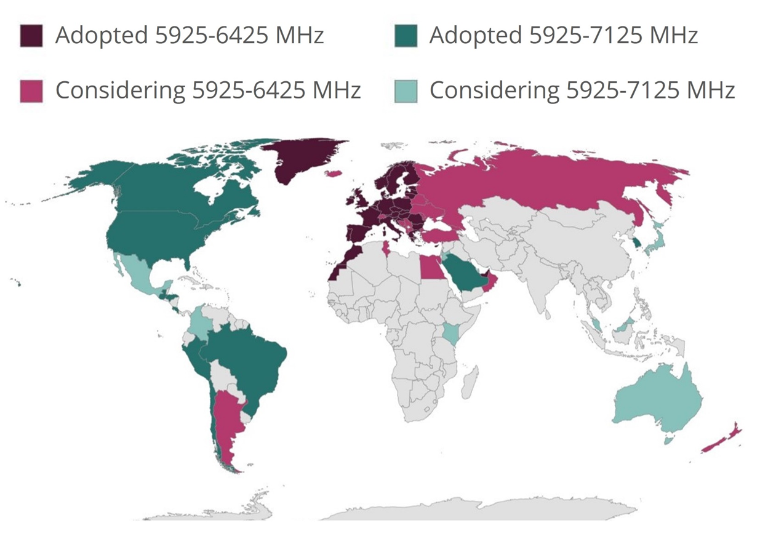
Coexistence will become increasingly important as
6 GHz spectrum opens globally for unlicenced operation

Slide 72
The battle for 6 GHz continues globally …
Refined from Sept 2021
Lower 6 GHz available in Europe
  The EC has formally released the lower 6 GHz band for unlicensed used by a formal announcement in the Official Journal of the European Union
    It is now binding for every EU member state to update their national frequency allocation plans before 1 Dec 2021
    Applies to VLP & LPI operation, without the standard power operation available in the US
GSMA advocating licensed 6 GHz
  GSMA are aggressively advocating for at least the upper 6 GHz band to be made available for licenced operation only
    GSMA with Ericsson, Huawei, Nokia & ZTE have published a joint statement advocating for licensed operation in some/all of 6 GHz
  GSMA are also urging governments to do nothing with
  6 GHz until at WRC-23
    See Vision 2030, Insights for Mid-band Spectrum Needs – GSMA - July 2021

Slide 73
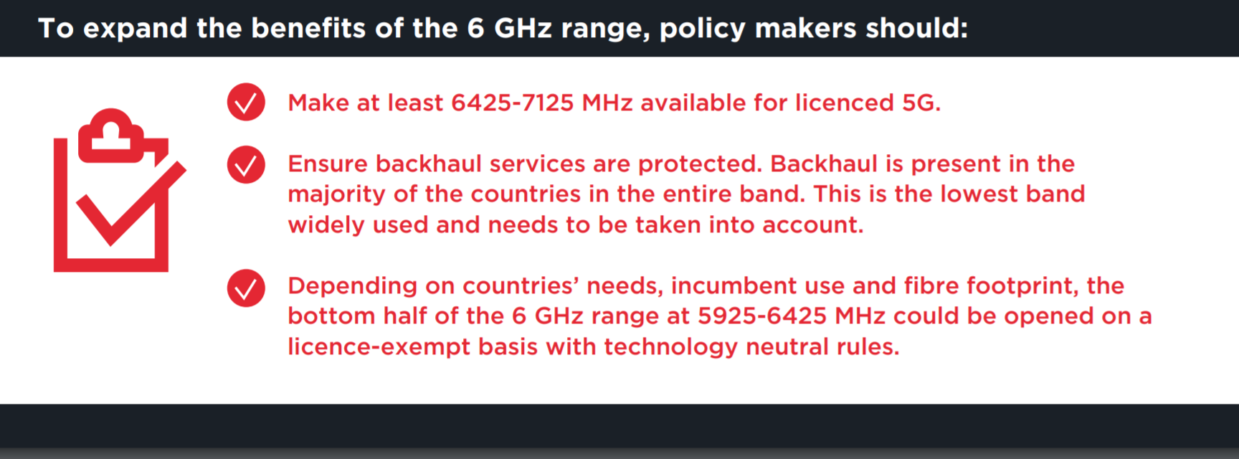
… with GSMA leading a campaign to reserve as much as 6 GHz as possible for licensed use
Refined from Sept 2021
  From https://www.gsma.com/spectrum/wp-content/uploads/2021/05/6-GHz-Capacity-to-Power-Innovation.pdf
GSMA are after as much (“at least”) of the 6GHz band as possible for licensed use

Slide 74
… but Europe is now starting to study RLAN access to the upper 6 GHz band
  The European Electronic Communications Committee (ECC) has decided to initiate studies on the Wireless Access Systems including Radio Local Area Networks (WAS/RLAN) operations in the 6425-7125 MHz band
    See decision

Slide 75
  Agenda items
  60 GHz coexistence

Slide 76
The Coex SC has previously discussed coexistence in 60 GHz …
  At the Coex SC meeting in Mar 2021 a submission was presented that provided the status of 60 GHz work in ETSI BRAN
    See 11-21-0430-00 (Assaf Kasher (Qualcomm))
  In May 2021, the Coex SC heard about Coexistence between radars and communication systems in the 60 GHz band
    See 11-21-0796-00 (Alecsander Eitan (Qualcomm) et al)
  In Jul 2021,the Coex SC heard about Coexistence between radars and communication systems in the 60GHz band – U.S. Update
    See 11-21-1089-00 (Alecsander Eitan (Qualcomm) et al)
  In Sep 2021, the Coex SC heard NPRM work was occurring in 802.18

Slide 77
… but there is not much to report to the Coex SC about 60 GHz coexistence today
  The e-mail was sent to Alecsander Eitan (Qualcomm) asking for an update on 60 GHz coexistence activities
  From Alecsander Eitan (Qualcomm)
    Unfortunately, there is nothing new that can be reported
    Many submissions have been sent to the FCC, and several comments on the other submissions have been also sent
    There are some discussions between companies on compromise ideas

Slide 78
  Coex SC
  Plans for next meeting

Slide 79
The Coex SC may continue its normal business in January 2022
Possible agenda items
  Discuss coexistence measurement studies
  Review ETSI BRAN coex activities from Dec 2021
    EN 301 893 (5 GHz)
      Impact on 802.11be coex with 802.11ax in 5 GHz
    EN 303 687 (6 GHz)
      NB FH update
      Enabling 802.11be features in 6 GHz (& 5 GHz)
  60 GHz update
  …
Submissions are requested …

Slide 80
The IEEE 802.11 Coexistence SC virtual meeting in November 2021 is adjourned!

