Slide 1
Sensing Transmission in Partial Bandwidths
Date: 2022-01-06
Authors:

Slide 2
Abstract
OFDMA is an OFDM-based multiple access scheme where different subsets of subcarriers are allocated to different users, allowing simultaneous data transmission to or from one or more users [3].
Initiate TGbf discussion on usage of UL-OFDMA based measurements for Sensing
[New] Provide measurement data from real application (starting slide 9)

Slide 3
TB Procedure for Sensing
Motion 25c defines a trigger-based (TB) procedure for Sensing
TB procedure leverages components and features from P802.11az [1]
Sensing applications have broader uses than Ranging applications
  Constraints based on Ranging applications may not apply to Sensing applications

Slide 4
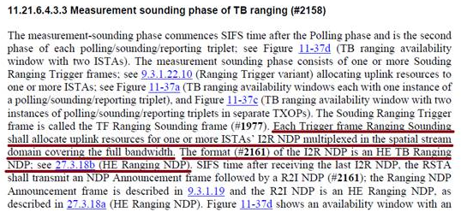
802.11az Ranging Procedure
Ranging measurement procedure defined by P802.11az mandates that uplink transmissions cover the full bandwidth
  Section 11.21.6.4.3.3 of [1]

Slide 5
Bandwidth Requirements
There are sensing applications which may benefit from control over the bandwidth of a sensing transmission
  For example, [2] discusses cases where course sensing resolution identifies an object and fine sensing resolution discriminates details of the object (slide 16).
OFDMA RU allocation can provide coarse/fine resolution in TB measurement procedure
  Making better use of spectrum
  Providing flexibility in transmission
  Providing for a more flexible Wi-Fi sensing system

Slide 6
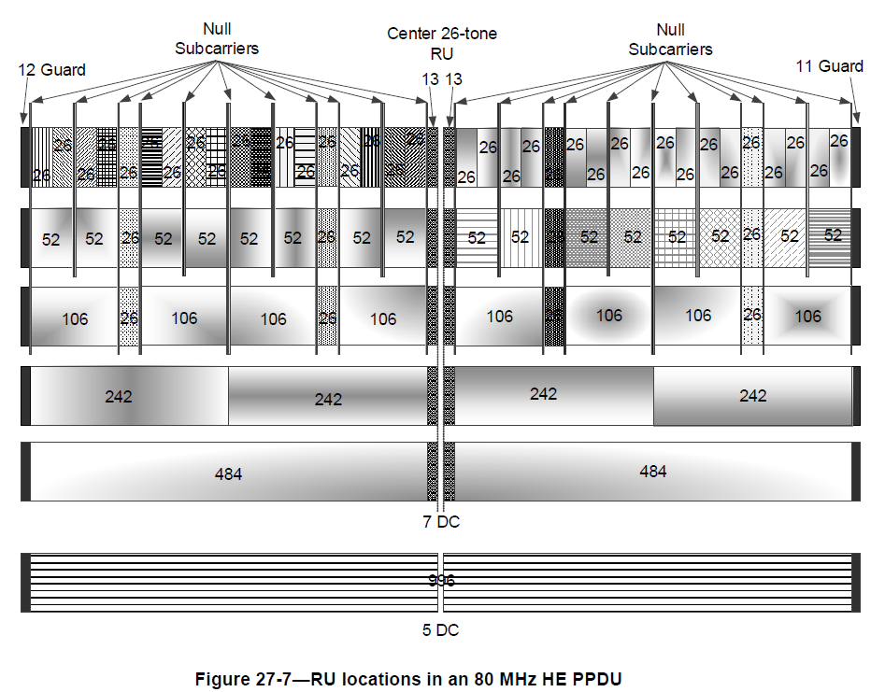
OFDMA for Coarse and Fine Sensing Measurements
Figure 27-7 [3] shows resource units (RU) in a 80-MHz OFDMA channel
Fewer subcarriers equate to narrower bandwidth
Note: An HE MU PPDU using OFDMA transmission can carry a mixture of 26-, 52-, 106-, 242-, 484-, and 996-tone RUs. [3]

Slide 7
OFDMA for Coarse and Fine Sensing Measurements
7.1.4.2.3 Trigger frame (TF) sounding phase [4]
  (Motion 25c, 21/0990r2; Motion 27, 21/1015r2) The TF sounding phase consists of
  The transmission of a trigger frame by an AP to solicit NDP transmission(s) from STA(s); and
  The transmission of an NDP by STA(s) SIFS after receiving the trigger frame.
242-subcarrier RUs used for 4x course sensing measurements @ 20 MHz
484-subcarrier RUs used for 2x finer sensing measurements @ 40 MHz
increased bandwidth reallocated to devices (sensing transmitters) that benefit from a finer resolution sensing measurement (e.g., Device 1 & 4)

Slide 8
Example Application ~ STA Selection
1. Scan environment for potential targets
  Perform lower resolution measurements utilizing UL-OFDMA
2. Target Visible by STA1 and STA4
  Perform higher resolution measurement (a or b, depending on requirements)
(a)
(b)

Slide 9
Measurement Data from Real Application
Following feedback from the presentation of r0, measurements from test environment were added
  Based on a two-story detached home
  Single 5GHz BSS with one AP (sensing receiver) and six STAs (sensing transmitters)
  AP on the first floor and STAs distributed in rooms around the home
  Ground truth measured through an independent system
  Tester moves through the environment while sensing data from all STAs is recorded, and synchronized with ground truth information

Slide 10
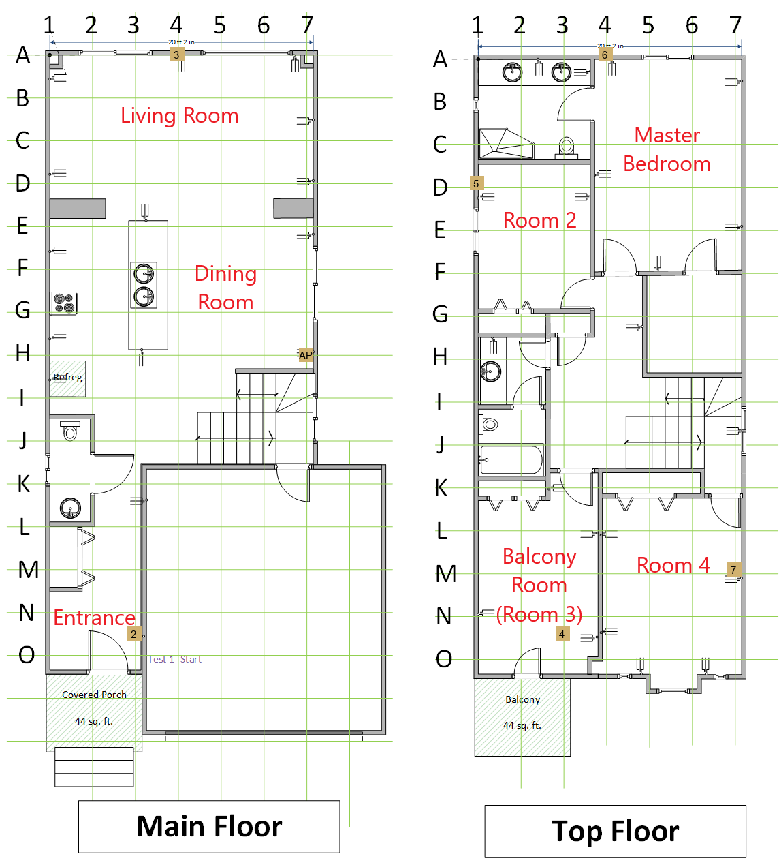
Measurement Data from Real Application
AP (Sensing Receiver)
STA (Sensing Transmitter)

Slide 11
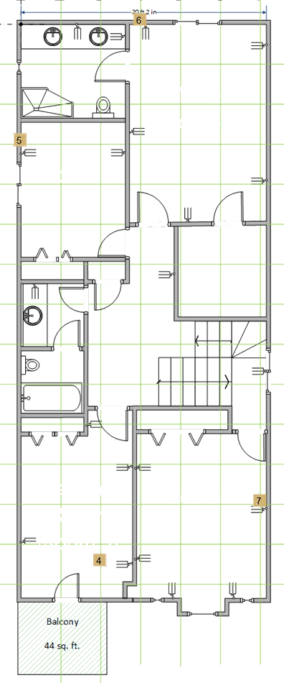
Walking Path
O
N
M
L
K
J
I
H
G
F
E
D
C
B
A
Balcony Room
Room 2
1
2
1
3
Hallway
3
Room 4
Master Bedroom
4
2
5
4
6
7
While in each room (1 to 4), test subject moved around all the available space

Slide 12
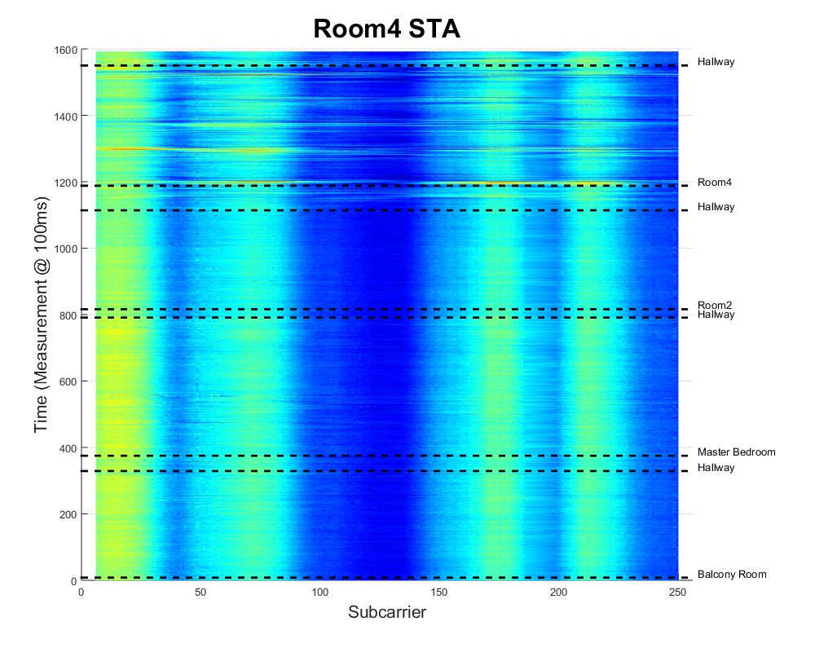
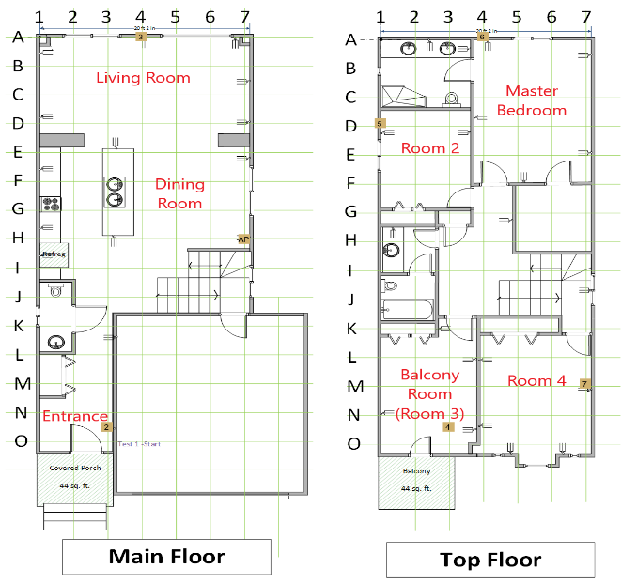
CSI from Room4 STA Measured by AP
CSI of the static channel is visible and consistent over time
Presence of test subject in Room 4 can be seen as channel disturbances
Approach on the upper hallway to Room 4 also visible.
Disturbance due to the tester movement is present on all OFDM subcarriers.
Little disturbance when the test subject is in other rooms
Graph shows counter of measurement (100-ms period) versus OFDM subcarrier (i.e., frequency in an 80-MHz channel). Amplitude of the I-Q vector is encoded as color.
Location of the test subject is shown on the right-hand y-axis

Slide 13
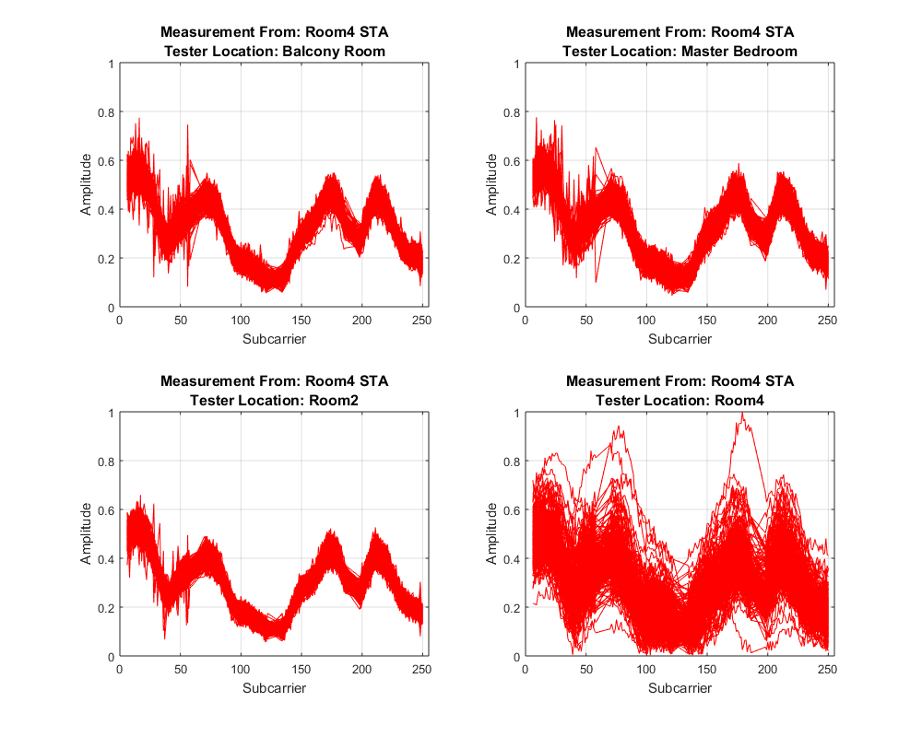
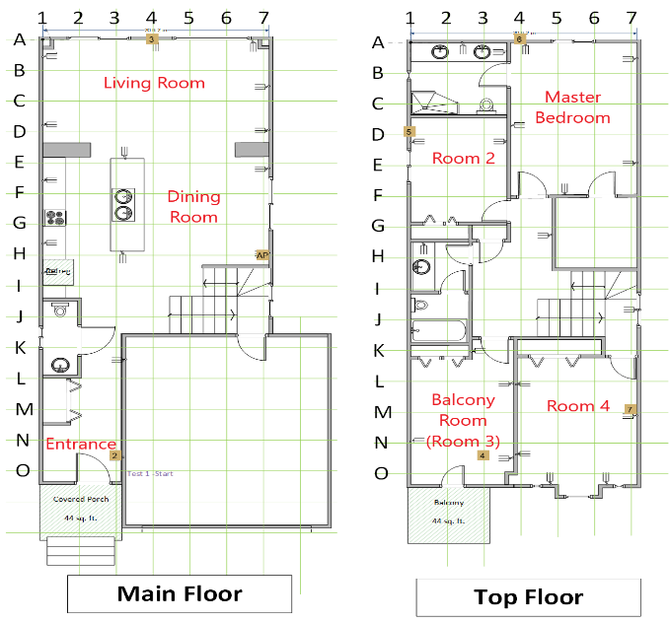
CSI from Room4 STA Measured by AP
Relative disturbance in measurements as a result of the presence of tester is clear.
Uniformity of the amplitude variance is present across the whole band
Same data as previous chart, but each magnitude response plotted on-top of each other.
Each of the four graphs represent measurements made as the tester was present in the identified rooms.

Slide 14
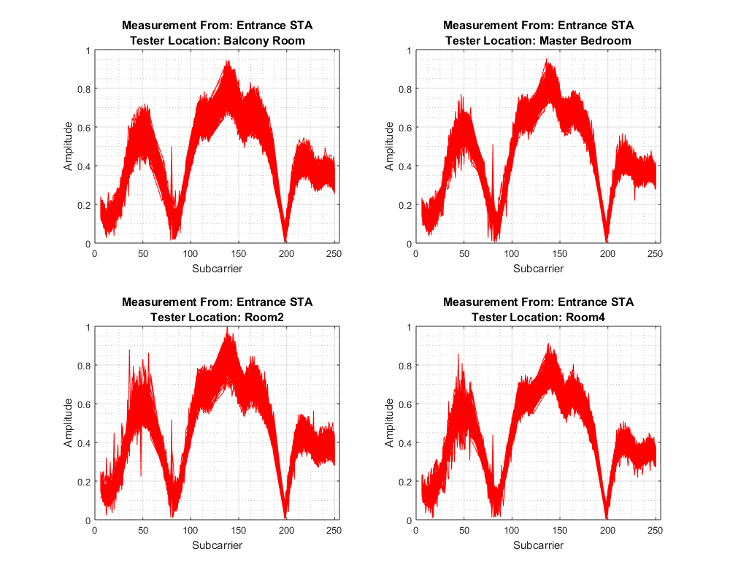
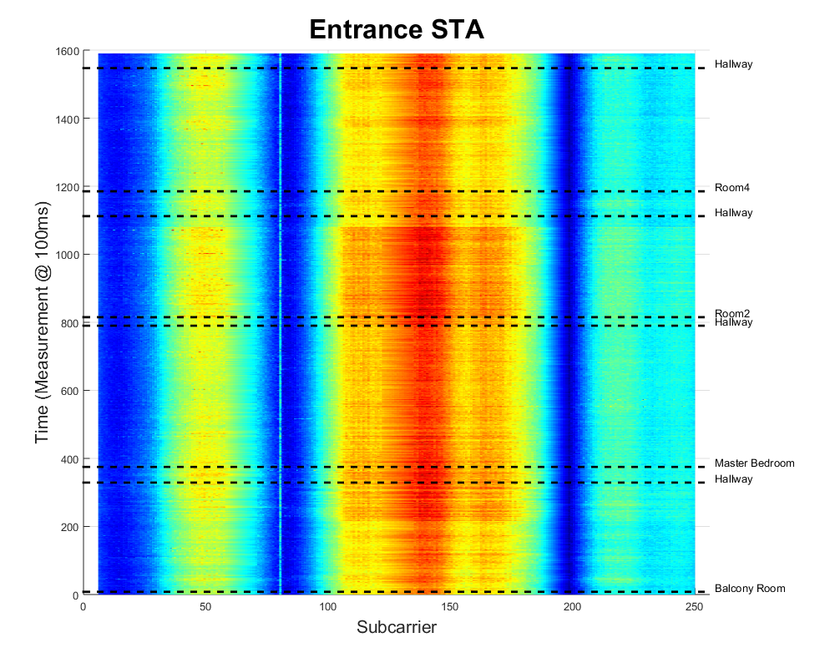
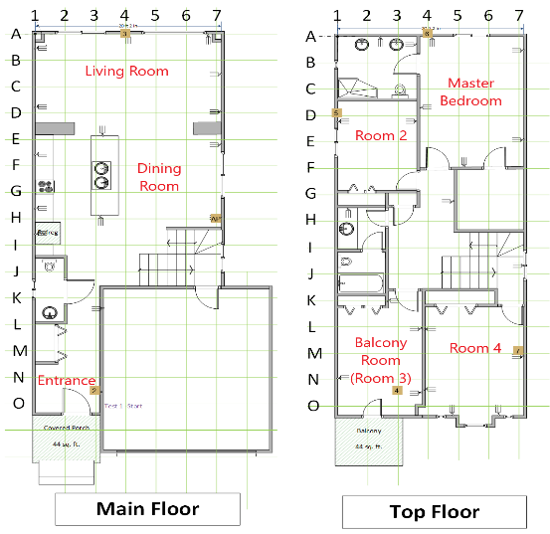
CSI from Entrance STA Measured by AP

Slide 15
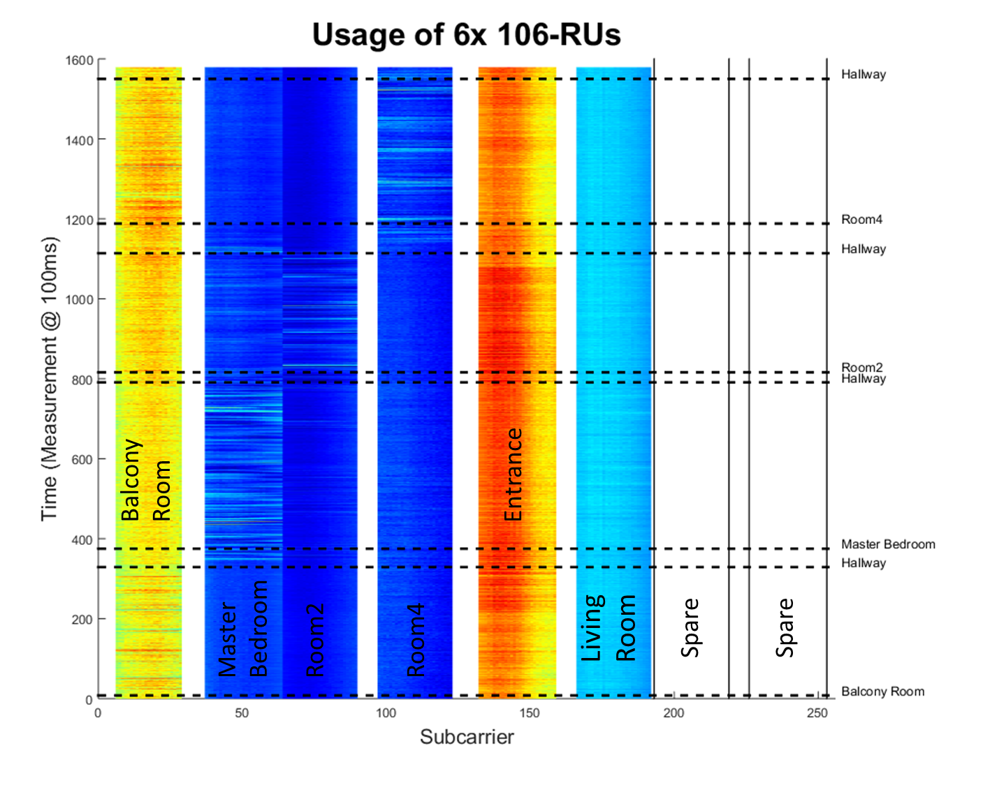
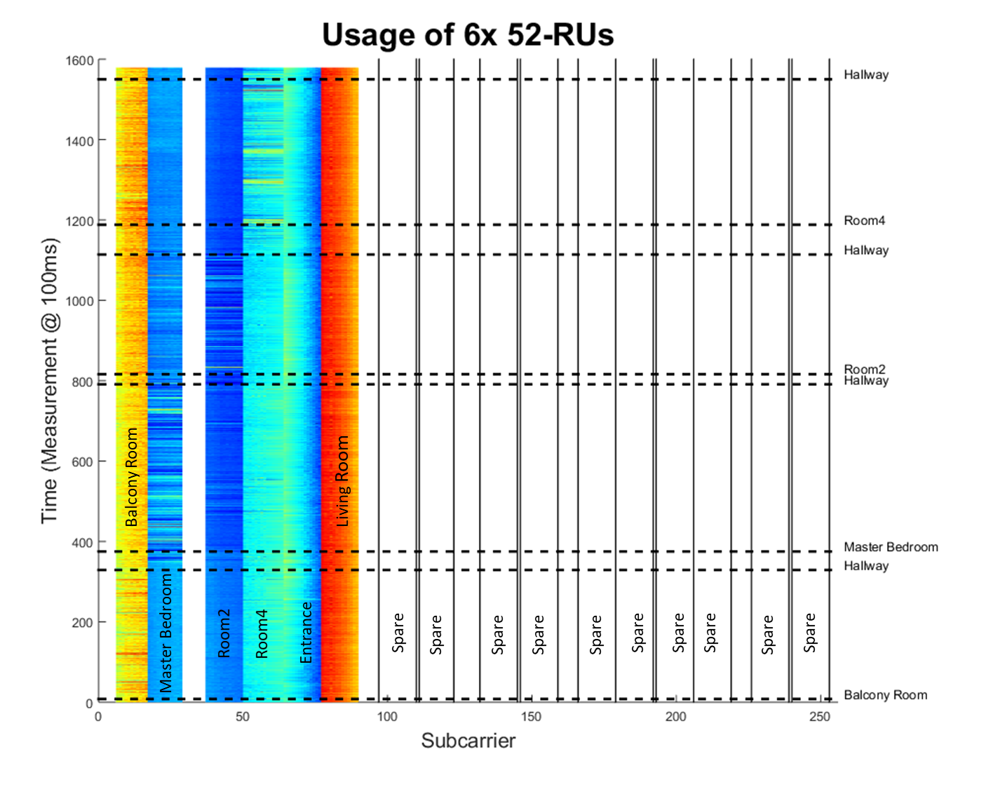
Simulation of OFDMA Usage
Subset of measured data plotted in various RU configurations
Allocate a subset of subcarriers to each sensing transmitter using partial BW RU
  Two examples: Six 106-RUs (two spare) & Six 52-RUs (ten spare)
  More challenging case used for rest of simulation (52-RU)

Slide 16
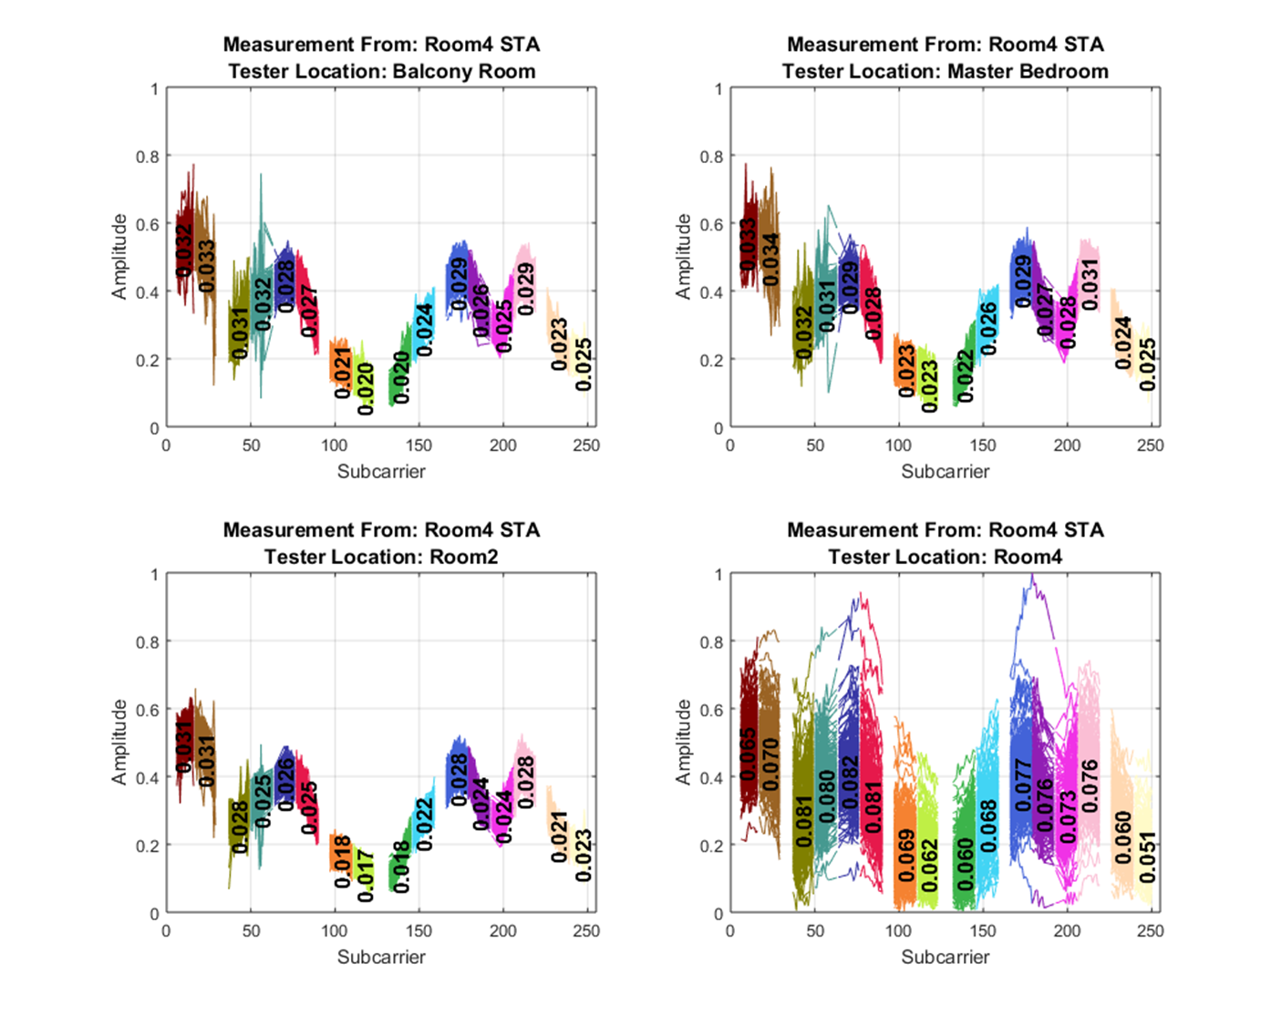
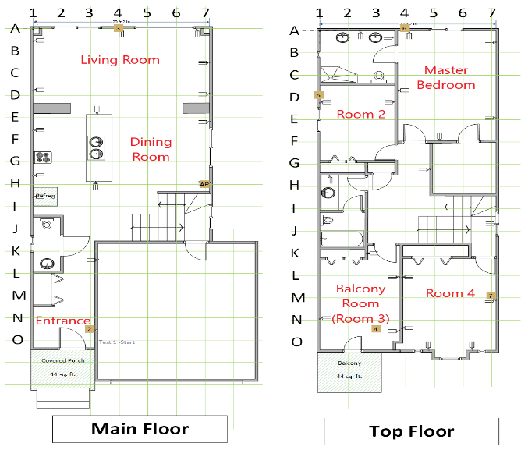
Simulation of OFDMA Usage
Quantify change by computing std-dev.
Std-Dev of the measurements in each 52-RU block is consistent across the whole band
Figure from Slide 13, color coding of each 52-RU channel.
Numerical value is the variance of the measurement in the selected OFDMA RU.

Slide 17
Conclusions
TB components described in 11az amendment allocate UL resources to be full bandwidth.
Ranging constraints may not apply to all Sensing applications
UL-OFDMA offers spectrum efficient way to produce coarse and fine measurements
UL-OFDMA can be used to help with an application’s STA selection process

Slide 18
[New] Conclusions
Measurement results show clear disturbances on subset of channels due to human movement in specific areas.
Measurements show disturbances can be detected on subset of channel (52-RU or ~5 MHz bandwidth analyzed).
Data demonstrates obtaining a low bandwidth measurement from many devices can provide a tool to help application determine which channels should be used for Sensing.
Spatial domain scheduling enables similar mechanism but is limited by number of antennas

Slide 19
References
[1] IEEE Draft P802.11az/D4.0, “Amendment 4: Enhancements for positioning”
[2] 11-21-1035-02-00bf-sensing-specific-feedback-using-ndpa-and-trigger-frames
[3] IEEE P801.11ax/D8.0, “Amendment 1: Enhancements for High Efficiency WLAN”
[4] 11-21-0504-03-00bf-specification-framework-for-tgbf.docx

Slide 20
SP1
Do you agree that the Sensing TB procedure shall provide the ability to allocate OFDMA RUs for the NDP transmission for the measurement phase to one or more STAs that are not Full-Bandwidth?
Y/N/A = 17/17/5

Slide 21
Appendix:
All Measurement Data

Slide 22
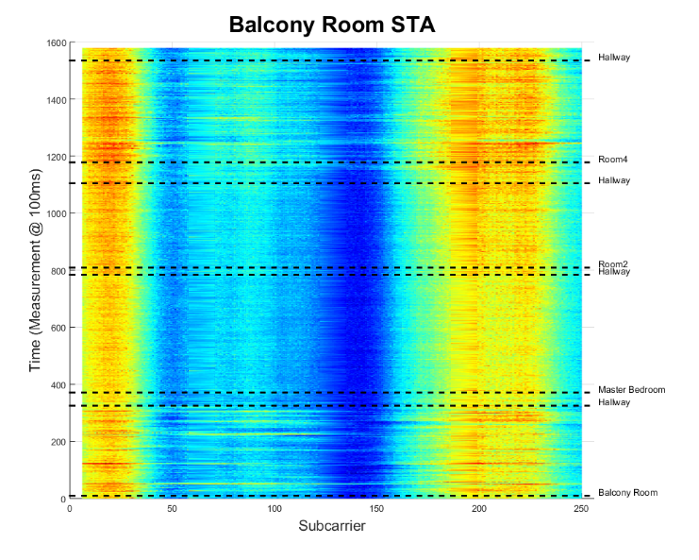
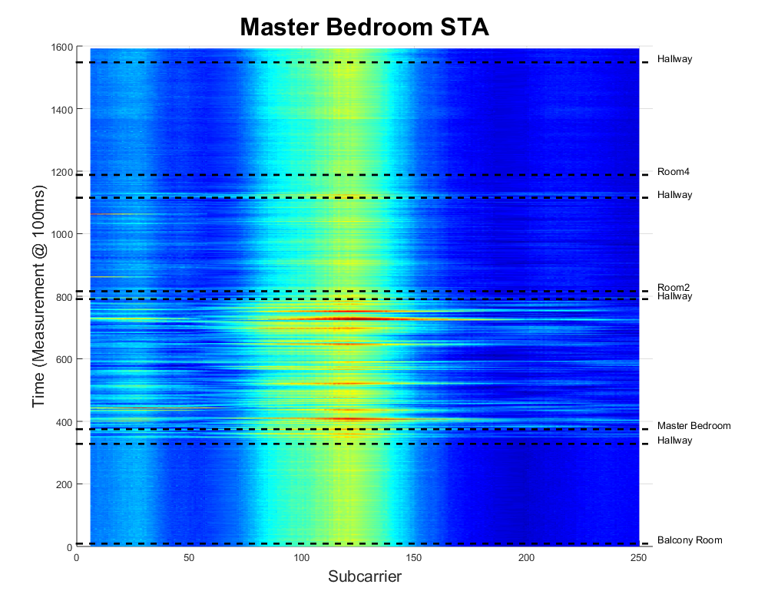
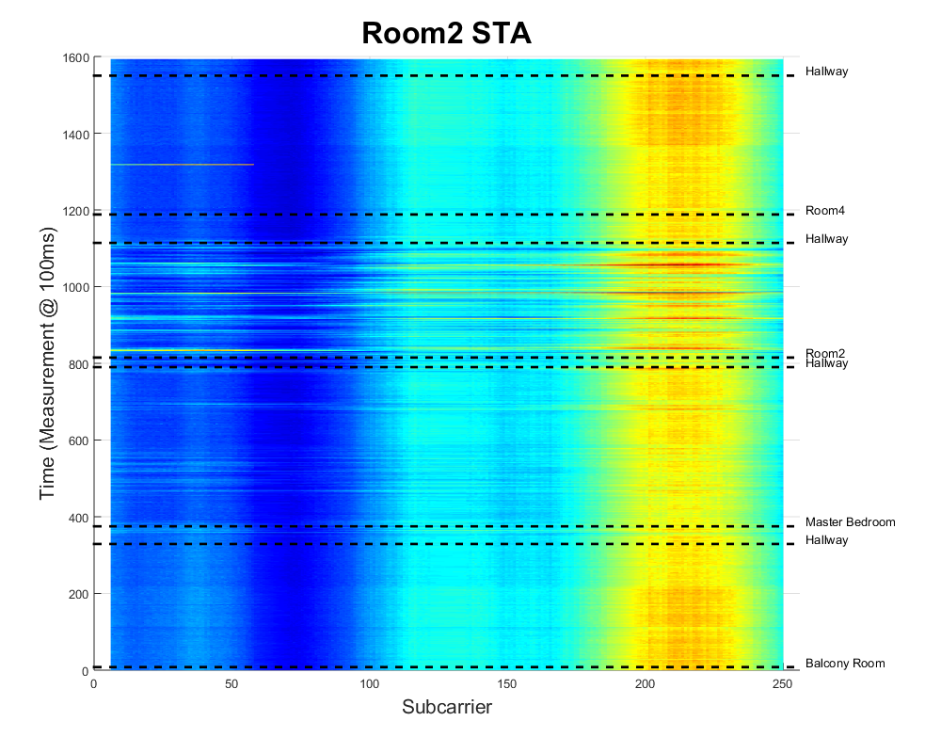
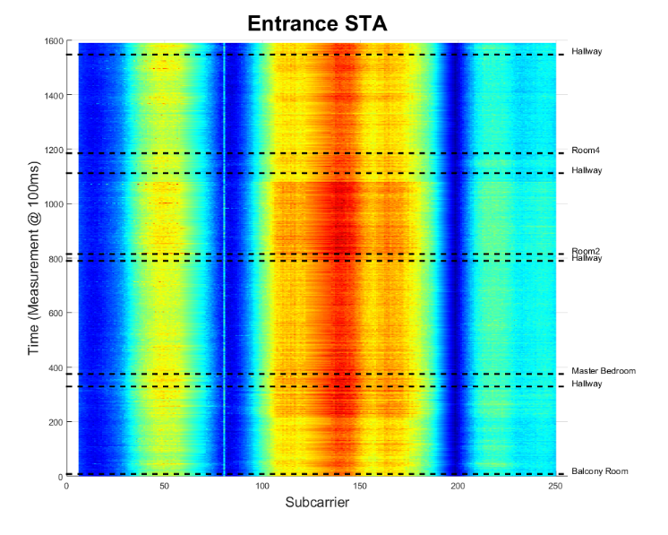
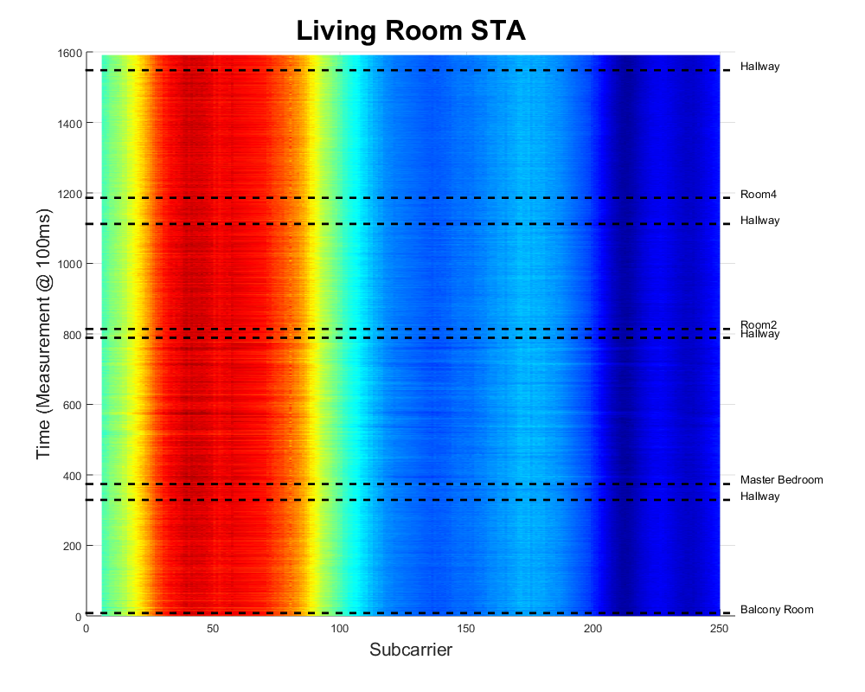
Chris Beg, Cognitive Systems

Slide 23
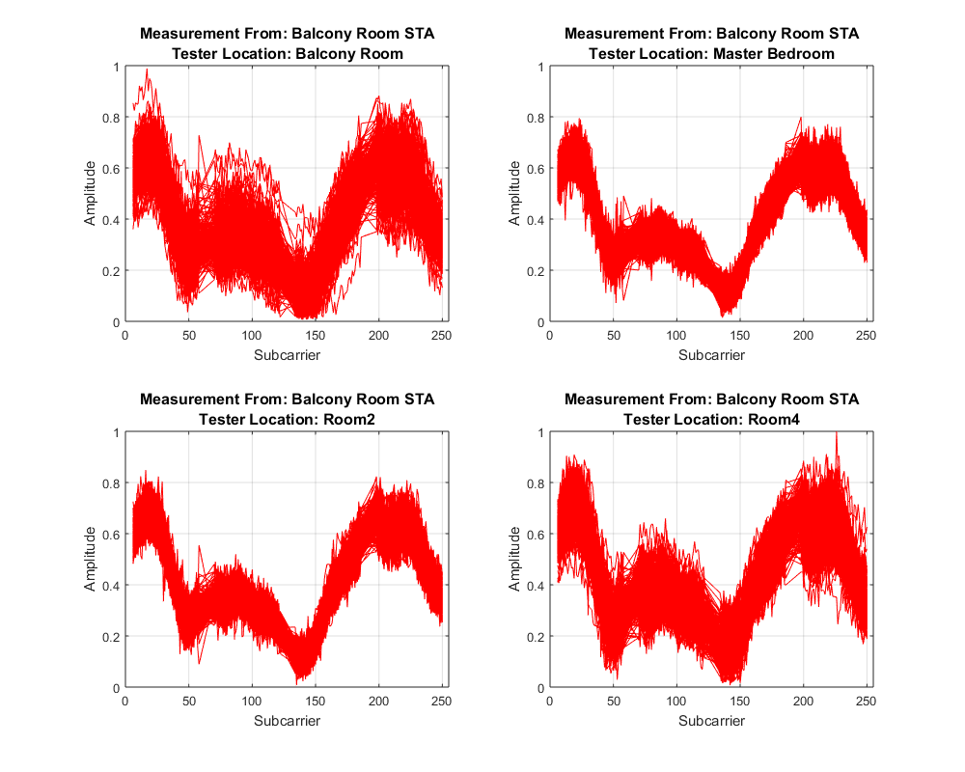
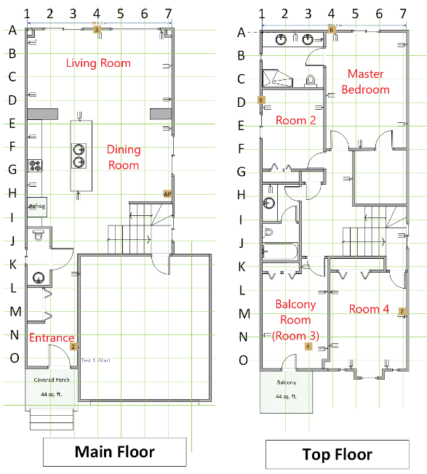
Chris Beg, Cognitive Systems

Slide 24
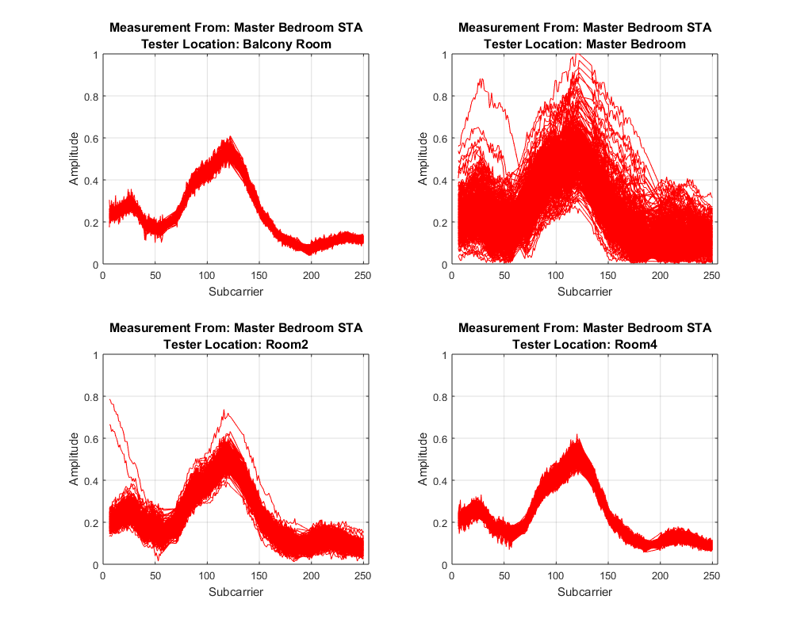
Chris Beg, Cognitive Systems

Slide 25
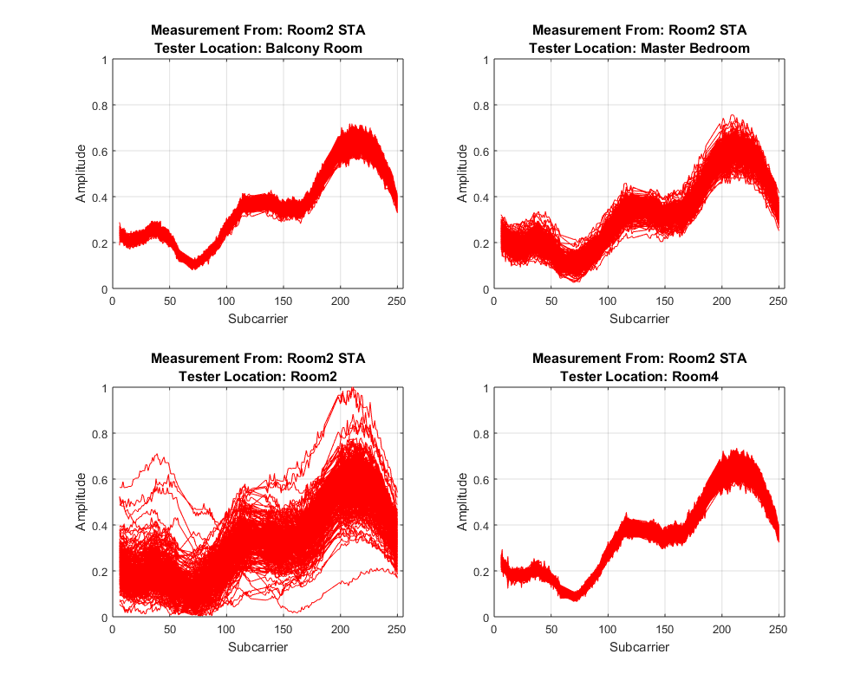
Chris Beg, Cognitive Systems

Slide 26
Chris Beg, Cognitive Systems

Slide 27
Chris Beg, Cognitive Systems

Slide 28
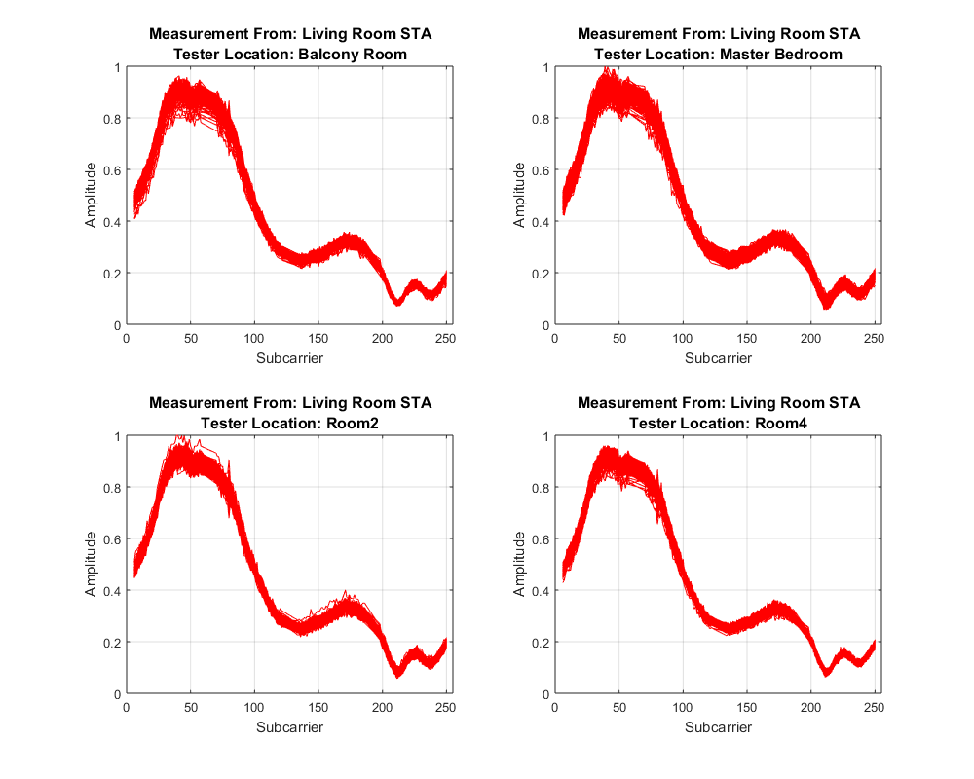
Chris Beg, Cognitive Systems

Slide 29
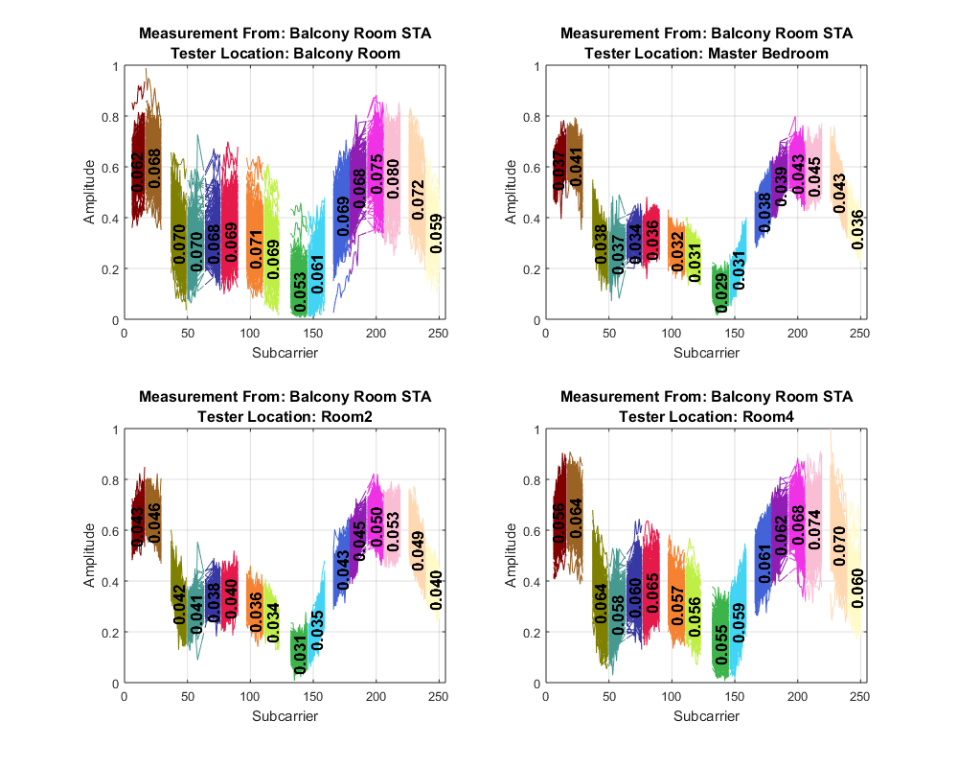
Chris Beg, Cognitive Systems

Slide 30
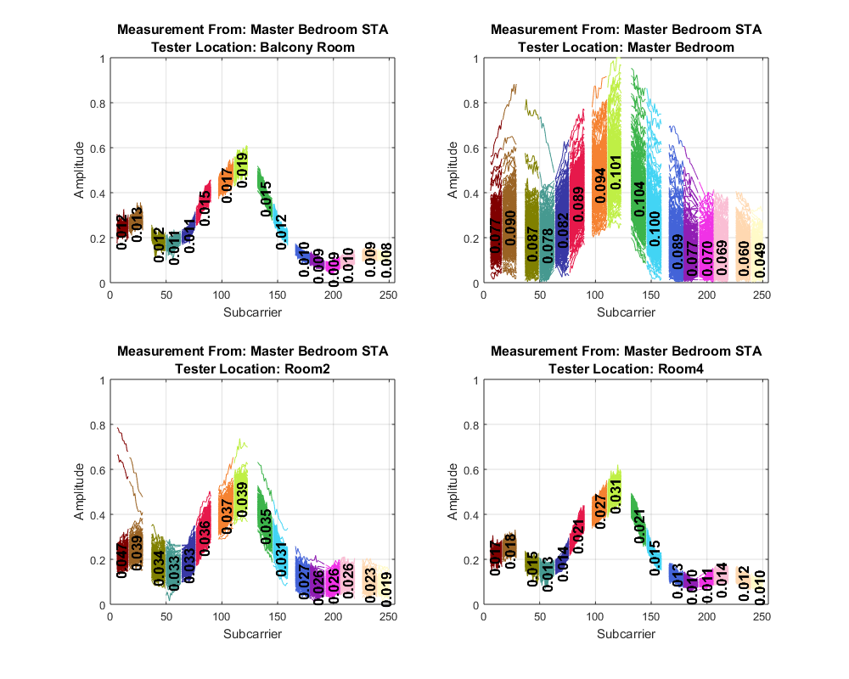
Chris Beg, Cognitive Systems

Slide 31
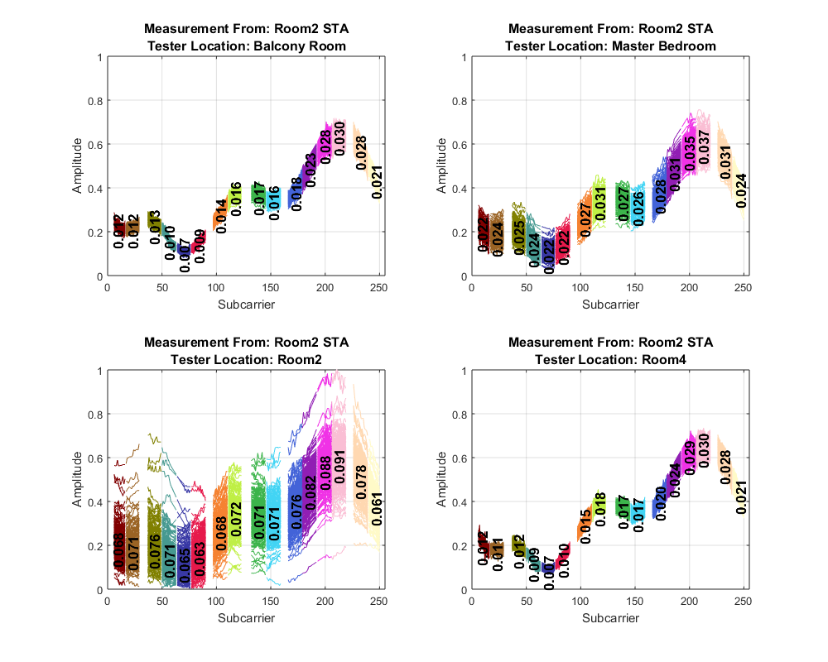
Chris Beg, Cognitive Systems

Slide 32

Chris Beg, Cognitive Systems

Slide 33
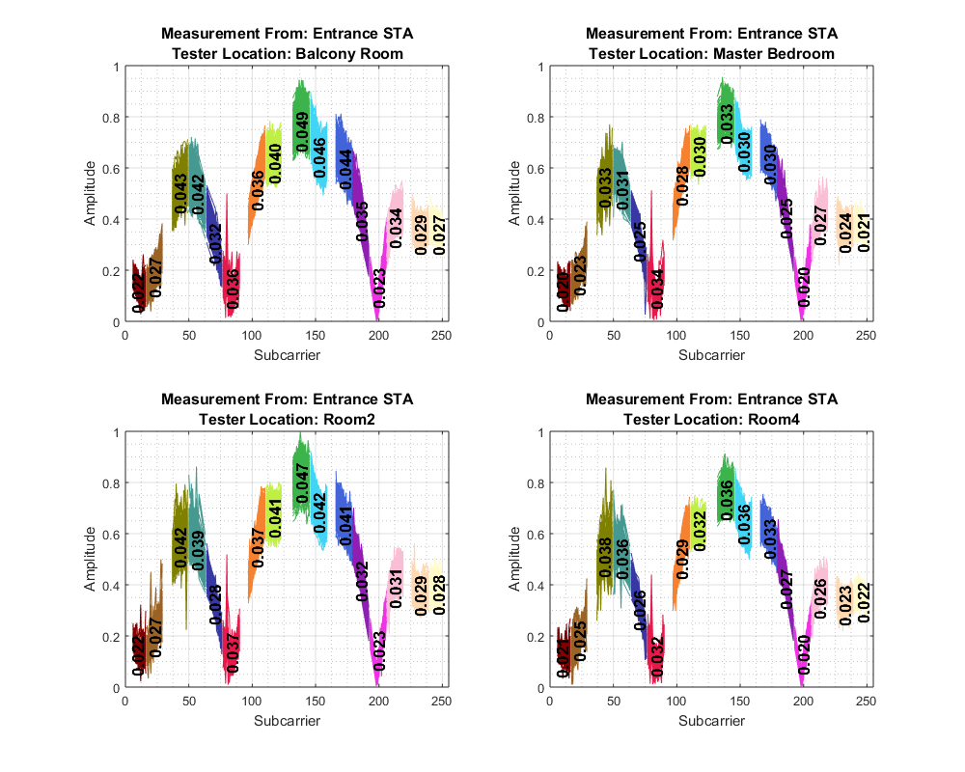
Chris Beg, Cognitive Systems

Slide 34
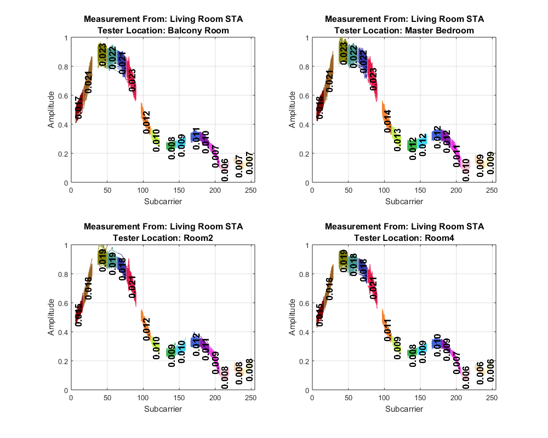
Chris Beg, Cognitive Systems

