Slide 1
Sensing Transmission in Partial Bandwidths
Date: 2021-10-25
Authors:

Slide 2
Abstract
OFDMA is an OFDM-based multiple access scheme where different subsets of subcarriers are allocated to different users, allowing simultaneous data transmission to or from one or more users [3].
Initiate TGbf discussion on usage of UL-OFDMA based measurements for Sensing

Slide 3
TB Procedure for Sensing
Motion 25c defines a trigger-based (TB) procedure for Sensing
TB procedure leverages components and features from P802.11az [1]
Sensing applications have broader uses than Ranging applications
  Constraints based on Ranging applications may not apply to Sensing applications

Slide 4
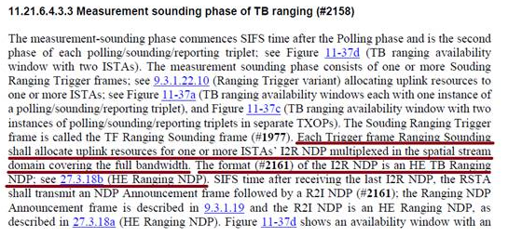
802.11az Ranging Procedure
Ranging measurement procedure defined by P802.11az mandates that uplink transmissions cover the full bandwidth
  Section 11.21.6.4.3.3 of [1]

Slide 5
Bandwidth Requirements
There are sensing applications which may benefit from control over the bandwidth of a sensing transmission
  For example, [2] discusses cases where course sensing resolution identifies an object and fine sensing resolution discriminates details of the object (slide 16).
OFDMA RU allocation can provide coarse/fine resolution in TB measurement procedure
  Making better use of spectrum
  Providing flexibility in transmission
  Providing for a more flexible Wi-Fi sensing system

Slide 6
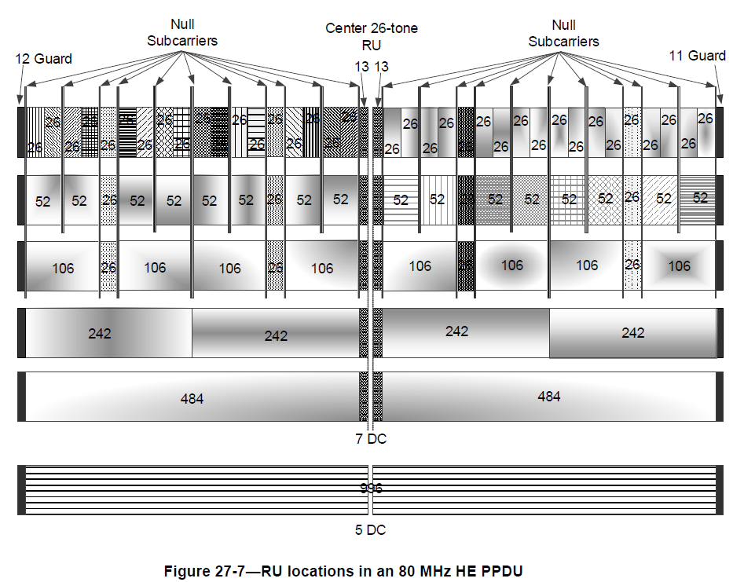
OFDMA for Coarse and Fine Sensing Measurements
Figure 27-7 [3] shows resource units (RU) in a 80-MHz OFDMA channel
Fewer subcarriers equate to narrower bandwidth
Note: An HE MU PPDU using OFDMA transmission can carry a mixture of 26-, 52-, 106-, 242-, 484-, and 996-tone RUs. [3]

Slide 7
OFDMA for Coarse and Fine Sensing Measurements
7.1.4.2.3 Trigger frame (TF) sounding phase [4]
  (Motion 25c, 21/0990r2; Motion 27, 21/1015r2) The TF sounding phase consists of
  The transmission of a trigger frame by an AP to solicit NDP transmission(s) from STA(s); and
  The transmission of an NDP by STA(s) SIFS after receiving the trigger frame.
242-subcarrier RUs used for 4x course sensing measurements @ 20 MHz
484-subcarrier RUs used for 2x finer sensing measurements @ 40 MHz
increased bandwidth reallocated to devices (sensing transmitters) that benefit from a finer resolution sensing measurement (e.g., Device 1 & 4)

Slide 8
Example Application ~ STA Selection
1. Scan environment for potential targets
  Perform lower resolution measurements utilizing UL-OFDMA
2. Target Visible by STA1 and STA4
  Perform higher resolution measurement (a or b, depending on requirements)
(a)
(b)

Slide 9
Conclusions
TB components described in 11az amendment allocate UL resources to be full bandwidth.
Ranging constraints may not apply to all Sensing applications
UL-OFDMA offers spectrum efficient way to produce coarse and fine measurements
UL-OFDMA can be used to help with an application’s STA selection process

Slide 10
References
[1] IEEE Draft P802.11az/D4.0, “Amendment 4: Enhancements for positioning”
[2] 11-21-1035-02-00bf-sensing-specific-feedback-using-ndpa-and-trigger-frames
[3] IEEE P801.11ax/D8.0, “Amendment 1: Enhancements for High Efficiency WLAN”
[4] 11-21-0504-03-00bf-specification-framework-for-tgbf.docx

Slide 11
SP1
Do you agree that the Sensing TB procedure shall provide the ability to allocate OFDMA RUs for the NDP transmission for the measurement phase to one or more STAs that are not Full-Bandwidth?
Y/N/A = 17/17/5

