Slide 1
Sensing Transmission in Partial Bandwidths
Date: 2021-10-25
Authors:

Slide 2
Abstract
OFDMA is an OFDM-based multiple access scheme where different subsets of subcarriers are allocated to different users, allowing simultaneous data transmission to or from one or more users [3].
Initiate TGbf discussion on usage of UL-OFDMA based measurements for Sensing

Slide 3
TB Procedure for Sensing
Motion 25c defines a trigger-based (TB) procedure for Sensing
TB procedure leverages components and features from P802.11az [1]
Sensing applications have broader uses than Ranging applications
  Constraints based on Ranging applications may not apply to Sensing applications

Slide 4
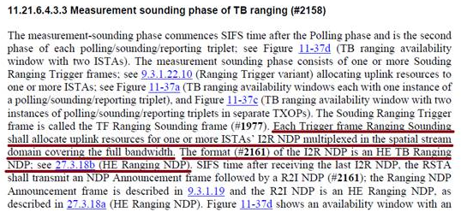
802.11az Ranging Procedure
Ranging measurement procedure defined by P802.11az mandates that uplink transmissions cover the full bandwidth
  Section 11.21.6.4.3.3 of [1]

Slide 5
Bandwidth Requirements
There are sensing applications which may benefit from control over the bandwidth of a sensing transmission
  For example, [2] discusses cases where course sensing resolution identifies an object and fine sensing resolution discriminates details of the object (slide 16).
OFDMA RU allocation can provide coarse/fine resolution in TB measurement procedure
  Making better use of spectrum
  Providing flexibility in transmission
  Providing for a more flexible Wi-Fi sensing system

Slide 6
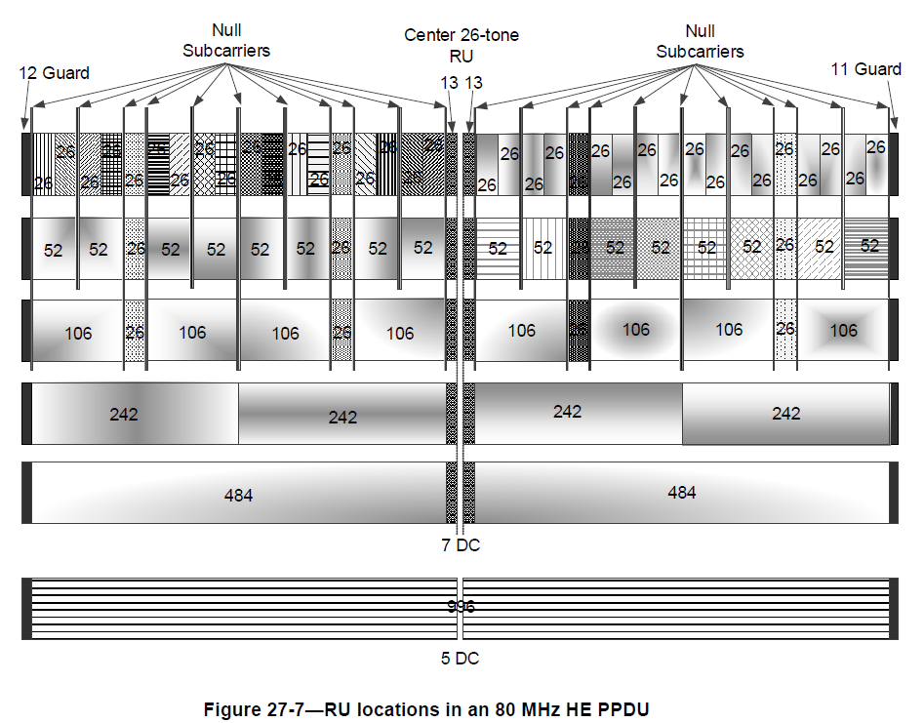
OFDMA for Coarse and Fine Sensing Measurements
Figure 27-7 [3] shows resource units (RU) in a 80-MHz OFDMA channel
Fewer subcarriers equate to narrower bandwidth
Note: An HE MU PPDU using OFDMA transmission can carry a mixture of 26-, 52-, 106-, 242-, 484-, and 996-tone RUs. [3]

Slide 7
OFDMA for Coarse and Fine Sensing Measurements
7.1.4.2.3 Trigger frame (TF) sounding phase [4]
  (Motion 25c, 21/0990r2; Motion 27, 21/1015r2) The TF sounding phase consists of
  The transmission of a trigger frame by an AP to solicit NDP transmission(s) from STA(s); and
  The transmission of an NDP by STA(s) SIFS after receiving the trigger frame.
242-subcarrier RUs used for 4x course sensing measurements @ 20 MHz
484-subcarrier RUs used for 2x finer sensing measurements @ 40 MHz
increased bandwidth reallocated to devices (sensing transmitters) that benefit from a finer resolution sensing measurement (e.g., Device 1 & 4)

Slide 8
Example Application ~ STA Selection
1. Scan environment for potential targets
  Perform lower resolution measurements utilizing UL-OFDMA
2. Target Visible by STA1 and STA4
  Perform higher resolution measurement (a or b, depending on requirements)
(a)
(b)

Slide 9
Conclusions
TB components described in 11az amendment allocate UL resources to be full bandwidth.
Ranging constraints may not apply to all Sensing applications
UL-OFDMA offers spectrum efficient way to produce coarse and fine measurements
UL-OFDMA can be used to help with an application’s STA selection process

Slide 10
References
[1] IEEE Draft P802.11az/D4.0, “Amendment 4: Enhancements for positioning”
[2] 11-21-1035-02-00bf-sensing-specific-feedback-using-ndpa-and-trigger-frames
[3] IEEE P801.11ax/D8.0, “Amendment 1: Enhancements for High Efficiency WLAN”
[4] 11-21-0504-03-00bf-specification-framework-for-tgbf.docx

Slide 11
SP1
Do you agree that the Sensing TB procedure shall provide the ability to allocate OFDMA RUs to one or more STAs that are not Full-Bandwidth?

