Slide 1
Low-Complexity Scaling and Quantization for CSI Report
Date: 2021-09-24
Authors:
Name | Affiliations | Address | Phone | email
Steve Shellhammer | Qualcomm |  |  | shellhammer@ieee.org
Bin Tian |  |  |  | btian@qti.qualcomm.com
Ali Raissinia |  |  |  | alirezar@qti.qualcomm.com
Simone Merlin |  |  |  | smerlin@qti.qualcomm.com

Slide 2
Introduction
The 802.11 standard includes a specification of a CSI report for Beamforming
  This was originally introduced in 802.11n
  This has since been superseded by a SVD feedback method
Here we provide a summary of the 802.11n CSI report and then introduce several lower complexity options, for 802.11bf

Slide 3
Background
IEEE 802.11 standard
  Clause 9.4.1.27 CSI Report field – Details of the Report format
  Specified for HT (802.11n)
  SNR for each Receive Chain
  CSI for Subcarrier/Row/Column
CSI Field Parameters | Meaning | Where Indicated | Range of Values
Nb | Number of Bits for I or Q | MIMO Control Field | {4, 5, 6, 8}
Nc | Number of Columns | MIMO Control Field | 0 to 3
Nr | Number of Rows | MIMO Control Field | 1 to 4
Here we will focus on the CSI Matrices and do not discuss the SNR field

Slide 4

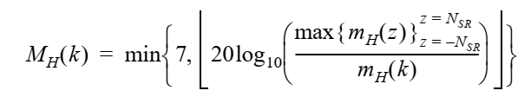
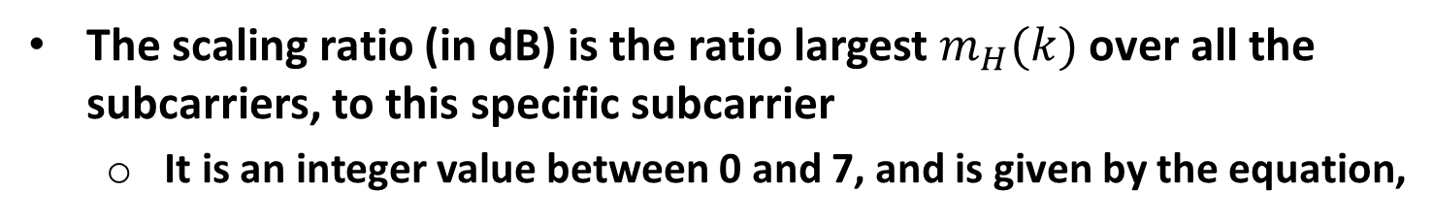
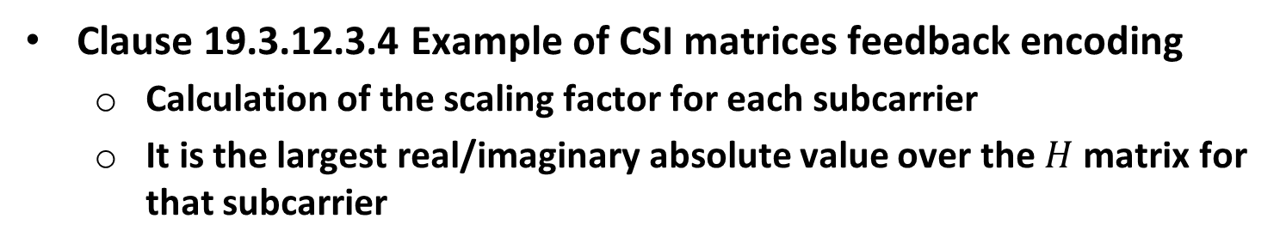
Background (cont.)
Clause 19.3.12.3.4 Example of CSI matrices feedback encoding
  Calculation of the scaling factor for each subcarrier
  It is the largest real/imaginary absolute value over the $H$ matrix for that subcarrier
The scaling ratio (in dB) is the ratio largest $m_{H}(k)$ over all the subcarriers, to this specific subcarrier
  It is an integer value between 0 and 7, and is given by the equation,

Slide 5

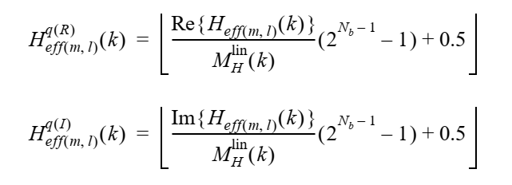
Background (cont.)
The linear scaling factor is given by,
Each In-phase and Quadrature value is scaled to a twos complement value as follows,

Slide 6
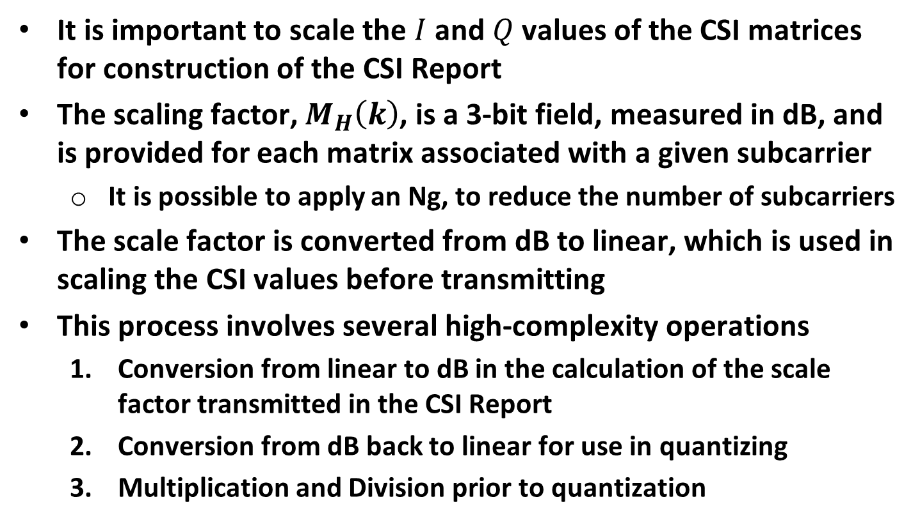
Observations
It is important to scale the $I$ and $Q$ values of the CSI matrices for construction of the CSI Report
The scaling factor, $M_{H}\left(k\right)$, is a 3-bit field, measured in dB, and is provided for each matrix associated with a given subcarrier
  It is possible to apply an Ng, to reduce the number of subcarriers
The scale factor is converted from dB to linear, which is used in scaling the CSI values before transmitting
This process involves several high-complexity operations
  Conversion from linear to dB in the calculation of the scale factor transmitted in the CSI Report
  Conversion from dB back to linear for use in quantizing
  Multiplication and Division prior to quantization

Slide 7
Lower Complexity Options
To ease of implementation, we suggest that lower complexity approaches be considered
  A follow-up presentation on quantization analysis is being prepared
Option #1
  The simplest quantization approach is to round to the specified resolution in the CSI Report, without any scaling
  This simplifies the implementation but reduces the dynamic range
Option #2 (Described in the subsequent slides)
  An approach like the 802.11n CSI scaling and quantization could be used, where the scaling is done using power-of-two scaling factors, to avoid the complexity of the multiplication and division operations
  Also, this approach can eliminate the non-linear operation of conversion between linear and dB scale
  This provides a good representation of the channel even in a frequency selective fading channel

Slide 8
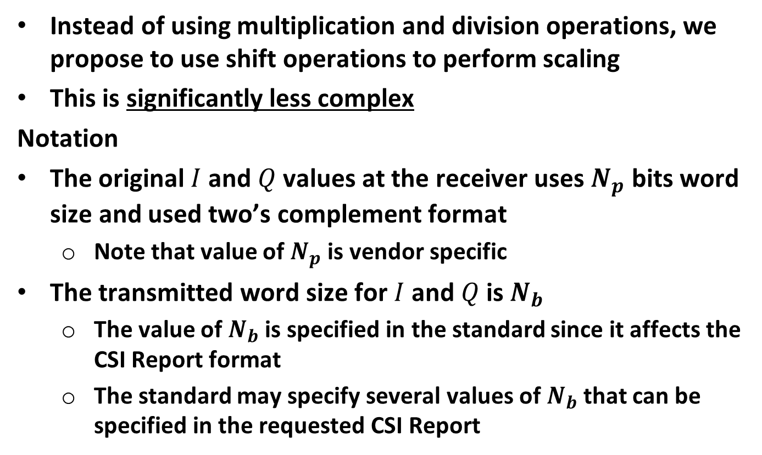
Proposal
Instead of using multiplication and division operations, we propose to use shift operations to perform scaling
This is significantly less complex
Notation
The original $I$ and $Q$ values at the receiver uses $N_{p}$ bits word size and used two’s complement format
  Note that value of $N_{p}$ is vendor specific
The transmitted word size for $I$ and $Q$ is $N_{b}$
  The value of $N_{b}$ is specified in the standard since it affects the CSI Report format
  The standard may specify several values of $N_{b}$ that can be specified in the requested CSI Report

Slide 9
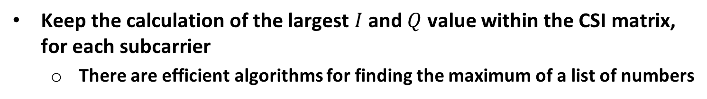
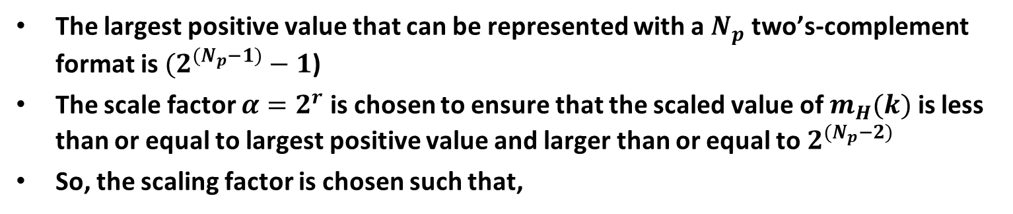
Proposal
Keep the calculation of the largest $I$ and $Q$ value within the CSI matrix, for each subcarrier
  There are efficient algorithms for finding the maximum of a list of numbers
The largest positive value that can be represented with a $N_{p}$ two’s-complement format is $(2^{{(N}_{p}−1)}−1$)
The scale factor $α=2^{r}$ is chosen to ensure that the scaled value of $m_{H}(k)$ is less than or equal to largest positive value and larger than or equal to $2^{{(N}_{p}−2)}$
So, the scaling factor is chosen such that,
$${(2}^{(N_{p}−1)}−1)≥α m_{H}\left(k\right)≥2^{(N_{p}−2)}$$
This is the maximum power-of-two scaling which can be applied while avoiding an overflow

Slide 10
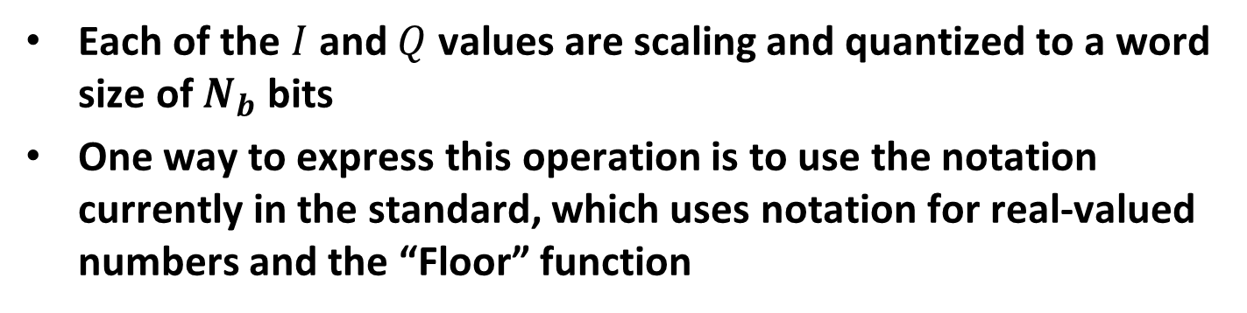
Proposal (cont.)
Each of the $I$ and $Q$ values are scaling and quantized to a word size of $N_{b}$ bits
One way to express this operation is to use the notation currently in the standard, which uses notation for real-valued numbers and the “Floor” function
$$H_{eff\left(m,l\right)}^{q\left(R\right)}\left(k\right)= \left\lfloor α Re\left\{H_{eff\left(m,l\right)}\left(k\right)\right\}\left(2^{{(N}_{b} −N_{p})}\right)+0.5\right\rfloor$$
$$H_{eff\left(m,l\right)}^{q\left(I\right)}\left(k\right)= \left\lfloor α Im\left\{H_{eff\left(m,l\right)}\left(k\right)\right\}\left(2^{{(N}_{b}{−N}_{p})}\right)+0.5\right\rfloor$$
In practice this can be performed with simple shifting and rounding operations, either in hardware or software

Slide 11
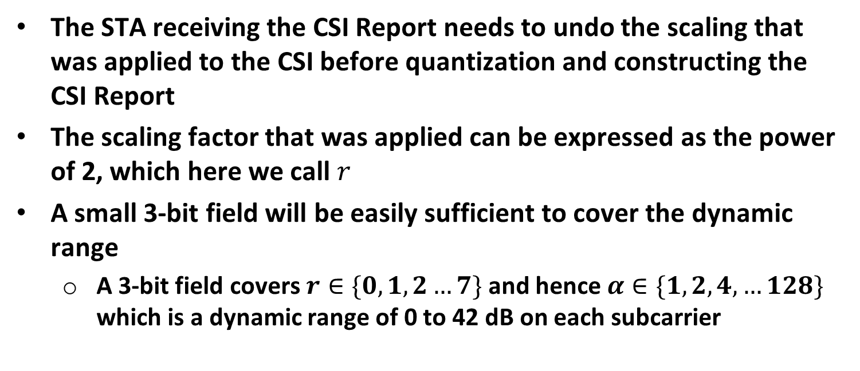
Communicating the Scale Factor in the CSI Report
The STA receiving the CSI Report needs to undo the scaling that was applied to the CSI before quantization and constructing the CSI Report
The scaling factor that was applied can be expressed as the power of 2, which here we call $r$
A small 3-bit field will be easily sufficient to cover the dynamic range
  A 3-bit field covers $r∈\{0, 1, 2…7\}$ and hence $α∈\{1, 2, 4,…128\}$ which is a dynamic range of 0 to 42 dB on each subcarrier

Slide 12
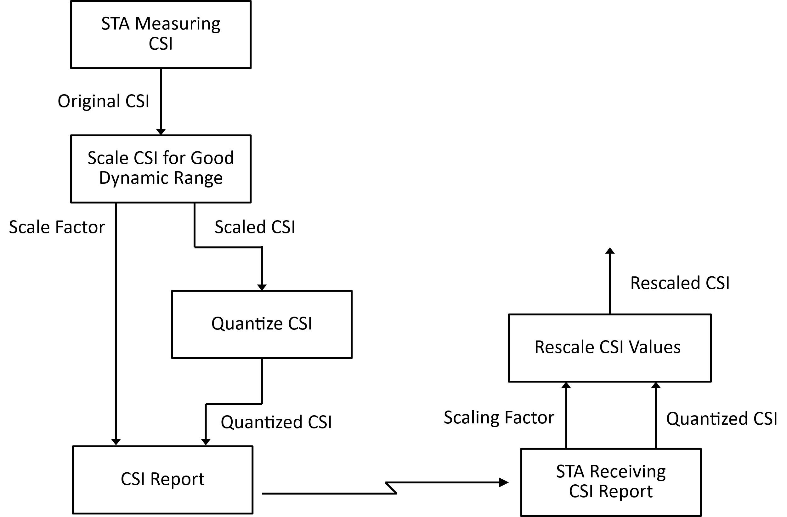
Illustration of Scaling and Quantizing Process

Slide 13
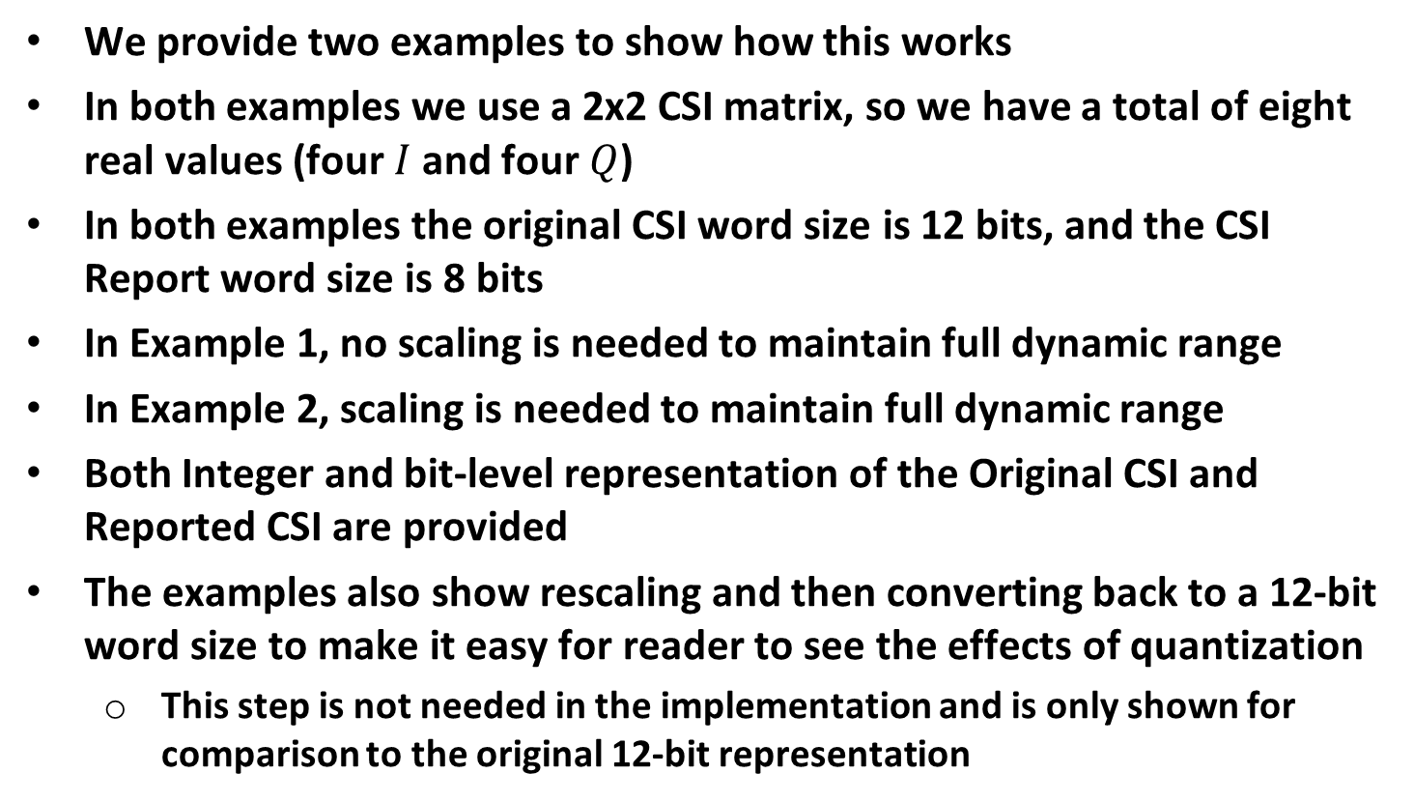
Examples
We provide two examples to show how this works
In both examples we use a 2x2 CSI matrix, so we have a total of eight real values (four $I$ and four $Q$)
In both examples the original CSI word size is 12 bits, and the CSI Report word size is 8 bits
In Example 1, no scaling is needed to maintain full dynamic range
In Example 2, scaling is needed to maintain full dynamic range
Both Integer and bit-level representation of the Original CSI and Reported CSI are provided
The examples also show rescaling and then converting back to a 12-bit word size to make it easy for reader to see the effects of quantization
  This step is not needed in the implementation and is only shown for comparison to the original 12-bit representation

Slide 14


Example 1
I/Q Values (Integer) | I/Q Values (Bit-Level)
1362 | {0, 1, 0, 1, 0, 1, 0, 1, 0, 0, 1, 0}
-891 | {1, 1, 0, 0, 1, 0, 0, 0, 0, 1, 0, 1}
1677 | {0, 1, 1, 0, 1, 0, 0, 0, 1, 1, 0, 1}
1557 | {0, 1, 1, 0, 0, 0, 0, 1, 0, 1, 0, 1}
-548 | {1, 1, 0, 1, 1, 1, 0, 1, 1, 1, 0, 0}
-667 | {1, 1, 0, 1, 0, 1, 1, 0, 0, 1, 0, 1}
-60 | {1, 1, 1, 1, 1, 1, 0, 0, 0, 1, 0, 0}
1555 | {0, 1, 1, 0, 0, 0, 0, 1, 0, 0, 1, 1}
Original CSI Values
$$r=0$$
$$α=2^{0}=1$$
I/Q Values (Integer) | I/Q Values (Bit-Level)
85 | {0, 1, 0, 1, 0, 1, 0, 1}
-56 | {1, 1, 0, 0, 1, 0, 0, 0}
105 | {0, 1, 1, 0, 1, 0, 0, 1}
97 | {0, 1, 1, 0, 0, 0, 0, 1}
-34 | {1, 1, 0, 1, 1, 1, 1, 0}
-42 | {1, 1, 0, 1, 0, 1, 1, 0}
-4 | {1, 1, 1, 1, 1, 1, 0, 0}
97 | {0, 1, 1, 0, 0, 0, 0, 1}
CSI Report Values
No Scaling is required
Quantized to 8 bits
Reconstructed CSI Values
I/Q Values (Integer) | I/Q Values (Bit-Level)
1360 | {0, 1, 0, 1, 0, 1, 0, 1, 0, 0, 0, 0}
-896 | {1, 1, 0, 0, 1, 0, 0, 0, 0, 0, 0, 0}
1680 | {0, 1, 1, 0, 1, 0, 0, 1, 0, 0, 0, 0}
1552 | {0, 1, 1, 0, 0, 0, 0, 1, 0, 0, 0, 0}
-544 | {1, 1, 0, 1, 1, 1, 1, 0, 0, 0, 0, 0}
-672 | {1, 1, 0, 1, 0, 1, 1, 0, 0, 0, 0, 0}
-64 | {1, 1, 1, 1, 1, 1, 0, 0, 0, 0, 0, 0}
1552 | {0, 1, 1, 0, 0, 0, 0, 1, 0, 0, 0, 0}
Converted from 8-bit word size to 12-bit word size
This allows for comparison with original measured CSI

Slide 15


Example 2
I/Q Values (Integer) | I/Q Values (Bit-Level)
-281 | {1, 1, 1, 0, 1, 1, 1, 0, 0, 1, 1, 1}
-231 | {1, 1, 1, 1, 0, 0, 0, 1, 1, 0, 0, 1}
-494 | {1, 1, 1, 0, 0, 0, 0, 1, 0, 0, 1, 0}
352 | {0, 0, 0, 1, 0, 1, 1, 0, 0, 0, 0, 0}
-343 | {1, 1, 1, 0, 1, 0, 1, 0, 1, 0, 0, 1}
-70 | {1, 1, 1, 1, 1, 0, 1, 1, 1, 0, 1, 0}
-162 | {1, 1, 1, 1, 0, 1, 0, 1, 1, 1, 1, 0}
-288 | {1, 1, 1, 0, 1, 1, 1, 0, 0, 0, 0, 0}
Original CSI Values
$$r=2$$
$$α=2^{2}=4$$
I/Q Values (Integer) | I/Q Values (Bit-Level)
-70 | {1, 0, 1, 1, 1, 0, 1, 0}
-58 | {1, 1, 0, 0, 0, 1, 1, 0}
-123 | {1, 0, 0, 0, 0, 1, 0, 1}
88 | {0, 1, 0, 1, 1, 0, 0, 0}
-86 | {1, 0, 1, 0, 1, 0, 1, 0}
-17 | {1, 1, 1, 0, 1, 1, 1, 1}
-40 | {1, 1, 0, 1, 1, 0, 0, 0}
-72 | {1, 0, 1, 1, 1, 0, 0, 0}
CSI Report Values
Scaled by shifting each value to the left by two bits
Then quantized to 8 bits
Reconstructed CSI Values
I/Q Values (Integer) | I/Q Values (Bit-Level)
-280 | {1, 1, 1, 0, 1, 1, 1, 0, 1, 0, 0, 0}
-232 | {1, 1, 1, 1, 0, 0, 0, 1, 1, 0, 0, 0}
-492 | {1, 1, 1, 0, 0, 0, 0, 1, 0, 1, 0, 0}
352 | {0, 0, 0, 1, 0, 1, 1, 0, 0, 0, 0, 0}
-344 | {1, 1, 1, 0, 1, 0, 1, 0, 1, 0, 0, 0}
-68 | {1, 1, 1, 1, 1, 0, 1, 1, 1, 1, 0, 0}
-160 | {1, 1, 1, 1, 0, 1, 1, 0, 0, 0, 0, 0}
-288 | {1, 1, 1, 0, 1, 1, 1, 0, 0, 0, 0, 0}
First converted from 8-bit word size to 12-bit word size
Then scaled by shifting right by two bits
This allows for comparison with original measured CSI

Slide 16
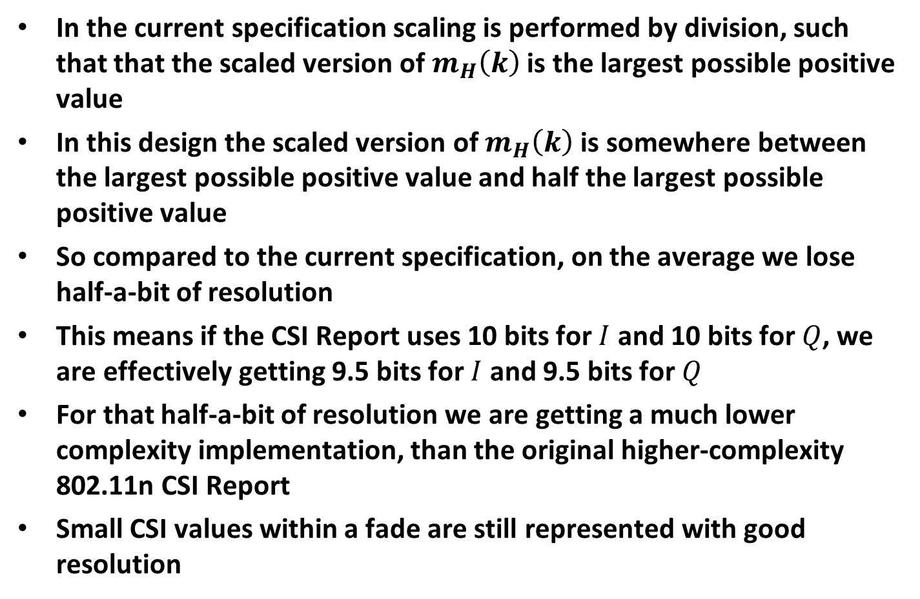
Quantization Effect
In the current specification scaling is performed by division, such that that the scaled version of $m_{H}\left(k\right)$ is the largest possible positive value
In this design the scaled version of $m_{H}\left(k\right)$ is somewhere between the largest possible positive value and half the largest possible positive value
So compared to the current specification, on the average we lose half-a-bit of resolution
This means if the CSI Report uses 10 bits for $I$ and 10 bits for $Q$, we are effectively getting 9.5 bits for $I$ and 9.5 bits for $Q$
For that half-a-bit of resolution we are getting a much lower complexity implementation, than the original higher-complexity 802.11n CSI Report
Small CSI values within a fade are still represented with good resolution

Slide 17
Summary
We have a proposed a low-complexity scaling and quantization design with the following benefits
  Converting from linear to dB has been eliminated
  Converting from dB to linear has been eliminated
  Division has been replaced by a shift operation
This significant reduction in complexity has a cost of half-a-bit of resolution, which we think is a reasonable trade-off for the lower complexity implementation
CSI values even within a fade are well represented
In addition to deciding on the CSI scaling and quantization there are several other decisions to make about the CSI report
  What word sizes do we support for the quantized CSI values?
  What other parameters are to be included in the CSI Report?

Slide 18
Straw Poll #1
For construction of the CSI Report do you support using power-of-two scaling on each subcarrier?

Slide 19
Straw Poll #2
Do you support transmitting the power-of-two exponent in the CSI Report, for each subcarrier, so that the recipient of the CSI Report can rescale the CSI values?

