Slide 1
ETSI 6GHz Narrow Band Status
Date: 2021-Sept-20
Authors:

Slide 2
Abstract
- These slides gives a status of the Narrow Band activities since May 2021

Slide 3
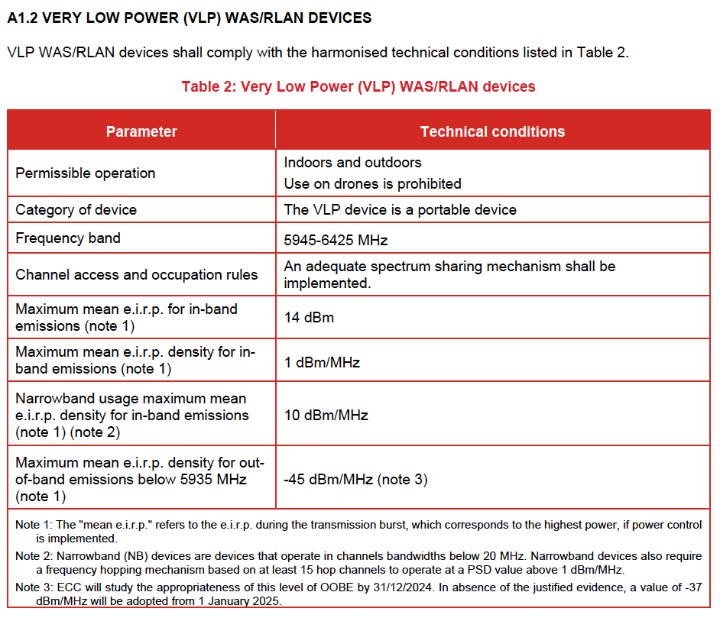
Background
In November 2020 the regulations [1] were amended to include Narrow band systems operating in the VLP category. An extract of the draft regulations is below:

Slide 4
Summary of Technical Submissions to BRAN110
[BRAN(21)109h004r2]
Document proposing an alternate optimized eDAA algorithm for NB systems, specifically focused on detecting WB systems and prioritizing WB systems once initial NB access has been gained.
[BRAN(21)110019]
Summary of the BRAN(21)109h004r2 document with additional info graphics to detail examples of how eDAA works
[BRAN(21)110045]
Document simulating eDAA effects on WB, it was discussed that the throughput reduction seen during initial (maximum 500ms) NB access could be acceptable but in some cases that the latency of WB could be affected, but these are corner case scenarios

Slide 5
Summary of Technical Submissions to BRAN110d
[BRAN(21)110a003]
Document presenting WB-WB scenarios that exist and can have the same effects claimed by the NB-WB simulations, it included some clarifications on points made in [BRAN(21)110045]
[BRAN(21)110d003r1]
Document providing comments on BRAN(21)110a003, focussing on possible corner cases where NB-WB can interfere, several potential issues identified in the simulations that FHSS is not interpreted correctly, needs further study
[BRAN(21)110d004]
Possible routes for EN 303 687. Options: (1) continue discussion to December on NB, (2) Exclude NB from the first version of the standard (3) Look at new NB WI

Slide 6
Summary of Technical Submissions to BRAN110d
[BRAN(21)110d005]
Document discussing the current status and the unequal treatment of NB vs WB, it points out rules and procedural issues and reconfirms that the regulations does not specify different treatment. They are both equal.
[BRAN(21)110d006]
Document studying NB vs WB coexistence and proposing to either adopt all the DAA, LBT and MU variants from the EN 300 328 harmonized standard directly or Adopt the DAA, LBT and MU variants from the EN 300 328 harmonized standard as the baseline and applying the further changes proposed by Ericsson and Apple

Slide 7
Summary of Technical Submissions to BRAN110d
[[BRAN(21)110d007]
Document proposing to adopt NB FH based on requirements described EN 300 328 and adapted to technical conditions described in EC decision 2021/1067. The next work item should be used to continue the study of NB FH vs LBE coexistence.
[[BRAN(21)110d008]
Document to either adopt all the DAA, LBT and MU variants from the EN 300 328 harmonized standard directly or Adopt the DAA, LBT and MU variants from the EN 300 328 harmonized standard as the baseline and applying the further changes proposed by Ericsson and Apple
[BRAN(21)110d009]
Document describing inaccuracies in BRAN(21)110d003r1.

Slide 8
Discussion
Lots of discussion around all the proposals
No compromise from wide-band community at all (Many NB concessions made)
Regulators made it clear that there needs to be compromises, from both sides
There is no priority for WB over NB the regulations are clear
EN 303 687 could be blocked, if no compromise shown from WB community based upon procedural aspects
Need to agree an adequate solution for NB including possible changes for WB
Avoid the “free for all” via notified body route

Slide 9
Next Steps
Meetings
BRAN 111 – 27th September – 1st October
Inputs Needed
Wide-band community needs to specify changes in the spectrum sharing defined, as to date no compromises have been offered by the wide band community

Slide 10
References
[1] ECC Decision (20)01, On the harmonised use of the frequency band 5945-6425 MHz for Wireless Access Systems including Radio Local Area Networks (WAS/RLAN), Approved 20 November 2020

