Slide 1
TGbi - Enhancing Privacy – Rotating MAC addresses over the air
Date: 2021-07-27
Authors:
Name | Affiliations | Address | Phone | email
A. De la Oliva | InterDigital, UC3M | Avda. De la Universidad 30, Leganes, Madrid, Spain | +34 91 6248803 | aoliva@it.uc3m.es
Joseph LEVY | InterDigital, Inc. | 111 W 33rd Street New York, NY 10120 | +1.631.622.139 | jslevy@ieee.org

Slide 2
Problematic with IEEE 802.11aq pre-association randomization of MAC Addresses
IEEE 802.11aq dramatically improved the privacy of IEEE 802.11 by enabling the pre-association randomization of MAC addresses
  Prior to associating to an AP, the STA may randomize its MAC address
Current implementations randomize the address before joining a new AP, but store this MAC address and use it always when connected to it (across multiple associations)
This opens the door to several attack vectors and privacy risks, as collected in DCN 0641

Slide 3
What are the main problems identified?
Several use cases have been presented showcasing the following problems:
  Maintaining a MAC address constant during long periods of time and associate it to specific networks allows the correlation of information
    Correlation between the data generated by devices at home, physically observable events and identity of the devices (e.g., MAC address) is possible, potentially leaking private data about the users’ behavior.
    Correlation between the presence of a MAC address in a network and the presence of the user in a certain place, tracking of the user movements

Slide 4
How can we increase the privacy of IEEE 802.11
Reduce the risk surface for tracking the user by reducing the time a MAC address is used
  This means rotating the MAC address while associated
As shown in 802.11bh this may lead to potential issues
  What if we could change the MAC address without affecting the observable behavior of the wireless medium?

Slide 5
Over the Air/Over the Network MAC Address
Network MAC address (nMAC): This MAC address corresponds to the MAC address used for the association and authentication process between the AP and the STA and is the one indexed in the RSNA. This MAC address is used to set up the RSNA, for routing traffic to the STA on the wired network segment and it is also the one used for mobility related operations such as Fast Transition mechanisms.
Over the Air MAC address (otaMAC): This MAC address is the one included in over the air frames between a STA and an AP, either in the address 2 or 3 of the IEEE 802.11 frame. Its only purpose is to keep private the nMAC of the STA and may potentially be changed on a packet basis.

Slide 6
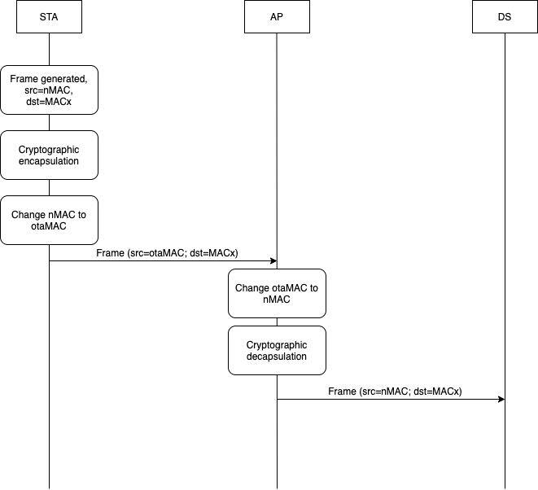
Main concept - uplink

Slide 7
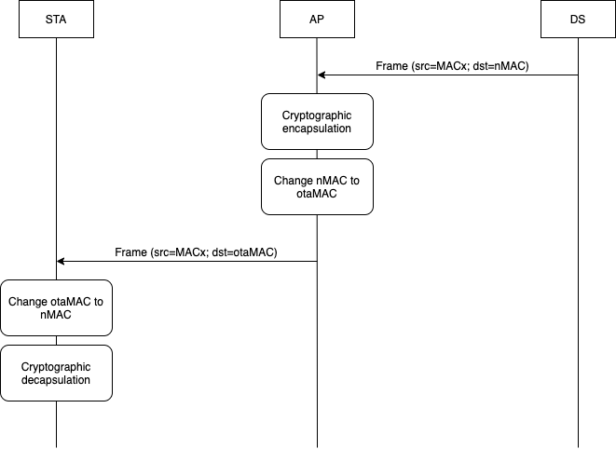
Main concept - downlink

Slide 8
Conclusions
TGbi can enhance IEEE 802.11 to be more privacy-friendly
The use of “fixed” MAC addresses for an association allows users to be tracked during that association and impacts user privacy.
The proposed mechanism to rotate MAC addresses will mitigate this privacy concern, without impacting network operation
  Of course, surrounding mechanisms for signaling, control, etc.. Need to be defined

