Slide 1
TG bh Resolvable Address
Date: 2021-09
Authors:

Slide 2
Resolvable Address
Bluetooth Low Energy BLE has a feature of resolvable address.
This is an outline of that feature
A possible similar use is outlined for 802.11
Disclaimer: I am not expert at this. This is solely from first time reading of BLE Spec. I just think it is worthwhile investigating.

Slide 3
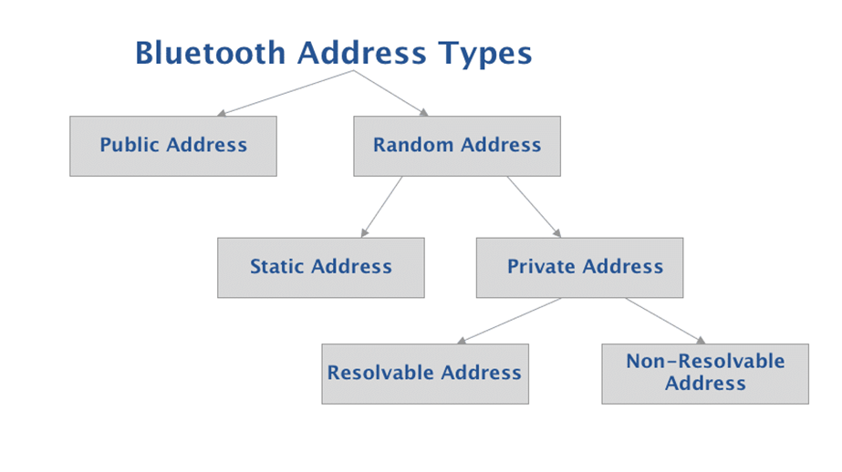
BLE Addresses
MAC Address 48-bit
Two Types:
Public
Random
Must use at least one type but can use both

Slide 4
Random Addresses
Random addresses are more popular than Public addresses since they do not require registration with the IEEE. A Random address is an identifier that’s either programmed into the device or generated at runtime (depending on the subtype).
The two subtypes of Random addresses are:
Random Static Address
Random Private Address

Slide 5
Random Static
Random Static Addresses can be used in one of two ways:
It can be assigned and fixed for the lifetime of the device
It can be changed at bootup
However, it cannot be changed during runtime.
The format of Random Static Addresses looks like this:
1 and 1 are fixed in the most significant bits (MSB)
The remaining 46 bits are chosen randomly by the developer/manufacturer

Slide 6
Random Private Address
Resolvable and non-resolvable.
Random Private addresses are used specifically for protecting the privacy of a Bluetooth device, to hide the identity, and to prevent tracking of the device.

Slide 7
Resolvable Private Address
Purpose
To prevent malicious third-parties from tracking a (Bluetooth) device while still allowing one or more trusted parties from identifying the (Bluetooth) device of interest.
Resolvable
Uses a key shared with trusted device.
Key is referred to as IRK (Identity Resolving Key)
Address is originally generated using IRK and a random number
In Bluetooth, a trusted device is a bonded device.
Bonding is the optional step that takes place after the pairing of two BLE devices. The Bonding process involves the storage of keys by each of the devices that are bonded with each other.
Changing address
This type of address changes periodically. The recommendation per the Bluetooth specification is to have it change every 15 minutes (this is evident in all iOS devices).

Slide 8
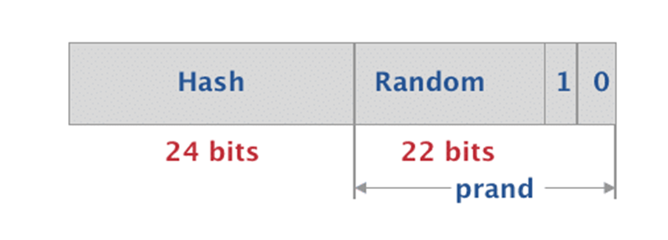
Resolvable Random Private Address
Resolvable Random Private Address format
0 and 1 are fixed in the most significant bits (MSB)
The next 22 bits are randomly generated
The prand constitutes of these most significant 24 bits
The lower 24 bits represent a hash value which is generated using the prand and the IRK

Slide 9
Steps to implement privacy
A key referred to as the IRK (Identity Resolving Key) is used in generating and resolving the resolvable random private address.
The IRK generated by each device locally either randomly or assigned during manufacturing.
During bonding, each device stores its peer’s IRK in what’s called a resolving list.
The IRK is then used to resolve the private address of a peer device
verifying that the hash included in the private address matches the output of the local hash computation according to the following equation: hash = ah(IRK, prand)
Since the device has the IRK stored locally and has access to the prand included as part of the private address which is included in the BLE packets, it can perform this computation.
It’s important to note that the IRK is not used to reveal the peer’s Identity Address which is either a Public Address or a Random Static Address, but rather for verification purposes only

Slide 10
Outline for 802.11 devices
Type of Address is identifiable by the two MSBs
We use the locally admin bit to indicate random
Could we reserve another bit to indicate “resolvable” or “private”?
When securely associated, IRKs exchanged and stored by the AP and STA
When associating again, the hash included in the address can be verified, and the device identified.

Slide 11
Advantages
Does not require same random address to be used when returning to the same ESS.
More secure.

